Slide 1

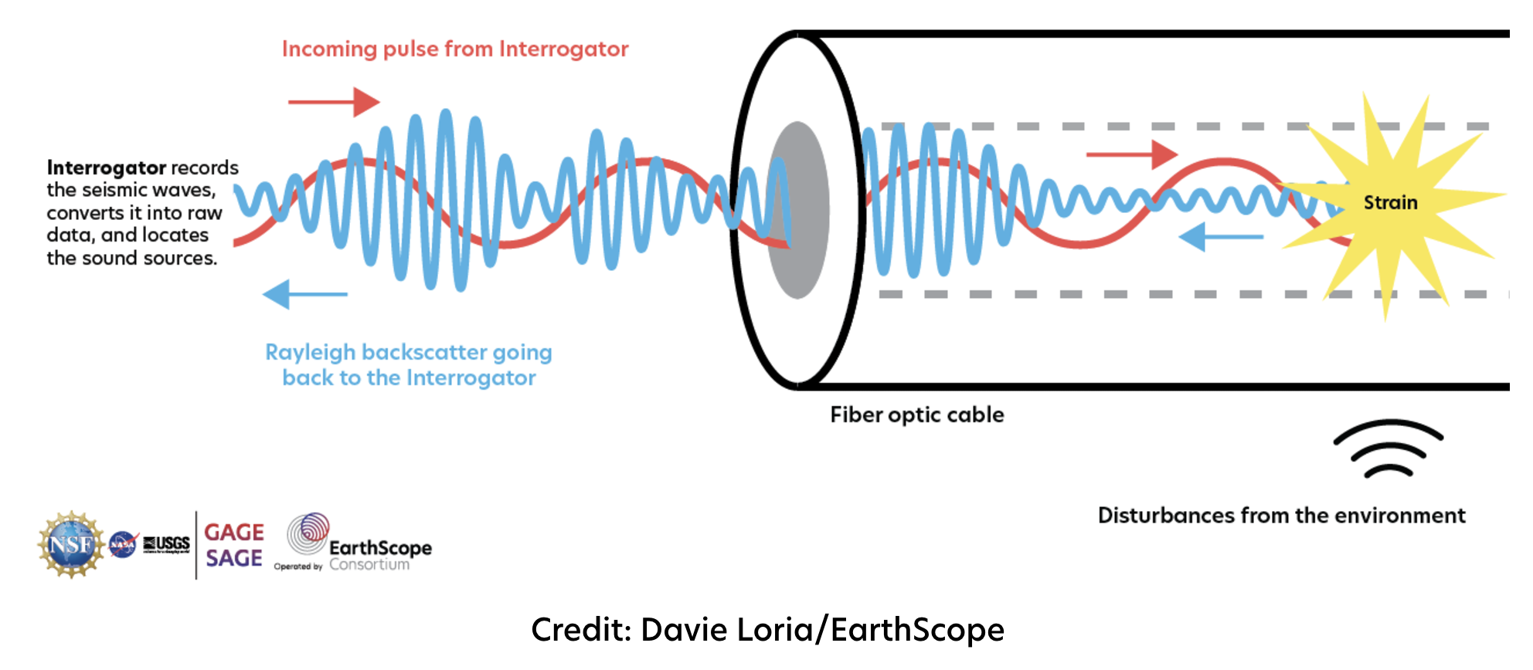
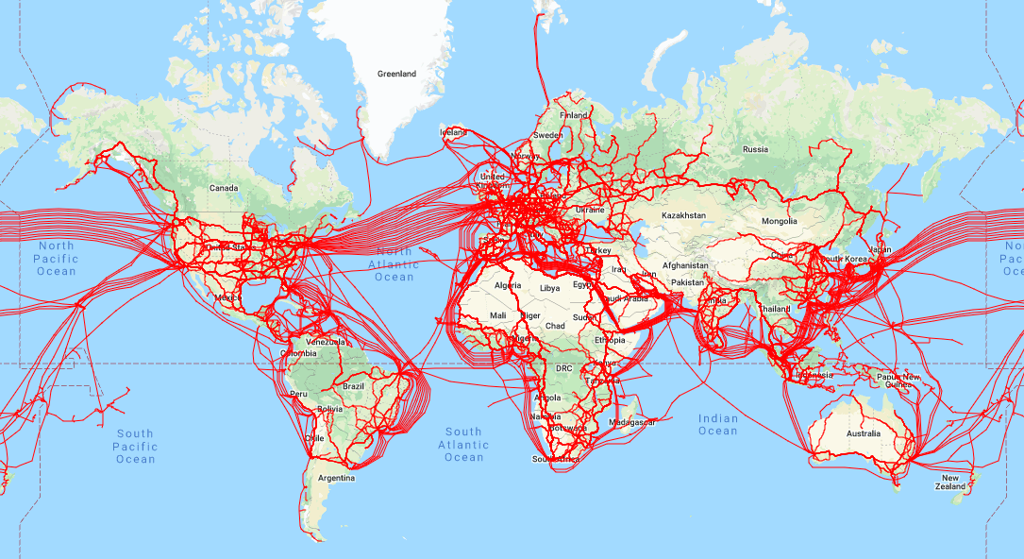
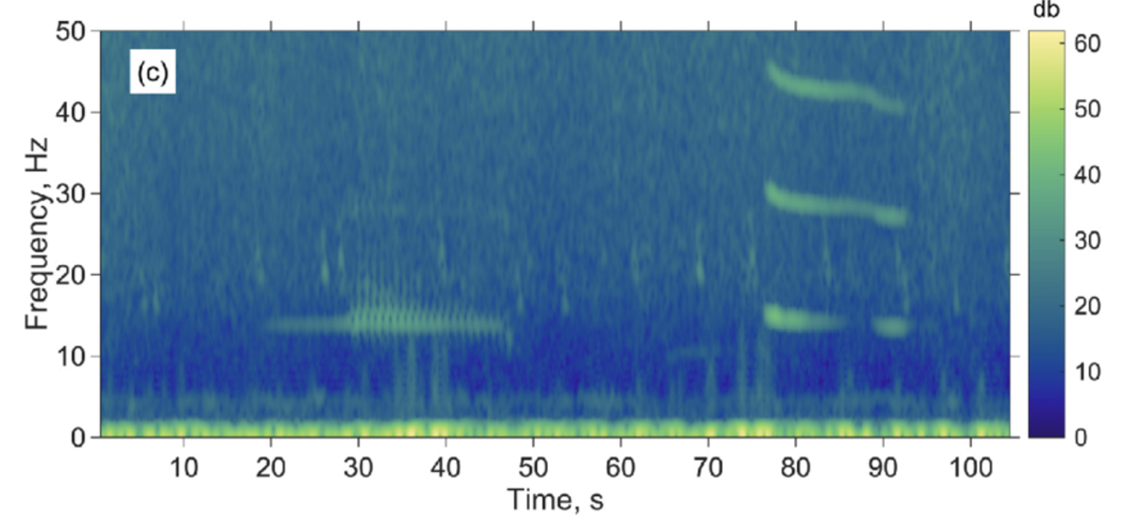
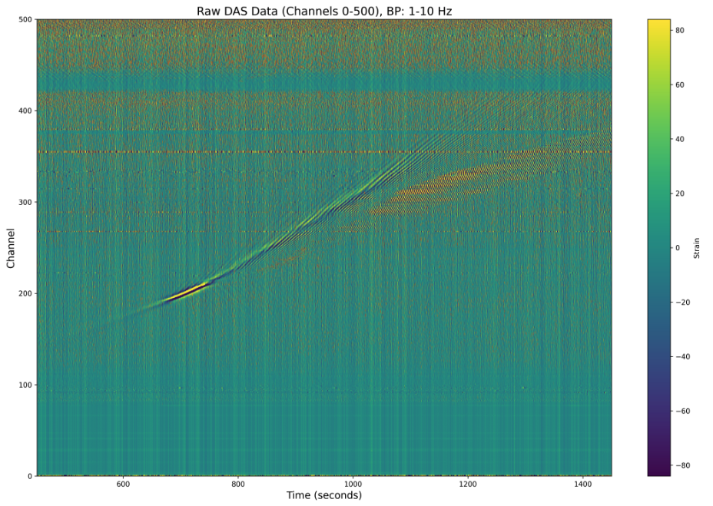
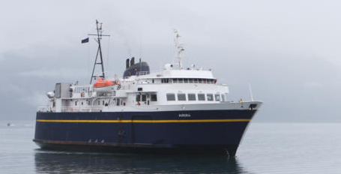
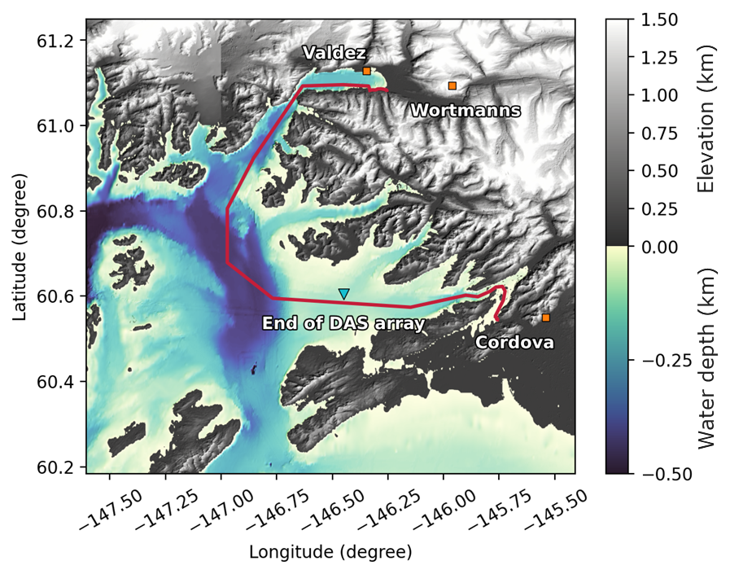
Collaborative Research: CIRC: Planning-M: Internet Sensor Network Testbeds
Ruifeng Xu University of Wisconsin | Weijun Pan University of Wisconsin
Motivation
Typosquatting domains are purposely registered to capture traffic from similar top domains.
These domains have been verified to be related to domain parking and cybersecurity issues.
A comprehensive analysis to report the phenomenon of typosquatting domains in these years.
Related Work
Cheng analyzed five major social VR platforms, identifying scalability issues due to increasing network resource consumption as the number of users grows. Their study highlights the impact of avatar data forwarding on BW and latency constraints.
Sun demonstrated that edge-based caching reduces backhaul congestion and latency in 5G-powered AR/VR applications. Similarly, Zhou introduced a mobile edge computing framework to optimize BW and latency by pre-caching field-of-view data and selectively processing content on device.
First Workshop on Internet Sensing Testbed
Goal: Bring together thought leaders from diverse communities to consider the framework for the testbed
Held in Madison, WI on December 5 and 6, 2024
Attended by 25 experts from geoscience, physics, electrical engineering, and computer science
Talks and small group discussion on relevant topics
Experiences with fiber-based sensing
Sensing capacity in OTN transceivers
Sensing in the global Internet
Motivation & Research Questions
Mixed Reality (MR) has gained significant global attention, yet research on network performance in MR applications remains limited.
What are the key network performance bottlenecks and constraints in MR environments, and how can they be systematically measured and characterized?
What strategies can be employed to optimize network efficiency in MR environments?
Approach
Step #1: Identification – utilize search to find maps of physical locations
Step #2: Transcription – multiple methods to automate data entry
Step #3: Verification – ensure that data reflects latest network maps
Hypothesis: Physical sites are limited in number and fixed in location.
From Wilcock et al. “Distributed Acoustic Sensing Recording of Low-frequency Whale Calls and Ship Noise off the Oregon Coast”, in JASA Express Letters 2023.
Distributed acoustic sensing uses backscattered light to sense strain in fiber. New generations of OTN transceivers are being developed to export state of polarization and phase information from their signal processors which can also be used to detect strain on fiber.
Using fiber sensing for off-shore monitoring. An offshore DAS Array in Prince William Sound, AK monitors a ferry between Cordova and Valdez.
Global Internet fiber infrastructure can be adapted for opportunistic ground-motion sensing.
Channel Number
Strain [με]
Workshop Outcomes
Significant enthusiasm and clear need for a national Internet-based sensing testbed
Strong synergies between fiber-based sensing and quantum networking
Strong interest from industry participants (equipment and Internet Service Providers)
Volunteers for leadership on developing key elements of the envisioned midscale proposal
Next Steps
The leadership team will organize subgroups to develop key components of the proposal:
Dark fiber repository
Data processing and storage
Build-out and management
Organize Second Workshop on Internet Sensing Testbed
Target additional participants who can contribute to proposal development
Time [s]
Timeline
Q1/Q2 ’25:
Conduct meetings with subgroups to work on proposal framework
Organize workshop #2
Q3 ’25:
Host workshop #2 in Madison, WI (late July)
Finalize midscale framework
Q4 ‘25/Q1 ’26:
Finalize and submit the proposal

