Slide 1
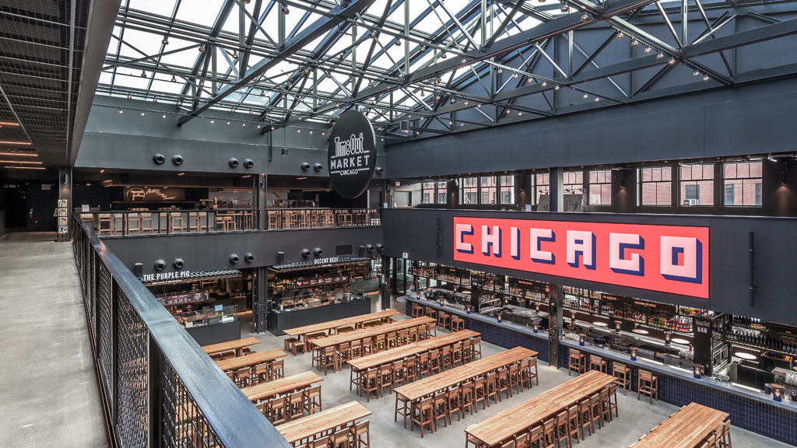
Restaurant Classification
10/27/2020 CURRENT WORK IN PROCESS!

Slide 2
Overview
01 Background
02 Data
03 Natural Language Processing Overview
04 Model Overview
05 Model Results
06 Summary & Next Steps

Slide 3
01 Background
The goal is to apply Natural Language Processing and Machine Learning to build a multinomial classification model. This model will predict the results of a food inspection based on the inspector’s comments.
As a result, other features, such as location, business type, and risk factor, are not included in the predictive modeling and are only be included for descriptive analysis purposes
Data is provided by the City of Chicago Health and Human Services and is updated via an API every time the model is run. Most recent run date is October 2020.

Slide 4
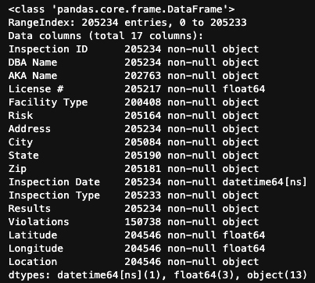
02 Data Overview

Slide 5
Natural Language Processing
Talk about some of the ways the text is processed
Regex
Lemmatization
Tokenization

Slide 6
Model Overview
Naïve Bayes, Logistic Regression, Support Vector Machine
Strengths and weaknesses of each?
Parameter overview
Best Performing Model Logistic Regression

Slide 7
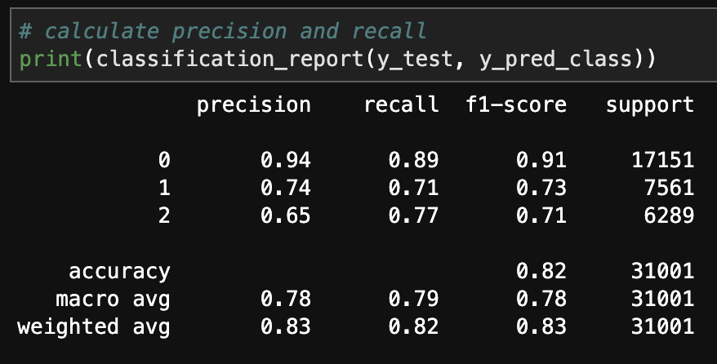
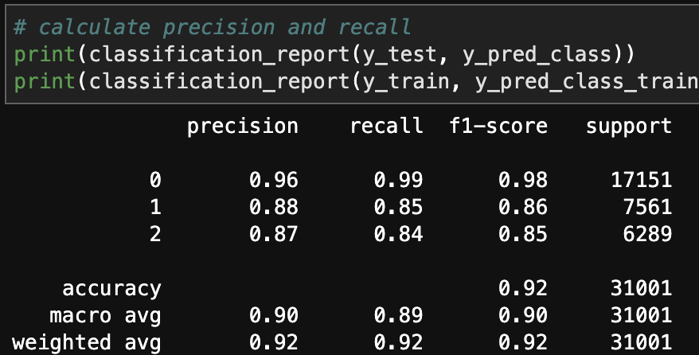
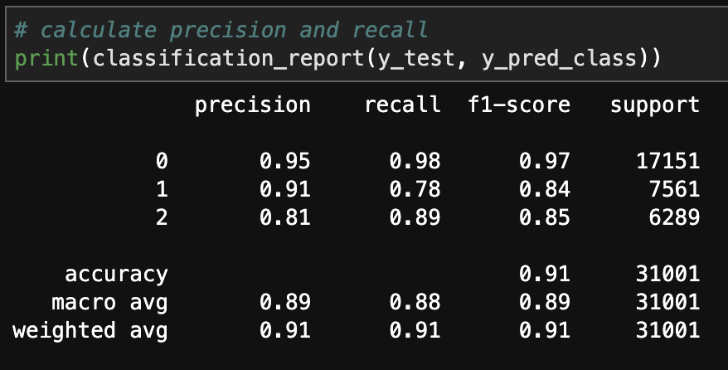
Model Comparison

Slide 8
