Slide 1
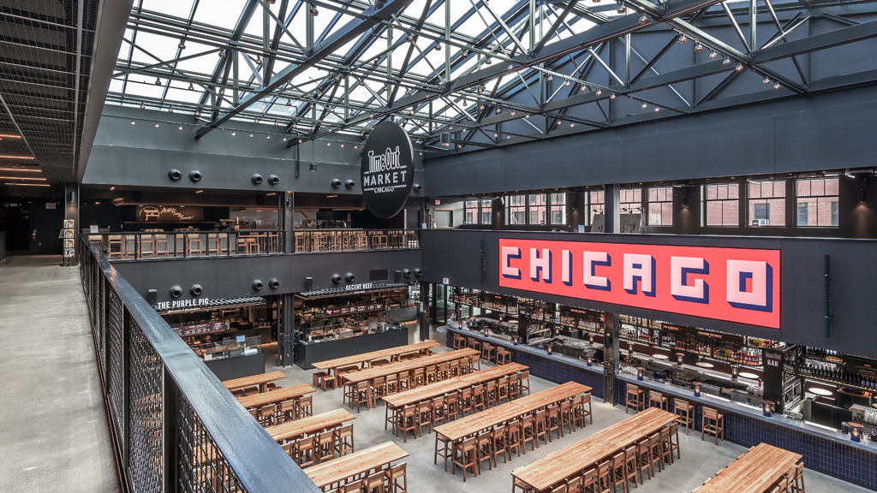
Restaurant Classification

Slide 2
Overview
The goal is to apply Natural Language Processing and Machine Learning to build a multinomial classification model. This model will predict the results of a food inspection based on the inspector’s comments.
As a result, the model will only consider the inspector’s comments. Other features, such as location, business type, and risk factor, will not be included.
The data source is provided by the City of Chicago Health and Human Services and is for the timeframe (____)

Slide 3
Overview
Introduction
Data
Natural Language Processing
Classification
Model Results
Summary

Slide 4
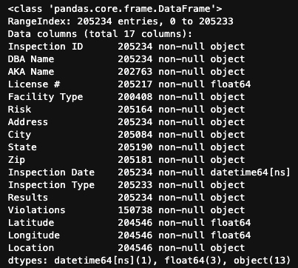
Data
Source: https://data.cityofchicago.org/Health-Human-Services/Food-Inspections/4ijn-s7e5

Slide 5
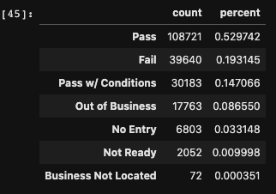
Model Overview

