Slide 1
Oct2020
File created on: 10/28/20 11:52:23 AM CDT

Slide 2
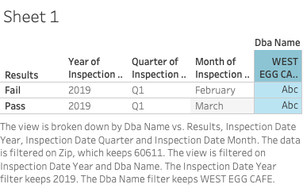

Slide 3
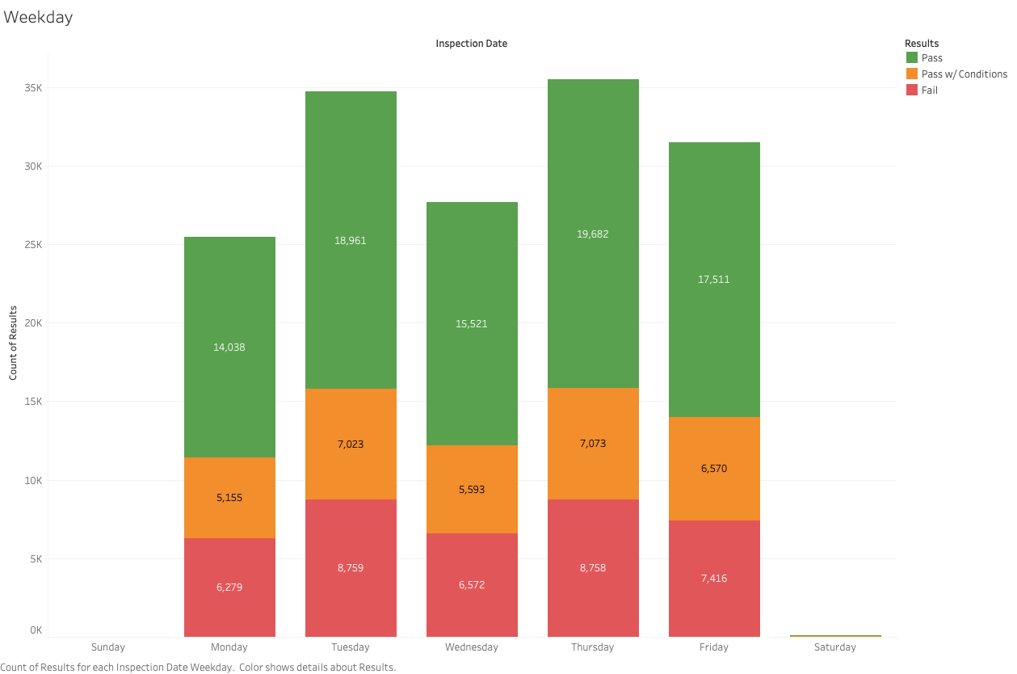

Slide 4
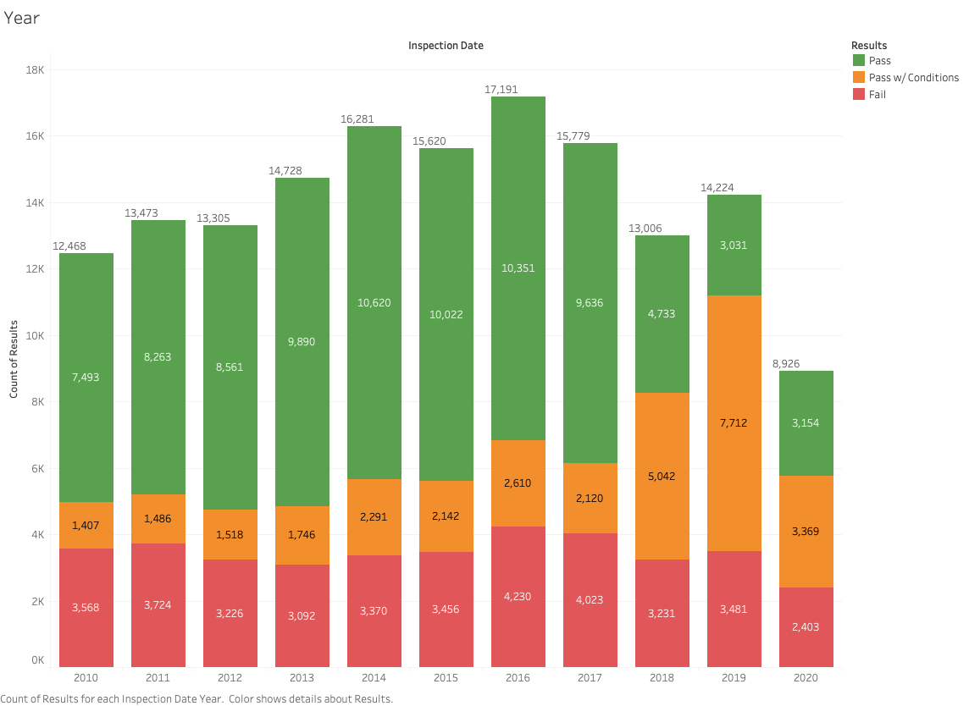

Slide 5
