Slide 1
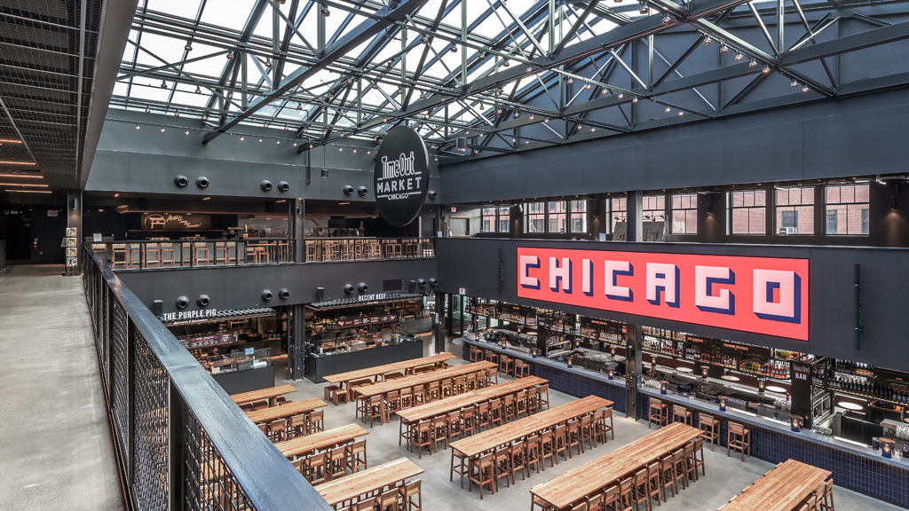
Restaurant Classification
10/27/2020 CURRENT WORK IN PROCESS!

Slide 2
Overview
01 BACKGROUND
02 DATA
02.1 OVERVIEW
02.2 SAMPLE
02.3 OBSERVATIONS
03 NATURAL LANGUAGE PROCESSING
04 MODEL OVERVIEW
05 MODEL RESULTS
06 SUMMARY & NEXT STEPS

Slide 3
01 BACKGROUND
The goal is to apply Natural Language Processing and Machine Learning to build a multinomial classification model. This model will predict the results of a food inspection (e.g. ‘pass’, ‘pass w/ comments’, or ‘fail’) based on the inspector’s comments.
As a result, other features, such as location, business type, and risk factor, are not included in the predictive modeling and are only included for descriptive analysis purposes
Data is provided by the City of Chicago Health and Human Services and is updated via an API every time the model is run. Most recent run date is October 25th 2020.

Slide 4
02 DATA [overview]
Dataset was last updated October 28th 2020
Contains 155,000+ inspections and over 16,000 unique addresses, an average 9 inspections per address
18 features (detail on next slide)
Over 10 years of data from 1/4/2010 – 10/26/2020

Slide 5
02 DATA [sample]
Row | Data
inspection_id | 2303761
dba_name | TRUMP INTERNATIONAL HOTEL
aka_name | SIXTEEN
license_ | 2048785
facility_type | Restaurant
risk | Risk 1 (High)
address | 401 N WABASH AVE
city | CHICAGO
state | IL
zip | 60611
inspection_date | 2019-07-26T00:00:00.000
inspection_type | Suspected Food Poisoning
results | Fail
violations | (see detail on right)
latitude | Not Disclosed
longitude | Not Disclosed
location | Not Disclosed
Violations detail/format: seven code violations
"10. ADEQUATE HANDWASHING SINKS PROPERLY SUPPLIED AND ACCESSIBLE - Comments: - MUST PROVIDE HANDWASH SIGNAGE AT ALL OF THE BARS' HANDWASH SINKS. - | 10. ADEQUATE HANDWASHING SINKS PROPERLY SUPPLIED AND ACCESSIBLE - Comments: - OBSERVED NO HANDWASH SINK IN THE OUTDOOR PATIO BAR AND IN THE OUTDOOR PATIO'S DISHWASH ROOM. MUST INSTALL A HANDWASH SINK IN BOTH AREAS. ALL HANDWASH SINKS SHALL BE EQUIPPED TO PROVIDE AN ADEQUATE SUPPLY OF WATER AT A TEMPERATURE OF AT LEAST 100F TO MEET FACILITY'S PEAK HOT WATER DEMANDS. PRIORITY FOUNDATION VIOLATION#:7-38-030(c). CITATION ISSUED. - | 16. FOOD-CONTACT SURFACES: CLEANED & SANITIZED - Comments: - OBSERVED A SLIGHT DEBRIS BUILDUP ON THE INTERIOR OF THE LEFT SIDE ICE MACHINE IN THE 16TH FL KITCHEN. MUST REMOVE DEBRIS, DETAIL CLEAN, SANITIZE, AND MAINTAIN. - | 39. CONTAMINATION PREVENTED DURING FOOD PREPARATION, STORAGE & DISPLAY - Comments: - OBSERVED THE ICE BINS IN THE OUTDOOR PATIO BAR DO NOT HAVE ANY LIDS. MUST PROVIDE THE ICE BINS TO BE EQUIPPED WITH TIGHT FITTING LIDS, AND MAINTAIN THE LIDS TO BE CLOSED AT ALL TIMES IN BETWEEN USAGE. - | 43. IN-USE UTENSILS: PROPERLY STORED - Comments: - OBSERVED THE ICE SCOOP IN THE OUTDOOR PATIO ICE BIN STORED WITH THE HANDLE DIRECTLY ON THE ICE. MUST REMOVE AND STORE THE ICE SCOOP OFF OF THE ICE AND AWAY FROM POTENTIAL SOURCES OF CONTAMINATION. - | 44. UTENSILS, EQUIPMENT & LINENS: PROPERLY STORED, DRIED, & HANDLED - Comments: - MUST STORE THE CLEAN DISHES/UNTENSILS ON THE DISH RACKS AND ON THE SHELVES INVERTED TO PREVENT POTENTIAL SOURCES OF CONTAMINATION. - | 47. FOOD & NON-FOOD CONTACT SURFACES CLEANABLE, PROPERLY DESIGNED, CONSTRUCTED & USED - Comments: - OBSERVED IN THE OUTDOOR PATIO'S DISHROOM A SHELVING/TABLE UNIT THAT IS RAW WOOD AND MATTE PAINTED. MUST RE-FINISH THE UNIT WITH A SEALANT THAT PROVIDES A NON-ABSORBENT, SMOOTH, EASILY CLEANABLE SURFACE. - | 55. PHYSICAL FACILITIES INSTALLED, MAINTAINED & CLEAN - Comments: - OBSERVED THE WALLS OF THE OUTDOOR PATIO'S DISHROOM TO BE CEMENT THAT IS PAINTED WITH A MATTE FINISH. MUST PAINT WALLS WITH A SEALANT THAT PROVIDES THE WALLS TO BE NON-ABSORBENT, SMOOTH, AND EASILY CLEANABLE. - | 55. PHYSICAL FACILITIES INSTALLED, MAINTAINED & CLEAN - Comments: - OBSERVED NO OVERHEAD PROTECTION PROVIDED AT THE OUTDOOR PATIO BAR. MUST INSTALL OVERHEAD PROTECTION FOR THE BAR. Overhead protection shall be provided that fully extends over all beverages, utensil holding facilities and equipment associated with the outdoor beverage bar. The overhead protection shall be of solid construction and horizontally beyond all equipment, work, and storage areas. -"

Slide 6
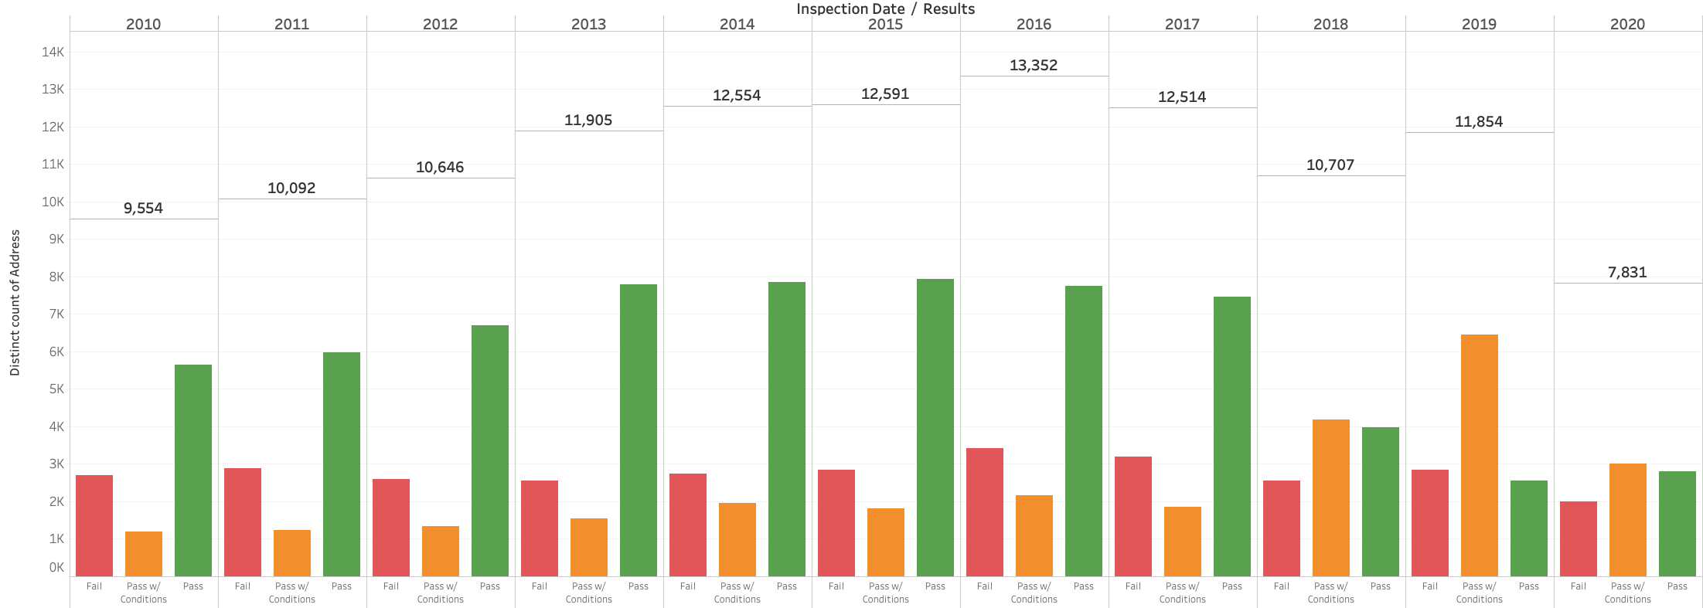
02 DATA [observations]
13,352, peak number of total inspections
6,443, peak number of ”pass w/ comments”
Total number of inspections (normalized, as of September in all years) are down in 2020.

Slide 7
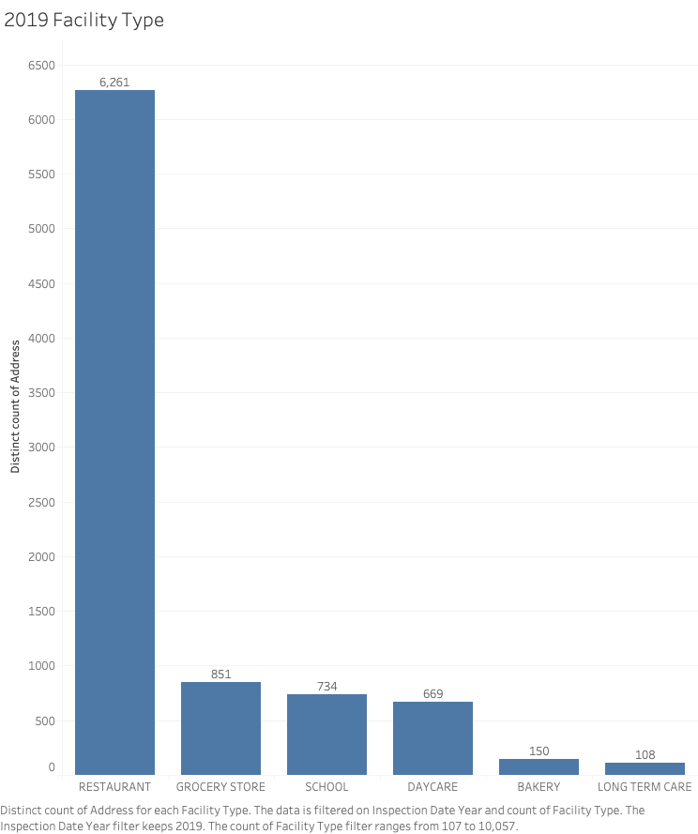
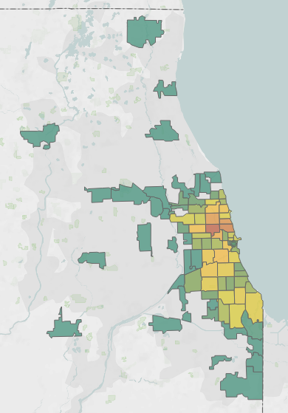
02 DATA [observations]
2019 Most Popular Zip Codes
Five most-prevalent
facility types in 2019
78 Unique Zip Codes
across Chicago
60647
678 distinct addresses

Slide 8
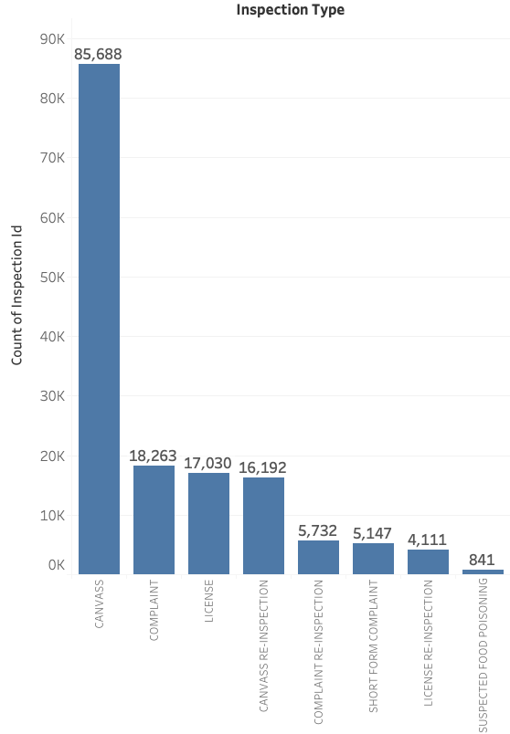
02 DATA [observations]

Slide 9
03 NATURAL LANGUAGE PROCESSING
Lemmatization
Tokenization

Slide 10
04 MODEL OVERVIEW
Naïve Bayes, Logistic Regression, Support Vector Machine
Strengths and weaknesses of each?
Parameter overview
Best Performing Model Logistic Regression

Slide 11
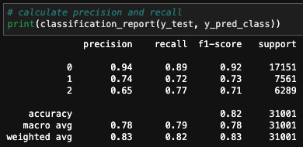
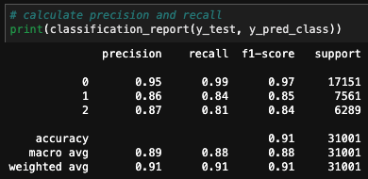
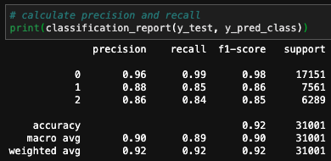
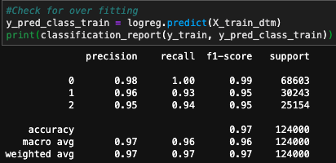
05 MODEL COMPARISON [baseline]
Naïve Bayes
Support Vector Machines
Logistic Regression
Best performing model: Logistic Regression
Precision = 0.92; [i.e. what proportion of predictions for a class are true?]
Recall = 0.92; [i.e. what proportion of an actual class are correctly classified?]
Accuracy = 0.92; [i.e. what proportion of all classes are correctly classified?]

Slide 12
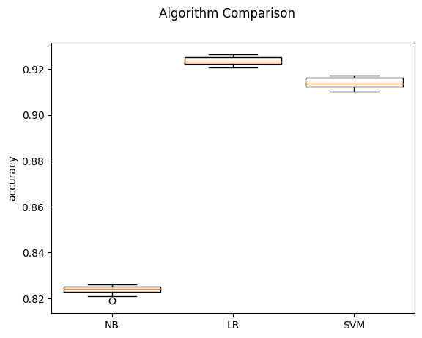
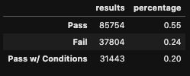
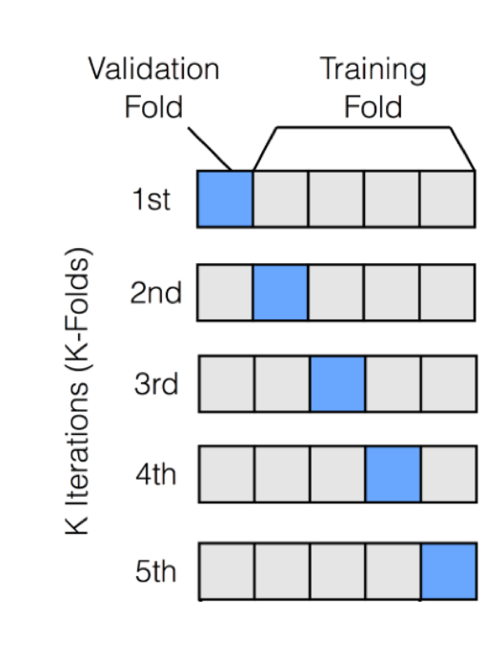
05 MODEL COMPARISON [cross validation]
Dataset imbalance
Stratified 10-Fold Cross Validation
K-Fold variation used with imbalanced datasets
10-fold stratified shuffle cross validation results boxplot
In terms of accuracy, Logistic regression performs the best

