Slide 1

Restaurant Classification
10/27/2020 CURRENT WORK IN PROCESS!

Slide 2
Overview
01 BACKGROUND
02 DATA
03 NATURAL LANGUAGE PROCESSING
04 MODEL OVERVIEW
05 MODEL RESULTS
06 SUMMARY & NEXT STEPS

Slide 3
01 BACKGROUND
The goal is to apply Natural Language Processing and Machine Learning to build a multinomial classification model. This model will predict the results of a food inspection based on the inspector’s comments.
As a result, other features, such as location, business type, and risk factor, are not included in the predictive modeling and are only be included for descriptive analysis purposes
Data is provided by the City of Chicago Health and Human Services and is updated via an API every time the model is run. Most recent run date is October 2020.

Slide 4
02 DATA OVERVIEW
Most common fail reasons
List of codes

Slide 5
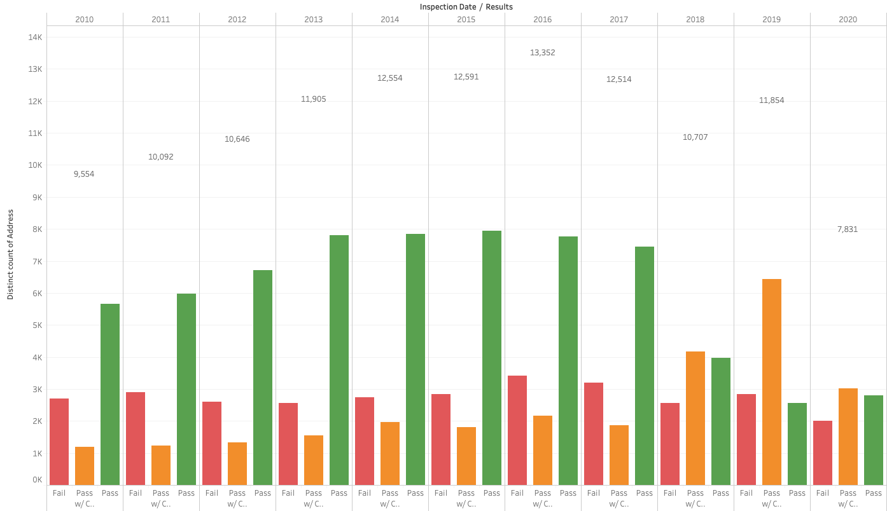
INSPECTIONS DATA [observations]
Total number of inspections, through September of all years, are down in 2020.
Inspections peaked in 2016.
Significantly more ”pass with conditions” results in 2019 than other years

Slide 6
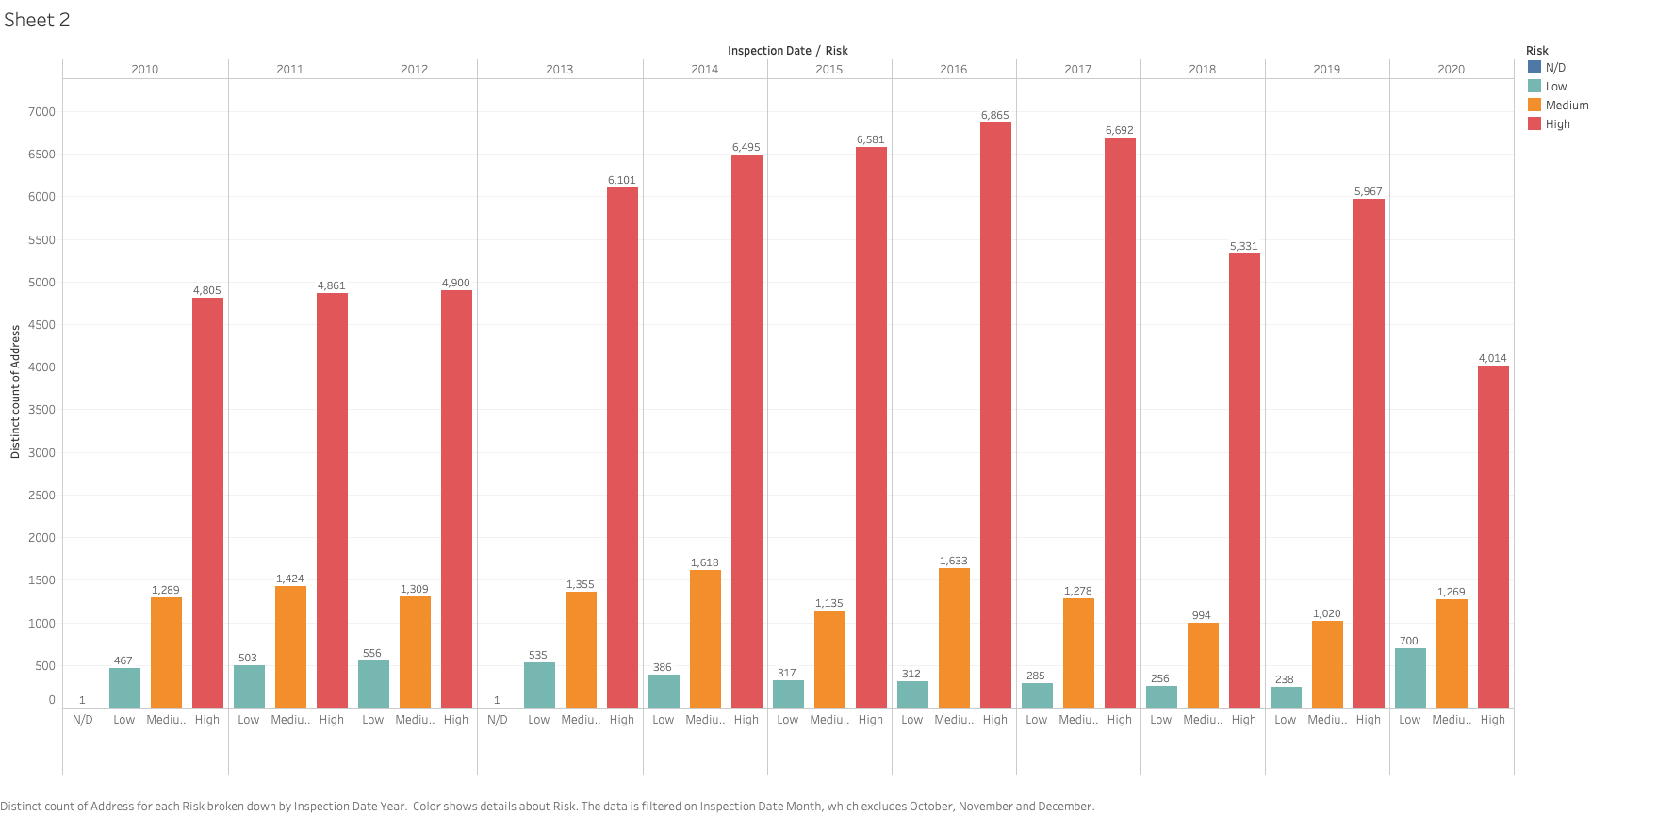
INSPECTIONS DATA [observations]
ZIP Codes
Low/Medium/High Risk by Year
Notes:
Data includes inspection dates through September of every year

Slide 7
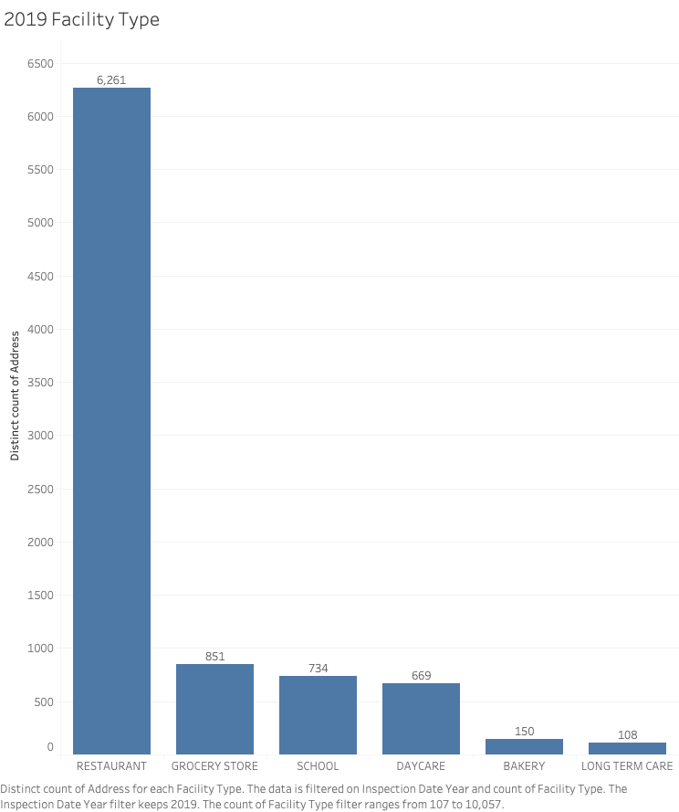
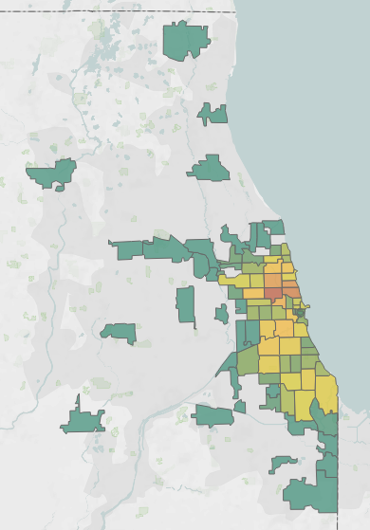
INSPECTIONS DATA [observations]
2019 Most Popular Zip Codes
Five most prevalent
types of facilities
in 2019
78 Unique Zip Codes
60647
678 distinct addresses

Slide 8
03 NATURAL LANGUAGE PROCESSING
Lemmatization
Tokenization

Slide 9
04 MODEL OVERVIEW
Naïve Bayes, Logistic Regression, Support Vector Machine
Strengths and weaknesses of each?
Parameter overview
Best Performing Model Logistic Regression

Slide 10
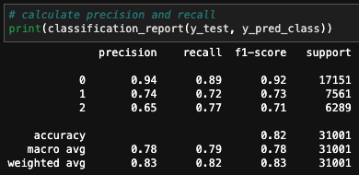
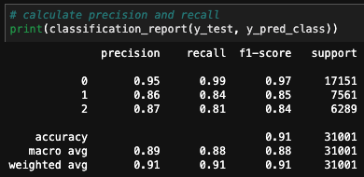
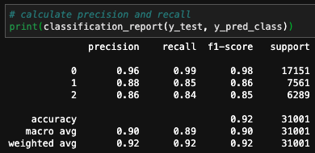
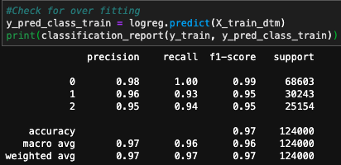
05 MODEL COMPARISON [baseline]
Naïve Bayes
Support Vector Machines
Logistic Regression
Best performing model: Logistic Regression
Precision = 0.92; [i.e. what proportion of predictions for a class are true?]
Recall = 0.92; [i.e. what proportion of an actual class are correctly classified?]
Accuracy = 0.92; [i.e. what proportion of all classes are correctly classified?]

Slide 11
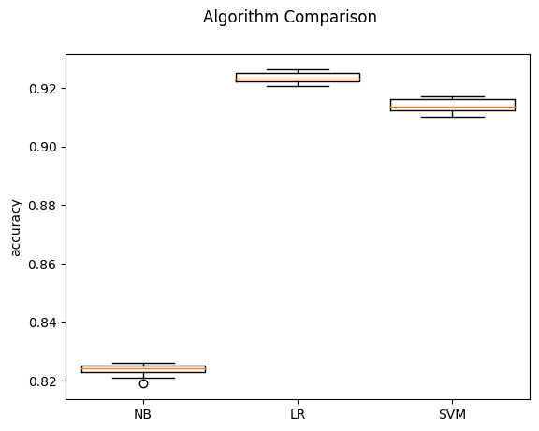
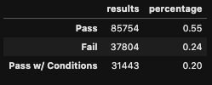
05 MODEL COMPARISON [cross validation]
STRATIFIED K-FOLD CROSS VALIDATION

Slide 12
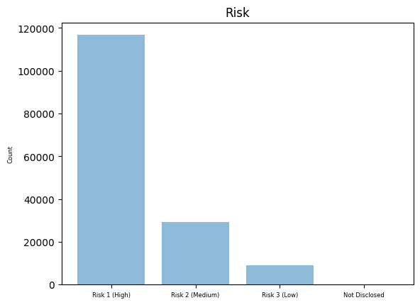
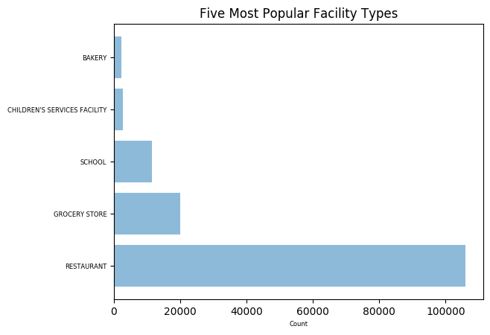
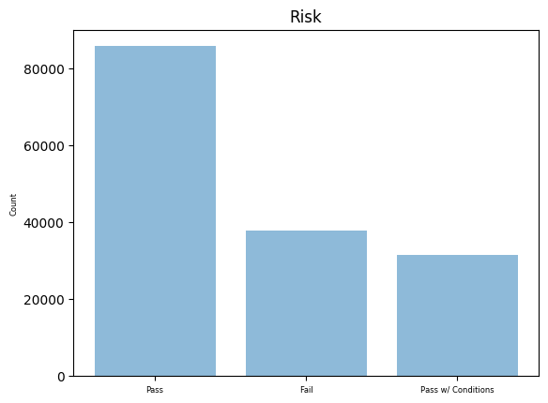
DATA OBSERVATIONS

Slide 13
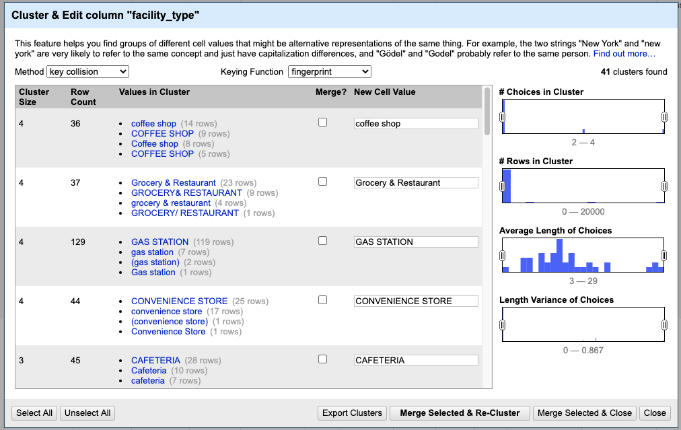
DATA OBSERVATIONS

