Slide 1
Jumpman23 Analysis
Stephen Stark
Position:
Date

Slide 2
Problem Overview
Executive Summary
Dataset
Data Integrity Issues
New York Market Update
Growth Strategies
Results & Next Steps

Slide 3
Executive Summary
There aren’t significant data integrity issues
The New York market is strong:
Completed X transactions in the month of October 2014
Average delivery time was xx mins
X unique customers, over x% order more than once, x% more than twice
Dinner is the most popular meal ordered
Engage the most and least frequent customers and Jumpmen:
How could the product be improved? Biggest hurdles? Greatest successes?
Growth strategies:

Slide 4



Jumpman to Customer Delivery Process
Customer places order
Delivery Starts
Jumpman arrives at the pickup location
Places order
Departs pickup location
Arrives at customer’s location

Slide 5
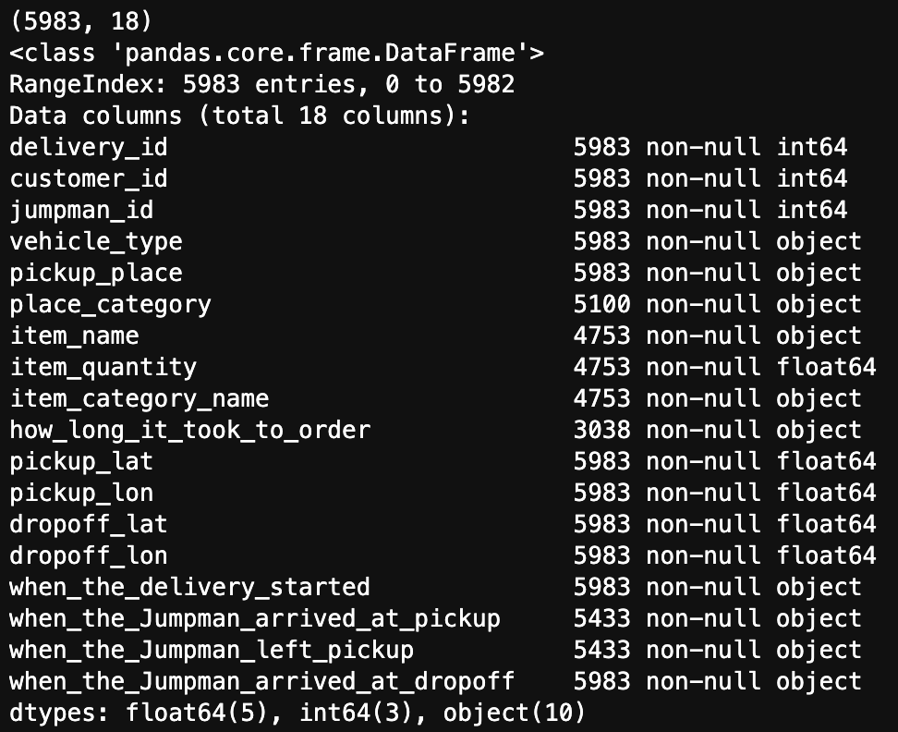
Dataset
5,900+ records and 18 features
Engineered Features:
-One
-Two
-Three

Slide 6
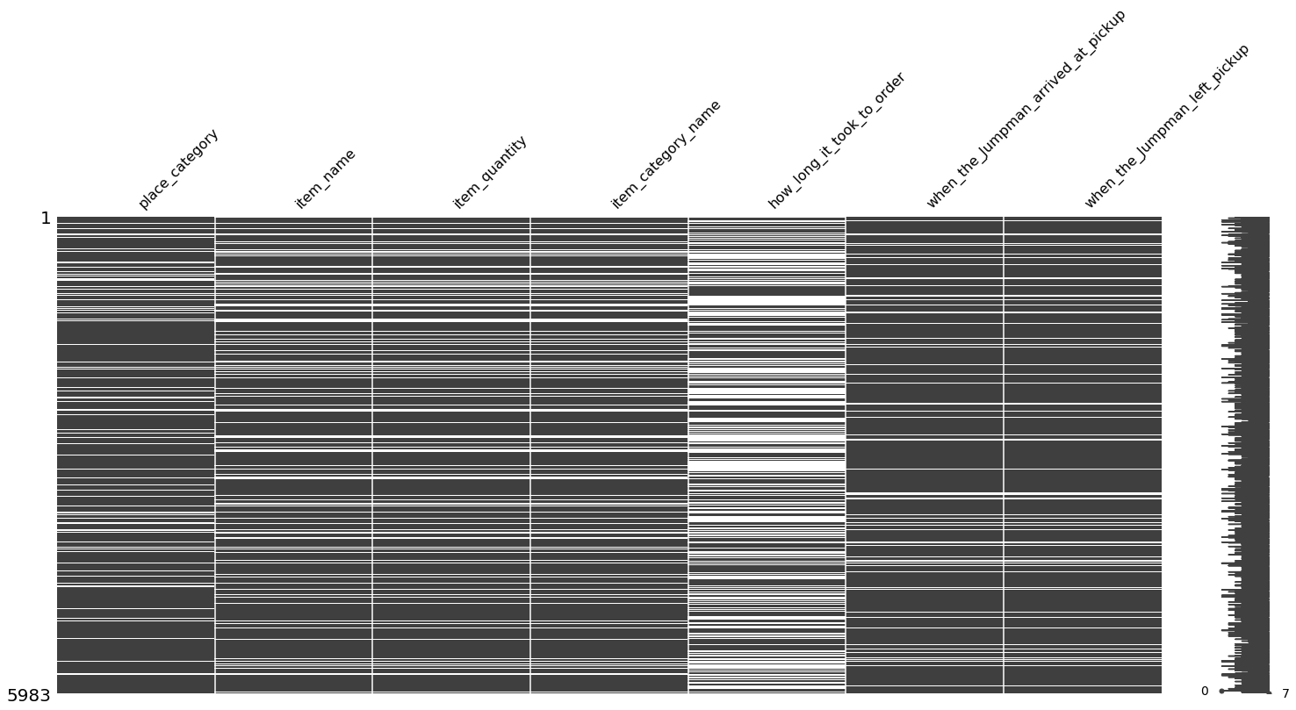
Integrity Concerns

Slide 7
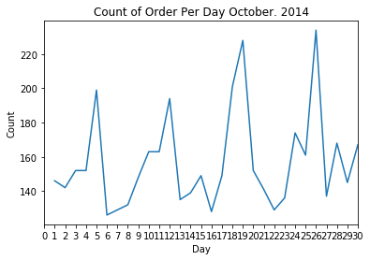
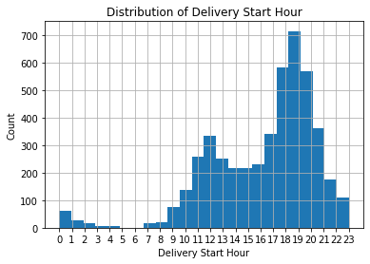

Slide 13
Appendix
Links to Analysis
Thank you for the opportunity, I can be reached at
stephenstark@uchicago.edu
Stephen stark linkedin
Stephen stark github

