Slide 1
Jumpman23 New Market Analysis
Stephen Stark
October 2020
Presented to:

Slide 2
ANALYSIS OVERVIEW
1 EXECUTIVE SUMARY
2 INTRODUCTION
3 NEW MARKET ANALYSIS
4 DATA INTEGRITY CONCERNS
5 GROWTH STRATEGY
6 NEXT STEPS
7 APPENDIX

Slide 3
1 EXECUTIVE SUMMARY
The New York market is strong with significant growth potential:
Completed 4,700 transactions in the month of October 2014
45-minute average delivery time
2,900+ unique customers served; 16% order twice, 6% order three or more times
Most popular delivery time is between 6PM-8PM
GROWTH RECOMMENDATION #1: TARGETED CAMPAIGN TO SPECIFIC ZIP CODES
[11226, 10025, 11211]: have the lowest market penetration rate, currently reaching 60 of the 290K potential customers
[10282,10007,10069]: have the highest average household median income $200K+ and a low market penetration rate, currently reaching 110 of the 17K potential customers
GROWTH RECOMMENDATION #2: Focus on Jumpmen and Customer engagement. Survey the ones who use the service the most to to gather feedback on their hurdles and challenges. Also engage with the customers who only used once and haven’t returned
GROWTH RECOMMENDATION #3: Decrease wasted time at restaurants. Explore a restaurant partnership model to minimize the time spent waiting at the pickup location.

Slide 4
2 INTRODUCTION
Methodology:
Examine data integrity concerns
Exploratory data analysis
Feature engineering
Determine growth strategy
Assumptions:
Place category, item name, item quantity, category name were all replaced with “not disclosed”
Estimated time to order using an average value for the dataset as my analysis did not show meaningful deviation by place category
Dropped records that did not have Jumpman pickup arrival and departure times
Multiple items from the same order were broken out into separate records. I decided to only keep one record per delivery id
Excluded records with suspicious values. One record suggested a bicyclist traveled 100+ mph

Slide 5
3 NEW MARKET ANALYSIS
KNOW THE MARKET
CUSTOMERS
+
JUMPMEN
+
BUSINESSES

Slide 6
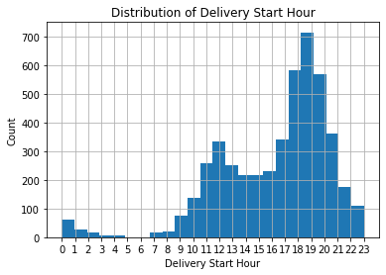
3.1 NEW MARKET ANALYSIS [CUSTOMERS]
Who are they?
Most popular order time is dinner (6PM – 8PM) followed by lunch
[10001, 10002, 10003, 10011, 10012] the five most frequented dropoff zip code location
These customers have an average median household income of $80K and an average population per zip code of 46K
Prefer to order from Italian, American, burger joints, Japanese, and dessert categories
Loyalty
Most loyal customer, customer id #369272, ordered 23 times
Average order frequency per customer is 1.6
30% of customers ordered more than once

Slide 7
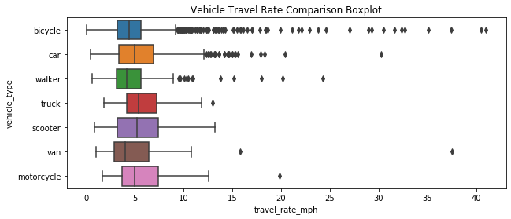

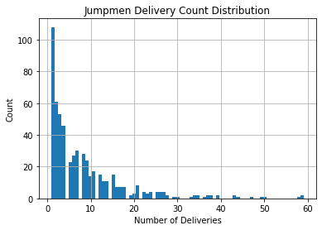
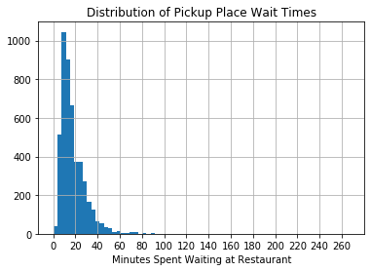
3.2 NEW MARKET ANALYSIS [JUMPMEN]
5,400+ total miles traveled*
72% of deliveries via bicycle, 21% by car
*based on Haversine distance
83,000 minutes spent waiting at businesses, or ~1,400 hours
Average wait time of 17 minutes per business
max = 59
565 Jumpmen on the platform
The average Jumpman completed 8.3 deliveries, or one every four days
max = 17.7

Slide 8
3.2.1 THE JUMPMAN JOURNEY
Jumpman23 is an on-demand delivery platform connecting “Jumpmen” and customers.
Jumpmen are sent to merchants to pickup any items requested by the customer.
Whenever possible, Jumpman23 will order the requested items ahead to save the Jumpmen time.
Each time a Jumpman23 delivery is completed, a record is saved to the Jumpman23.
Delivery Starts
Jumpman arrives at the pickup location
Places order
Departs pickup location
Arrives at customer’s location
Jumpman
Delivery
Journey

Slide 9
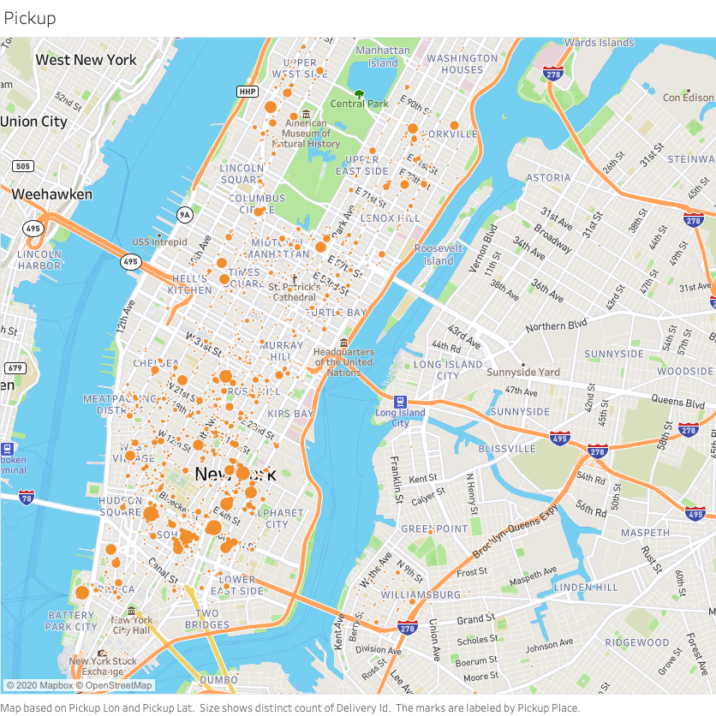
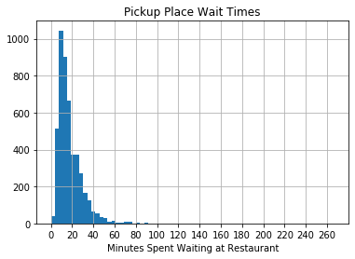
3.3 NEW MARKET ANALYSIS [BUSINESSES]
What are the key findings?
What are the key findings?

Slide 10
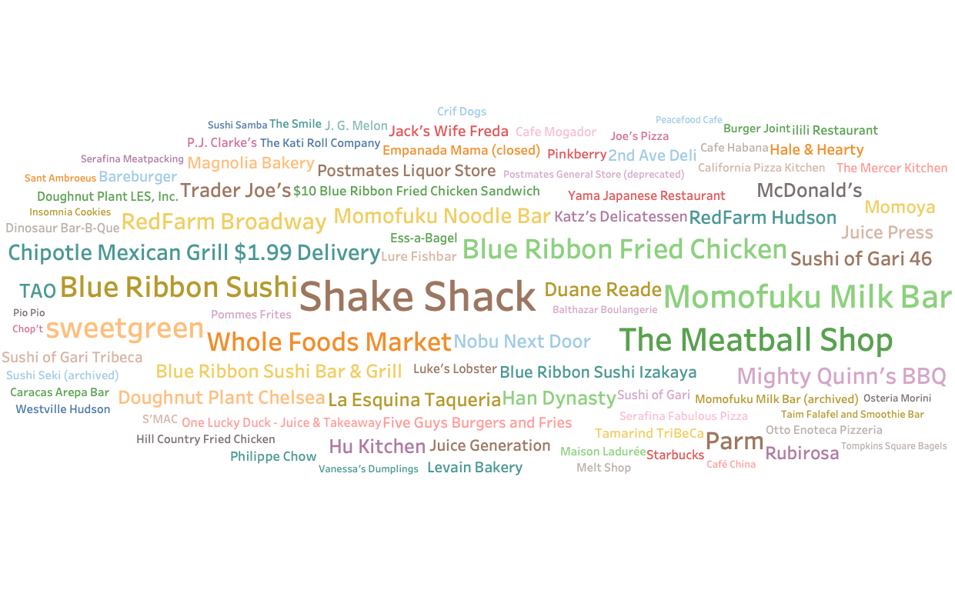
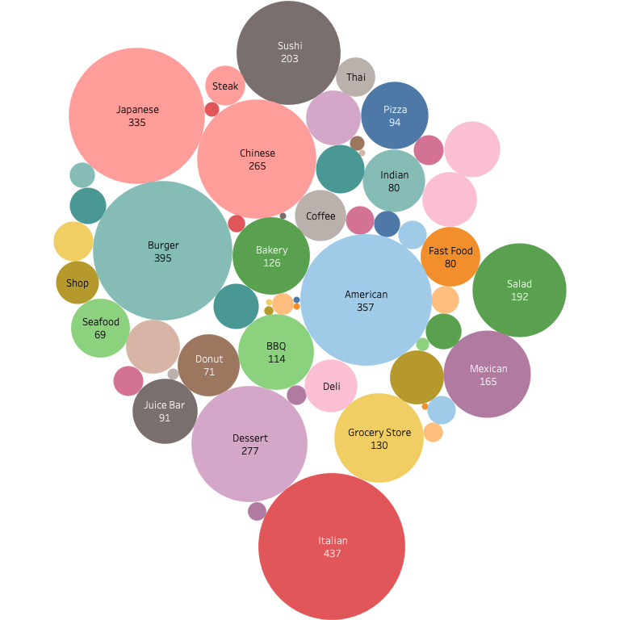
3.3 NEW MARKET ANALYSIS [BUSINESSES]
Most Frequented Pickup Spots
50+ categories available
on the platform

Slide 11
4 DATA INTEGRITY CONCERNS
There is a systematic issue in data collection as evidence by the missing records:
Attribute | Missing Value Count
delivery_id | 0
customer_id | 0
jumpman_id | 0
vehicle_type | 0
pickup_place | 0
place_category | 883
item_name | 1230
item_quantity | 1230
item_category_name | 1230
how_long_it_took_to_order | 2945
pickup_lat | 0
pickup_lon | 0
dropoff_lat | 0
dropoff_lon | 0
when_the_delivery_started | 0
when_the_Jumpman_arrived_at_pickup | 550
when_the_Jumpman_left_pickup | 550
when_the_Jumpman_arrived_at_dropoff | 0

Slide 12
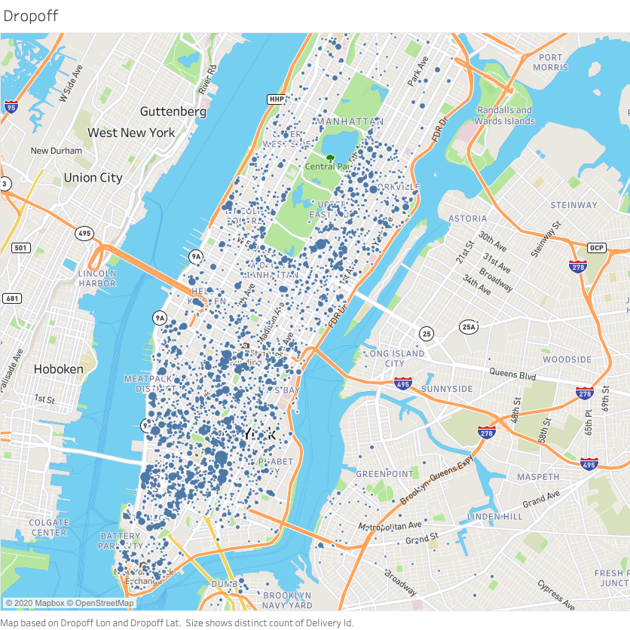
Popular Pickup & Dropoff Locations

Slide 13
05 Growth Strategy
Minimize wait times for Postmen. Recommend partnership with restaurants to minimize wasted time.
Target untapped Zip Codes.
Do customers leave the platform after a long wait time?
Time is everything. Seek to minimize the time spent waiting at the business. Consider a partnership model with the most frequented businesses to expedite this part of the equation.
Notes:
The time to delivery is a simple function of the the time the delivery starts, the time spent waiting at the pickup place, and the time spent traveling to the customer. We should seek to minimize time spent waiting at the business since the time spent traveling to the customer is out of our control.

Slide 14
05 Growth Opportunities
MOST POPULOUS
MOST WEALTHY
Zip Code | Estimated Population | # Unique Customers | Market Penetration (X 10)
11226 | 101,572 | 3 | 0.030%
10025 | 94,600 | 26 | 0.275%
11211 | 90,117 | 31 | 0.344%
11206 | 81,677 | 2 | 0.024%
10002 | 81,410 | 135 | 1.658%
11221 | 78,895 | 2 | 0.025%
10029 | 76,003 | 39 | 0.513%
11215 | 63,488 | 13 | 0.205%
10009 | 61,347 | 121 | 1.972%
10023 | 60,998 | 73 | 1.197%
Zip Code | Median Household Income | Estimated Population | # Unique Customers | Market Penetration (X 10)
10282 | 230,952 | 4,783 | 27 | 5.645%
10007 | 216,037 | 6,988 | 38 | 5.438%
10069 | 170,630 | 5,199 | 45 | 8.656%
10162 | 168,667 | 1,685 | 64 | 37.982%
10280 | 129,574 | 7,853 | 18 | 2.292%
11109 | 125,871 | 3,523 | 2 | 0.568%
10005 | 124,670 | 7,135 | 18 | 2.523%
10006 | 119,274 | 3,011 | 31 | 10.296%
10065 | 115,519 | 32,270 | 99 | 3.068%
10024 | 109,956 | 59,283 | 1 | 0.017%

Slide 15
06 Next Steps
Next Steps
Hire me!
Invest in quality assurance measures to investigate data inconsistencies
Broaden the scope of the analysis. More data! Time series modeling to account for seasonality. What insights from other markets could we leverage to better forecast the New York Market?

Slide 16
07 Appendix
For more detail, the full analysis can be found on my GitHub profile
I hope you enjoyed my analysis. Please reach out with any further questions.
stephenstark@uchicago.edu
Stephen Stark | LinkedIn
Stephen Stark | GitHub

Slide 17
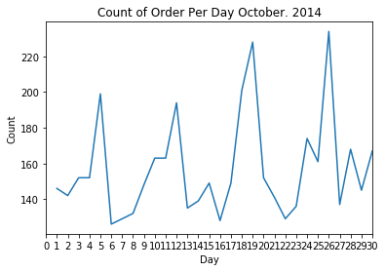

Slide 18
Dataset
Sample Record
Attribute | Entry
delivery_id | 1476547
customer_id | 83095
jumpman_id | 132725
vehicle_type | bicycle
pickup_place | Bareburger
place_category | Burger
item_name | Bare Sodas
item_quantity | 1
item_category_name | Drinks
how_long_it_took_to_order | 0:06:45
pickup_lat | 40.7285
pickup_lon | -73.9984
dropoff_lat | 40.7286
dropoff_lon | -73.9951
when_the_delivery_started | 10/28/14 21:39
when_the_Jumpman_arrived_at_pickup | 10/28/14 21:37
when_the_Jumpman_left_pickup | 10/28/14 21:59
when_the_Jumpman_arrived_at_dropoff | 10/28/14 22:04
Attribute | Entry
delivery_id | 1476547
customer_id | 83095
jumpman_id | 132725
vehicle_type | bicycle
pickup_place | Bareburger
place_category | Burger
item_name | Bare Sodas
item_quantity | 1
item_category_name | Drinks
how_long_it_took_to_order | 0:06:45
pickup_lat | 40.7285
pickup_lon | -73.9984
dropoff_lat | 40.7286
dropoff_lon | -73.9951
when_the_delivery_started | 10/28/14 21:39
when_the_Jumpman_arrived_at_pickup | 10/28/14 21:37
when_the_Jumpman_left_pickup | 10/28/14 21:59
when_the_Jumpman_arrived_at_dropoff | 10/28/14 22:04
5,900+ records and 18 features
Engineered Features:
-One
-Two
-Three

Slide 19
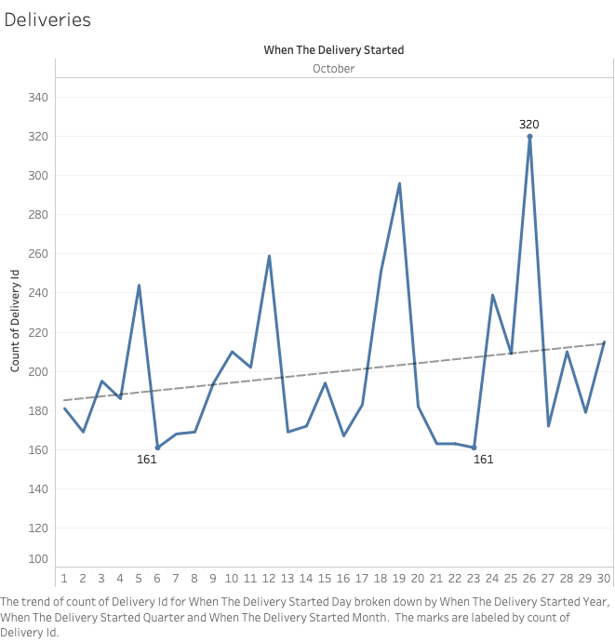

Slide 20
Jumpmen misc.

