Slide 1
Jumpman23 [New Market Analysis]
Stephen Stark
October 2020
Presented to:

Slide 2
ANALYSIS OVERVIEW
1 EXECUTIVE SUMARY
2 INTRODUCTION
3 NEW MARKET ANALYSIS
4 DATA
5 GROWTH STRATEGY
6 NEXT STEPS
7 APPENDIX

Slide 3
1 EXECUTIVE SUMMARY
The New York market is STRONG with SIGNIFICANT GROWTH POTENTIAL:
Completed 4,700 transactions in the month of October 2014
45-minute average delivery time
2,900+ unique customers served; 16% order twice, 6% order three or more times
Most popular delivery time is between 6PM-8PM
GROWTH RECOMMENDATION #1: Targeted campaigns to specific zip codes.
[11226, 10025, 11211]: have the lowest market penetration rate, currently reaching 60 of the 290K potential customers
[10282,10007,10069]: have the highest average household median income $200K+ and a low market penetration rate, currently reaching 110 of the 17K potential customers
GROWTH RECOMMENDATION #2: Focus on Jumpmen and Customer engagement. Survey the ones who use the service the most to to gather feedback on their hurdles and challenges. Also engage with the customers who only used once and haven’t returned.
GROWTH RECOMMENDATION #3: Decrease wasted time at restaurants. Explore a restaurant partnership model to minimize the time spent waiting at the pickup location.

Slide 4
2 INTRODUCTION
Methodology:
Examine data integrity concerns
Exploratory data analysis
Feature engineering
Determine growth strategy
Assumptions:
Place category, item name, item quantity, category name were all replaced with “not disclosed”
Estimated time to order using an average value for the dataset as my analysis did not show meaningful deviation by place category
Dropped records that did not have Jumpman pickup arrival and departure times
Multiple items from the same order were broken out into separate records. I decided to only keep one record per delivery id
Excluded records with suspicious values. One record suggested a bicyclist traveled 100+ mph

Slide 5
3 NEW MARKET ANALYSIS
KNOW THE BUSINESS
CUSTOMERS
+
JUMPMEN
+
BUSINESSES

Slide 6

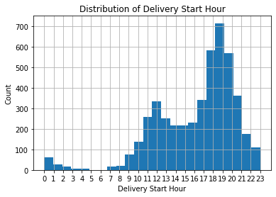
3.1 NEW MARKET ANALYSIS [CUSTOMERS]
CUSTOMER PROFILE
Dinner is most popular (6PM – 8PM) followed by lunch
Five most frequented drop off zip codes are
[10001, 10002, 10003, 10011, 10012]
Average median household income of $80K, with average population of 46K per zip code
Most popular categories: Italian, American, burgers, Japanese, and dessert
CUSTOMER LOYALTY
Most loyal customer, customer id #369272, ordered 23 times!
Average order frequency per customer is 1.6x
30% of customers ordered more than once
RETURN CUSTOMER

Slide 7
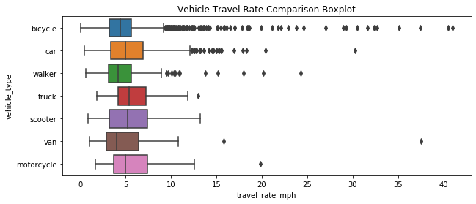
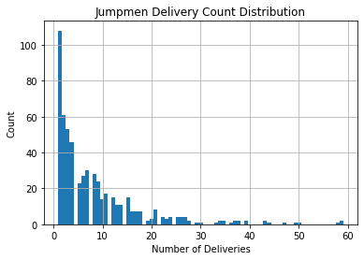
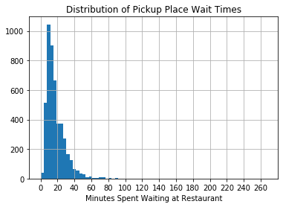
3.2 NEW MARKET ANALYSIS [JUMPMEN]
5,400+ total miles traveled*
72% of deliveries via bicycle, 21% by car
*based on Haversine distance
83,000 minutes spent waiting at businesses, or ~1,400 hours
Average wait time of 17 minutes per business
max = 59
565 Jumpmen on the platform
The average Jumpman completed 8.3 deliveries, or one every four days
max = 17.7

Slide 8
3.2 NEW MARKET ANALYSIS [JUMPMEN]
The Jumpman Journey
Jumpman23 is an on-demand delivery platform connecting “Jumpmen” and customers.
Jumpmen are sent to merchants to pickup any items requested by the customer.
Whenever possible, Jumpman23 will order the requested items ahead to save the Jumpmen time.
Each time a Jumpman23 delivery is completed, a record is saved to the Jumpman23.
Delivery Starts
Jumpman arrives at the pickup location
Places order
Departs pickup location
Arrives at customer’s location
Jumpman
Delivery
Journey

Slide 9
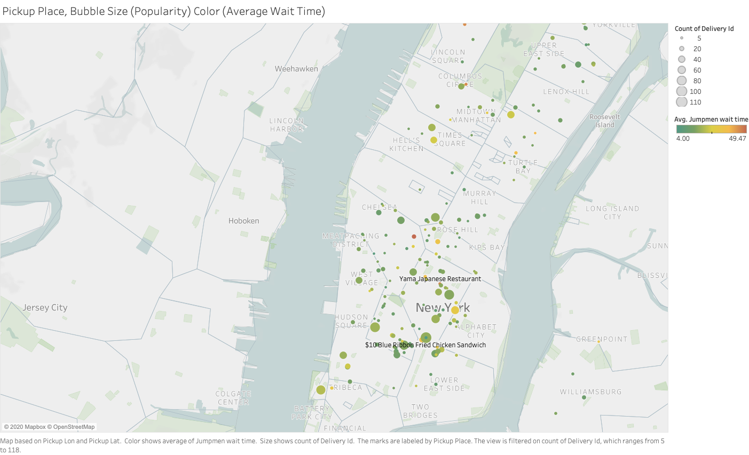
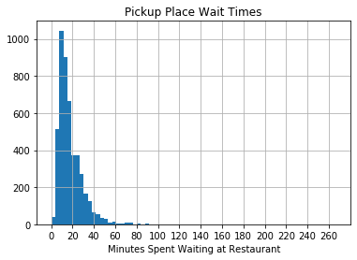
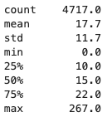
3.3 NEW MARKET ANALYSIS [BUSINESSES]
Some of the most popular restaurants can be found in the East Village, SoHo, and Lower East Side neighborhoods
Average Jumpmen wait time is almost 18 minutes
The right skew indicates inefficiency. I recommend a partnership model to decrease time spend at restaurants

Slide 10
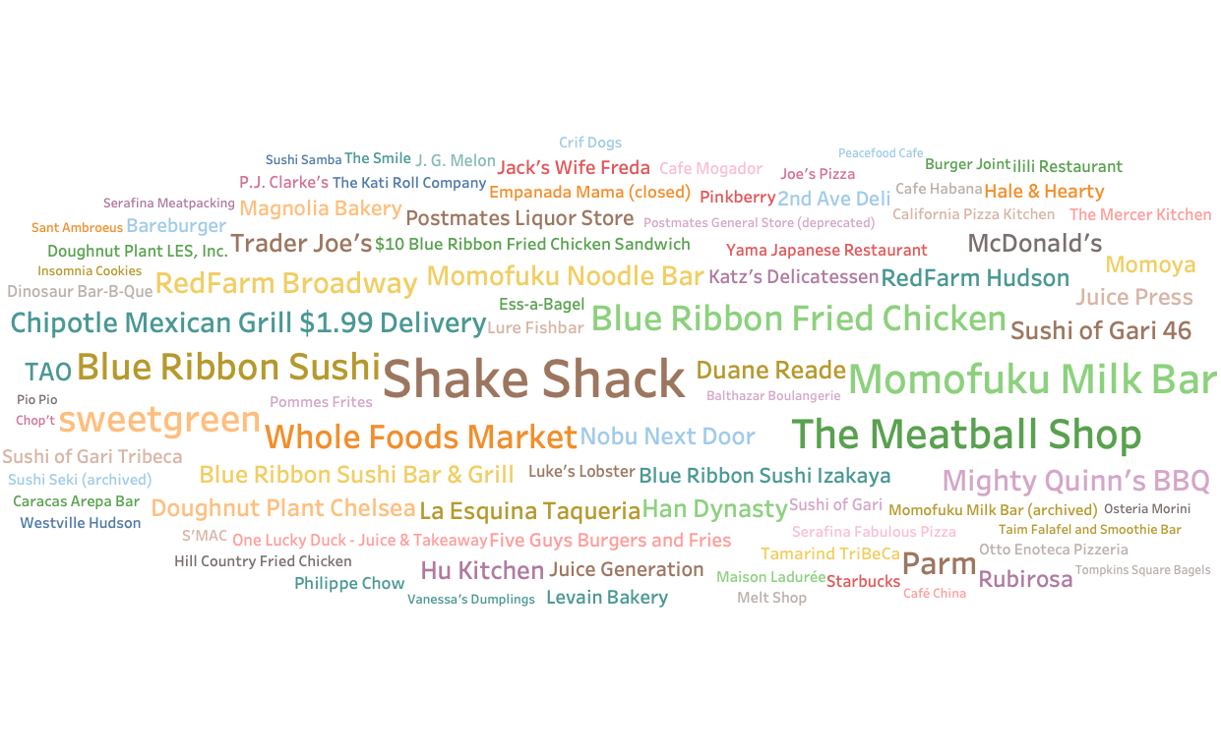
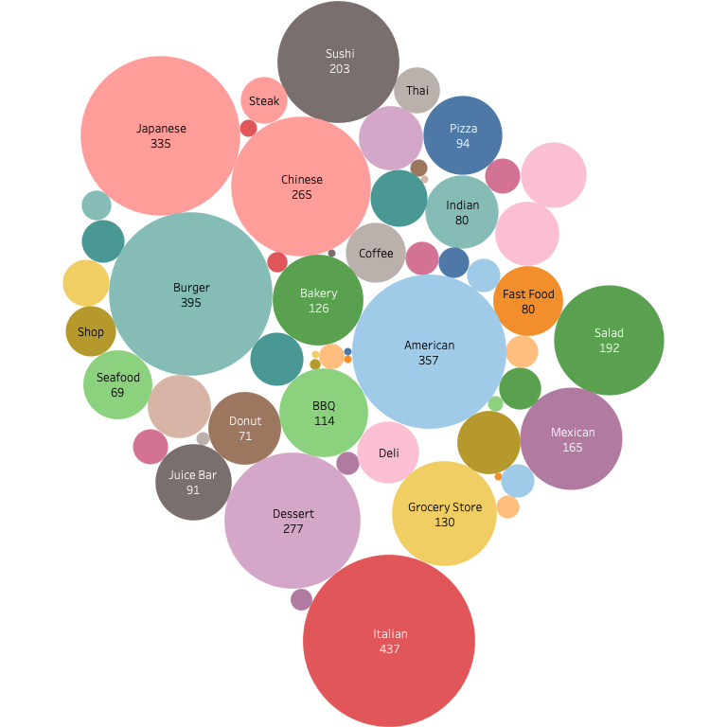
3.3 NEW MARKET ANALYSIS [BUSINESSES]
Most Frequented Pickup Spots
50+ categories available
on the platform

Slide 11
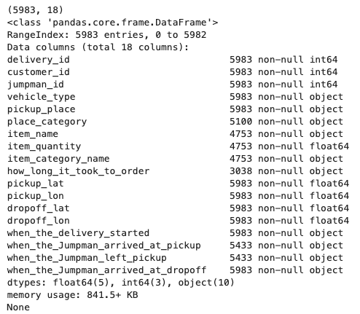
4 DATA
Job_ID → a unique identifier of a delivery
Customer_id → a unique identifier for the Jumpman23 customer
Jumpman_id → a unique identifier for the Jumpman who completed the delivery
vehicle_type → The method of transport the Jumpman used to complete the delivery
pickup_place → The name of the Pickup location
place_category → A categorization of the Pickup location
Item_name → the name of the item requested
Item_quantity → how many of that item was requested
Item_category_name → categorization provided by the merchant, think “appetizers”, ”soups” etc
How_long_it_took_to_order → how long it took to place the order [interval]
pickup_lat → the coordinates of the pickup location
pickup_lon → the coordinates of the pickup location
dropoff_lat → the coordinates of the dropoff location
dropoff_lon → the coordinates of the dropoff location
when_the_delivery_started→ localized timestamp representing when the delivery began
when_the_Jumpman_arrived_at_pickup → localized timestamp representing when the Jumpman arrived at the pickup location
when_the_Jumpman_left_pickup → localized timestamp representing when the Jumpman left the pickup location
Initial dataset: 5,983 records, 18 features

Slide 12
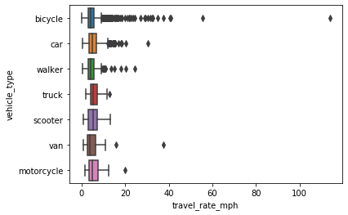







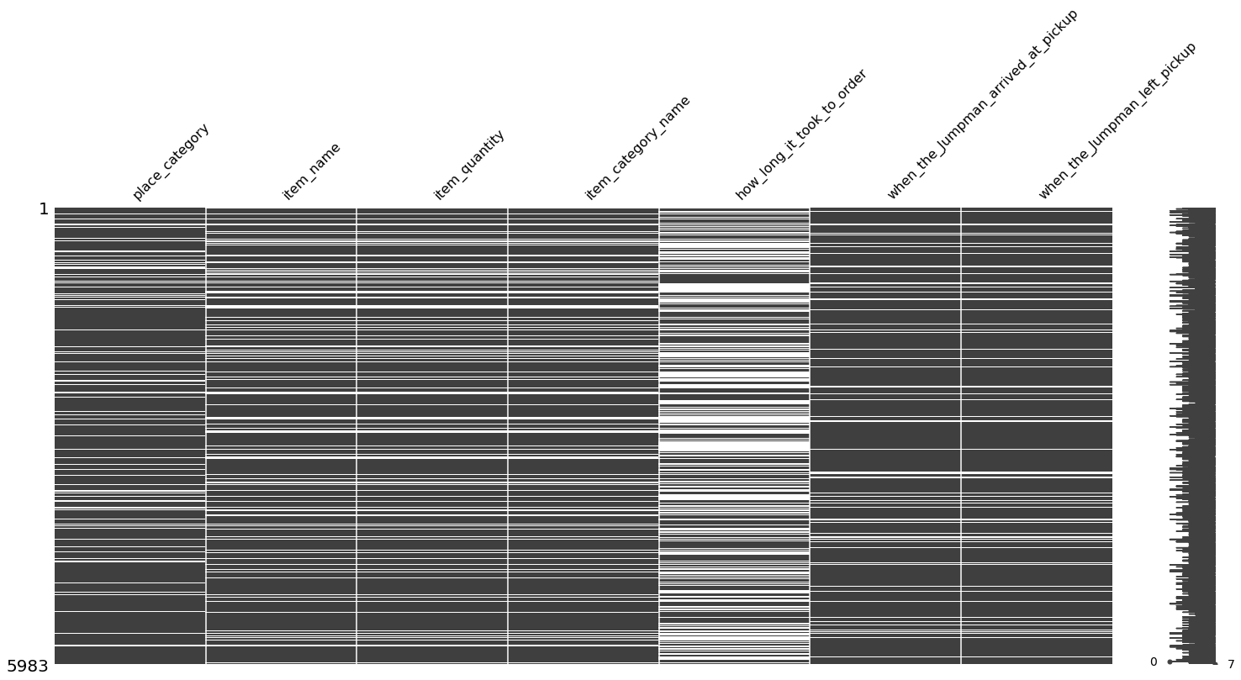
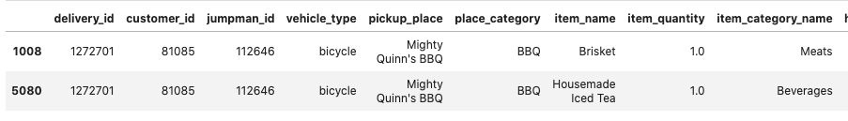
4.1 DATA [INTEGRITY CONCERNS]
SYSTEMIC data quality problems
SUSPICIOUS…
115 mph
Attribute | Missing Value Count
delivery_id | 0
customer_id | 0
jumpman_id | 0
vehicle_type | 0
pickup_place | 0
place_category | 883
item_name | 1,230
item_quantity | 1,230
item_category_name | 1,230
how_long_it_took_to_order | 2,945
pickup_lat | 0
pickup_lon | 0
dropoff_lat | 0
dropoff_lon | 0
when_the_delivery_started | 0
when_the_Jumpman_arrived_at_pickup | 550
when_the_Jumpman_left_pickup | 550
when_the_Jumpman_arrived_at_dropoff | 0
Heatmap showing seven columns of missing data, by record descending vertically. White space indicates missing data. Significant.
Notice data is usually missing for multiple columns for the same record. Systemic data collection issue!
Not even Lance Armstrong could achieve these speeds!
Deliveries with multiple items are broken out on as separate records
In total, data quality concerns are significant and should be addresses. However, they do not pose a threat to this analysis.

Slide 13
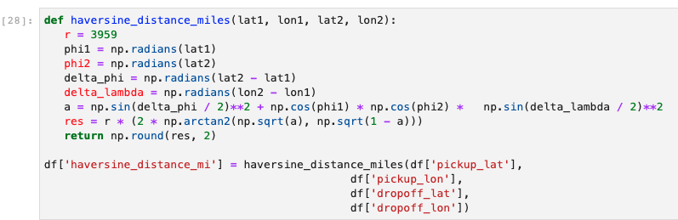
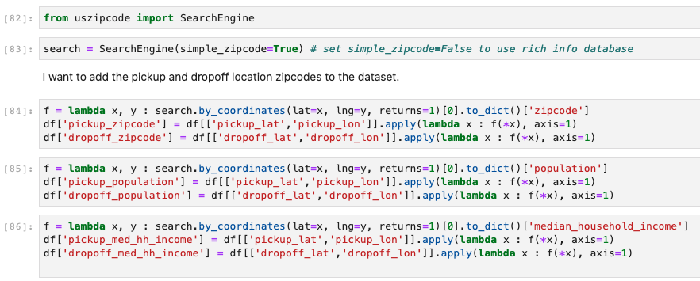
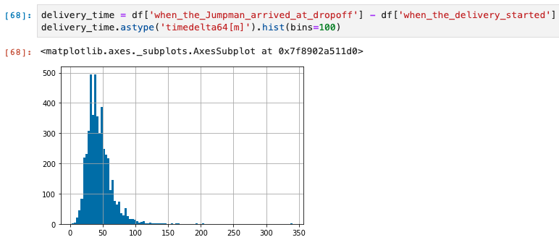
4.2 DATA [FEATURE ENGINEERING]
DEMOGRAPHIC & GEOGRAPHIC DATA
I used Haversine distance, aka “as the crow flies”, as a measure of distance between two coordinate points
“uszipcode” package provides access US census data in dictionary format
A sample function returns zip code based on latitude and longitude coordinates
I engineered certain new features (e.g. total delivery time or time spent at pickup) that are a function of existing features

Slide 14
5 GROWTH STRATEGY
GROWTH RECOMMENDATIONS
TARGETED CAMPAIGNS
+
ENGAGEMENT
+
WAIT TIMES

Slide 15
5.1 GROWTH STRATEGY [TARGETED CAMPAIGNS]
GROWTH RECOMMENDATION #1: Targeted campaigns to specific zip codes.
[11226, 10025, 11211]: have the lowest market penetration rate, currently reaching 60 of the 290K potential customers
[10282,10007,10069]: have the highest average household median income $200K+ and a low market penetration rate, currently reaching 110 of the 17K potential customers
Target UNTAPPED MARKETS
0.26%
Current reach of the 10 highest earning* zip codes
*by estimated average household income
286,000
60
Population of NY’s three most populous zip codes
Number of current customers in those same three zip codes
Notes:
The time to delivery is a simple function of the the time the delivery starts, the time spent waiting at the pickup place, and the time spent traveling to the customer. We should seek to minimize time spent waiting at the business since the time spent traveling to the customer is out of our control.

Slide 16
5.1 GROWTH STRATEGY [TARGETED CAMPAIGNS]
10 MOST POPULOUS ZIP CODES
10 HIGEST EARNING ZIP CODES
Zip Code | Estimated Population | # Unique Customers | Market Penetration (X 10)
11226 | 101,572 | 3 | 0.030%
10025 | 94,600 | 26 | 0.275%
11211 | 90,117 | 31 | 0.344%
11206 | 81,677 | 2 | 0.024%
10002 | 81,410 | 135 | 1.658%
11221 | 78,895 | 2 | 0.025%
10029 | 76,003 | 39 | 0.513%
11215 | 63,488 | 13 | 0.205%
10009 | 61,347 | 121 | 1.972%
10023 | 60,998 | 73 | 1.197%
Zip Code | Median Household Income | Estimated Population | # Unique Customers | Market Penetration (X 10)
10282 | 230,952 | 4,783 | 27 | 5.645%
10007 | 216,037 | 6,988 | 38 | 5.438%
10069 | 170,630 | 5,199 | 45 | 8.656%
10162 | 168,667 | 1,685 | 64 | 37.982%
10280 | 129,574 | 7,853 | 18 | 2.292%
11109 | 125,871 | 3,523 | 2 | 0.568%
10005 | 124,670 | 7,135 | 18 | 2.523%
10006 | 119,274 | 3,011 | 31 | 10.296%
10065 | 115,519 | 32,270 | 99 | 3.068%
10024 | 109,956 | 59,283 | 1 | 0.017%
Market Penetration (X10) =
(# Unique Customers / Estimated Population) *10

Slide 17
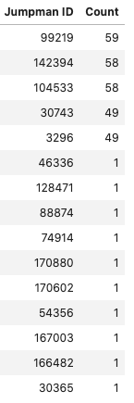
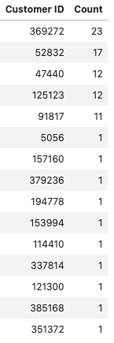
5.2 GROWTH STRATEGY [ENGAGEMENT]
GROWTH RECOMMENDATION #2: Focus on Jumpmen and Customer engagement. Survey the ones who use the service the most to to gather feedback on their hurdles and challenges. Also engage with the customers who only used once and haven’t returned.
Five most active Jumpmen/Customers on the platform
Ten minimally active Jumpmen/Customers (random sample)

Slide 18
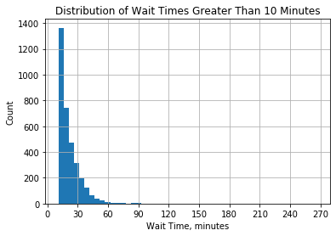
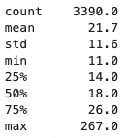
5.3 GROWTH STRATEGY [WAIT TIMES]
GROWTH RECOMMENDATION #3: Decrease wasted time at restaurants. Explore a restaurant partnership model to minimize the time spent waiting at the pickup location.
Minimize WAIT TIMES for Jumpmen. Recommend partnership model with restaurants to minimize wasted time.
Set an ambitious goal to have Jumpmen spending no longer than 15 minutes at each restaurant. Achieve this goal by implementing a business partnership model.
In October 2014, reducing all wait times to a max of 15 minutes would have saved Jumpmen a total of 14,000 minutes, or an average of 27 minutes per Jumpman
Giving time back to Jumpmen allows them to put more time into the platform

Slide 19





6 NEXT STEPS [BEYOND THIS ANALYSIS]
Implement the outlined growth strategies
Survey/Customer Engagement
VIP Postmen & VIP Customers: What works for them? What are their hurdles?
If someone left the platform after a single delivery, ask them what, if anything, went wrong?
Define specific KPIs to better understand performance.
The CEO wants to grow the business 20%. In terms of what? Number of transactions? Number of customer’s reached? Number of restaurants on the platform? Completed transaction value?
Invest in quality assurance measures to investigate data inconsistencies
Broaden the scope of the analysis. More data!
Time series modeling to account for seasonality. What insights from other markets could we leverage to better forecast the New York Market?

Slide 20
7 APPENDIX
I hope you enjoyed my analysis. Please reach out with any further questions.
The full analysis can be found on my GitHub profile.
Contact Information:
Stephen Stark
Email | LinkedIn | GitHub

