Slide 1
Tableau_Dashboard
File created on: 10/7/20 5:13:22 PM CDT

Slide 2
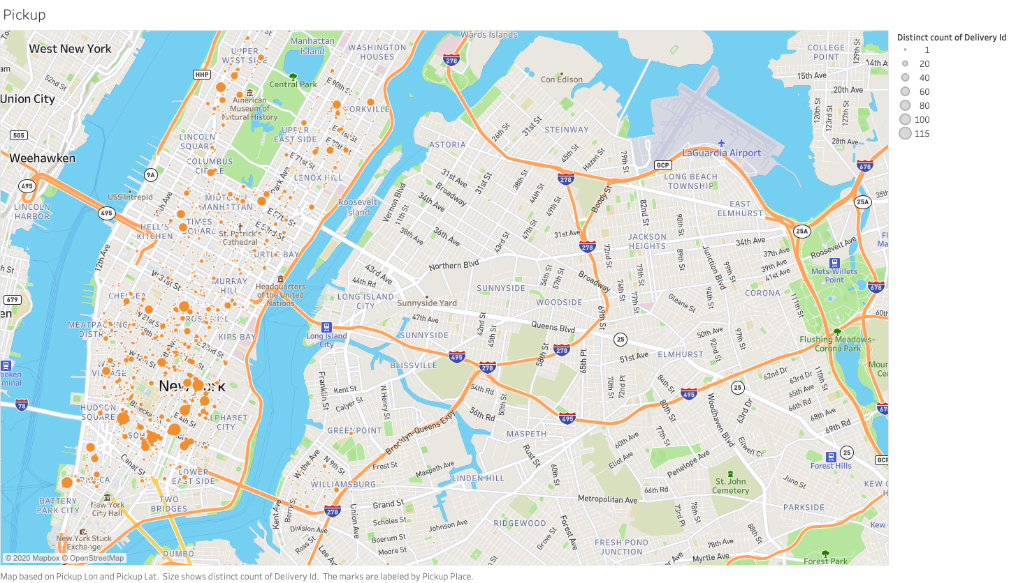

Slide 3
