Slide 1
Jumpman23 New Market Analysis
Stephen Stark
October 2020

Slide 2
ANALYSIS OVERVIEW
01 EXECUTIVE SUMARY
02 INTRODUCITON
03 NEW MARKET ANALYSIS
04 DATA INTEGRITY CONCERNS
05 GROWTH STRATEGY
06 NEXT STEPS
07 APPENDIX

Slide 3
01 EXECUTIVE SUMMARY
Three prong growth strategy recommendations:
Target zip codes a,b,c,d, and e
Jumpmen and Customer engagement
Decrease wasted time at restaurants
The New York market is strong:
Completed X transactions in the month of October 2014
Average delivery time was xx mins
X unique customers, over x% order more than once, x% more than twice
Dinner is the most popular meal ordered

Slide 4
02 INTRODUCTION
Jumpman23 is an on-demand delivery platform connecting “Jumpmen” and customers.
Jumpmen are sent to merchants to pickup any items requested by the customer.
Whenever possible, Jumpman23 will order the requested items ahead to save the Jumpmen time.
Each time a Jumpman23 delivery is completed, a record is saved to the Jumpman23.
Delivery Starts
Jumpman arrives at the pickup location
Places order
Departs pickup location
Arrives at customer’s location
Jumpman
Delivery
Journey

Slide 5
03 NEW MARKET ANALYSIS
KNOW YOUR CUSTOMERS
+
KNOW YOUR JUMPMEN
+
UNDERSTAND THE MARKET’S BUSINESSES

Slide 6
03 NEW MARKET ANALYSIS [CUSTOMERS]

Slide 7
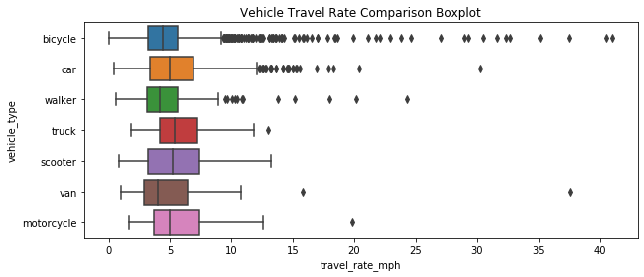

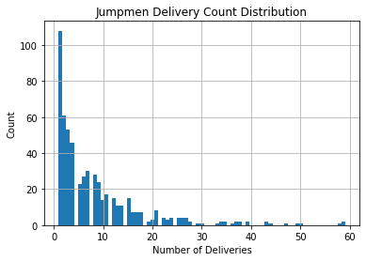
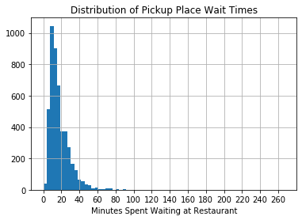
03 NEW MARKET ANALYSIS [JUMPMEN]
In the month of October 2014:
565 Jumpmen on the platform
The average Jumpman completed 8.3 deliveries, or one every four days
5,400+ total miles traveled*
72% of deliveries via bicycle, 21% by car
83,000 minutes spent waiting at businesses, or ~1,400 hours
max = 17.7
Average wait time of 17 minutes
max = 59
*based on Haversine distance

Slide 8
Jumpmen misc.

Slide 9
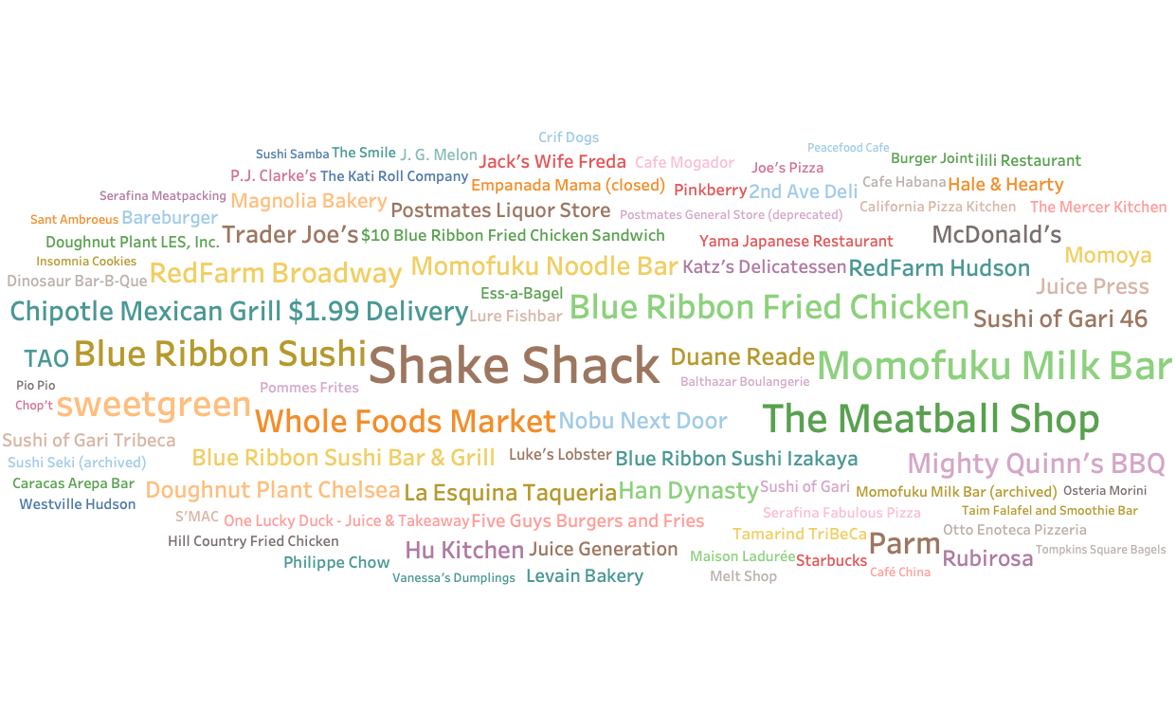
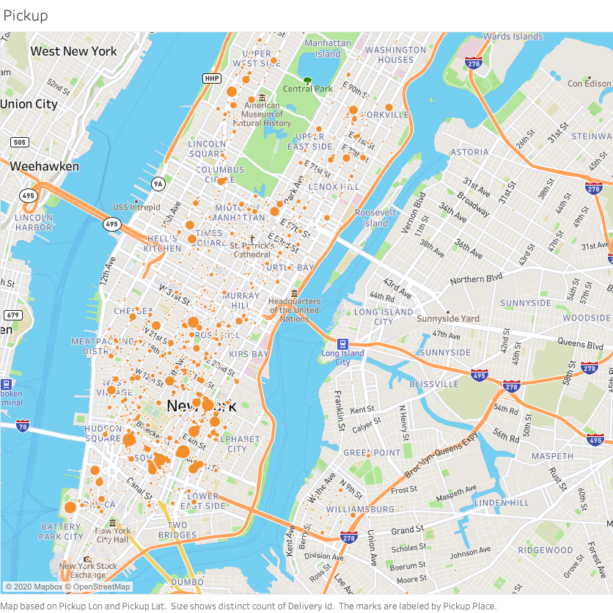
03 NEW MARKET ANALYSIS [BUSINESSES]

Slide 10
04 DATA INTEGRITY CONCERNS
Attribute | Missing Value Count
delivery_id | 0
customer_id | 0
jumpman_id | 0
vehicle_type | 0
pickup_place | 0
place_category | 883
item_name | 1230
item_quantity | 1230
item_category_name | 1230
how_long_it_took_to_order | 2945
pickup_lat | 0
pickup_lon | 0
dropoff_lat | 0
dropoff_lon | 0
when_the_delivery_started | 0
when_the_Jumpman_arrived_at_pickup | 550
when_the_Jumpman_left_pickup | 550
when_the_Jumpman_arrived_at_dropoff | 0
There is a systematic issue in data collection as evidence by the missing records. Assumptions:
Place category, item name, item quantity, category name were all replaced with “not disclosed”
Estimated time to order using an average value for the dataset as my analysis did not show meaningful deviation by place category
Dropped records that did not have Jumpman pickup arrival and departure times
For next steps, I would recommend a classification model to predict the category of the restaurant name. This could be implemented using natural language processing and a simple machine learning.

Slide 11
Attribute | Entry
delivery_id | 1476547
customer_id | 83095
jumpman_id | 132725
vehicle_type | bicycle
pickup_place | Bareburger
place_category | Burger
item_name | Bare Sodas
item_quantity | 1
item_category_name | Drinks
how_long_it_took_to_order | 0:06:45
pickup_lat | 40.7285
pickup_lon | -73.9984
dropoff_lat | 40.7286
dropoff_lon | -73.9951
when_the_delivery_started | 10/28/14 21:39
when_the_Jumpman_arrived_at_pickup | 10/28/14 21:37
when_the_Jumpman_left_pickup | 10/28/14 21:59
when_the_Jumpman_arrived_at_dropoff | 10/28/14 22:04

Slide 12
Dataset
Sample Record
Attribute | Entry
delivery_id | 1476547
customer_id | 83095
jumpman_id | 132725
vehicle_type | bicycle
pickup_place | Bareburger
place_category | Burger
item_name | Bare Sodas
item_quantity | 1
item_category_name | Drinks
how_long_it_took_to_order | 0:06:45
pickup_lat | 40.7285
pickup_lon | -73.9984
dropoff_lat | 40.7286
dropoff_lon | -73.9951
when_the_delivery_started | 10/28/14 21:39
when_the_Jumpman_arrived_at_pickup | 10/28/14 21:37
when_the_Jumpman_left_pickup | 10/28/14 21:59
when_the_Jumpman_arrived_at_dropoff | 10/28/14 22:04
5,900+ records and 18 features
Engineered Features:
-One
-Two
-Three

Slide 13
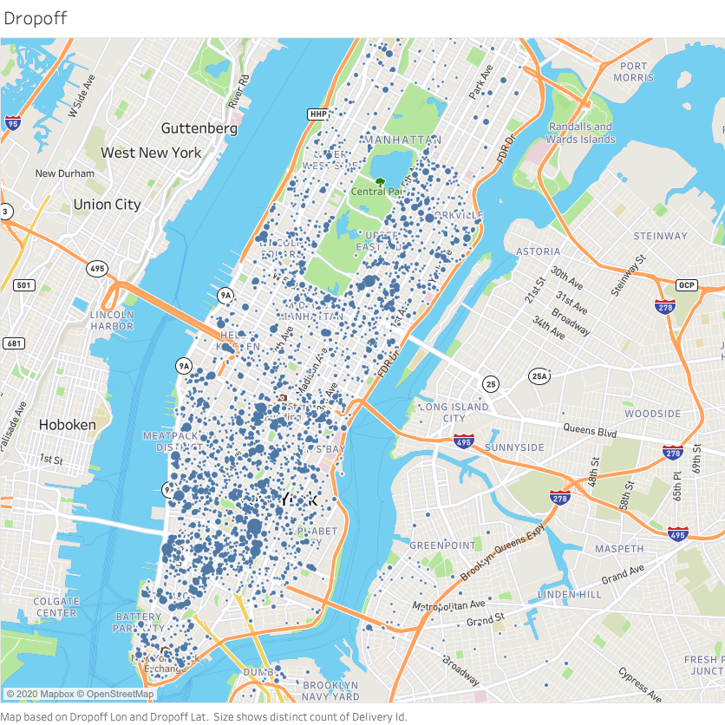
Popular Pickup & Dropoff Locations

Slide 14
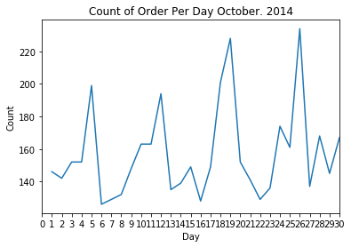
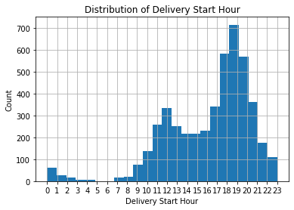

Slide 15
Who are the Jumpmen?
565 Jumpmen completed 4,719 deliveries in October 2014
Half completed 5 deliveries or more
Avg. = 8.4
Max = 59

Slide 16
Growth Strategy
Minimize wait times for Postmen. Recommend partnership with restaurants to minimize wasted time.
Target untapped Zip Codes.
Do customers leave the platform after a long wait time?
Time is everything. Seek to minimize the time spent waiting at the business. Consider a partnership model with the most frequented businesses to expedite this part of the equation.
Notes:
The time to delivery is a simple function of the the time the delivery starts, the time spent waiting at the pickup place, and the time spent traveling to the customer. We should seek to minimize time spent waiting at the business since the time spent traveling to the customer is out of our control.

Slide 17
Growth Opportunities
Zip Code | Estimated Population | # Unique Customers | Market Penetration X 10
11226 | 101,572 | 3 | 0.030%
10025 | 94,600 | 26 | 0.275%
11211 | 90,117 | 31 | 0.344%
11206 | 81,677 | 2 | 0.024%
10002 | 81,410 | 135 | 1.658%
11221 | 78,895 | 2 | 0.025%
10029 | 76,003 | 39 | 0.513%
11215 | 63,488 | 13 | 0.205%
10009 | 61,347 | 121 | 1.972%
10023 | 60,998 | 73 | 1.197%
Zip Code | Median Household Income | Estimated Population | # Unique Customers | Market Penetration X 10
10282 | 230,952 | 4783 | 27 | 5.645%
10007 | 216,037 | 6988 | 38 | 5.438%
10069 | 170,630 | 5199 | 45 | 8.656%
10162 | 168,667 | 1685 | 64 | 37.982%
10280 | 129,574 | 7853 | 18 | 2.292%
11109 | 125,871 | 3523 | 2 | 0.568%
10005 | 124,670 | 7135 | 18 | 2.523%
10006 | 119,274 | 3011 | 31 | 10.296%
10065 | 115,519 | 32270 | 99 | 3.068%
10024 | 109,956 | 59283 | 1 | 0.017%

Slide 20
Appendix
Links to Analysis
Thank you for the opportunity, I can be reached at
stephenstark@uchicago.edu
Stephen stark linkedin
Stephen stark github

