Slide 1
Prediction of MLS All Stars
Scott Steehler
Dr. Bradley Boehmke & Dr. Yan Yu
Notes:
Thank you, looking forward to discuss my findings and experiences on this project

Slide 2
Overview
Introduction
Problem Description
Data Preparation
Analysis & Modeling
Conclusions
References

Slide 3
Scott Steehler Expected Graduation: Fall 2022
Fall 2020: Began in the Data Analytics Graduate Certificate
Fall 2021: Transitioned to the MS Business Analytics Program
Current Position: Senior Data Analyst (Western Southern)
Notes:
Brief overview of time in program, make note of full time role/part time student

Slide 4
Problem Description
Each year, the Major League Soccer (MLS) All-Star game marks the mid-point of the season. Since 1996, this game has been an opportunity to highlight the league’s best players in an exhibition game.
Throughout the history of the All-Star game, selections have been made using a wide variety of criteria including league coaches voting, league commissioner selections, and even social media polls. Regardless of the method, the goal has always been to highlight the best players across the league.
This project aims to build a predictive model that will be able to select the best players from MLS using performance statistics.
Notes:
DON’T READ word for word
Summarize
Personal connection to soccer
Potential applications in the future = industry or sports betting

Slide 5
Acquiring Data & Prep
Plans A, B, and C

Slide 6
Finding and Scraping Data
Data Requirements
Significant Challenges
Multiple seasons of consistent statistics
Free or low cost
Game level granularity, so games prior to the All-Star game could be isolated
Only two sources of data were available, and one specifically prohibited downloading or scraping
Fbref.com
Multiple scripts/packages from other users
Eventually needed to write a custom web scrape function using Beautiful Soup
Significant testing and development time
Notes:
Game level grain
Only one real source
Challenge and time required to build my first real scraping script
Dynamically built tables on website
Unsure if future scraping is possible due to policy/technology changes

Slide 7
Exploratory Data Analysis
2017-2022 seasons scraped
2017 and 2020 excluded
Between 700-800 players participate each season
Data represents the full population
26-28 players selected as All-Stars each season (4 seasons)
3.8% of field players & 4.9% of goalkeepers
2.75 goalkeepers, 8 defenders, 8.5 midfielders, 7.5 forwards
Different statistics keep for goalkeepers
Overlap between position groups
Primarily between forwards and midfielders
Generally, All-Stars performance statistics are significantly higher than other players.
7 times more likely to be a captain on the team
Twice the average number of minutes played
Notes:
Walk through the bullets

Slide 8
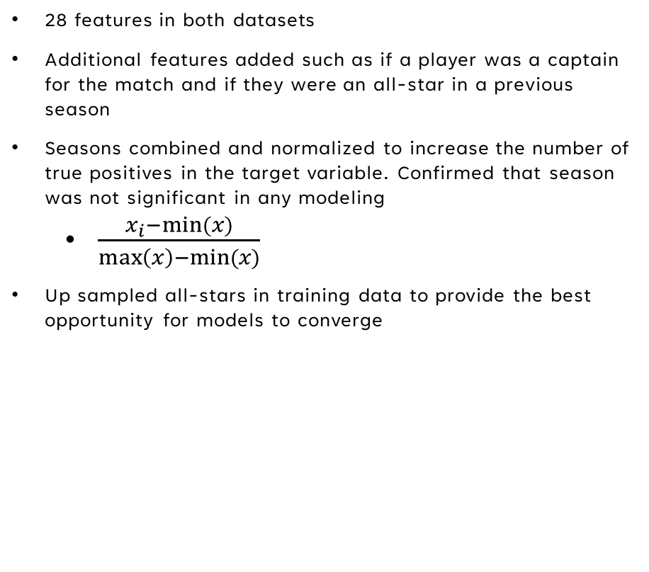
Feature Engineering and Normalization
28 features in both datasets
Additional features added such as if a player was a captain for the match and if they were an all-star in a previous season
Seasons combined and normalized to increase the number of true positives in the target variable. Confirmed that season was not significant in any modeling
$\frac{x_{i}−min⁡(x)}{\max\left(x\right)−min⁡(x)}$
Up sampled all-stars in training data to provide the best opportunity for models to converge
Notes:
Needed to squeeze all of the value from existing data
Captain and previous all-star status were significant in multiple models
Normalization was required and checked
Normalizing the data also made it easier to use in model that are sensitive to scale (NN, KNN)
Only upsampled training data

Slide 9
Modeling & testing

Slide 10
Modeling
Models Considered
Evaluation Criteria
Logistic Regression
K Nearest Neighbor
Random Forest/Decision Tree
XGBoost/Adaboost
Neural Network
Selecting All-Stars requires a focus on true positives output from a binary classification.
Recall used for all models
Risks overfitting and increased false positives
GridSearchCV used extensively for model optimization
Notes:
Focus on selected models
RF is more robust than DT
XGBoost is much more tunable than Adaboost
Neural Network struggled to converge, likely due to small sample size

Slide 11
Results
 | Forwards | Midfielders | Defenders | Goalkeepers
Selected Model | XGBoost | Logistic | Logistic | XGBoost
F1 Score | 0.35 | 0.19 | 0.20 | 0.27
Recall | 0.75 | 0.55 | 1 | 1
Players Selected Each Year | 7 | 8 | 8 | 3
Model Success | 5 (71.4%) | 5 (62.5%) | 2 (25.0%) | 1 (33.3%)
True Positive in Top 20 | 7 (100.0%) | 5 (62.5%) | 5 (62.5%) | *3 (100.0%)
*GK evaluated out of top 10 due to small sample size
Notes:
Players selected is rounded average from years in data
Focus on green
Explain why this is a better metric for model evaluation since it fits with the All Star selection process

Slide 12
Conclusions
Project Successes
Future Improvements
Forward and midfielder models show significant success when selecting the top n results based on predicted probability
Defender and goalkeeper models had moderate success with getting true positives in the top 10 or 20
Attempt to identify additional metrics that are more specific to defenders
Evaluate non-performance statistics for integration into the model such as salary, social media popularity, or other accolades/awards
Test models using a new season as the test data rather than blended seasons (ex. 2023 season)
Test other evaluation metrics, such as F1_beta score which would require tuning for appropriate beta to balance recall and precision.
Reduce overfitting

Slide 13
Acknowledgements
Dr. Boehmke and Dr. Yu for their assistance in this project
Dr. White for her leadership of the BANA program
My wife, Traci, for her never-ending support as I pursued this degree even when I had class 12 hours after our son first came home from the hospital
Notes:
Read
Learned many of these techniques in Dr. Yu’s Data Mining course

Slide 14


References
Fbref.com for providing open access to a wide range of spots statistics
Scikit-learn community and maintainers for developing an incredibly powerful set of models and functions

