Slide 1

My Alexa Cafe experience
By: Sofia Stein

Slide 2
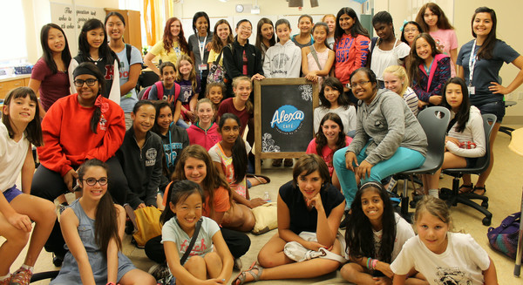
Cal
Replace this image with your own screenshot. Then delete this text.
3D printing
June 27th – July 1st)

Slide 3

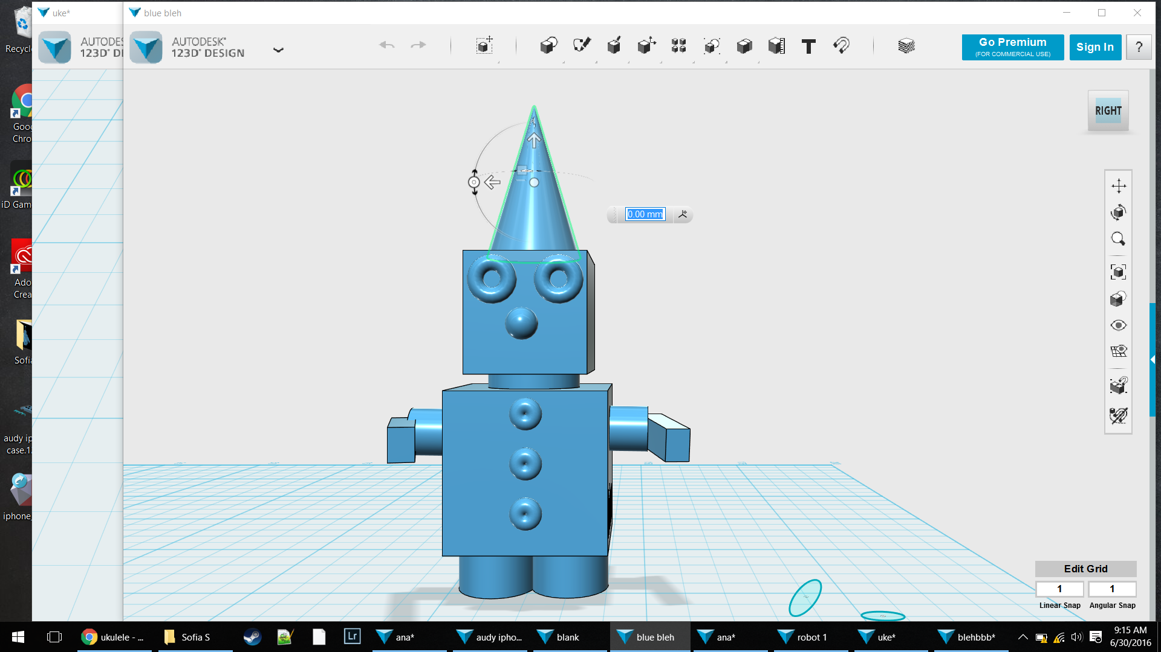
I learned how to move things.
I learned how to scale things.
I learned how to turn 2D into 3D.
Replace this image with your own screenshot. Then delete this text.

Slide 4

Write Title for Page
Explain something you’ve learned here.
Explain something you’ve learned here.
Explain something you’ve learned here.
Explain something you’ve learned here.
Explain something you’ve learned here.
Replace this image with your own screenshot. Then delete this text.

Slide 5
Write Title for Page
Explain something you’ve learned here.
Explain something you’ve learned here.
Explain something you’ve learned here.
Explain something you’ve learned here.
Explain something you’ve learned here.
Replace this image with your own screenshot. Then delete this text.

Slide 6
Write Title for Page
Explain something you’ve learned here.
Explain something you’ve learned here.
Explain something you’ve learned here.
Explain something you’ve learned here.
Explain something you’ve learned here.
Replace this image with your own screenshot. Then delete this text.

Slide 7
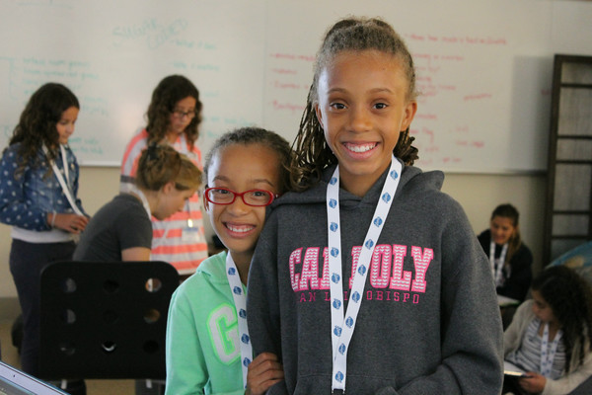
My Favorite Memory
Type a few sentences or a paragraph about your favorite memory from this week. Update the photo above with one of your own or maybe a favorite screenshot!

