Slide 1
Welcome to the Maintenance Game

Slide 2
Welcome to the Maintenance Game
Now that you’re logged in, please give this game your full attention.

Slide 3
Welcome to the Maintenance Game
Now that you’re logged in, please give this game your full attention.
To make sure your data is recorded correctly, do not switch tabs or leave this window while playing. Doing so may stop the game early or make your results unusable. Please also check that your volume is turned on.

Slide 4
Welcome to the Maintenance Game
Now that you’re logged in, please give this game your full attention.
To make sure your data is recorded correctly, do not switch tabs or leave this window while playing. Doing so may stop the game early or make your results unusable. Please also check that your volume is turned on.
Take a breath, get comfortable—and let’s begin 🙂

Slide 5
Please take a moment to read the instructions carefully. Each slide will remain on screen for at least two seconds before you can continue to the next one.
Notes:
(there should be no minimal time in moving backward only forward)

Slide 6
After each section, there will be a short comprehension check. You will be given two chances to accurately respond to the questions in this check, and failure to do so will cause the game to end early.
Notes:
(there should be no minimal time in moving backward only forward)

Slide 7
Thank you for playing, and let’s get started!
Notes:
(there should be no minimal time in moving backward only forward)

Slide 8
This is BleeBlop. BleeBlop is a Robot.

Slide 9
Bleeblop’s Goal is to Reach Robonia in time for the yearly Roboday celebration,

Slide 10
But their journey there won’t be easy…

Slide 11
For Bleeblop to move most efficiently, their gloop needs to be at the ideal level.

Slide 12
The ideal level for Bleeblop’s gloop will be indicated using a star.
Ideal Level

Slide 13
Over time, Bleeblop’s gloop will naturally drain…

Slide 14
So, you will need to add to BleeBlop’s gloop to keep them moving efficiently!

Slide 15
As you do this, be careful…

Slide 16
If Bleeblop’s main gloop container maxes out…

Slide 17
Bleeblop will overheat.

Slide 18
If Bleeblop’s main gloop container empties…

Slide 19
Bleeblop will shut down.

Slide 20
Overheating or shutting down will force Bleeblop to go backwards to the last repair shop they passed, and progress will be lost.

Slide 21
Your job is to keep BleeBlop’s gloop levels at the ideal height so that they can get to Robonia as fast as possible!

Slide 22
Where is BleeBlop trying to go?
To Mars
To Robonia
To Providence, RI
Out on the town
To Disneyland

Slide 23
What naturally happens to BleeBlop’s gloop over time?
It freezes
It fills
Nothing
It drains
It expands

Slide 24
What happens if Bleeblop’s gloop container maxes out?
Bleepblop moves as fast as possible
Bleepblop overheats
Bleeblop stops moving completely
Nothing

Slide 25
What happens if Bleeblop’s gloop container empties?
Bleepblop stops moving completely
Bleepblop moves as fast as possible
Bleeblop shuts down
Nothing

Slide 26
When does BleeBlop move the fastest
When their gloop level is as high as possible
When their gloop level is at the ideal height
When their gloop level is just below the maximum
When their gloop levels are as low as possible

Slide 27
Oops, there was at least one incorrect response.
It seems that you did not quite understand…
Notes:
Show this after all of the sections questions if they get at least one wrong (not just after the question that they missed) and then send them back to the BleeBlop intro screen.
A Description of which question they missed should be given after the slide

Slide 28
EXAMPLE
Oops, there was at least one incorrect response.
It seems that you did not quite understand…
Where Bleeblop is trying to go
What happens when Bleeblop’s gloop container empties
Notes:
Show this after all of the sections questions if they get at least one wrong (not just after the question that they missed) and then send them back to the BleeBlop intro screen

Slide 29
No worries—let’s review this section of the instructions
one last time.
To be clear, any more incorrect answers will end the game and result in minimal compensation.
Notes:
Show this after all of the sections questions if they get at least one wrong (not just after the question that they missed) and then send them back to the BleeBlop intro screen.
A Description of which question they missed should be given after the slide

Slide 30
Unfortunately, you have not passed the comprehension portion of the task, so the game will have to end here.
Thank you for your participation!
Notes:
Show this if they finish the questions in the section, but failed to get them all right after 2 tries

Slide 31
Awesome! Here’s how you can help BleeBlop:

Slide 32
Use the left arrow key to add to the main gloop container.
Add gloop

Slide 33
Sometimes, Bleeblop will have an extra storage container for their gloop.
Storage Container

Slide 34
When BleeBlop has more than the ideal amount of gloop, the gloop that naturally drains will fill this container.

Slide 35
IMPORTANT: this only happens if Bleeblop has MORE than the ideal amount of gloop.
If their gloop is at or below the ideal level, the draining gloop is simply lost.

Slide 36
By clicking the up arrow, you can dump some stored gloop back into the main gloop container.
Move gloop from storage to main container

Slide 37
At the end of each day, you will get to see how far you helped Bleeblop travel.
Miles traveled: 5.6

Slide 38
Bleeblop’s gloop levels will reset when the new day begins,

Slide 39
But you’ll get to keep whatever gloop you’ve stored (even if it isn’t always accessible).

Slide 40
To summarize…
Use the left arrow key to add gloop to the main container
Use the up arrow key to dump gloop to the main container from storage
Draining gloop will ONLY be stored when Bleeblop’s main gloop container is filled above the ideal level AND there is storage space available
The main gloop container resets every day, but stored gloop is maintained

Slide 41
What happens if Bleeblop overheats?
Bleeblop moves at superspeed
Nothing
Bleeblop goes back for help and loses progress
Bleeblop gives up and the game ends

Slide 42
What happens if Bleeblop shuts down?
Nothing
Bleeblop stops moving
Bleeblop gives up and the game ends
Bleeblop goes back for help and loses progress

Slide 43
What key can you use to add to Bleeblop’s main gloop container?
Space bar
Left arrow key
Right arrow key
Up arrow key
Shift key

Slide 44
What key can you use to dump gloop into the main container from storage?
Space bar
Left arrow key
Right arrow key
Up arrow key
Shift key

Slide 45
When does gloop get stored? (mark all necessary conditions)
The gloop in the main container is above the ideal level
The gloop in the main container is draining
The round has ended
The storage container has empty space
The main gloop container is filled above its max

Slide 46
When is Bleeblop’s stored gloop reset?
When the main container reaches the ideal level
Never
At the end of each day
When Bleeblop reaches Robonia
When Bleeblop overheats or shuts down

Slide 47
When is Bleeblop’s main gloop container reset?
When it reaches the ideal level
Never
At the end of each day
When Bleeblop reaches Robonia
When Bleeblop overheats or shuts down

Slide 48
Oops, there was at least one incorrect response.
It seems that you did not quite understand…
Notes:
Show this after all of the sections questions if they get at least one wrong (not just after the question that they missed) and then send them back to the BleeBlop intro screen.
A Description of which question they missed should be given after the slide

Slide 49
EXAMPLE
Oops, there was at least one incorrect response.
It seems that you did not quite understand…
Where Bleeblop is trying to go
What happens when Bleeblop’s gloop container empties
Notes:
Show this after all of the sections questions if they get at least one wrong (not just after the question that they missed) and then send them back to the BleeBlop intro screen

Slide 50
No worries—let’s review this section of the instructions
one last time.
To be clear, any more incorrect answers will end the game and result in minimal compensation.
Notes:
Show this after all of the sections questions if they get at least one wrong (not just after the question that they missed) and then send them back to the BleeBlop intro screen.
A Description of which question they missed should be given after the slide

Slide 51
Unfortunately, you have not passed the comprehension portion of the task, so the game will have to end here.
Thank you for your participation!
Notes:
Show this if they finish the questions in the section, but failed to get them all right after 2 tries

Slide 52
Awesome Job!

Slide 53
Bleeblop is counting on you to make it to Robonia in time!

Slide 54
The closer you can keep Bleeblop’s gloop level to its ideal, the faster BleeBlop will progress towards Robonia.

Slide 55
If you are able to get Bleeblop at least 75% of the way to Robonia before the annual Roboday celebration, you will receive a $5 bonus!
Notes:
This one is tricky I think we should say they receive the bonus when they make it at least 75% zthere or so and than have you reach Robonia when Bleeblop has the ideal level avery days or something, because we want people to keep playing through all trials even if the already achieved the goal. --FP

Slide 56
What must happen for you to receive the $5 bonus?
Bleeblop uses all of their gloop
Bleeblop goes to a repair shop
Bleeblop gets 75% of the way to Robonia
Bleeblop never overheats or shuts down
Bleeblop gets all the way to Robonia

Slide 57
Oops, that was an incorrect response.
It seems that you did not quite understand…
What must happen for you to receive the $5 bonus
Notes:
Show this after all of the sections questions if they get at least one wrong (not just after the question that they missed) and then send them back to the BleeBlop intro screen

Slide 58
No worries—let’s review one last time.
To be clear, another incorrect answer will end the game and result in minimal compensation.
Notes:
Show this after all of the sections questions if they get at least one wrong (not just after the question that they missed) and then send them back to the BleeBlop intro screen.
A Description of which question they missed should be given after the slide

Slide 59
Unfortunately, you have not passed the comprehension portion of the task, so the game will have to end here.
Thank you for your participation!
Notes:
Show this if they finish the questions in the section, but failed to get them all right after 2 tries

Slide 60
Ready to Go?
Notes:
Yes! Let’s Get Bleeblop to Robonia!
Mmm… I think I need to review the instructions again

Slide 61
Great!

Slide 62
We’ll do a few practice rounds and then send you and Bleeblop on your way!

Slide 63
Great work! Bleeblop can’t wait to travel with you!

Slide 64
Let’s get started!

Slide 67
Overheating or running out of power will force Bleeblop to go back for help and lose progress

Slide 68
Overheating or running out of power will cause Bleeblop to go backwards to the last repair shop that they passed

Slide 69
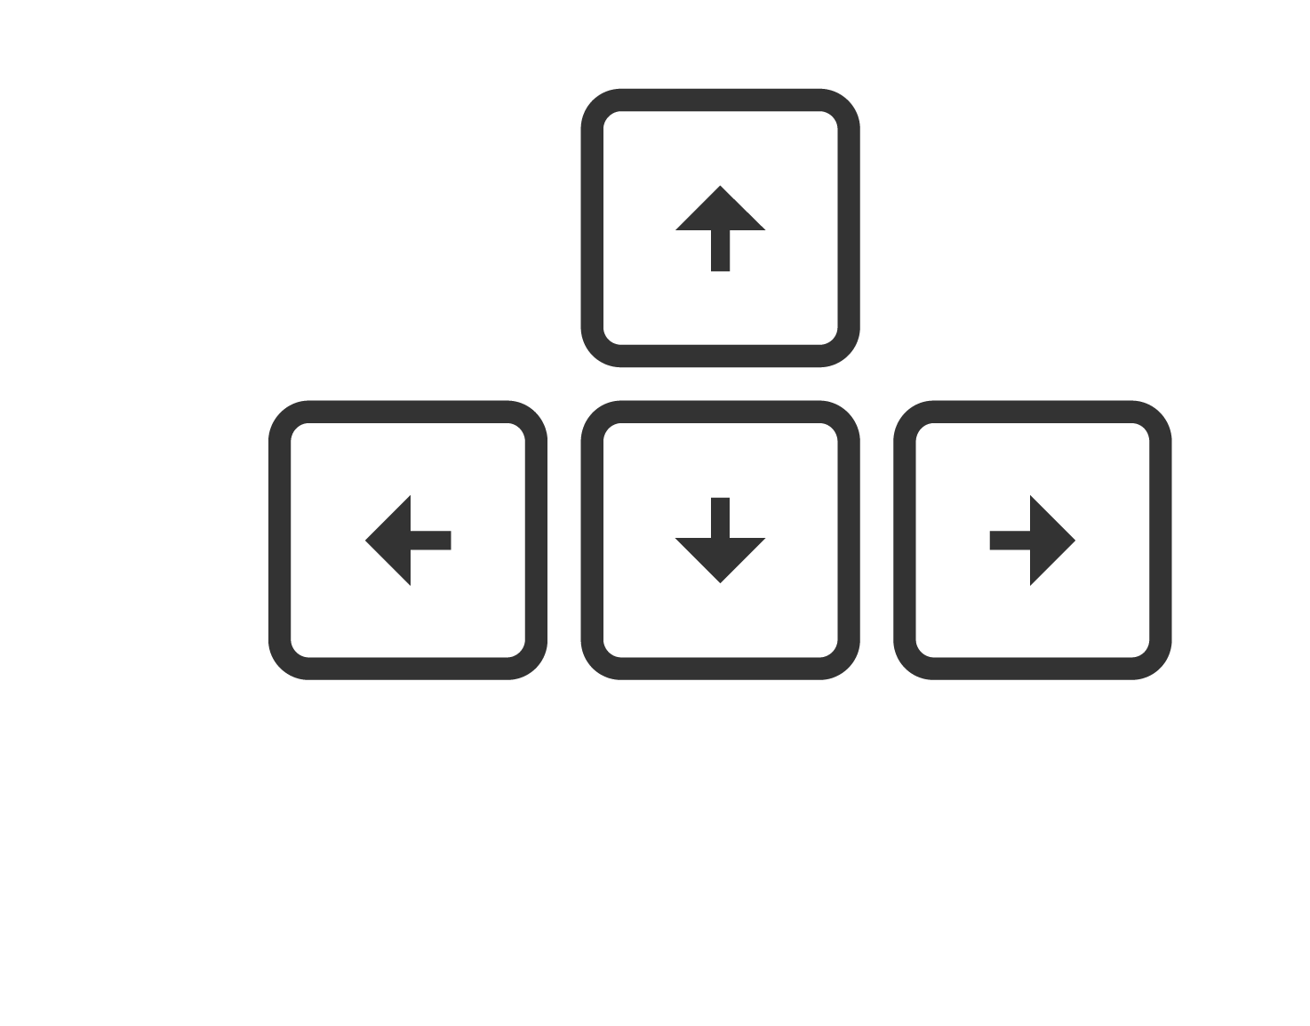

By clicking the up arrow, you can dump some stored gloop back into the main gloop container
Move gloop from storage to main container

Slide 70
Use the left arrow key to add to the main gloop container
Add gloop

Slide 71
Bleeblop’s gloop levels will reset at the end of each day

Slide 72
5 rounds without storage and then five rounds with storage (using different color liquids, and a different velocity) giving feedback as it goes - if the main container goes empty: “Oh no! Bleeblop ran out of power… Remember, you can use the left arrow key to add to the main gloop container, and clicking the up arrow key will dump some stored gloop into the container if it is available. Try to keep the main gloop container at the ideal level (maybe have an arrow pointing to it) so Bleeblop can move as fast as possible!” - if the main container reaches the max: “Oh no! Bleeblop overheated… Remember, Bleeblop’s gloop levels naturally drain overtime, so sometimes it may be best to hold off from filling the main container to keep Bleeblop’s gloop at the ideal level (maybe have an arrow pointing to it). Keeping the main gloop container at the ideal level will let Bleeblop move as fast as possible!” - if they hit the up arrow key on a no storage round: “Bleeblop’s stored gloop is not available today… Bleeblop still has what you stored, it just cannot be accessed right now. Remember, you can always use the left arrow key to add to the main gloop container!” - if they hit the up arrow key on a storage round but the storage is empty: “Bleeblop does not have any stored gloop to use at the moment… The storage container will fill with whatever drains when the main container is above the ideal level.”

Slide 73
Welcome to the Maintenance Game
Now that you’re logged in, please give this game your full attention.
To make sure your data is recorded correctly, do not switch tabs or leave this window while playing. Doing so may stop the game early or make your results unusable. Please also check that your volume is turned on.
Take a breath, get comfortable—and let’s begin 🙂

Slide 74
Please take a moment to read the instructions carefully.
Each slide will remain on screen for at least two seconds before you can continue to the next one.
Thank you for playing!
Notes:
(there should be no minimal time in moving backward only forward)

Slide 75
Oops, there was at least one incorrect response.
It seems that you did not quite understand
this section…
No worries—let’s review the instructions
one last time.
To be clear, any more incorrect answers will end the game and result in minimal compensation.
Notes:
Show this after all of the sections questions if they get at least one wrong (not just after the question that they missed) and then send them back to the BleeBlop intro screen

