Slide 1
Ski Resort Vacations
Group: Bill Nash, Scott Stevener, Erica Unterreiner and Rui Wang

Slide 2
Motivation and Summary
We need a VACATION!
Chose to evaluate ski resorts across North America
Providing a way to look at many resorts before honing in on a location that suits an end user’s needs

Slide 3
Data Cleanup & Exploration
Describe the exploration and cleanup process
Read file into dataframe, observed N/A values
Removed columns with missing information
Removed incorrect information (e.g. Greenland, lat/long for certain resorts)
Discuss insights you had while exploring the data that you didn't anticipate
The amount of missing data
While there are 2/3 more resorts in USA versus Canada, the # of resorts per province are generally greater than # of resorts per state with the exception of Colorado)
Discuss any problems that arose after exploring the data, and how you resolved them
Removed Greenland because it didn’t fit nicely on our map (apologies Greenland!)
Notes:
read the file into a pandas data frame, observed n/a values.
Discuss insights you had while exploring the data that you did not anticipate:
accuracy of race identification
Discuss any problems that arose after exploring the data, and how you resolved them:
n/a values – researched through MN website; figuring out how to deal with date timestamps

Slide 4
Process / Architecture
CSV converted to json and then geojson (python script)
Lat/long python script
Given small data set, created sqlite (python script); though also created schema for mySQL
Flask/Sqlalchemy
Leaflet/Plotly/D3
HTML/CSS/Bootstrap
Heroku deployment

Slide 5
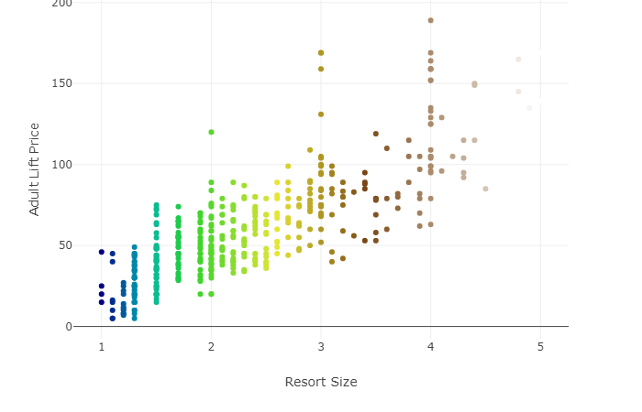
Data Exploration - Overview

Slide 6
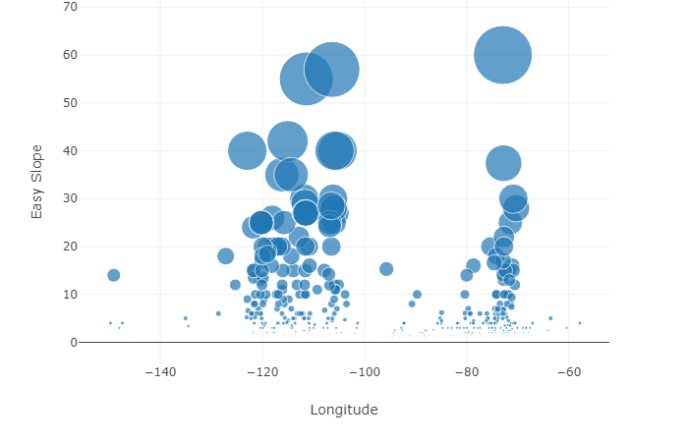
Data Exploration – Overview (cut from final)

Slide 7
Data Analysis
Gather relevant data from ski resort website and location data from google API
Review plot visualizations for trends
Generally, the higher the altitude the higher the lift ticket price
Draw conclusions if possible, and set limits for those conclusions

Slide 8
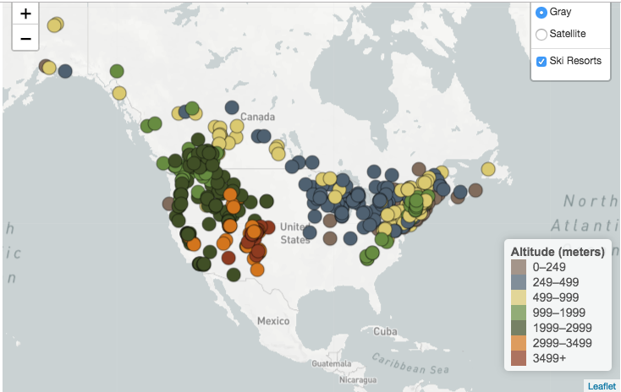
Data Analysis Where are the resorts?

Slide 9
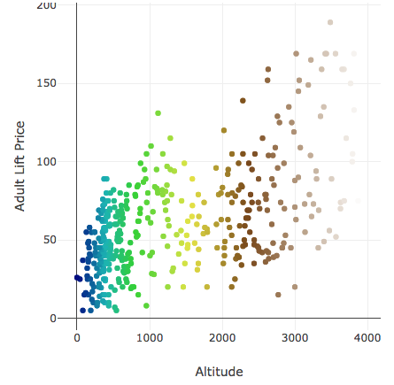
Data Analysis Who has better pricing? What factors correlate?

Slide 10
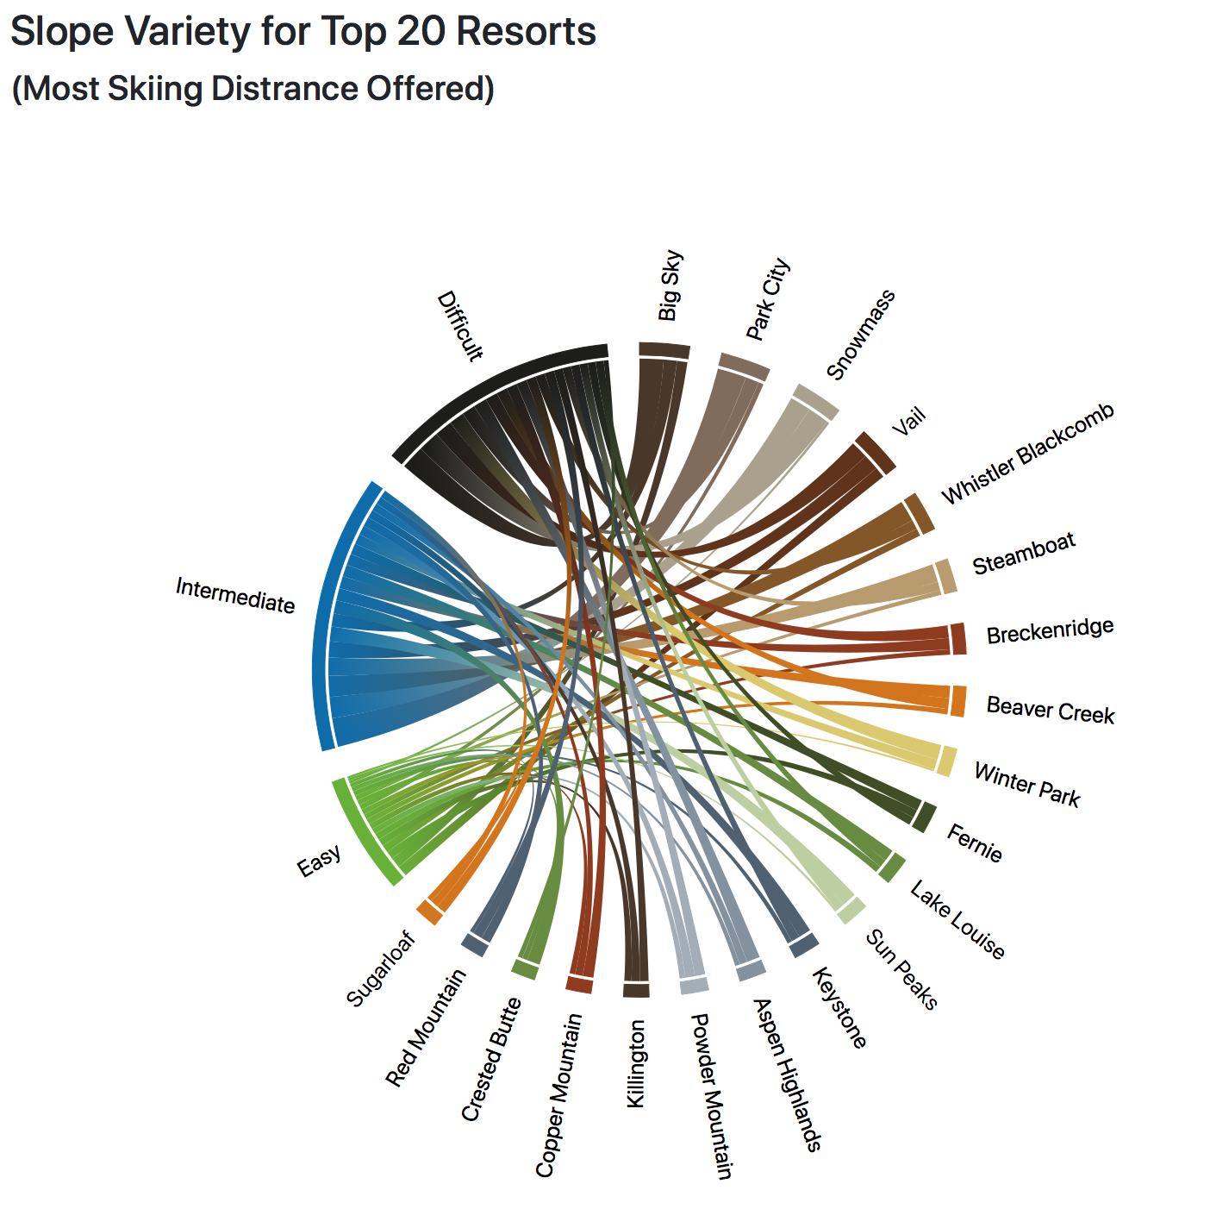
Data Analysis

Slide 11
Post Mortem
Data Limitations
Many of the attributes in the original data set were missing
Additional Data/Questions
Future work – Look at top 10 in skiable distance vs bottom 10 in skiable distance – does it impact slope offering variety?
Layer in average snowfall
Create additional base maps

