Slide 1

What Can I Do With Git?

Slide 2
Software carpentry
Write software for people not computers
Automate repetitive tasks
Use the computer to record history
Make incremental changes
Use version control
Don’t repeat yourself
Plan for mistakes
First make it correct, then make it fast
Document design & purpose not mechanics
Conduct code reviews
Wilson et al. (2014) Best practices for scientific computing. PLoS Biology 12: e1001745

Slide 3
What is version control?
What does git do?
Keeps track of changes made to files
Lets you go back to old versions
Only one version in your directory
Can also be used to…
  Keep files synced at multiple locations
  Work with other people
  Publish your code
Notes:
Also mention then you can play with things without worry – as lauren mentioned yesterday

Slide 4
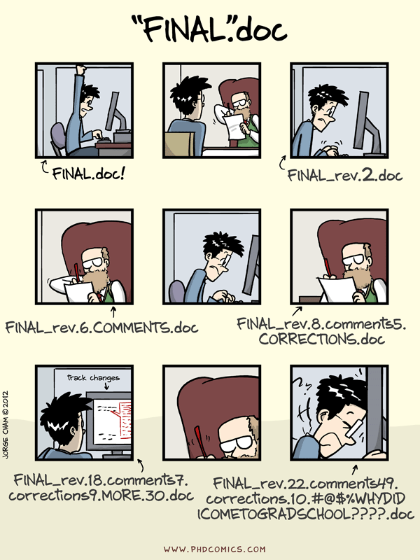
“Piled Higher and Deeper” by Jorge Cham, http://www.phdcomics.com

Slide 5
More Realistically
script_v1.py
script_v2.py
file-04-05-2015.docx
file-06-08-2016.docx
2015-05-04-file.docx
2016-06-07file_PI.docx
2016-06-08-file.docx
“Piled Higher and Deeper” by Jorge Cham, http://www.phdcomics.com

Slide 6
Why Learn Git?
Reproducible Research
  For you
    Your closest collaborator is you 6 months ago, and you don't respond to emails.
  For publishing your analysis
For collaboration
  Code review
  Working together on a project

Slide 7
Side Note: Git is awesome!
Lots of flexibility and workflows and pipelines
Learning the most common ones usages for working by yourself today
Lots of good google-able resources!

Slide 8
Branches Lesson

Slide 9
Working in Parallel to ‘master’
You may want to keep the ‘stable’ version as your master, and make changes in parallel
Then if the changes are good and tested, then merge them into your main/‘master’ branch
In this case we are going to make two paralell branches from ‘master’ one
Imagine we are running an analysis and are unsure if python or bash would be faster. Let’s test it! But leave the master branch as is incase neither works out.

Slide 10
commit qet947
commit abc123
commit mno789
commit bie582
commit rst038
commit xyz456
bashdev
master
pythondev
commit bna503

Slide 11
Making pythondev Branch
Making the branch and then checking it out
$ git branch pythondev
$ git branch
$ git checkout pythondev

Slide 12
‘Write’ Python script/Track It
We will only touch the script for this example but imagine you worked a long time on it.
$ touch script.py
$ git add script.py
$ git commit –m “wrote and tested python script”

Slide 13
Checking Our Work
To see that this branch has that commit and that file we will list the directory and look at the log
$ ls
$ git log --oneline

Slide 14
Switching Back to master Branch
Next we will switch back to the master branch and see that it is unchanged.
$ git checkout master
$ git branch
$ ls
$ git log --oneline

Slide 15
Making bashdev Branch
Next we will repeat this process working on the bash version of our script. This time we will make and checkout the branch in one step,
$ git checkout –b bashdev
$ git branch
$ ls
Notes:
branch naming - https://stackoverflow.com/questions/273695/git-branch-naming-best-practices

Slide 16
‘Write’ Bash Script & Track It
As before imagine you worked a long time on the script.
$ touch script.sh
$ git add script.sh
$ git commit –m “wrote and tested bash script”

Slide 17
Checking Our Work
To see that this branch has that commit and that file we will list the directory and look at the log
$ ls
$ git log --oneline

Slide 18
Turns out…
The python one was much more efficient. So lets merge it back into the master branch. You always merge the branch you want into the branch you are in, so first we must switch back to the master branch.
$ git checkout master
$ git merge pythondev

Slide 19
Deleting the Old Branches
You can keep these old branches but you probably want to clean them up since they might be confusing later.
$ git branch -d bashdev
This gives us a warning since we never merged it into our master branch. We will still delete it
$ git branch -D bashdev
$ git branch -d pythondev

Slide 20


Github
Git Server
GitLab

Slide 21
Example Github Repos
All Software Carpentry Lessons are version controlled with git
  https://github.com/swcarpentry/git-novice
The website for this workshop is kept in a git repo
  https://github.com/sstevens2/2017-08-02-chicago-frb

Slide 22
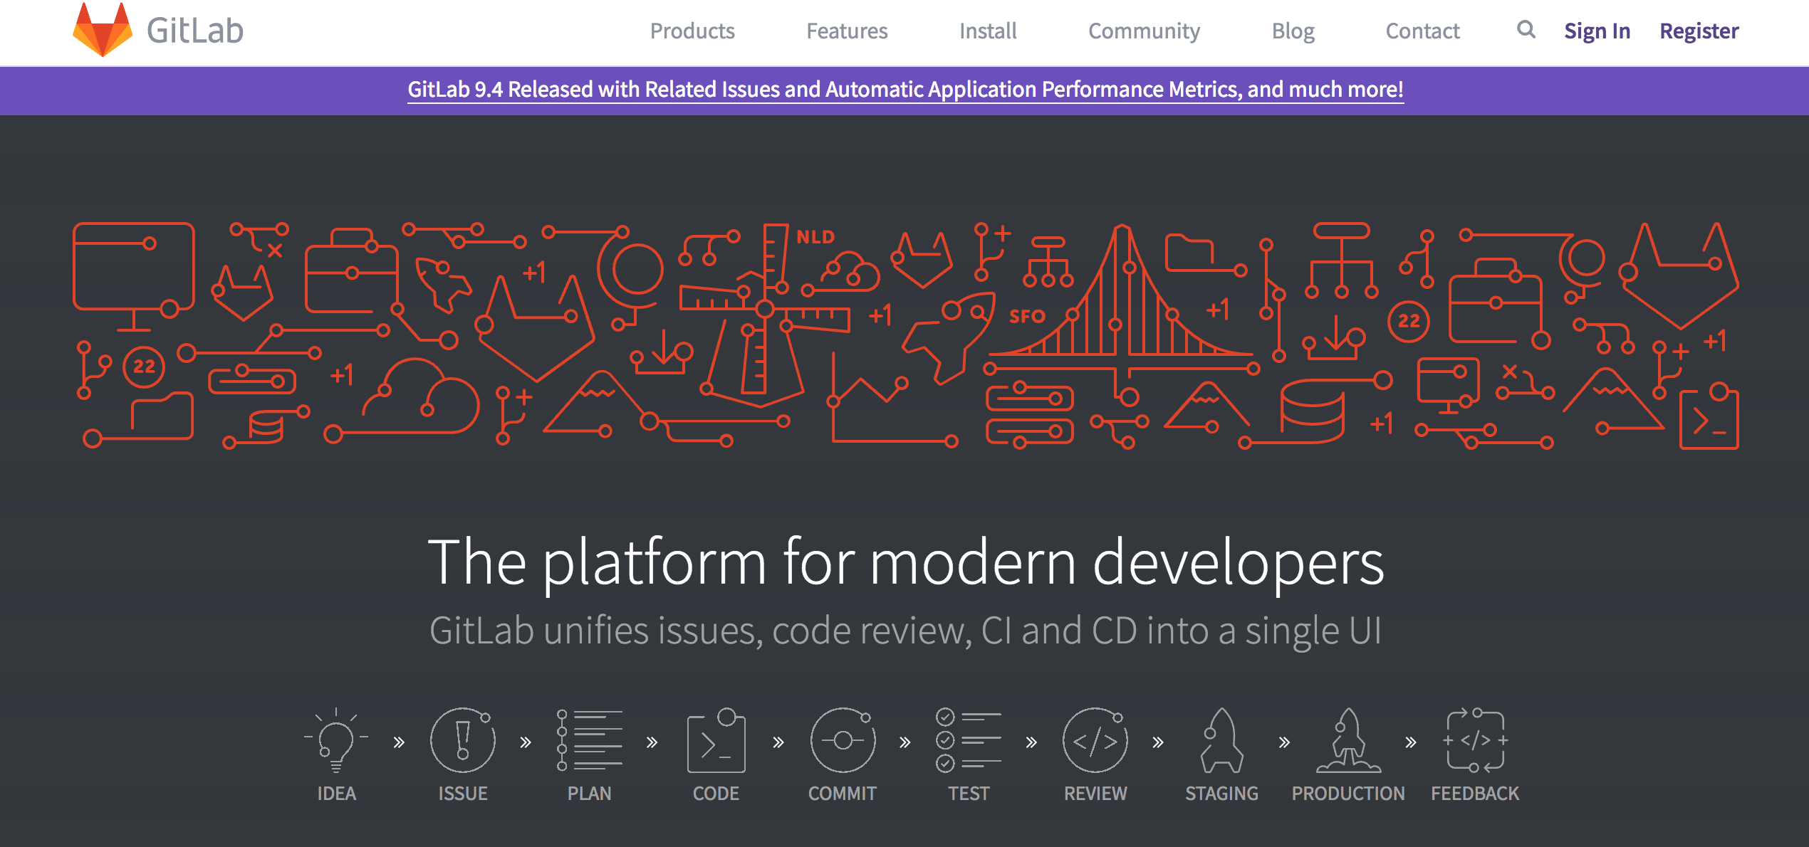
https://www.linux.com/learn/how-run-your-own-git-server

Slide 23
For those who prefer clicking
There are GUI’s for using git!
Examples:
  Github Desktop, SourceTree, GitKraken…
More found at:
  https://git-scm.com/download/gui/windows
R users: Rstudio has git integration!

Slide 24
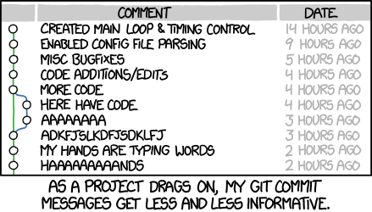
Alt-text:Merge branch 'asdfasjkfdlas/alkdjf' into sdkjfls-final
https://xkcd.com/1296/

Slide 25
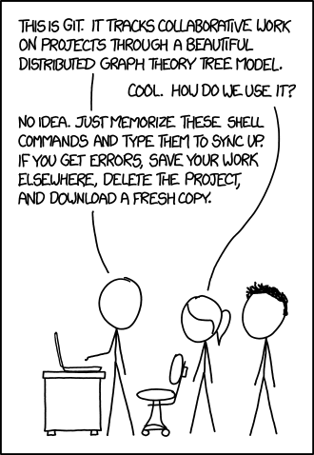
Alt-text: If that doesn't fix it, git.txt contains the phone number of a friend of mine who understands git. Just wait through a few minutes of 'It's really pretty simple, just think of branches as...' and eventually you'll learn the commands that will fix everything.
https://xkcd.com/1597/

