Slide 1
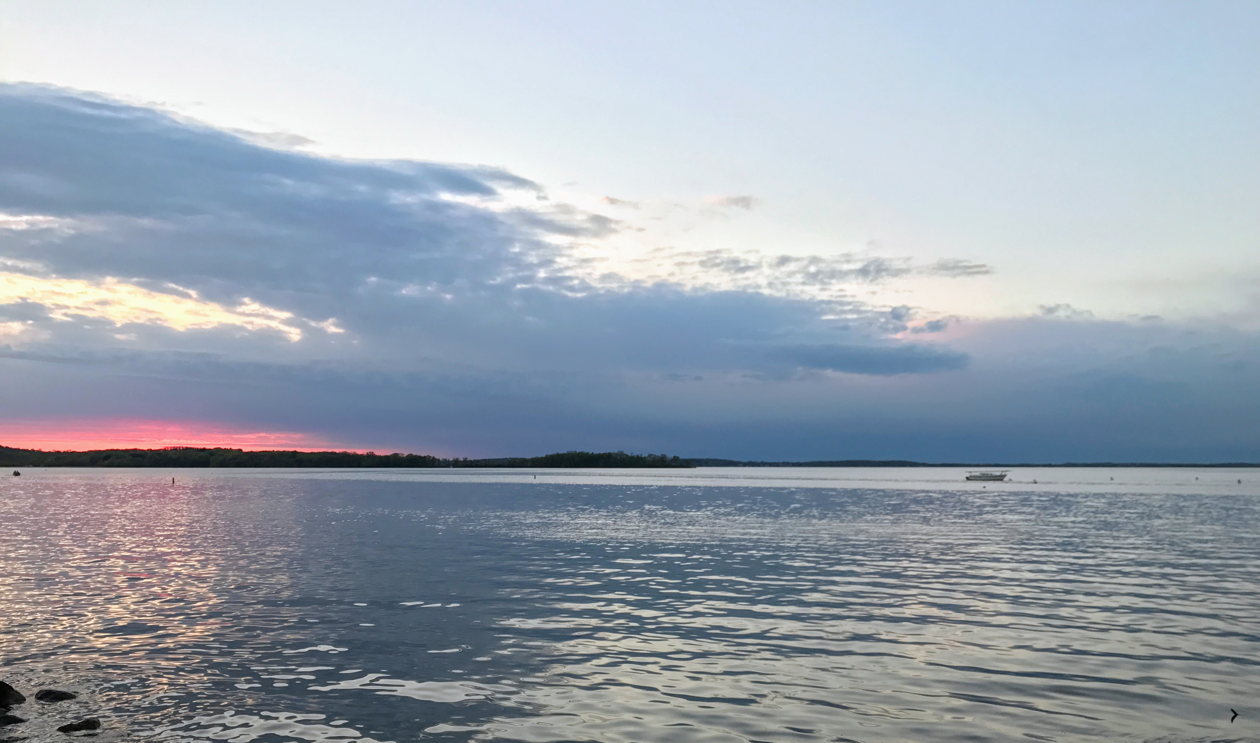
5th Year Committee Meeting
Sarah Stevens
@microStevens
McMahon Lab

Slide 2
Agenda
Updates
Short Intro
Current Project
Goals/Timeline

Slide 3
Updates
2nd Paper accepted in ISME
Contrasting patterns of genome-level diversity across distinct co-occurring populations
Taught 4 Data/Software Carpentry Workshops
Attended Anvi’o Workshop
Taught Anvi’o Workshop
Attended Open Science Grid User School
Attended Microbial Population Biology GRC
‘Retired’ from leading ComBEE

Slide 4
Microbes Perform Many Nutrient Transformations in Lakes
Azam and Malfatti Nature Rev Microbiol 2007
Notes:
Azam and Malfatti Nature Rev Microbiol 2007

Slide 5
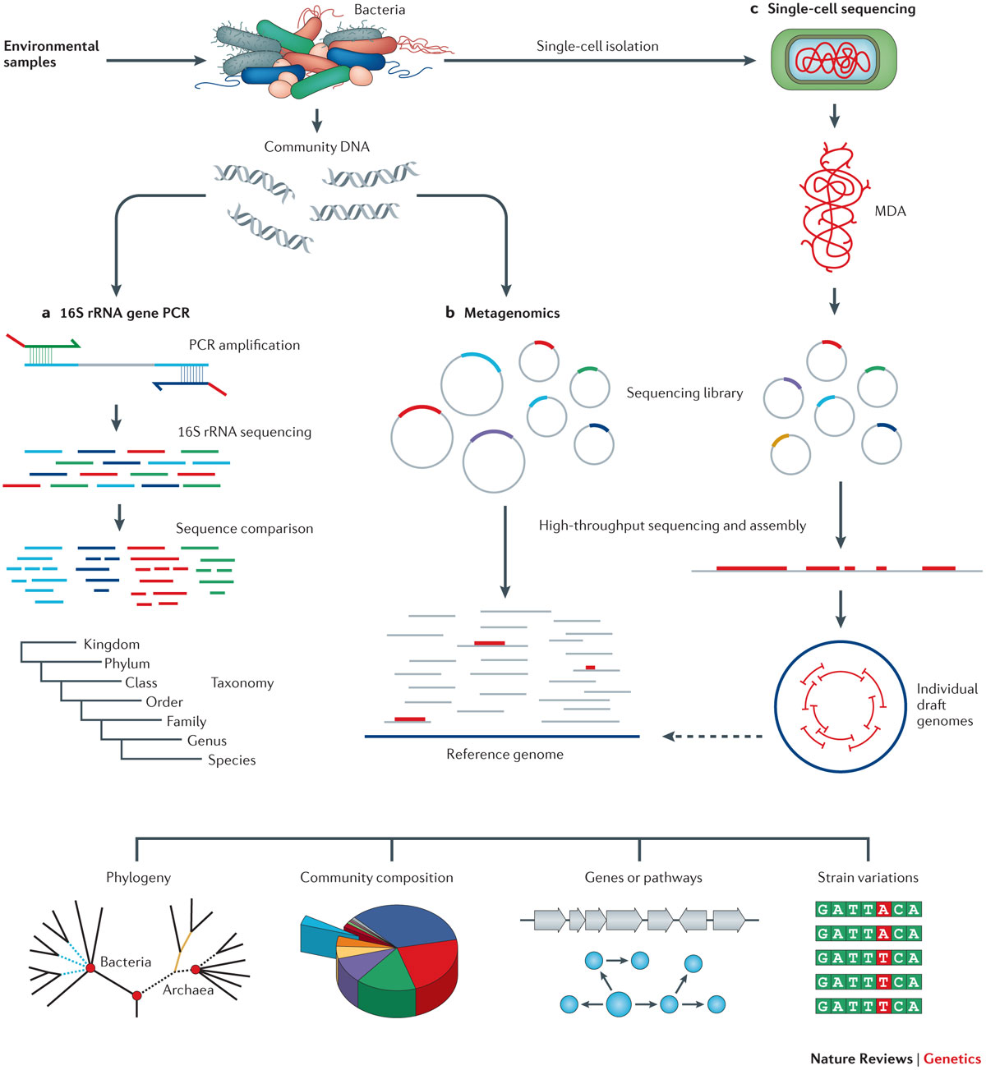
Lasken and McLean Nature Rev Genetics 2014

Slide 6
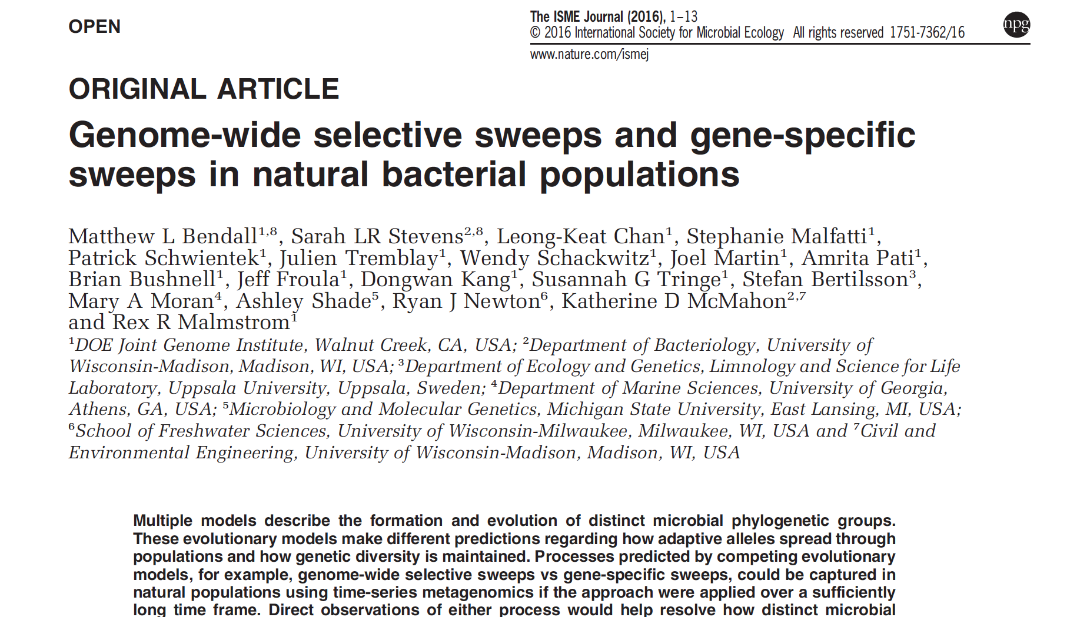

Slide 7
Current Project

Slide 8
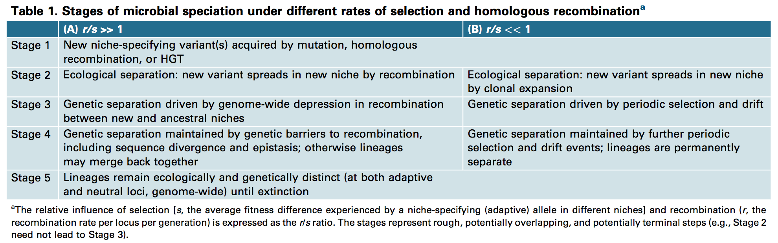
Shapiro and Polz 2014 Trends in Microbiology

Slide 9
Questions
Are there ecologically distinct strains/genotypes within previously defined sequence-discrete populations?
What stage of speciation are these distinct strains/genotypes at in their separation?
Is there a barrier to recombination between co-exiting strains?

Slide 10
Stats on Metagenomes
Crystal Bog
2007-2009
82 metagenomes
20 Gbp assembled
Mary Lake
2009, 12 depths
12 metagenomes
11 Mbp assembled
Mendota
2008-2012
94 metagenomes
11 Gbp assembled
Trout Bog
epilimnion
2007-2009
47 metagenomes
hypolimnion
2005, 2007-2009, 2012-2013
82 metagenomes

Slide 11
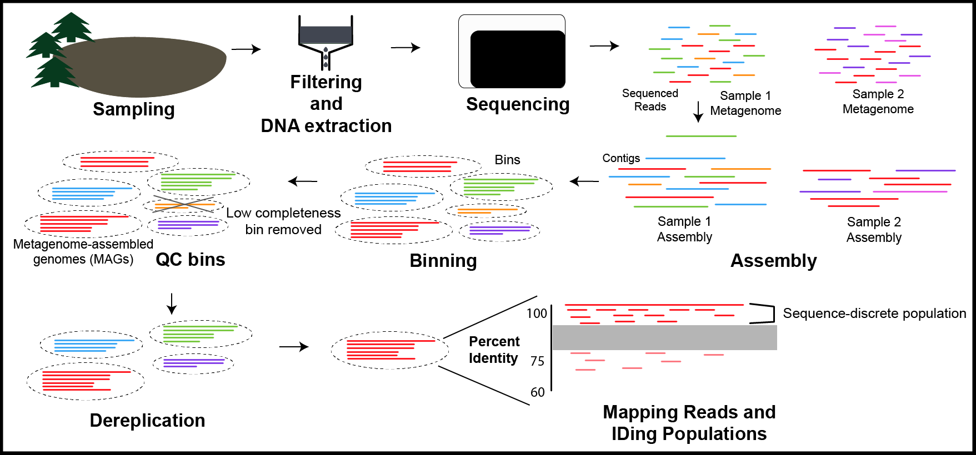
Data Processing

Slide 12
Stats on MAGs so far
Crystal Bog
2505 bins, 564 passed filtering
Phyla with > 10 bins:
Actinobacteria(342), Proteobacteria(267), Verrucomicrobia(113), Bacteroidetes(41), Candidatus Saccharibacteria(31), Chlorobi(29), Parcubacteria (10),
Mary Lake
352 bins, 104 passed filtering
Phyla with > 10 bins:
Proteobacteria(99), Actinobacteria(34), Planctomycetes(21), Verrucomicrobia(18), Bacteroidetes(18), Cyanobacteria(11)
Notes:
Filtering is ones with > 50% completion and less than 10% redundancy using 139 single copy genes

Slide 13
Goals/Timeline
Thesis Writing and Defense Prep
Data Analysis of
Haplotypes/SNVs
Get bins from all metagenome sets de-replicated and classified
Edit Paper
Write 3rd Paper
Oct
Nov
Dec
Jan
Feb
Mar
Apr
May
Jun
Jul
Aug
Sep
Schedule Prospectus
Prospectus
Thesis
Defense

Slide 14
Crystal Bog (CB) v. Trout Bog (TB)
Both dystrophic (high in DOC)
Both seepage lakes
Share 45-60% of their top 20 clades based on 16S tags
Different mixing regimes
CB has a smaller surface area
TB is deeper
About 5 miles apart
Notes:
TB – Dimictic
CB -- Polymictic

Slide 15
Next Questions
Are there related sequence-discrete populations in TB and CB?
How similar are they based on ANI?
ANI for reference MAGs to each other
ANI when mapping reads from same vs different lake
For populations that are very similar between the two lakes:
Are there genes present in one lake but not the other?
Is there evidence for (ecological or physical) barrier to recombination?
Might also be able to compare MAGs from Mary Lake
Notes:
Mary Lake never mixes-meromictic
*Are there related sequence-discrete populations in TB and CB? How closely related are they? Do they share a common gene pool? Are there genes present in one lake but not the other for these closely related populations? Is there an ecological or physical barrier to recombination between these two lakes?*

Slide 16
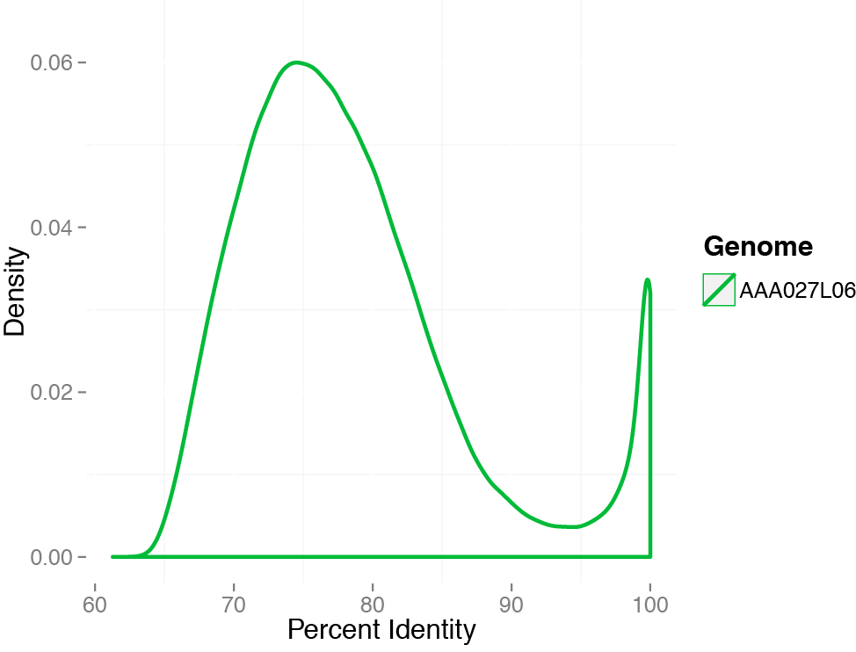
SAGs allow us to capture sequence discrete populations
Subject: acI-B1 from L. Mendota
discontinuity
Mendota metagenome: 9 June 2009

Slide 17
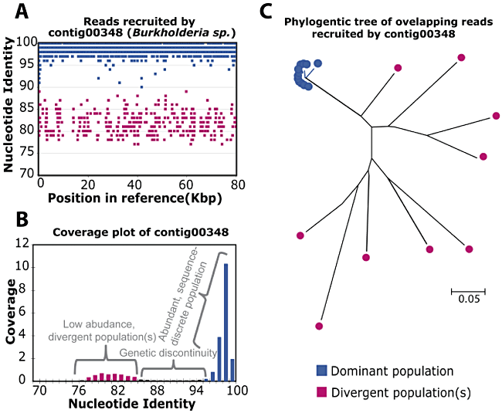
Sequence discrete populations
Caro-Quintero and Konstantinidis 2012 EnvMicro
Notes:
Lake Lanier to isolate genome

Slide 18
SAGs allow us to capture sequence discrete populations
Subject: acI-B1 from L. Mendota
discontinuity
Mendota metagenome: 9 June 2009

