Slide 1
Virtual Application Profiler (VAPP)
Problem
  Increasing hardware complexity
  Programmers need to understand interactions between architecture and their software
Goals
  Quickly simulate application execution over many architecture configurations
  Analyze and debug programs designed for parallel architecture
  Allow developers to view and query intermediate execution traces
Approach
  Software-based log-and-replay system

Slide 2
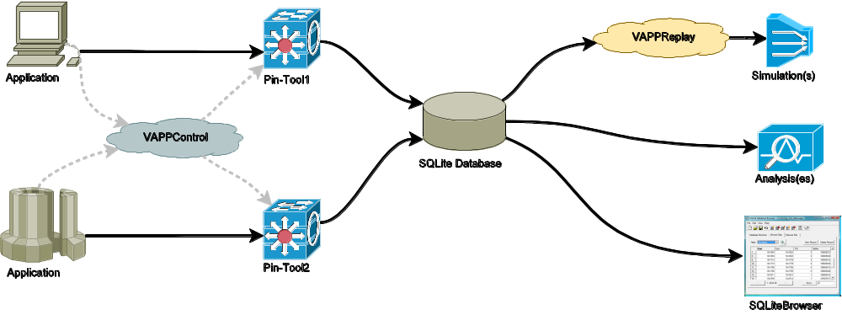
Design
Pin tools log memory accesses, function calls, image loads, locking, memory allocation, etc.
SQLite database store execution trace
Collection of replay and analysis programs take database as input
  Replay execution on simulated hardware
  Analyze memory access patterns
  Lockset verification

Slide 3
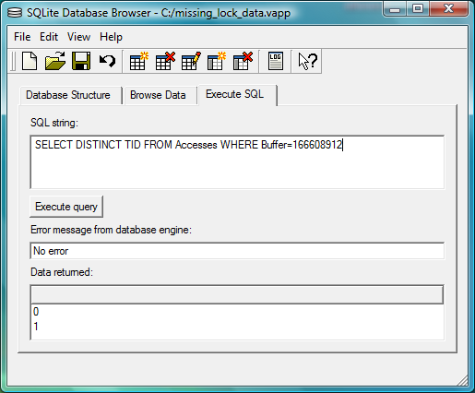
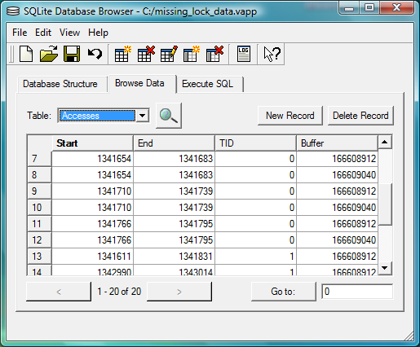
SQLite Database
Developer can easily examine all trace data
SQLite Database Browser
Many types
of custom
analysis
can be
formulated
using SQL
E.g. which threads access a particular memory buffer

Slide 4
Replay and Analysis
Variety of analysis tools have been implemented on top of the database
Cache simulator
  Prototype of a complete memory hierarchy simulator
Lockset algorithm
  Detect which locks protect which memory buffers in a parallel program
  Identify inconsistent locking patterns and unprotected accesses

Slide 5
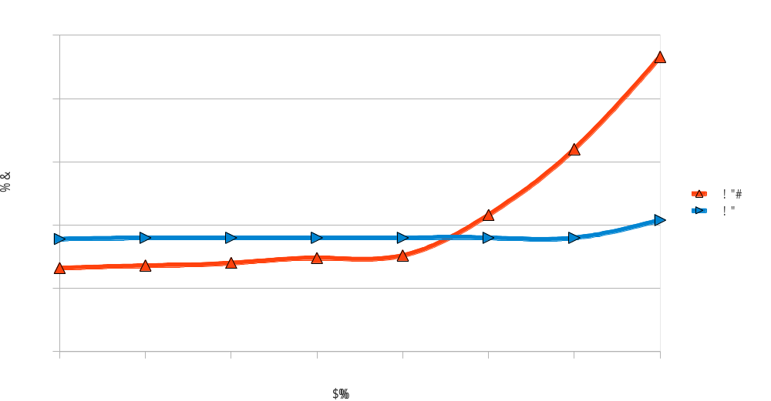
Simulator Performance
Goal is to amortize cost of running instrumented code over many simulations
Increase # loop iterations (N) in simple benchmark application
In practice, prototype version is bogged down by I/O costs of database
For large applications, running pure Pin versions is better (for now)

Slide 6
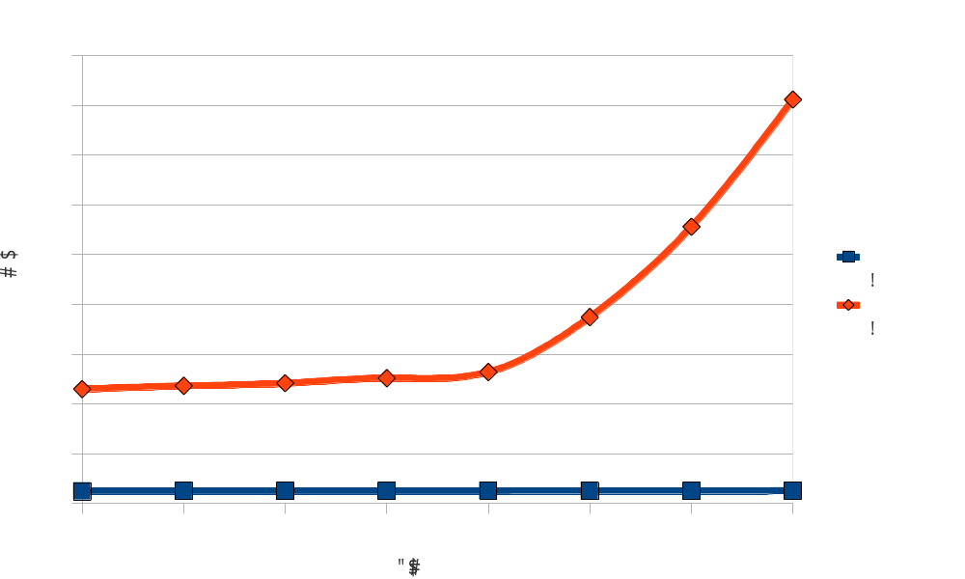
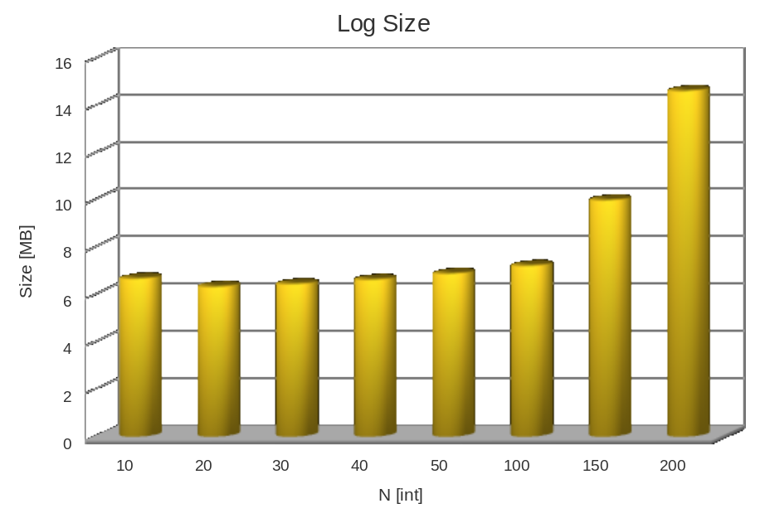
Logging Performance
Writing logging information dominates execution time
Log size grows exponentially as N increases
Allow application to dynamically enable/disable logging

Slide 7
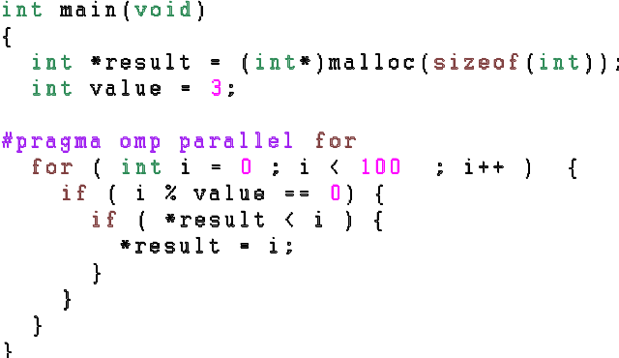
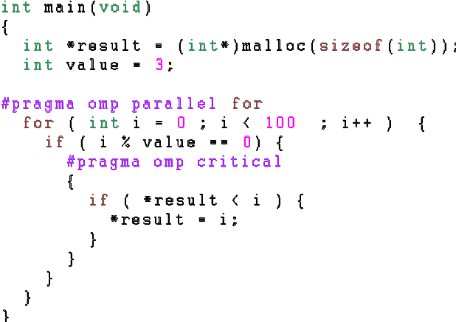
Parallel Program Analysis
Memory accesses in parallel programs tracked at buffer level
Support pthreads and Open MP
Discover unprotected accesses to shared memory
Example:
== ANALYSE =======================================
Thread 0 -> [11018256,11018288,11019872,11020080]>
Thread 1 -> [11018256,11018288,11019872]>
shared buffer 11018256
t1 []
t2 []
shared buffer 11018288
t1 []
t2 []
shared buffer 11019872
t1 []
t2 []
== ANALYSE =======================================
Thread 0 -> [32243728,32243760,32245344,32245552]>
Thread 1 -> [32243728,32243760,32245344]>
shared buffer 32243728
t1 [666]>
t2 [666]>
shared buffer 32243760
t1 []
t2 []
shared buffer 32245344
t1 []
t2 []
result NOT protected
result protected by
Internal Open MP lock

Slide 8
Future Work
Implement trace compression
  Will greatly reduce log size
  Database I/O dominates execution time so performance will significantly improve
Allow analysis of program behavior over multiple executions
Track lock contention and feed information back to system
  Recommend particular lock types
  Pin memory that is used exclusively by one thread
Use logged information to support deterministic replay

