Slide 1
Aborigine Culture
By Scott Stoudt

Slide 2
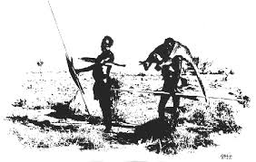
History
The word "aboriginal" means "the first" or "earliest known".
The aboriginals do not identify themselves as aboriginals, but recognize each other based on their clan, tribe, or the sub group of their language.
It is believed that the Aborigines came over from South East Asia.

Slide 3
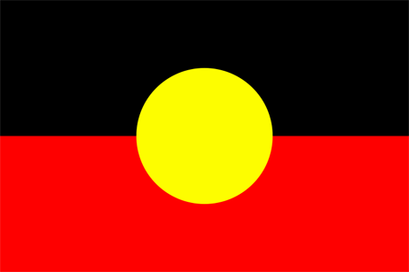
History
Symbols:
Black- Aboriginal people
Yellow- The sun (the constant re-newer of life)
Red- The earth and also represents ochre, which is used by Aboriginal people in ceremonies.
Aboriginal Flag

Slide 4
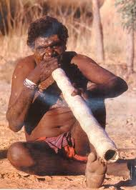
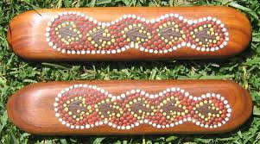
Music
The Didgeridoo has a sound that is a low-pitched drone. It is commonly considered the national instrument of Aboriginal people, and it is claimed to be the world's oldest wind instrument.
Australia clap sticks are called bimli. These sticks are used to keep time with the playing of the didgeridoo.

Slide 5
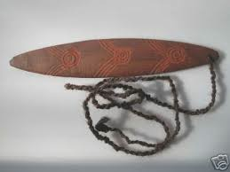
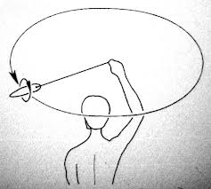
Music
This bullroarer consists of a simple wooden slat, 30 to 40cm in length and 5 to 7cm wide that is whirled around in a circle on the end of a length of cord.

Slide 6
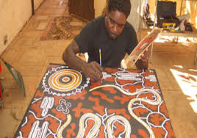
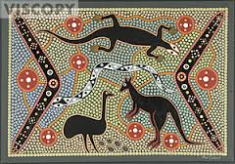
Art
Dot Painting:
Form of storytelling
Dots of paint traditionally made from natural pigments
Create patterns and images of plants and animals that represent their culture's creation myths

Slide 7
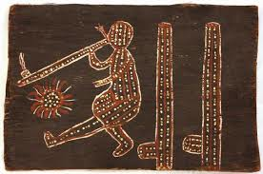
Art
Bark painting is one of the most well known Aboriginal art forms.
Could be done only in areas where trees with suitable bark were available.
It consists of pieces of flattened bark taken from trees such as the Stringybark.

Slide 8
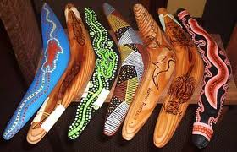
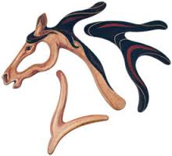
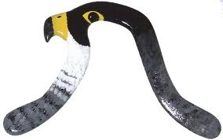
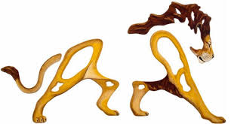
Art
Many people think boomerangs are solely for hunting or as toys you can throw around.
Boomerangs are also commonly used as a canvas for artistic carving or painting.
Boomerangs can also be painted and arranged to form animals and other things.

Slide 9
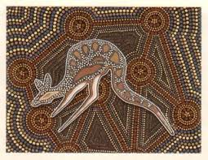
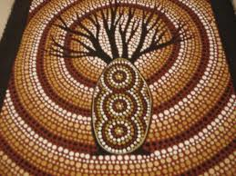
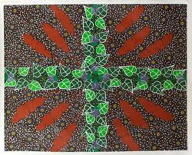
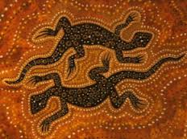
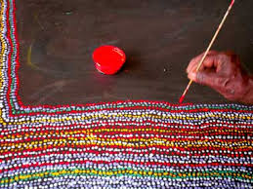

Slide 10
Folklore
Dreamtime Stories:
Australian Aborigines created stories to teach others about Dreamtime (the creation).
The "Dreamtime", the mythological past, was the time when spirit ancestors had travelled throughout the land, giving it its physical form, and setting down the rules to be followed by the Aboriginals.
Storytelling, along with art, singing and dancing, was the traditional way to educate about their history, cultures, and laws.
The Dreamtime stories are passed from Generation to generation-they are not owned.

Slide 11
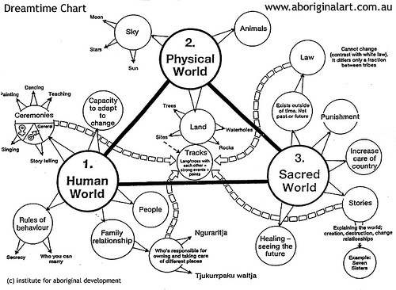

Slide 12
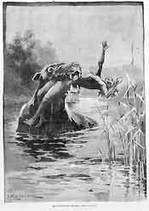
Folklore
Some Indigenous stories, like the bunyip have been absorbed into wider Australian folklore and identity.
Bunyip are man-eating animals that live in water holes, swamps, and creeks.

Slide 13
Today’s Aborigines
Some Indigenous people still live traditionally, but most inhabit urban areas around the country’s coastline.
Indigenous people have to work to maintain their cultural identity while at the same time find a place to fit within the complex society Australia has become.
Australia now shows a standard of living equal to the most sophisticated in the world and is home to world leaders in almost every aspect of life.
Indigenous people, however, do not share this standard of living.

Slide 14
Today’s Aborigines
Problems they face:
Living in poverty or sub-standard housing
Low education
Higher incarceration rates
Higher sickness rates
Lower incomes
Shorter life span

Slide 15
Today’s Aborigines
What is being done?
Practices such as segregation and ignoring Indigenous law and religion have been banned.
Awareness has grown at all levels that Indigenous people have a special culture which needs to be maintained.
Tourism ventures, such as art galleries and outback tours, are some other ways Indigenous culture is being highlighted and appreciated by people from around the world.
Indigenous people are also now amongst the nation’s leaders, represented in all levels of government and leading their own organizations to lobby for changes to benefit their people.

