Slide 1
The Common Seahorse
By Scott Stoudt
Period 6

Slide 2
Evolution
Seahorse Evolution
Osteichthyes Evolution
Came from pipefish
Earliest fossil 13mya
Separated late Oligocene (23mya)
Response to shallow water expansion
First jawed fish
  Acanthodian (400mya)
Modern bony fish (395mya)
Both are related
  Acanthodian evolved into modern body fish
  or
  Both shared common ancestor

Slide 3
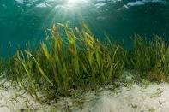
Habitat
Shallow waters
Coral reefs-Sea grass beds
  Sheltered
  Camouflage
They are everywhere
  Tropical
  Subtropical
  Temperate
Indo-Pacific Area
  Indian & North-western Pacific Ocean
Symbiotic Relationship:
Grass beds provide the seahorses with great camouflage

Slide 4
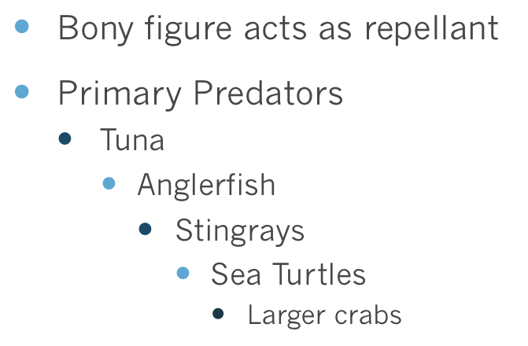
Biological Relationships
Seahorse Prey
Seahorse Predators
Middle of the food chain
Niche- Ambush Predator
  Sit & wait for prey
  Darts out & eats prey
Primary Prey
  Plankton
    Brine shrimp
      Small crabs
        Other small fish
Misc. Fact:
Males are the predominant competitors in finding a mate

Slide 5
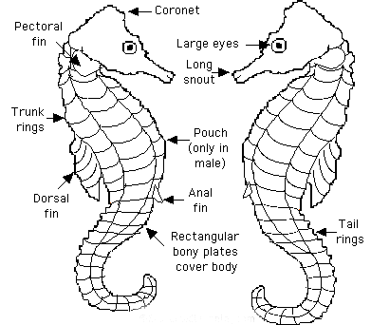
Feeding Adaptations
Waits for its food to avoid overexertion
Uses its long snout
Has no teeth/swallows live food whole
No stomach/quick digestive system
Always eating
Brine Shrimp
  ( +3,000/day)

Slide 6
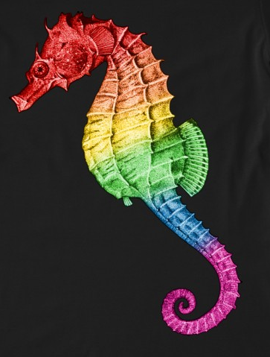
Defense Adaptations
Camouflage to avoid predators
  White, Yellow, Red, Brown, Black, Grey, Green, Gold
Rectangular bony plates make them less appealing to others
Harsh environment conditions
Tail used to stay put when sleeping

Slide 7
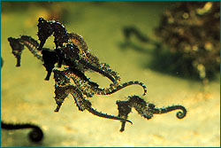
Reproduction
Courting
  Holding tails
  Priority for males
  Females are distracted and punished
  Mate for life
Courtship rituals
  Lasts several days
  Color changing
  Synchronized swimming
Mating
  Full moon
  Offers its water filled breeding bag to the female
  Female “docks” in the pouch to lay eggs
  After weeks babies are ready
  Sometimes the males die
  Babies are on there own(few survive)

Slide 8

Basic Characteristics
Kingdom---Animalia
Phylum---Chordata
Sub-Phylum---Vertebrata
Class---Osteichthyes
Order---Perciformes
Family---Syngnathidae
Genus---Hippocampus
Species---H. Kuda
*Seahorses have coronets which are like fingerprints. Each coronet is different.*

