Slide 1
Blinkit SQL Business Analysis
20 SQL queries | Business problem, query, real output and business solution
Revenue • Customers • Stores • Delivery • Promotions • Retention
Start ▶

Slide 2
Index: click any tile to jump to that query
01 Overall Business KPI Dashboard
02 Year-over-Year Revenue & Order Growth
03 Monthly Revenue Trend & Seasonal Performance
04 Top 10 Stores by Revenue
05 Store Performance Ranking Within Each City
06 Identify High-Value Customers
07 Customer Tier Performance
08 Reorder Rate by Customer Tier
09 First-Time vs Repeat Customer Revenue
10 Cancellation & Return Rate by Store
11 Reasons Behind Cancellations/Returns
12 Delivery Slot vs Customer Satisfaction
13 Express Eligibility vs Actual Delivery Performance
14 Stores with Poor Delivery Efficiency
15 Promotion Effectiveness
16 Rank Promo Codes by Revenue Contribution
17 Customer Cohort / Retention Analysis
18 Customers at Risk of Churn
19 Revenue Concentration
20 Operational Risk Score for Stores

Slide 3
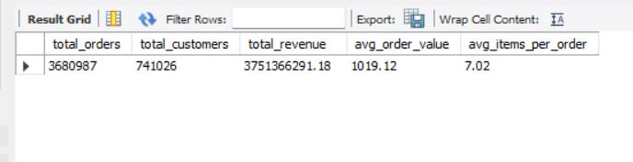
1. Overall Business KPI Dashboard
01/20
BUSINESS PROBLEM How is the business doing overall? One quick scorecard for management.
SQL QUERY
QUERY OUTPUT
SELECT COUNT(*) AS total_orders, COUNT(DISTINCT user_id) AS total_customers,
SUM(grand_total) AS total_revenue, ROUND(AVG(grand_total), 2) AS avg_order_value,
ROUND(AVG(total_qty), 2) AS avg_items_per_order
FROM blinkit_orders
WHERE order_status = 'Delivered';
BUSINESS SOLUTION
Scorecard: 36.8 lakh delivered orders, 7.41 lakh customers, ₹375 Cr revenue, AOV ₹1,019 and about 7 items per basket. This is the baseline every other query is compared against. Track it monthly: a fall in AOV or items per order warns us before revenue falls.
◀ Prev
Index
Next ▶

Slide 4
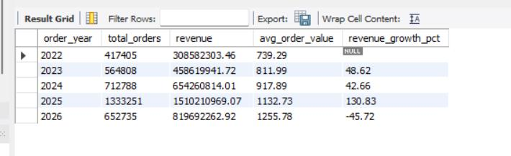
2. Year-over-Year Revenue & Order Growth
02/20
BUSINESS PROBLEM Is Blinkit growing every year, or slowing down?
SQL QUERY
QUERY OUTPUT
WITH yearly AS (
SELECT order_year, COUNT(*) AS total_orders, SUM(grand_total) AS revenue,
AVG(grand_total) AS avg_order_value
FROM blinkit_orders WHERE order_status = 'Delivered'
GROUP BY order_year
)
SELECT order_year, total_orders, ROUND(revenue,2) AS revenue,
ROUND(avg_order_value,2) AS avg_order_value,
ROUND((revenue-LAG(revenue) OVER(ORDER BY order_year)) /
NULLIF(LAG(revenue) OVER(ORDER BY order_year),0)*100,2) AS revenue_growth_pct
FROM yearly ORDER BY order_year;
BUSINESS SOLUTION
Revenue grew from ₹30.9 Cr (2022) to ₹151 Cr (2025) and AOV rose every year (₹739 to ₹1,256), so growth came from more orders and bigger baskets. 2026 (−45.7%) appears to be a partial year; compare it only with the same months of 2025. Action: keep investing in basket-building.
◀ Prev
Index
Next ▶

Slide 5
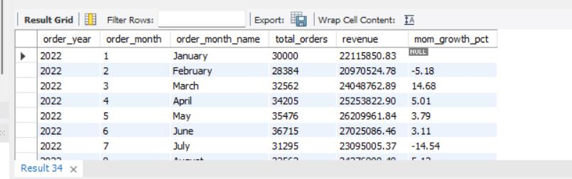
3. Monthly Revenue Trend & Seasonal Performance
03/20
BUSINESS PROBLEM Which months sell the most, and when do sales dip?
SQL QUERY
QUERY OUTPUT
WITH monthly AS (
SELECT order_year, order_month, order_month_name, COUNT(*) AS total_orders,
SUM(grand_total) AS revenue
FROM blinkit_orders WHERE order_status = 'Delivered'
GROUP BY order_year, order_month, order_month_name
)
SELECT order_year, order_month, order_month_name, total_orders, ROUND(revenue,2) AS revenue,
ROUND((revenue-LAG(revenue) OVER(ORDER BY order_year,order_month)) /
NULLIF(LAG(revenue) OVER(ORDER BY order_year,order_month),0)*100,2) AS mom_growth_pct
FROM monthly ORDER BY order_year, order_month;
BUSINESS SOLUTION
The monthly view shows the rhythm, e.g. early 2022 dips 5.2% in Feb then jumps 14.7% in Mar. Use peaks to plan stock, riders and offers in advance, and dips to schedule campaigns. Next step: chart the same month across years to separate true seasonality from overall growth.
◀ Prev
Index
Next ▶

Slide 6
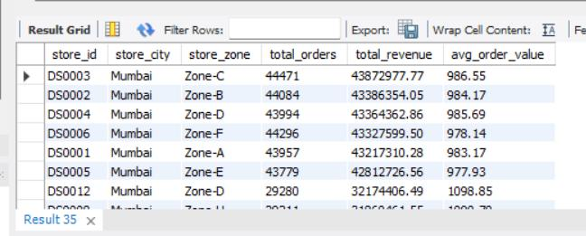
4. Top 10 Stores by Revenue
04/20
BUSINESS PROBLEM Which stores earn us the most money?
SQL QUERY
QUERY OUTPUT
SELECT store_id, store_city, store_zone, COUNT(*) AS total_orders,
ROUND(SUM(grand_total),2) AS total_revenue, ROUND(AVG(grand_total),2) AS avg_order_value
FROM blinkit_orders WHERE order_status = 'Delivered'
GROUP BY store_id, store_city, store_zone
ORDER BY total_revenue DESC LIMIT 10;
BUSINESS SOLUTION
Mumbai's six core stores (DS0001–DS0006) each bring ₹4.3–4.4 Cr at a near-identical AOV of about ₹980, so revenue is spread evenly, not carried by one store. Action: copy the Mumbai playbook (zones, stock, staffing) to weaker cities and protect these stores from stock-outs.
◀ Prev
Index
Next ▶

Slide 7
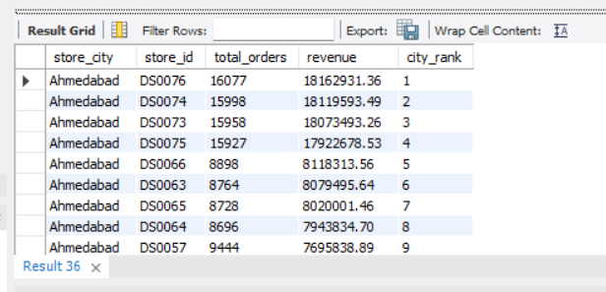
5. Store Performance Ranking Within Each City
05/20
BUSINESS PROBLEM Inside each city, which stores are the stars and which are lagging?
SQL QUERY
QUERY OUTPUT
WITH store_performance AS (
SELECT store_city, store_id, COUNT(*) AS total_orders, SUM(grand_total) AS revenue
FROM blinkit_orders WHERE order_status = 'Delivered'
GROUP BY store_city, store_id
)
SELECT store_city, store_id, total_orders, ROUND(revenue,2) AS revenue,
RANK() OVER(PARTITION BY store_city ORDER BY revenue DESC) AS city_rank
FROM store_performance ORDER BY store_city, city_rank;
BUSINESS SOLUTION
In Ahmedabad, four stores (DS0073–DS0076) earn about ₹1.8 Cr each, more than double the rest (₹0.8 Cr). Ranking inside a city is fair, because a small city's best store is not judged against Mumbai. Action: study what the top four do differently and fix or merge the bottom stores.
◀ Prev
Index
Next ▶

Slide 8
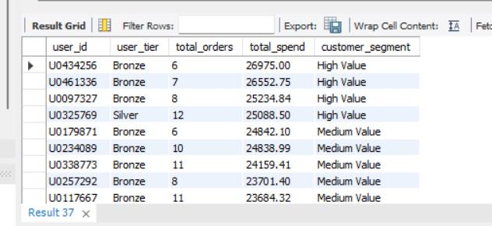
6. Identify High-Value Customers
06/20
BUSINESS PROBLEM Who are our biggest spenders?
SQL QUERY
QUERY OUTPUT
WITH customer_spend AS (
SELECT user_id, user_tier, COUNT(*) AS total_orders, SUM(grand_total) AS total_spend
FROM blinkit_orders WHERE order_status = 'Delivered'
GROUP BY user_id, user_tier
)
SELECT user_id, user_tier, total_orders, ROUND(total_spend,2) AS total_spend,
CASE WHEN total_spend >= 50000 THEN 'VIP'
WHEN total_spend >= 25000 THEN 'High Value'
WHEN total_spend >= 10000 THEN 'Medium Value'
ELSE 'Low Value' END AS customer_segment
FROM customer_spend ORDER BY total_spend DESC;
BUSINESS SOLUTION
Top spenders reach ₹25–27K lifetime spend and are mostly Bronze or Silver members, so loyalty tier does not match real spending. Nobody crosses the ₹50K VIP bar, so that threshold needs resetting. Action: reward by spend (early access, free-delivery thresholds, priority support).
◀ Prev
Index
Next ▶

Slide 9
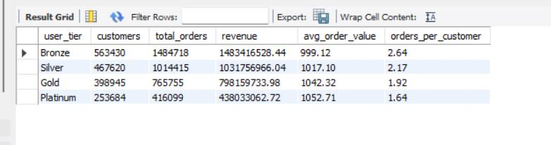
7. Customer Tier Performance
07/20
BUSINESS PROBLEM Do Gold and Platinum members really buy more than Bronze members?
SQL QUERY
QUERY OUTPUT
SELECT user_tier, COUNT(DISTINCT user_id) AS customers, COUNT(*) AS total_orders,
ROUND(SUM(grand_total),2) AS revenue, ROUND(AVG(grand_total),2) AS avg_order_value,
ROUND(COUNT(*)*1.0/COUNT(DISTINCT user_id),2) AS orders_per_customer
FROM blinkit_orders WHERE order_status = 'Delivered'
GROUP BY user_tier ORDER BY revenue DESC;
BUSINESS SOLUTION
Platinum customers spend a little more per order (₹1,053 vs ₹999 for Bronze) but order less often (1.64 vs 2.64 orders per customer). Tiers lift basket size, not frequency. Action: tie tier benefits to frequency, such as streak rewards, so higher tiers also order more.
◀ Prev
Index
Next ▶

Slide 10
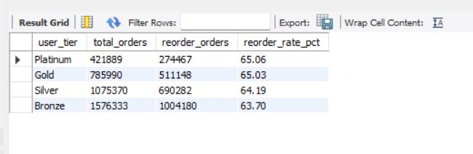
8. Reorder Rate by Customer Tier
08/20
BUSINESS PROBLEM Which member group comes back to reorder the most?
SQL QUERY
QUERY OUTPUT
SELECT user_tier, COUNT(*) AS total_orders, SUM(is_reorder) AS reorder_orders,
ROUND(SUM(is_reorder)*100.0/COUNT(*),2) AS reorder_rate_pct
FROM blinkit_orders GROUP BY user_tier ORDER BY reorder_rate_pct DESC;
BUSINESS SOLUTION
Reorder rates are almost flat, from 63.7% (Bronze) to 65.1% (Platinum), so tiers are not creating extra repeat behaviour. About two of every three orders are reorders in every tier. Action: test one-tap 'buy again' and staples reminders instead of relying on tiers.
◀ Prev
Index
Next ▶

Slide 11
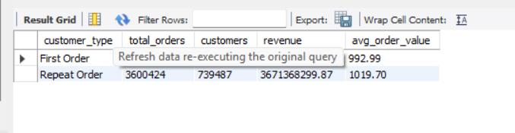
9. First-Time vs Repeat Customer Revenue
09/20
BUSINESS PROBLEM Does our money come from new customers or from people who keep coming back?
SQL QUERY
QUERY OUTPUT
SELECT CASE WHEN is_first_order=1 THEN 'First Order' ELSE 'Repeat Order' END AS customer_type,
COUNT(*) AS total_orders, COUNT(DISTINCT user_id) AS customers,
ROUND(SUM(grand_total),2) AS revenue, ROUND(AVG(grand_total),2) AS avg_order_value
FROM blinkit_orders WHERE order_status='Delivered' GROUP BY customer_type;
BUSINESS SOLUTION
Repeat orders bring ₹367 Cr of the ₹375 Cr total, with a higher AOV (₹1,020 vs ₹993 for first orders). The business runs on repeat buyers, so retention is worth more than acquisition. Action: move part of the new-user budget to habit-building and win-back.
◀ Prev
Index
Next ▶

Slide 12
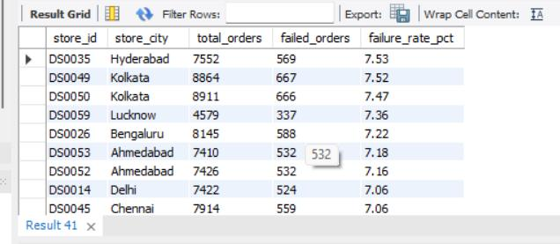
10. Cancellation & Return Rate by Store
10/20
BUSINESS PROBLEM Which stores lose the most orders to cancellations and returns?
SQL QUERY
QUERY OUTPUT
SELECT store_id, store_city, COUNT(*) AS total_orders,
SUM(CASE WHEN order_status<>'Delivered' THEN 1 ELSE 0 END) AS failed_orders,
ROUND(SUM(CASE WHEN order_status<>'Delivered' THEN 1 ELSE 0 END)*100.0/COUNT(*),2) AS failure_rate_pct
FROM blinkit_orders GROUP BY store_id, store_city
HAVING COUNT(*)>=100 ORDER BY failure_rate_pct DESC;
BUSINESS SOLUTION
Failure rates sit in a narrow 7.0–7.5% band; Hyderabad's DS0035 and Kolkata's DS0049/DS0050 are highest at about 7.5%. No store is wildly off, so the fix is process, not closures. Action: audit these stores for stock accuracy, rider availability and packing checks.
◀ Prev
Index
Next ▶

Slide 13
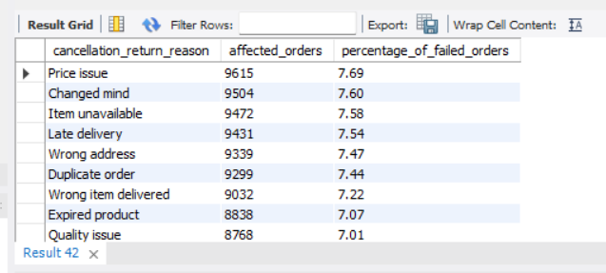
11. Reasons Behind Cancellations/Returns
11/20
BUSINESS PROBLEM Why do orders fail? What are customers and stores telling us?
SQL QUERY
QUERY OUTPUT
SELECT cancellation_return_reason, COUNT(*) AS affected_orders,
ROUND(COUNT(*)*100.0/SUM(COUNT(*)) OVER(),2) AS percentage_of_failed_orders
FROM blinkit_orders WHERE order_status<>'Delivered'
GROUP BY cancellation_return_reason ORDER BY affected_orders DESC;
BUSINESS SOLUTION
Reasons are evenly spread (7–7.7% each), led by price issue, changed mind, item unavailable and late delivery. Items unavailable, late, wrong, expired and poor-quality orders are in our control and add up to about 36% of failed orders. Action: fix inventory accuracy and delivery time first.
◀ Prev
Index
Next ▶

Slide 14
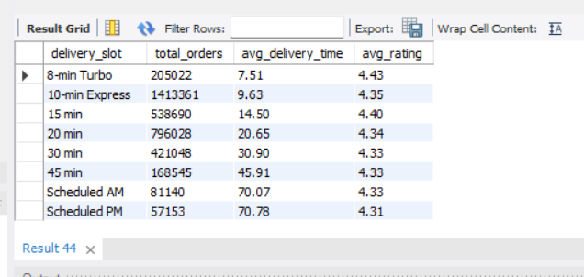
12. Delivery Slot vs Customer Satisfaction
12/20
BUSINESS PROBLEM Does a faster delivery slot make customers happier?
SQL QUERY
QUERY OUTPUT
SELECT delivery_slot, COUNT(*) AS total_orders,
ROUND(AVG(delivery_time_mins),2) AS avg_delivery_time,
ROUND(AVG(order_rating),2) AS avg_rating
FROM blinkit_orders WHERE order_status='Delivered'
GROUP BY delivery_slot ORDER BY avg_delivery_time;
BUSINESS SOLUTION
Faster slots earn better ratings: 8-min Turbo scores 4.43 against 4.31 for Scheduled PM (about 71 min). 10-min Express carries the most orders (14.1 lakh) at 9.6 min. Action: grow Express and Turbo where stores can hold the promise; keep scheduled slots for planned bulk baskets.
◀ Prev
Index
Next ▶

Slide 15
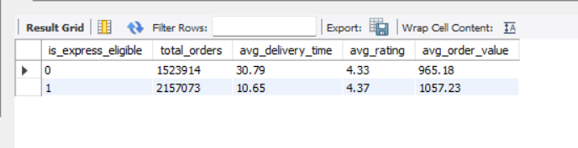
13. Express Eligibility vs Actual Delivery Performance
13/20
BUSINESS PROBLEM Is the Express promise really delivering faster?
SQL QUERY
QUERY OUTPUT
SELECT is_express_eligible, COUNT(*) AS total_orders,
ROUND(AVG(delivery_time_mins),2) AS avg_delivery_time,
ROUND(AVG(order_rating),2) AS avg_rating,
ROUND(AVG(grand_total),2) AS avg_order_value
FROM blinkit_orders WHERE order_status='Delivered'
GROUP BY is_express_eligible;
BUSINESS SOLUTION
Express-eligible orders arrive in 10.7 min vs 30.8 min, rate slightly higher (4.37 vs 4.33) and have a bigger basket (₹1,057 vs ₹965). Express is working. Action: widen the express-eligible catalogue and areas, because about 41% of orders are still not eligible.
◀ Prev
Index
Next ▶

Slide 16
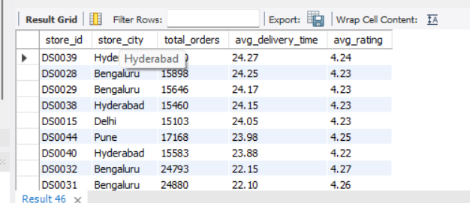
14. Stores with Poor Delivery Efficiency
14/20
BUSINESS PROBLEM Which busy stores are also slow?
SQL QUERY
QUERY OUTPUT
WITH store_metrics AS (
SELECT store_id, store_city, COUNT(*) AS total_orders,
AVG(delivery_time_mins) AS avg_delivery_time, AVG(order_rating) AS avg_rating
FROM blinkit_orders WHERE order_status='Delivered' GROUP BY store_id, store_city
), ranked AS (
SELECT *, NTILE(4) OVER(ORDER BY total_orders) AS volume_quartile,
NTILE(4) OVER(ORDER BY avg_delivery_time) AS delivery_quartile
FROM store_metrics
)
SELECT store_id, store_city, total_orders, ROUND(avg_delivery_time,2) AS avg_delivery_time,
ROUND(avg_rating,2) AS avg_rating
FROM ranked WHERE volume_quartile=4 AND delivery_quartile=4
ORDER BY avg_delivery_time DESC;
BUSINESS SOLUTION
Stores such as DS0039 (Hyderabad) and DS0028 (Bengaluru) handle heavy volume but take 24+ min per order, with ratings near 4.2. Busy and slow is exactly where customers feel the pain. Action: add pickers and riders at peak, rebalance zones and review store layout here first.
◀ Prev
Index
Next ▶

Slide 17
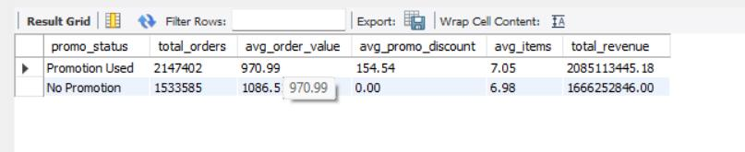
15. Promotion Effectiveness
15/20
BUSINESS PROBLEM Do discounts bring in better orders, or just cost us money?
SQL QUERY
QUERY OUTPUT
SELECT CASE WHEN promo_code='Not used' OR promo_code IS NULL THEN 'No Promotion'
ELSE 'Promotion Used' END AS promo_status,
COUNT(*) AS total_orders, ROUND(AVG(grand_total),2) AS avg_order_value,
ROUND(AVG(promo_discount),2) AS avg_promo_discount, ROUND(AVG(total_qty),2) AS avg_items,
ROUND(SUM(grand_total),2) AS total_revenue
FROM blinkit_orders WHERE order_status='Delivered' GROUP BY promo_status;
BUSINESS SOLUTION
Promo orders have a lower AOV (₹971 vs ₹1,087) and a ₹155 average discount, yet total revenue is higher (₹208 Cr vs ₹167 Cr) because more orders come with offers. Action: keep promotions but add minimum basket values so discounts push AOV up, not down.
◀ Prev
Index
Next ▶

Slide 18
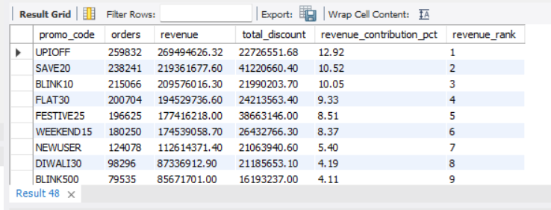
16. Rank Promo Codes by Revenue Contribution
16/20
BUSINESS PROBLEM Which promo codes earn the most, and which cost the most?
SQL QUERY
QUERY OUTPUT
WITH promo_data AS (
SELECT promo_code, COUNT(*) AS orders, SUM(grand_total) AS revenue,
SUM(promo_discount) AS total_discount
FROM blinkit_orders WHERE order_status='Delivered'
AND promo_code<>'Not used' AND promo_code IS NOT NULL
GROUP BY promo_code
)
SELECT promo_code, orders, ROUND(revenue,2) AS revenue, ROUND(total_discount,2) AS total_discount,
ROUND(revenue*100.0/SUM(revenue) OVER(),2) AS revenue_contribution_pct,
RANK() OVER(ORDER BY revenue DESC) AS revenue_rank
FROM promo_data ORDER BY revenue_rank;
BUSINESS SOLUTION
UPIOFF leads with 12.9% of revenue at a low discount cost (₹2.3 Cr), while SAVE20 and FESTIVE25 cost far more (₹4.1 Cr and ₹3.9 Cr) for less revenue. Action: rank codes by revenue per rupee of discount, scale UPIOFF-style codes and cap or trim the expensive ones.
◀ Prev
Index
Next ▶

Slide 19
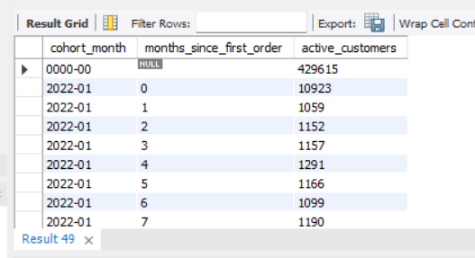
17. Customer Cohort / Retention Analysis
17/20
BUSINESS PROBLEM Do customers keep coming back month after month?
SQL QUERY
QUERY OUTPUT
WITH customer_first_order AS (
SELECT user_id, MIN(order_date) AS first_order_date
FROM blinkit_orders WHERE order_status='Delivered' GROUP BY user_id
), customer_orders AS (
SELECT DISTINCT o.user_id, DATE_FORMAT(f.first_order_date,'%Y-%m') AS cohort_month,
TIMESTAMPDIFF(MONTH,f.first_order_date,o.order_date) AS months_since_first_order
FROM blinkit_orders o JOIN customer_first_order f ON o.user_id=f.user_id
WHERE o.order_status='Delivered'
)
SELECT cohort_month, months_since_first_order, COUNT(DISTINCT user_id) AS active_customers
FROM customer_orders GROUP BY cohort_month, months_since_first_order
ORDER BY cohort_month, months_since_first_order;
BUSINESS SOLUTION
This table is the base for a retention heatmap: the Jan-2022 cohort starts at 10,923 customers and about 1,100–1,300 (10–12%) are active in each later month. Data note: a '0000-00' cohort (4.3 lakh rows) comes from missing first-order dates; clean it first. Action: build a % retention view.
◀ Prev
Index
Next ▶

Slide 20
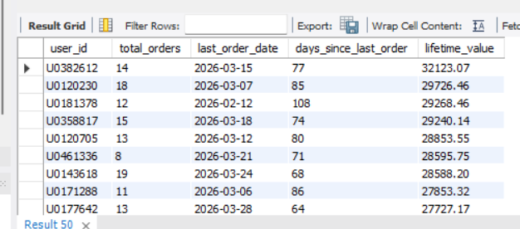
18. Customers at Risk of Churn
18/20
BUSINESS PROBLEM Which good customers have gone quiet?
SQL QUERY
QUERY OUTPUT
WITH customer_activity AS (
SELECT user_id, COUNT(*) AS total_orders, MAX(order_date) AS last_order_date,
SUM(grand_total) AS lifetime_value
FROM blinkit_orders WHERE order_status='Delivered' GROUP BY user_id
), overall AS (SELECT MAX(order_date) AS latest_date FROM blinkit_orders)
SELECT c.user_id, c.total_orders, c.last_order_date,
DATEDIFF(o.latest_date,c.last_order_date) AS days_since_last_order,
ROUND(c.lifetime_value,2) AS lifetime_value
FROM customer_activity c CROSS JOIN overall o
WHERE c.total_orders>=5 AND DATEDIFF(o.latest_date,c.last_order_date)>=60
ORDER BY lifetime_value DESC;
BUSINESS SOLUTION
Frequent customers with 8–19 orders have been silent for 64–108 days and hold ₹27–32K lifetime value each. They already like the product, so win-back is cheaper than acquiring new users. Action: send personalised offers and reminders, starting with the highest lifetime value.
◀ Prev
Index
Next ▶

Slide 21
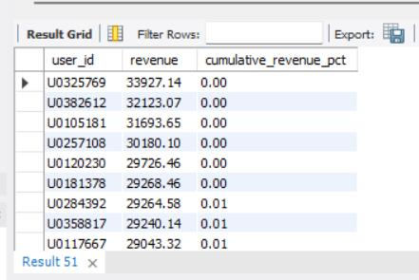
19. Revenue Concentration
19/20
BUSINESS PROBLEM Are we too dependent on a few big customers?
SQL QUERY
QUERY OUTPUT
WITH customer_revenue AS (
SELECT user_id, SUM(grand_total) AS revenue FROM blinkit_orders
WHERE order_status='Delivered' GROUP BY user_id
), ranked AS (
SELECT user_id, revenue,
SUM(revenue) OVER(ORDER BY revenue DESC ROWS BETWEEN UNBOUNDED PRECEDING AND CURRENT ROW) AS cumulative_revenue,
SUM(revenue) OVER() AS total_revenue
FROM customer_revenue
)
SELECT user_id, ROUND(revenue,2) AS revenue,
ROUND(cumulative_revenue*100.0/total_revenue,2) AS cumulative_revenue_pct
FROM ranked ORDER BY revenue DESC;
BUSINESS SOLUTION
Even the biggest customers contribute only 0.00–0.01% each to cumulative revenue, so revenue is widely spread and dependency on any single customer is very low, which is healthy. Action: still track the top 1% share over time, and focus growth on the broad base.
◀ Prev
Index
Next ▶

Slide 22
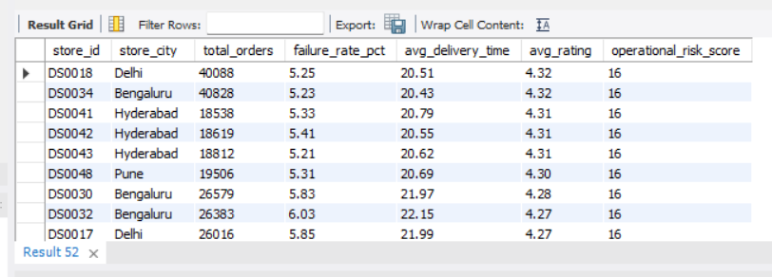
20. Operational Risk Score for Stores
20/20
BUSINESS PROBLEM Which stores need attention first when we combine failures, speed and ratings?
SQL QUERY
QUERY OUTPUT
WITH store_metrics AS (
SELECT store_id, store_city, COUNT(*) AS total_orders,
SUM(CASE WHEN order_status<>'Delivered' THEN 1 ELSE 0 END) AS failed_orders,
AVG(CASE WHEN order_status='Delivered' THEN delivery_time_mins END) AS avg_delivery_time,
AVG(CASE WHEN order_status='Delivered' THEN order_rating END) AS avg_rating
FROM blinkit_orders GROUP BY store_id, store_city
), scored AS (
SELECT *, NTILE(4) OVER(ORDER BY total_orders) AS volume_score,
NTILE(4) OVER(ORDER BY failed_orders*1.0/NULLIF(total_orders,0)) AS failure_score,
NTILE(4) OVER(ORDER BY avg_delivery_time) AS delivery_score,
NTILE(4) OVER(ORDER BY avg_rating DESC) AS rating_score
FROM store_metrics
)
SELECT store_id, store_city, total_orders,
ROUND(failed_orders*100.0/NULLIF(total_orders,0),2) AS failure_rate_pct,
ROUND(avg_delivery_time,2) AS avg_delivery_time, ROUND(avg_rating,2) AS avg_rating,
(volume_score+failure_score+delivery_score+rating_score) AS operational_risk_score
FROM scored WHERE total_orders>=100 ORDER BY operational_risk_score DESC;
BUSINESS SOLUTION
One risk score combines failures, speed and ratings. Large stores such as DS0018 (Delhi) and DS0034 (Bengaluru), with 40K+ orders each, rank at the top with about 5.2% failures and 20.5 min delivery. Their size means small slips hurt many customers. Action: fix these first. All show score 16, so use volume as the tie-break.
◀ Prev
Index
Next ▶

