Slide 1
Micro-Credit Defaulter Model
Submitted by Sudhakar Sasum

Slide 2
aim
Building a model which can be used to predict in terms of a probability for each loan transaction, whether the customer will be paying back the loaned amount within 5 days of insurance of loan. In this case, Label ‘1’ indicates that the loan has been payed i.e. Non- defaulter, while, Label ‘0’ indicates that the loan has not been payed i.e. defaulter.

Slide 3
Problem staement
A Microfinance Institution (MFI) is an organization that offers financial services to low income populations. MFS becomes very useful when targeting especially the unbanked poor families living in remote areas with not much sources of income. The Microfinance services (MFS) provided by MFI are Group Loans, Agricultural Loans, Individual Business Loans and so on.
Many microfinance institutions (MFI), experts and donors are supporting the idea of using mobile financial services (MFS) which they feel are more convenient and efficient, and cost saving, than the traditional high-touch model used since long for the purpose of delivering microfinance services. Though, the MFI industry is primarily focusing on low income families and are very useful in such areas, the implementation of MFS has been uneven with both significant challenges and successes.
Today, microfinance is widely accepted as a poverty-reduction tool, representing $70 billion in outstanding loans and a global outreach of 200 million clients.
We are working with one such client that is in Telecom Industry. They are a fixed wireless telecommunications network provider. They have launched various products and have developed its business and organization based on the budget operator model, offering better products

Slide 4
Problem statement
at Lower Prices to all value conscious customers through a strategy of disruptive innovation that focuses on the subscriber.
They understand the importance of communication and how it affects a person’s life, thus, focusing on providing their services and products to low income families and poor customers that can help them in the need of hour.
They are collaborating with an MFI to provide micro-credit on mobile balances to be paid back in 5 days. The Consumer is believed to be defaulter if he deviates from the path of paying back the loaned amount within the time duration of 5 days. For the loan amount of 5 (in Indonesian Rupiah), payback amount should be 6 (in Indonesian Rupiah), while, for the loan amount of 10 (in Indonesian Rupiah), the payback amount should be 12 (in Indonesian Rupiah).
The sample data is provided to us from our client database. It is hereby given to you for this exercise. In order to improve the selection of customers for the credit, the client wants some predictions that could help them in further investment and improvement in selection of customers.

Slide 5
Modeling of problem
Analytical Problem Framing
Mathematical/ Analytical Modeling of the Problem
Main theme of this project to build classification model with data imbalance techniques.work flow of this project
1)gathering data csv file
2)data preprocessing:checking for messy data,checking outliers,
3)data visulaisation:checking data imbalance by using different visualisation techniques.
4)correlation:checking correlation by heatmap
5))spilitting data: peforming train test split
6)standardisation:performing standard scaler
7)model fitting:performing model fitting by classification techniques such as random forest classifier ,adaboost classifiers with data imbalance techniques such as oversampling,smote
8)testing:predicting the output of test data
9)comparing accuracy score,roc scores of different classifications
10)conclude the best results with the above results

Slide 6
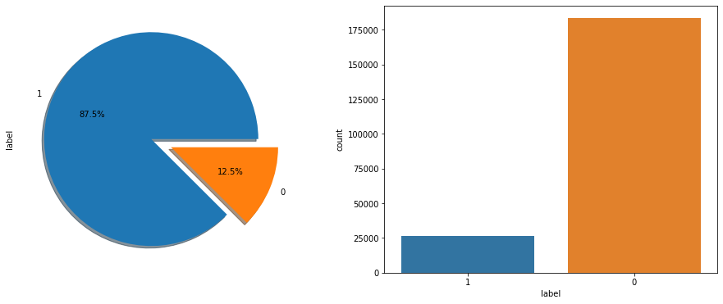
Data visualisation
You can see labels visualisation which label 1 consists of 80 percnet of data

Slide 7
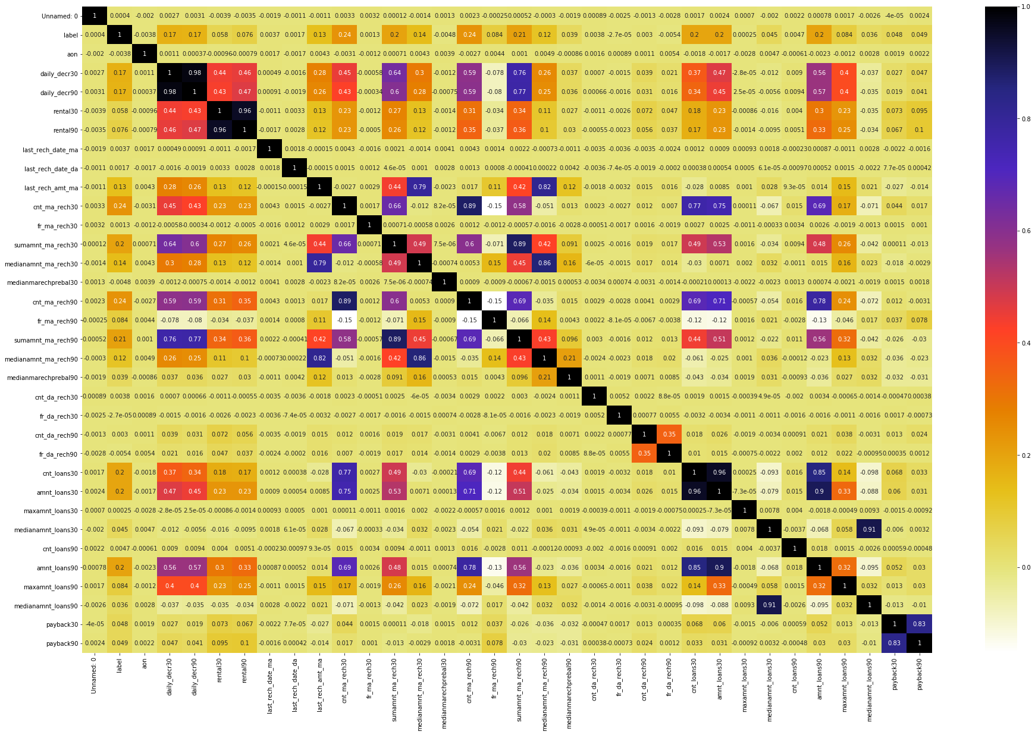
Data visualisation

Slide 8
correlation
We can use heat map to visualise correlation , we can see highly correlated features with respect to the label.
We can use RFE techniques for feature selection which could increase model performance

Slide 9
outliers
We should check outliers
Q1 = df.quantile(0.25)
Q3 = df.quantile(0.75)
IQR = Q3 - Q1
print(IQR)
We are getting more outliers ,but removing outliers can lead to loss of data

Slide 10
Train test split
# label analysis
print('Target Variable')
print(df.groupby(['label']).label.count())
from sklearn.model_selection import train_test_split
X_train,X_test,y_train,y_test=train_test_split(X,y,train_size=0.75)
Splitting the data into train and test

Slide 11
standardisation
from sklearn.preprocessing import StandardScaler
import numpy as np
scaler = StandardScaler()
X = scaler.fit_transform(X)
Standardization of datasets is a common requirement for many machine learning estimators implemented in scikit-learn; they might behave badly if the individual features do not more or less look like standard normally distributed data: Gaussian with zero mean and unit variance.

Slide 12
RandomForestClassifier smote oversampling
print("Before OverSampling, counts of label '1': {}".format(sum(y_train == 1)))
print("Before OverSampling, counts of label '0': {} \n".format(sum(y_train == 0)))
# import SMOTE module from imblearn library
# pip install imblearn (if you don't have imblearn in your system)
from imblearn.over_sampling import SMOTE
sm = SMOTE(random_state = 2)
X_train_res, y_train_res = sm.fit_sample(X_train, y_train.ravel())
Smote is used to overcome data imbalance

Slide 13
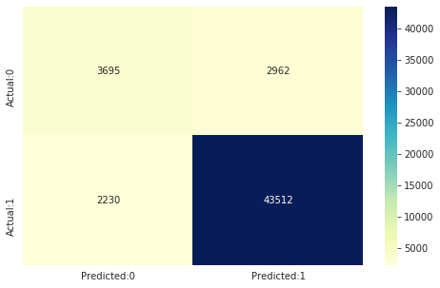
Random forest classifier with smote output confusion matrix

Slide 14
accuracy
precision recall f1-score support
0
1 0.62
0.94 0.56
0.95 0.59
0.94 6657
45742
accuracy
macro avg
weighted avg 0.78
0.90 0.75
0.90 0.90
0.77
0.90 52399
52399
52399
Accuracy score is 90 percent

Slide 15
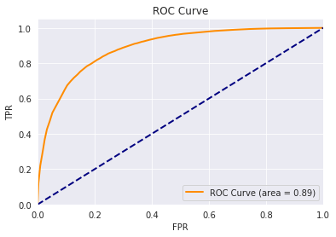
Roc curve

Slide 16
conclusion
After checking different classification techniques RandomForestClassifier with SMOTE oversampling gives best results.we can predict test data and save model by using joblib .

Slide 17
Thanking you
Sudhakar sasum

