Slide 1

Online Learning Management System
(eLearn)

Slide 2
Online Learning management system
Guided By :
Mrs. Swarnalata Pati
Designed By :
Name: Sudhamaya Sahoo
Regd. No : 1905106025
Semester: 5th Semester
College Of Engineering And Technology
Ghatikia,Bhubaneswar-751029

Slide 3
Objective Of this project :-
‘Online Learning Management System’ is a project which aims in developing a Online Application to maintain the works of a Department in the College Or in a teaching institute.
This project has many features like students and teacher details, Add, Edit and Delete class records, Upload of notes and Uploading notifications etc. A student or a teacher can Register/login to his unique id after assigning a roll no. and Teacher Id by Admin.
It also has a facility of admin login through which the admin can monitor the whole system. This System can be used to Add, Edit and Delete class records, Student or Teacher Data, see the ratings of teachers etc. The Admin after logging into his account can see how many students or teachers registered and how many notes uploaded with a well designed Dashboard.
Overall this project of mine is being developed to help the departments of any Teaching institution to maintain the daily works in the best way possible and also reduce the human efforts.

Slide 4
LITeRaTURE SURVEY :-
Literature survey is the most important step in software development process. Before developing the tool it is necessary to determine the time factor, economy and company strength.
Once the programmers start building the tool the programmers need lot of external support. This support can be obtained from senior programmers, from book or from websites. Before building the system the above consideration are taken into account for developing the proposed system.
I make this web based system by survey of these following literatures.
A Research Paper on “Document-Oriented E-Learning Components”
A review paper on “e-Learning:technology concepts”
“E-learning Advocate Project 2006/7 Integrating E-Learning into the English Curriculum at The University of Northampton.”

Slide 5
EXISTING SYSTEM :-
In the existing system we have already seen there are lots of Learning Managemet Systems. Some institutions also maintain these systems by using social media applications like Whatsapp or Facebook.
Also in the existing system we have seen some traditional system like classroom notes in physical mode, class schedules(Time-Tables) in physical mode, teachers and student data on a physical notebook record and sometimes notices and updates about classes or exams released through a physical copy mode.
The following are the drawbacks present in the existing system:
With the traditional system both students and teachers face many issues to maintain those physical mode of records.
With these pandemic periods most of the colleges are closed for a long period of time. In this crucial time students could not able to get their class records, notes, updates and notices etc. at a single place.
Also we have seen some institutions who has maintaining these records online, they could not able to give all the data at one platform.

Slide 6
Proposed System :-
My proposed system provides solution to existing system as follows:
In my learning management system a student can get all the data for any institution in one platform.
Also this system is proposed like there are no outsider student can enter to this system.
In this system admin of the institution is the key person who can give access to both students and teachers to enter the system.
Also admin can assign the subjects to the teacher and maintain the whole records of students and teachers.
After getting access, students can get all notes, class time tables, which subject has given to which teacher, all updates with a enhanced notification panel etc.
Also after getting access, teachers can upload notes and give any class or exam updates etc.

Slide 7
Project Functionalities :-
For Admin →
Dashboard
View/ Add Classes
Add subjects acc. To classes
Add/ Edit Lecturers details
Assign subjects to lecture
Add/ Edit Students details
View the evaluations
View all users
Change Password
Log Out
For Teachers →
Register
LogIn
View Profile
View Notifications
Add Categories
Upload/ Delete Documents
Add/ Delete Announcements
Change Password
Log Out
For Teachers →
Register
LogIn
View Profile
View Notifications
View Materials
Submit Quries
Submit Evaluations
Change Password
Log Out

Slide 8
System requirement :-
Software Requirements –
Frontend
HTML 5
CSS 3
Java Script
Backend
JSP (JAVA server page)
Servlet
MySQL (5.7)
System Requirements –
i3 Processor or similar to this Processor
Any OS with a Supported Web Browser
IDE
Eclipse

Slide 9
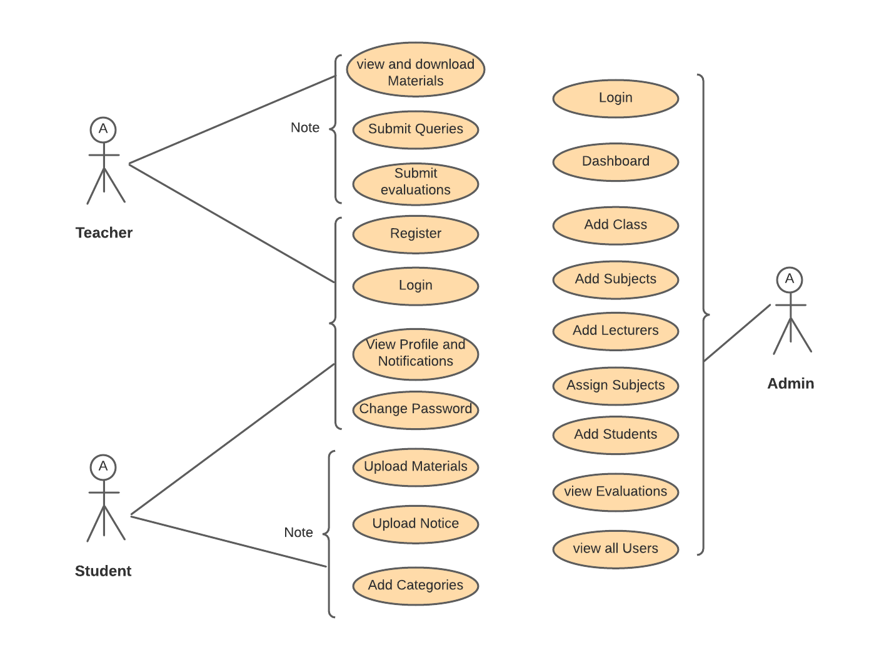
USE CASE DIAGRAM :-

Slide 10
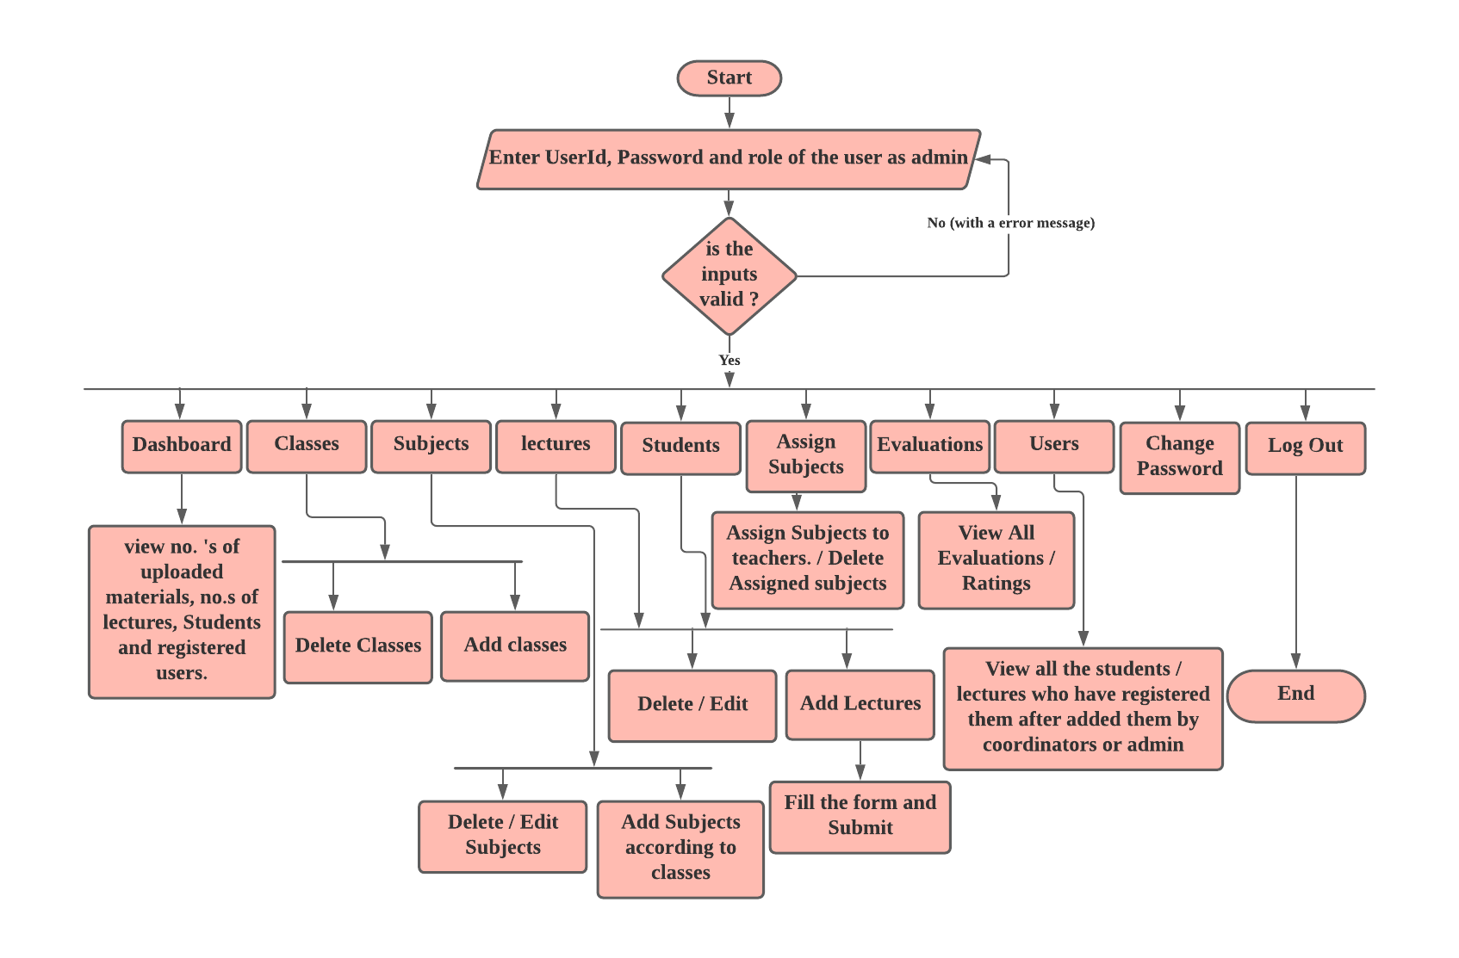
Activity Flow Diagram :-
(For Coordinator/Admin)

Slide 11
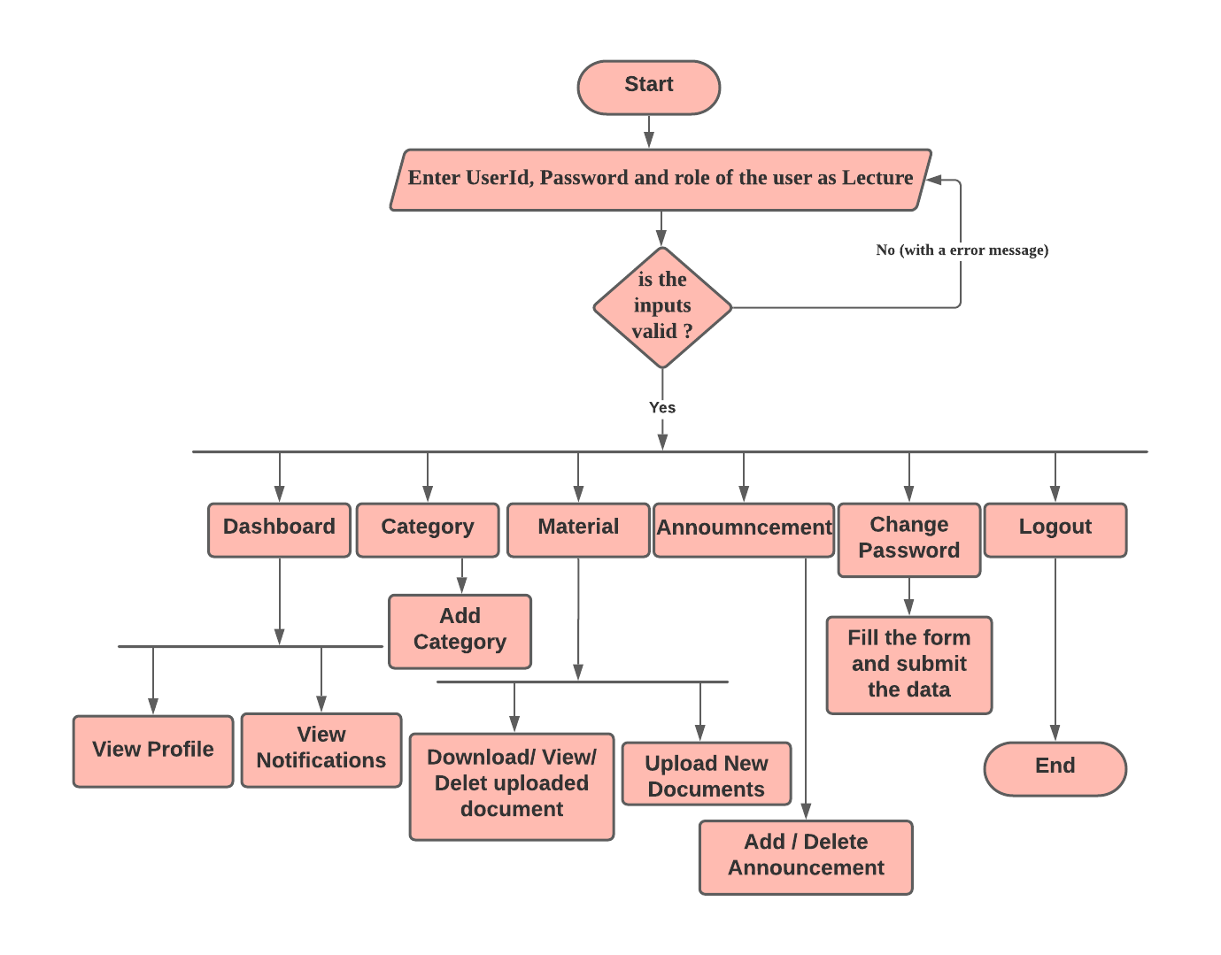
Activity Flow Diagram :-
(For Lectures)

Slide 12
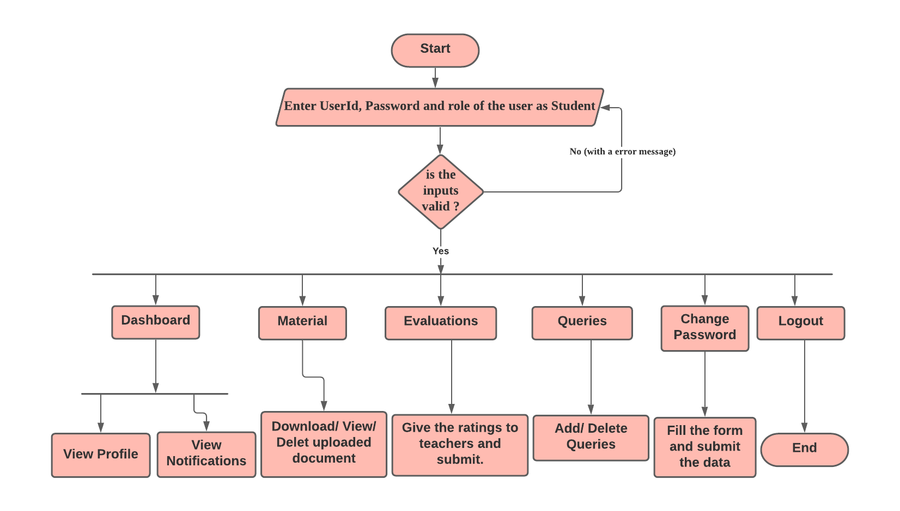
Activity Flow Diagram :-
(For Student)

Slide 13
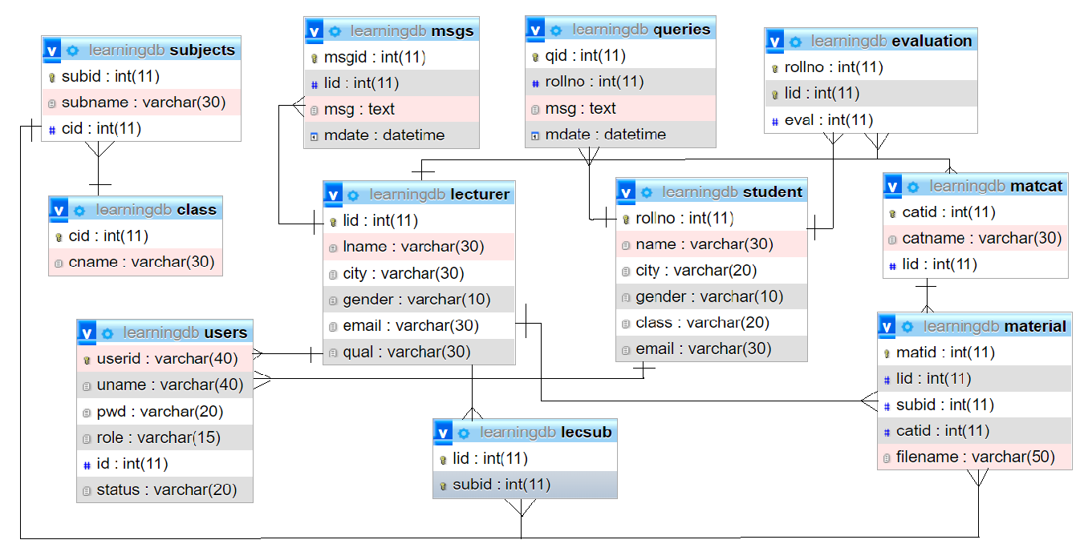
Database Design :-

Slide 14
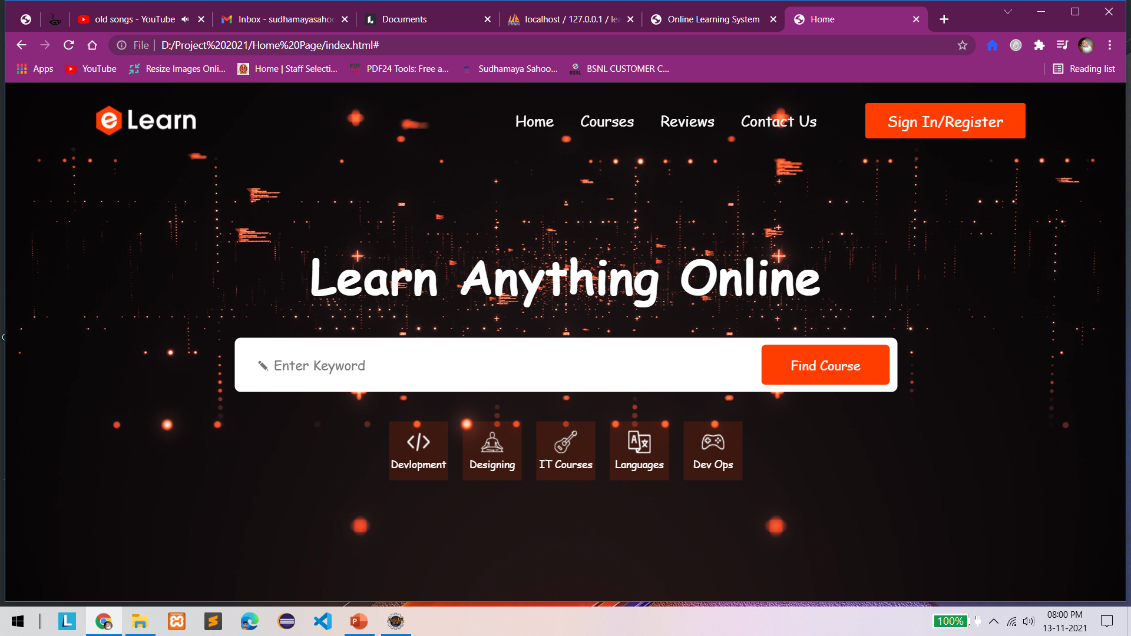
Home Page / Welcome Page -

Slide 15
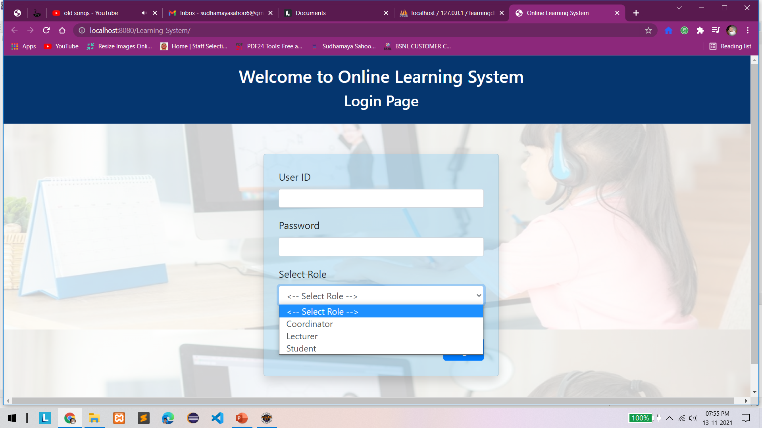
Signup and Login page -

Slide 16
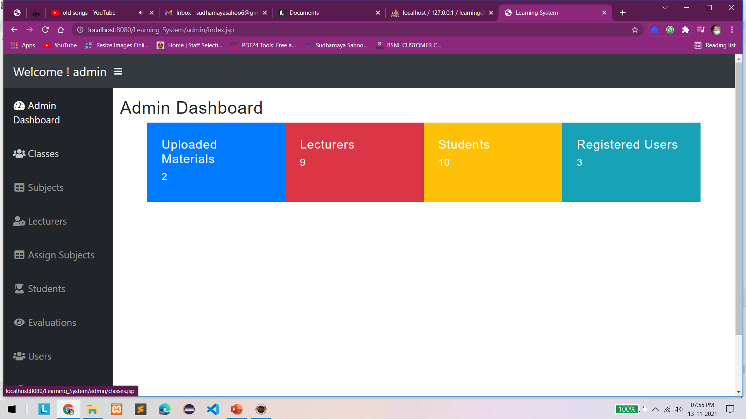
Admin Dashboard Page -

Slide 17
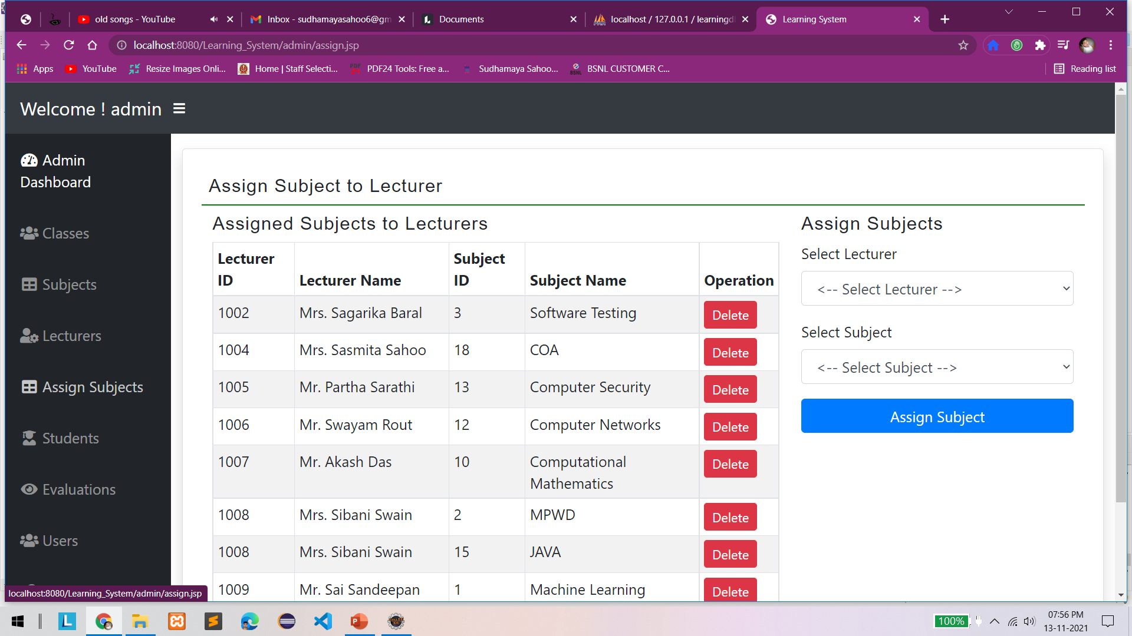

Slide 18
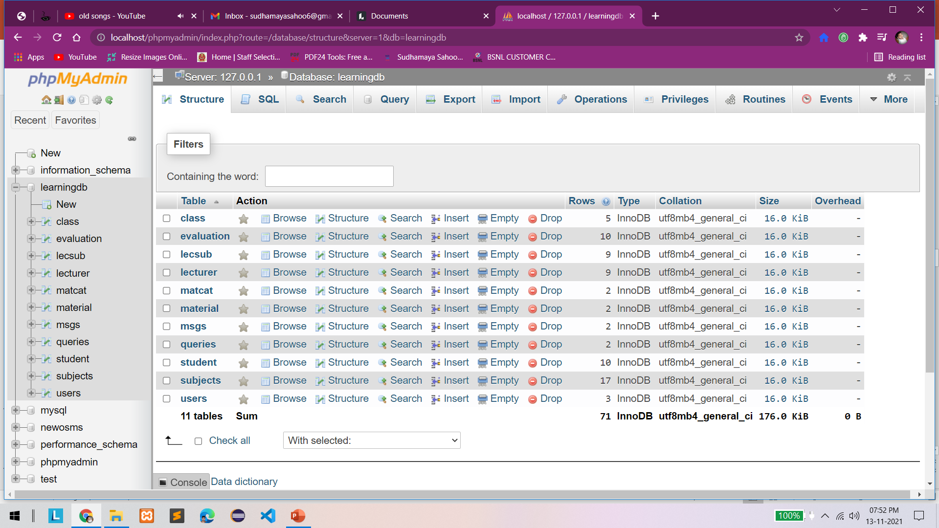
Database :-

Slide 19

Thank You
Any questions?

