Slide 1
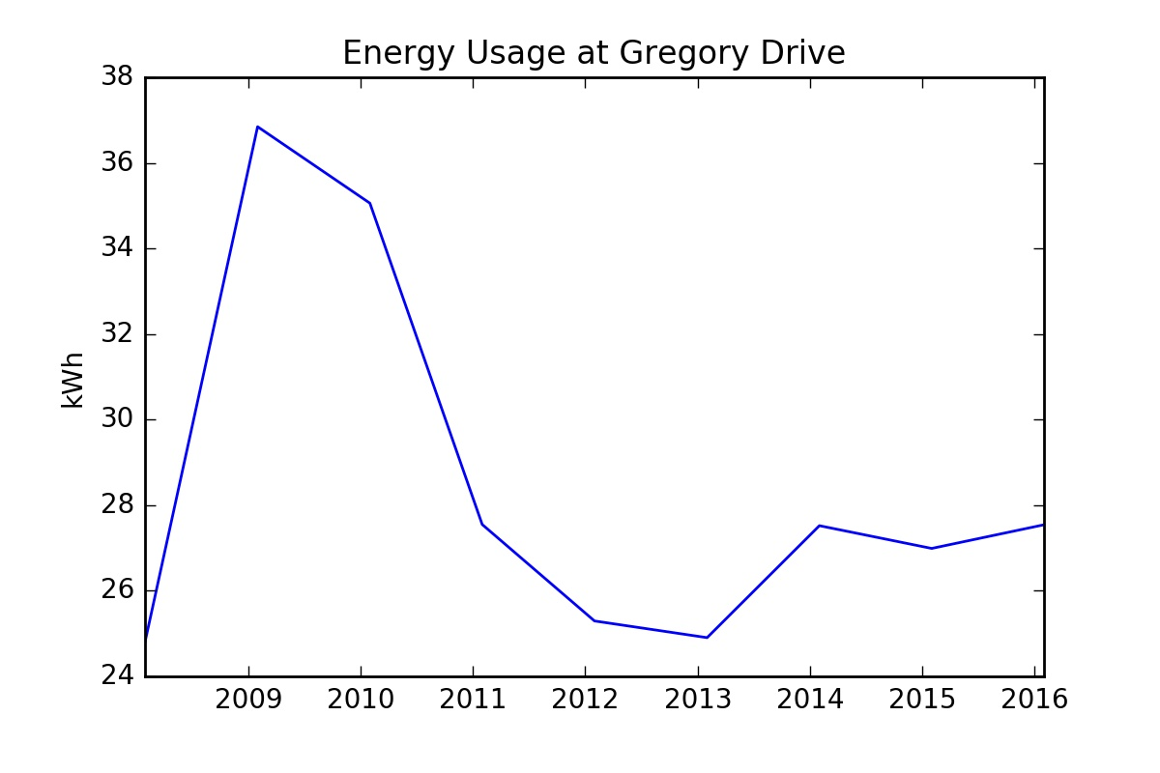

Slide 2
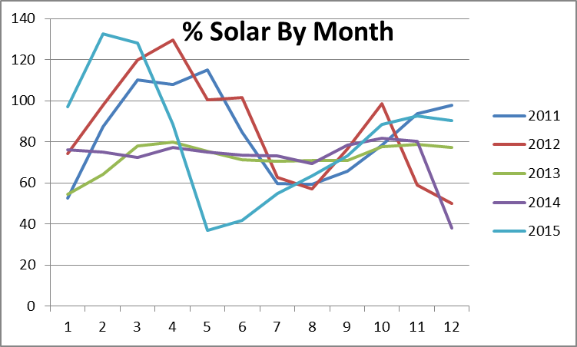

Slide 3
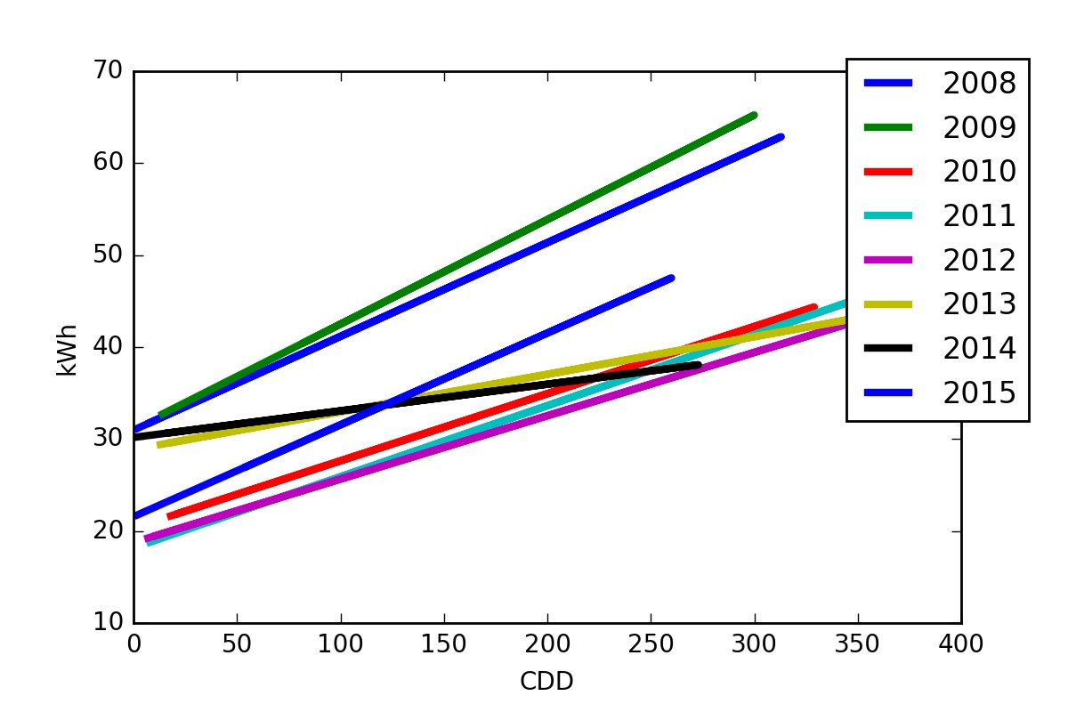

Slide 4
Energy Reduction from Siding
kWh used for AC in 2013: 34.72
kWh that would have been used for AC with 2012 insulation 58.53 kWh
kWh saved in 2013: 59.31%
kWh used for AC in 2014: 20.42 kWh
kWh that would have been used for AC with 2012 insulation: 48.62 kWh
kWh saved in 2014: 42.00%

