Slide 1
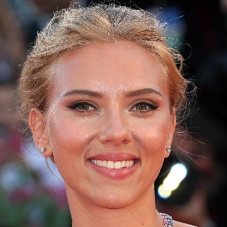

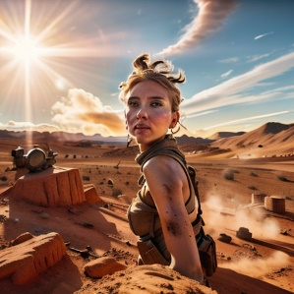
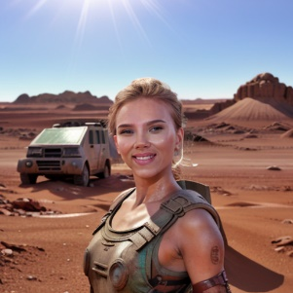
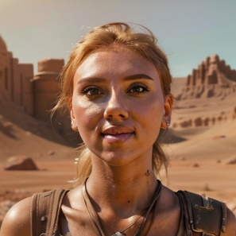




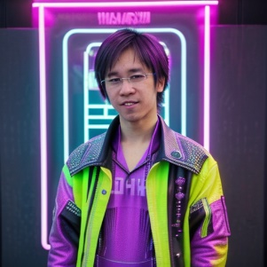
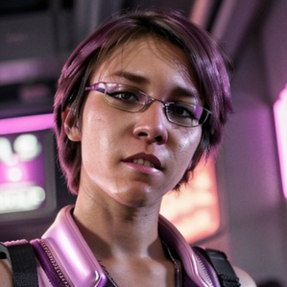

References |  | IP-Adapter | IPA-FaceID | IPA-FaceID-Plus | IPA-FaceID-Portrait | ConsistentID
Mars
Neonpunk
Notes:
1: img22
2:
3:
4:
5:

