Slide 1
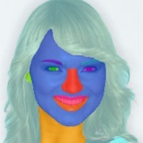
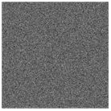
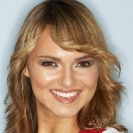
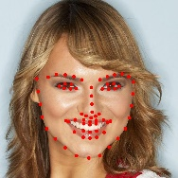
Multi-modal Facial Prompt Generator
A. Fine-grained ID Generator
concatenate
Caption: A young woman wearing a white sweater and a scarf
Text
Encoder
Overall Facial ID
Generator
Fine-grained ID
Generator
Image
Text
Text Embedding
She has a small nose, and her eyes are positioned on the sides of her face. She has a small mouth, and her ears are located on the sides of her head
Cross Attention
Cross Attention
Facial Mask
Text Conditional Embedding
Facial Encoder
BiSeNet
Facial Embedding
Image
Encoder
LLaVa1.5/ChatGPT4V
B. Overall Facial ID Generator
Image
Encoder
Loss = Denoise Loss + Facial Attention Loss
Face Embedding
Projection
InsightFace Model
Trainable Modules
Frozen Modules
Attention-drived ID-Preservation network

