Slide 1

Hacking
By Abi & Pavi

Slide 2
Contents
What is Hacking
History
Types of Hacking
Types of Hackers
Crackers
Hacking tools
Prevention
Advantages & Disadvantages
Conclusion

Slide 3
What is hacking?
Hacking is the gaining of access to a computer and viewing, copying, or creating data without the intention of destroying data or maliciously harming the computer.
Hacking refers to activities that seek to compromise digital devices, such as computers, smartphones, tablets, and even entire networks.

Slide 4
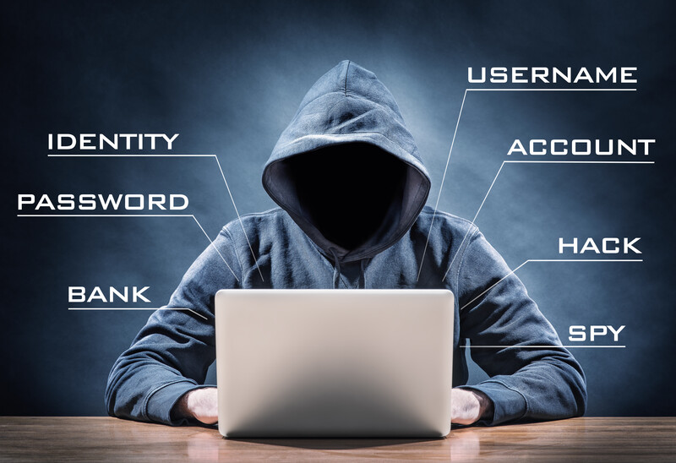
Who is hacker?
A hacker is any person engaged in hacking.
A hacker is a person skilled in information technology who uses their technical knowledge to achieve a goal or overcome an obstacle, within a computerized system by non-standard means.

Slide 5
History
First computer hack was in late 1960’s when Bell Labs successfully hacked and modified a UNIX operating system.
In 1980’s people started to hack computer system to gain access to confidential information.
Several groups formed to tap into sensitive information.
Gangs began fighting in early 1190’s.
In late 1990’s law enforcers began to take hacking seriously by making stricter laws against hacking.

Slide 6
Types of Hacking
Website Hacking
Network Hacking
Ethical Hacking
Email Hacking
Password Hacking
Online Banking Hacking
Computer Hacking

Slide 7
Type of hackers
1.Black hat hackers
2.White hat hackers
3.Grey hat hackers

Slide 8

Black Hat Hackers
Black hat hackers are malicious hackers, sometimes called crackers.
Black hats lack ethics, sometimes violate laws, and break into computer systems with malicious intent, and they may violate the confidentiality, integrity, or availability of an organization's systems and data.
They Hacks system for malicious purposes or self-gain.
Some wipe memory off of other computers for fun.

Slide 9

Grey Hat Hackers
A grey hat hacker is someone who may violate ethical standards or principles, but without the malicious intent ascribed to black hat hackers.
Grey hat hackers may engage in practices that seem less than completely above board, but are often operating for the common good.

Slide 10

White Hat Hackers
A white hat hacker or ethical hacker is an individual who uses hacking skills to identify security vulnerabilities in hardware, software or networks.
However, unlike black hat hackers or malicious hackers white hat hackers respect the rule of law as it applies to hacking.
A white hat is an ethical security hacker.
The good guys in the hacking world.

Slide 11
The dark side of Hacking
To gain unauthorized access in order to destroy information.
Gain unauthorized access to system or computer services in order to steal data for criminal purposes.
Terrorism.

Slide 12
Why do hackers hack?
Money: lot of hackers are simply motivated by money. Hackers don’t just hack businesses and ask for a ransom.
Steal/Leak Information: One of the most common reasons for hackers to hack is to steal or leak information.
Disruption: These hackers don’t care about money or data; they seem to feel that they have a higher purpose in life.
Espionage: Espionage is another type of theft except, instead of direct financial gain, the hackers are seeking protected information. Stolen information can be either sold or used by adversaries to gain tactical advantages.
Fun: A lot of hackers will tell you that breaking into a secure system is an enjoyable hobby that tests their knowledge and skills.

Slide 13
What to do when system got hacked
First thing to do is to disconnect your system from internet.
Run anti-virus scan on your computer.
Take it to a professional if problems persist.

Slide 14
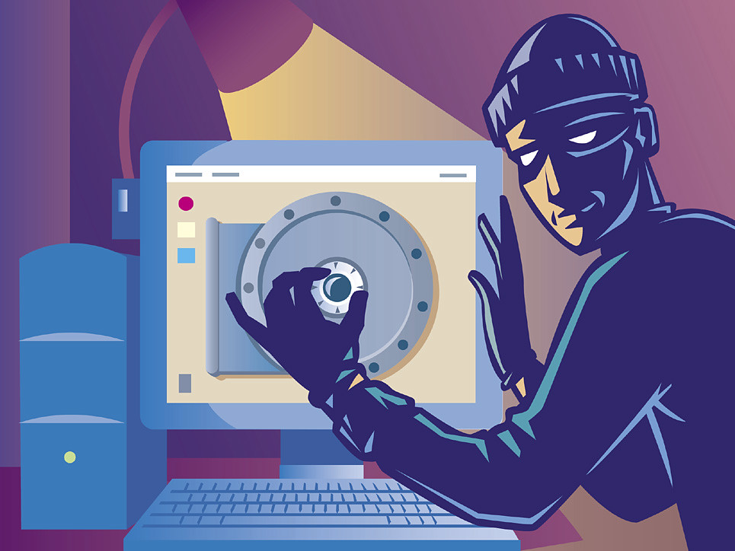
Crackers
Person who enter into others system and violet the system, damage the data, create havoc is called CRACKER.

Slide 15
Hackers vs. Crackers
Hackers | Crackers
It’s ethical | It’s unethical
Some hackers do have ethical certificates | Crackers do not have ethical certificates
It is use for good purposes too | Not used for good purposes

Slide 16
Hacking tools
Scanners: Program that automatically detects security weakness in remote host. Port scanners are used for hacking.
Telnet: It’s a terminal emulation program that allows us to connect to remote system.
Ftp: File transfer protocol is also used for hacking too.

Slide 17
Top Hacking Countries

Slide 18

Prevention
Install anti-virus software.
Install a firewall/ make sure you have one.
Have backups of any important information on your computer stored separately.
Use unique and strong passwords.
Don’t use unauthorized applications.
Don’t click unauthorized website links.

Slide 19

Prevention – Firewall maintenance
Block all access by default. When configuring a firewall, it's important to start by blocking access to the network from all traffic.
Regularly audit firewall rules and policies.
Keep the firewall up-to-date.
Keep track of authorized users.

Slide 20
Advantages of Hacking
To recover lost information, especially in case you lost your password.
To perform penetration testing to strengthen computer and network security.
To put adequate preventative measures in place to prevent security breaches.
To have a computer system that prevents malicious hackers from gaining access.

Slide 21
Disadvantages of Hacking
Massive security breach.
Unauthorized system access on private information.
Privacy violation.
Hampering system operation.
Denial of service attacks.
Malicious attack on the system.

Slide 22
Conclusion
As technology evolves, hackers evolves too. So, there is no way to stop hackers. But we can prevent yourself by proper maintenance and usage of computer.

Slide 23

Thank you !!

