Slide 1
Final Year Project
Simulation of
Autopilot
Notes:
First Screen

Slide 2
Project Advisor : Tarique Ahmed
Evaluation Committee Members
  Tarique Haider
  Nadeem Saleem
  Raisul-Haque Adnan

Slide 3
Presented By
Syed Siraj Ul Haque : ITU/S98/0144
Bachelor Of Engineering
in
Information Technology
1998 Batch

Slide 4
Project Objective
The goal of this project is to present an integrated treatment of basic elements of aircraft stability, flight control and autopilot.
This project is a small part of real time flight simulator.
It deals with motion and stability of aircraft and stability augmenter
It includes simulation of basic controller like pitch role heading speed and altitude
And Stability Augmentation System (SAS) which is used to control flight quality

Slide 5
Part 2
Aircraft Equations Of Motion
Longitudinal Motion
Lateral Motion
Flying qualities
Part 1
Introduction
Forces of Flight
Flight Control Surfaces
Stability of Aircraft
Static Stability of Aircraft
Part 3
Autopilot Design
Application of Modern Control Theory in Autopilot Design
Optimal control Theory

Slide 6
Part 1
Introduction
Forces of Flight
Flight Control Surfaces
Stability of Aircraft
Static Stability of Aircraft

Slide 7
Introduction
Aircraft Stability and Control
How well an airplane flies and how easily it can be controlled are subjects studied in aircraft stability and control
Aerodynamic Nomenclature
The motion of an airplane it is necessary to define a suitable
coordinate system for the formulation of the equations of
motion

Slide 8
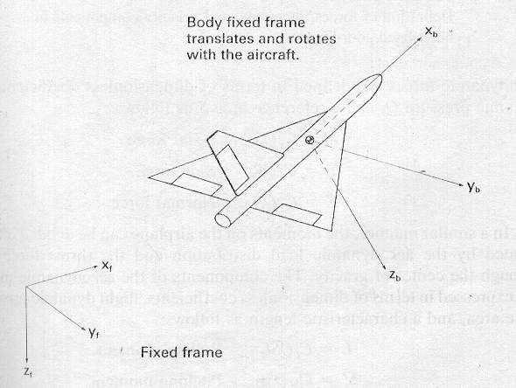
Coordinate System
Inertial Coordinate System
It is fixed to the Earth and consid-ered for the purpose of aircraft motion analysis
Body Coordinate System
The other coordinate system is fixed to the airplane and is referred to as a body coordinate system

Slide 9
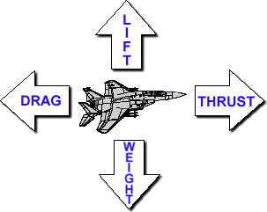
FORCES OF FLIGHT
Weight
Weight is simply the force of gravity acting on the aircraft.
Lift
Lift opposes weight and will be perpendicular (90 degrees) to the relative wind
Thrust
Thrust (measured in pounds or Newton) provides the velocity required for an aircraft's wings to produce lift
Drag
Like all objects moving through the atmosphere, aircraft create drag.

Slide 10
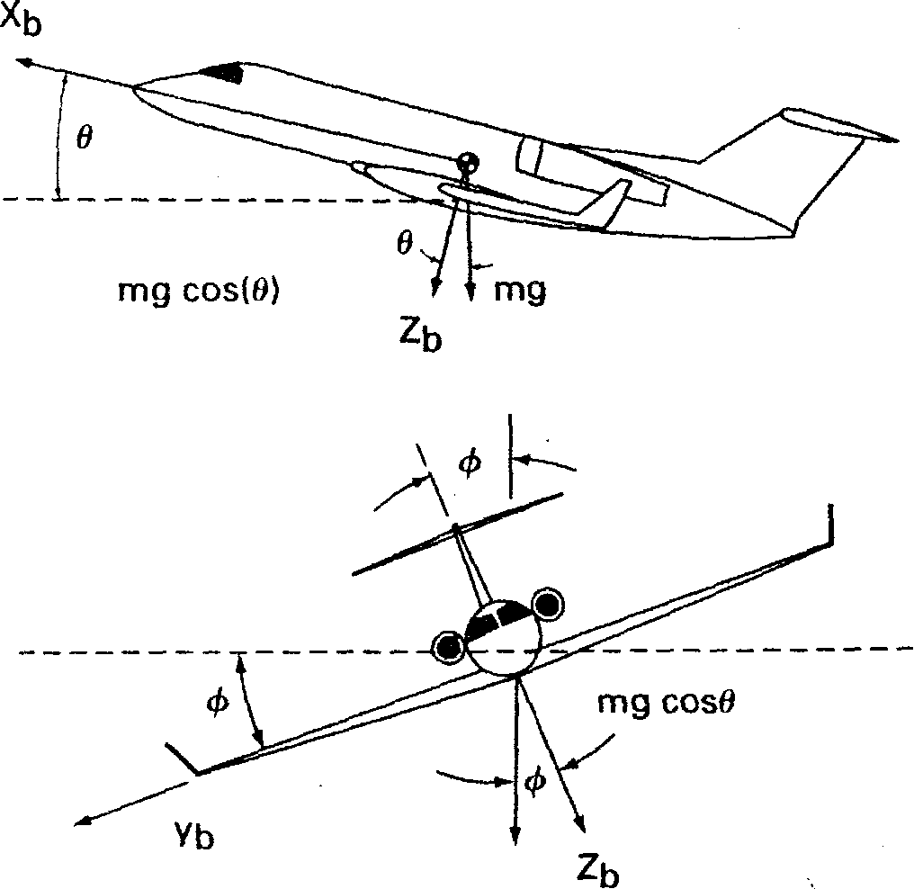



Weight (Gravitational force)
Weight is simply the force of gravity
Weight always acts toward the center of the earth.
When an aircraft is flying straight and level, weight opposes lift.
If the aircraft's wing is not producing enough lift to overcome gravity, the aircraft will be forced to descend.
If the amount of lift exceeds the force of gravity, the aircraft will be able to climb
The gravitational force components along the x, y, and z-axes are

Slide 11
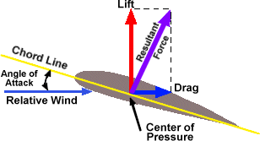
Lift
Lift opposes weight and will be perpendicular (90 degrees) to the relative wind
Lift is represented by the following formula:
Lift=½ (air density) x (velocity squared) x
(coefficient of lift) x (wing surface)

Slide 12
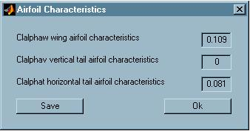
Lift
The Airfoil
An airfoil is any shape designed to produce lift. A conventional airfoil will consist of the leading edge, trailing edge, camber, and chord

Slide 13
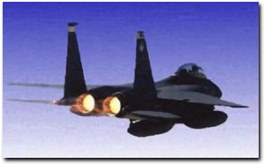
Thrust
Thrust is one of the four forces acting on an aircraft.
Thrust provides the velocity required for an aircraft's wings to produce lift.
Thrust is the forward force and lift is the force acting in the upward direction

Slide 14
Drag
Like all objects moving through the atmosphere, aircraft create drag. For aircraft flying at high airspeeds, drag is a surprisingly complicated subject
Types Of Drag
  Parasite Drag
  Induced Drag
  Wave Drag

Slide 15
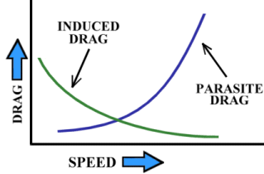
Induced and Parasite Drag
Induced Drag is a result of the wing producing lift
Parasite drag is what most people think of when considering drag. When riding a bike, lowering your body to a horizontal position reduces the amount of resistance by reducing the amount of air being disturbed by you and the bike

Slide 16
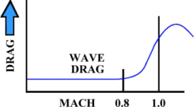
Wave Drag
When the aircraft approaches the speed of sound the pressure disturbance (or "wave") is caught by the aircraft (which is still producing the pressure disturbance) and the disturbances stack up to produce a wall of pressure that creates the wave drag effect

Slide 17
Motion of Airplane
The motion of an airplane in free flight can be extremely complicated.
Aircraft can maneuver about three axes and along three planes of motion
Three translational motions
1. .Horizontal
2. Vertical
3.Transverse
Three rotational motions
1.Pitch
2.Yaw
3.Roll

Slide 18
Motion Of Aircraft
The point in which these axes intersect is the aircraft's center of gravity
The center of gravity is the point that the aircraft is perfectly balanced.
All movements of the aircraft will be based off this one point.

Slide 19
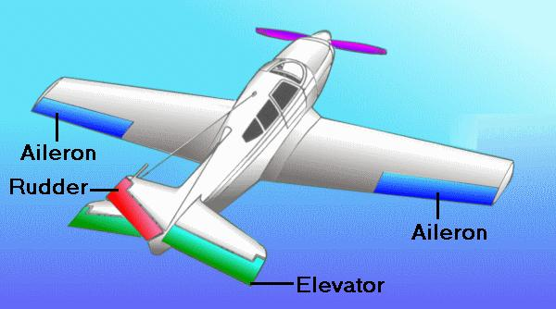
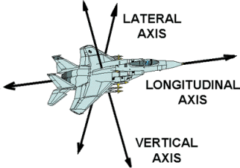
Motion Of Aircraft
Movement in the LATERAL AXIS refers to the pitch of the aircraft. ELEVATORS are the flight controls that control movement in this axis.
Movement in the VERTICAL AXIS is called yaw. RUDDERS perform this function.
Movement in the LONGITUDINAL AXIS is a roll motion. AILERONS are responsible for rolling the aircraft.

Slide 20
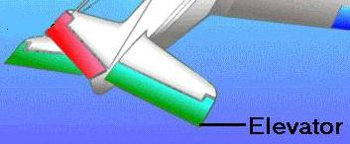
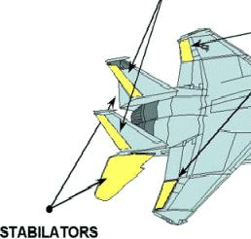
Elevators
Elevators (or Stabilators) control movement in the lateral axis (also called pitch
Elevators are connected to the horizontal stabilizer and can move both up and down.
Stabilators are used in many aircraft - they differ from elevators in that the entire horizontal stabilizer moves (the F-15 like most modern fighter aircraft has stabilators).
The elevators form the rear part of the horizontal tail assembly and are free to swing up and down.
Together, the horizontal stabilizer and the elevators form a single airfoil
A change in position of the elevators modifies the camber of the airfoil, which increases or decreases lift.

Slide 21
Elevators(contd)
The elevators are connected to the control wheel (or stick) by control cables
When forward pressure is applied on the wheel, the elevators move downward. This increases the lift produced by the horizontal tail surfaces
The increased lift forces the tail upward, causing the nose to drop
Conversely, when back pressure is applied on the wheel, the elevators move upward, decreasing the lift produced by the horizontal tail surfaces
The elevators control the angle of attack of the wings
When backpressure is applied on the control wheel, the tail lowers and the nose rises, increasing the angle of attack.

Slide 22
Aileron
Ailerons are mounted on the outside of the wings and control movement in the longitudinal axis (or roll)
When the stick or control wheel is moved to the left, the right aileron will deflect down and the left aileron will deflect up
Lowering the aileron on one wing raises the aileron on the other
The right aileron (now lower than the wing) will produce increased lift and will lift the right wing
The left aileron produces less lift

Slide 23
Aileron(contd)
The increased lift from the right wing and the reduced lift from the left wing cause the aircraft to roll to the left.
Rods or cables connect the ailerons to each other and to the control wheel (or stick) in the Cockpit
When pressure is applied to the right on the control wheel, the left aileron goes down and the right aileron goes up, rolling the airplane to the right

Slide 24
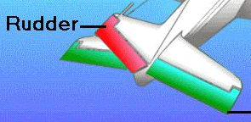
Rudders
Rudders move the aircraft along the vertical axis. This is called YAW
The rudders are connected to the vertical stabilizer can are controlled by rudder pedals as opposed to the control stick
Kicking the rudder to the right causes the rudder to move right and to produce greater lift on the right side of the vertical stabilizer
This increased lift pushes the tail to the left and the nose to the right
The rudder is used to with the ailerons to produce a coordinated turn.

Slide 25
STABILTIY OF AIRCRAFT
By stability we mean the tendency of the airplane to return to its equilibrium position after it has been disturbed.
Disturbance faced by an Aircraft
The disturbance may be generated by the pilot's actions or atmospheric phenomena. The atmospheric disturbances can be wind gusts, wind gradients, or turbulent air

Slide 26
Conditions for Airplane Stability
Aircraft with no inherent aerodynamic stability can be flown by providing artificial stability by an electromechanical device called Stability Augmentation System.
An airplane must have sufficient stability that the pilot does not become fatigued by constantly having to control the airplane owing to external disturbances.

Slide 27
Two conditions are necessary for an airplane to fly its mission successfully.
  The airplane must be able to achieve equilibrium flight and it must have the capability to maneuver for a wide range of flight velocities and altitudes
  Airplanes should have good handling qualities

Slide 28
Static Stability of Aircraft
Aircraft should be statically stable
Without static stability the pilot would have to continuously control the airplane to maintain a desired flight path, which would be quite fatiguing
The degree of static stability desired by the pilot has been determined through flying quality
The designer can control the degree of longitudinal and lateral directional stability by proper sizing of the horizontal and vertical tail surfaces

Slide 29
Dynamic Stability of Aircraft
Note that the vehicle can be statically stable but dynam­ically unstable
Static stability, therefore, does not guarantee dynamic stability
However, for the vehicle to be dynamically stable it must be statically stable
Dynamic stability usually is specified by the time it takes a disturbance to be damped to half of its initial amplitude or, in the case of an unstable motion, the time it takes for the initial amplitude of the disturbance to double

Slide 30
Dynamic Stability and SAS
The reduction of the disturbance with time indicates that there is resistance to the motion and, therefore, energy is being dissipated.
The dissipation of energy is called positive damping
If energy is being added to the system, then we have a negative damping
Positive damping for an airplane is provided by forces and moments that arise owing to the airplane's motion
An airplane that has negative aerodynamic damping will be dynamically unstable
To fly such an airplane, artificial damping must be designed into the vehicle
The artificial damping is provided by a stability augmentation system (SAS).

Slide 31
Definition of Longitudinal Static Stability
Two conditions are necessary for an airplane to be longitudinally stable
  To have static longitudinal stability the aircraft pitching moment curve must have a negative slope.
  Plane should trim at positive angle of attach

Slide 32
Contribution of Aircraft Components to Longitudinal Static Stability
Wing Contribution
Tail Contribution—Aft Tail
Canard—Forward Tail Surface
Fuselage Contribution
Propulsion unit

Slide 33
Longitudinal Control
Pitch control can be achieved by changing the lift on either a forward or aft control surface. If a flap is used, the flapped portion of the tail surface is called an elevator

Slide 34
Definition of Directional Static Stability
Directional, or weathercock, stability is concerned with the static stability of the airplane about the z axis.
To have static directional stability, the airplane must develop a yawing moment that will restore the airplane to its equilibrium.

Slide 35
Contribution of Aircraft Components to Directional Stability
The contribution of the wing to directional stability usually is quite small in comparison to the fuselage, provided the angle of attack is not large
The fuselage and engine nacelles, in general, create a destabilizing contribution to directional stability
Wing-fuselage contribution to directional stability is destabilizing so the vertical tail must be properly sized to ensure that the airplane has directional stability

Slide 36
Directional Control
Directional control is achieved by a control surface, called a rudder, located on the vertical tail.
By rotating the flap, the lift force (side force) on the fixed vertical surface can be varied to create a yawing moment about the center of gravity.
The size of the rudder is determined by the directional control requirements.

Slide 37
Definition of Roll Static Stability
An airplane possesses static roll stability if a restoring moment is developed when it is disturbed from a wings-level attitude.

Slide 38
Contribution of Aircraft Component
The roll moment created on an airplane when it starts to sideslip depends on
  Wing dihedral
  Wing sweep
  Position of the wing on the fuselage
  Vertical tail

Slide 39
Roll Control
Roll control is achieved by the differential deflection of small flaps called ailerons which are located outboard on the wings, or by the use of spoilers.
The basic principle behind these devices is to modify the spanwise lift distribution so that a moment is created about the x axis.

Slide 40
Part 2
Aircraft Equations Of Motion
Longitudinal Motion
Lateral Motion
Flying qualities

Slide 41
Aircraft Equations Of Motion
Nonlinear differential equations of motion of a rigid airplane is developed from Newton's second law of motion.
Linearization of these equations is accomplished using the small disturbance theory.
These equations will be valuable information on the dynamic characteristic of airplane motion.

Slide 42
Linearized Rigid Body Equations of Motion
Newton Second Law of Motion
Non-linear differential Equations
Small Disturbance theory
Linearized Equations of Motion

Slide 43
Small-disturbance theory
The equations developed in the previous section can be linearized using the small-disturbance theory.
In applying the small-disturbance theory we assume that the motion of the airplane consists of small deviations about a steady flight condition.
this theory cannot be applied to problems in which large-amplitude motions are to be expected

Slide 44
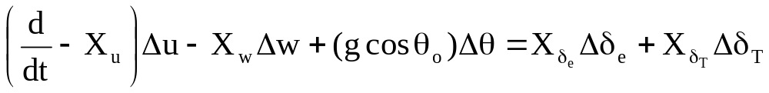
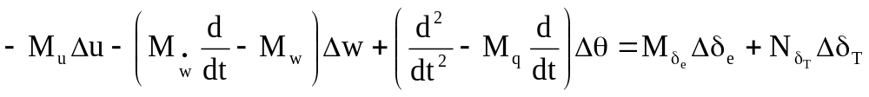
After Applying small disturbance theory to non-linear differential equations we get linearized equations of longitudinal and lateral equations
The linearized small disturbance longitudinal rigid body equation of motion.

Slide 45
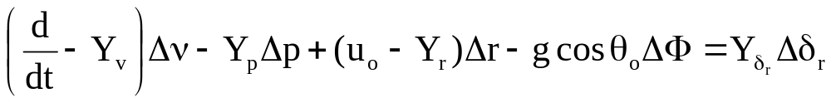
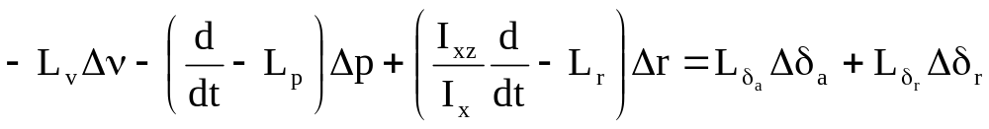
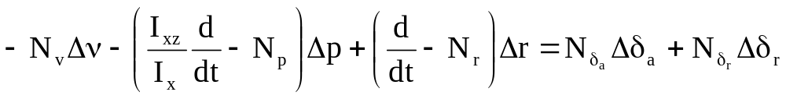
linearized small disturbance lateral rigid body equation of motion.

Slide 46
Inertial Coupling
In our analysis we treated the longitudinal and lateral equations separately.
In so doing we assumed that there is no coupling between the equations.
The first cases of inertial coupling started to appear when fighter aircraft designs were developed for supersonic flight.

Slide 47
Representation of stability coefficients and derivatives
We have seperated the equations of stability coefficients for lateral and longitudinal motions.
We have also seperated the equations for longitudinal and lateral derivatives.

Slide 48
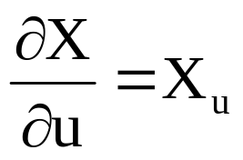

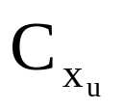
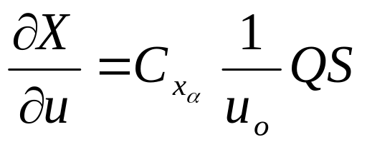
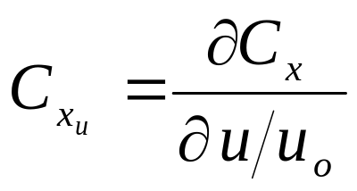
Stability Coefficients and Derivatives
The term
called the stability derivative is evaluated
at the reference flight condition.
We can also express
in terms of the stability Coefficient

Slide 49
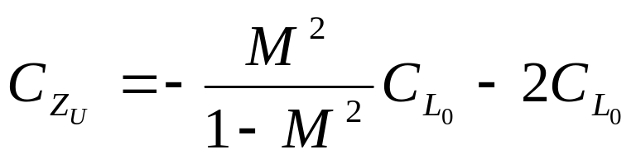
Now we will see some of the equations, we will see the nomenclature, what does they stand for and how they were used.
For example
The naming convention we have used is in this order
lon_sc_zfd_Czu

Slide 50
Similarly all the equations for lateral and longitudinal stability coefficients and derivatives are named using
the same naming convention.
Now they are programmed in matlab in the following manner.
function r=lon_sc_zfd_Czu(M,Cl)
M Mach number
Cl reference lift coefficient
Czu change in Z force due to change in forward speed u ( to be calculated here 'r' )
r=- ( (M^2*Cl)/(1-M^2) ) - 2*Cl;

Slide 51
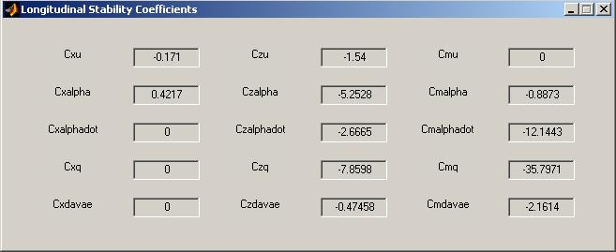
This window in our project shows the longitudinal stability coefficients

Slide 52
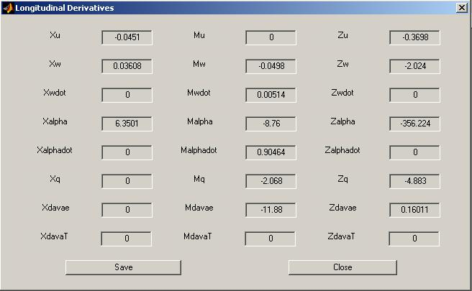
Similarly we have this window for longitudinal derivatives

Slide 53
Summary of Equation of motion
some simplifying assumptions will reduce the complexity of the problem.
First, we shall assume that the aircraft's motion consists of small deviations from its equilibrium flight condition.
Second, we shall assume that the motion of the airplane can be analyzed by separating the equations into two groups.

Slide 54
Summary of Equation of motion
The longitudinal and lateral equations are not coupled.
The X-force, Z-force, and pitching moment equations embody the longitudinal equations
The Y-force, rolling, and yawing moment equations form the lateral equations.

Slide 55
Motion of Aircraft and Their modes
Longitudinal Motion
  Long period mode
  Short period mode
Lateral Motion
  Spiral Mode
  Roll Mode
  Dutch Roll Mode

Slide 56
Longitudinal Motion
The longitudinal motion of an airplane disturbed from
its equilibrium flight condition is characterized by two oscillatory modes of motion.
Long-period mode: This mode of motion is lightly damped and has a long period.
Short period mode: This mode of motion is heavily damped and has a very short period.

Slide 57
Longitudinal Motion equation
As shown earlier The X-force, Z-force, and pitching moment equations embody the longitudinal equations

Slide 58
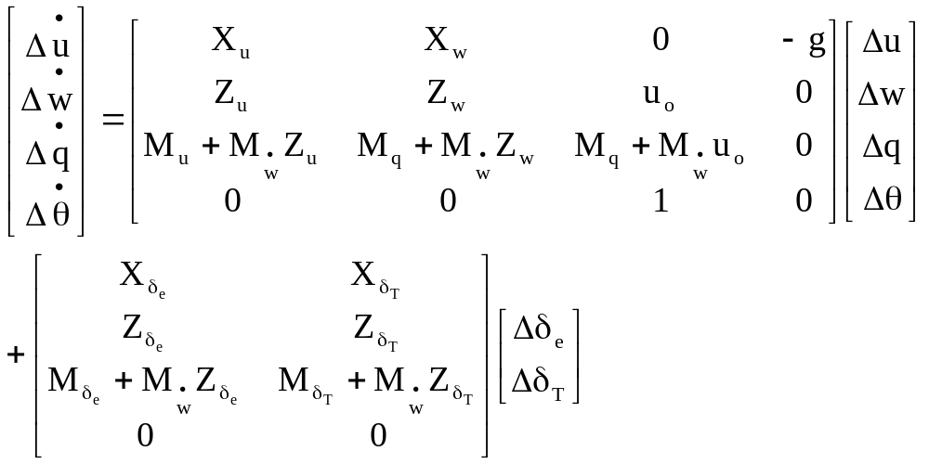
Longitudinal equation
State Space form

Slide 59
Longitudinal Approximations
For
Long period Mode
Short period Mode

Slide 60
Long-Period Approximation
the long-period or phugoid mode as a gradual interchange of potential and kinetic energy about the equilibrium altitude and airspeed.
The long-period mode is characterized by changes in pitch attitude, altitude, and velocity at a nearly constant angle of attack.

Slide 61
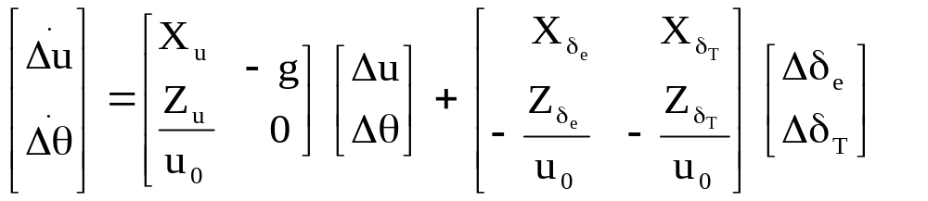
Long-Period Approximation
State Space form
The state-space equation for the long period or phugoid approximation is its follows:

Slide 62
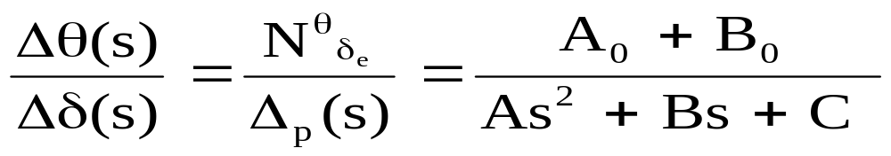
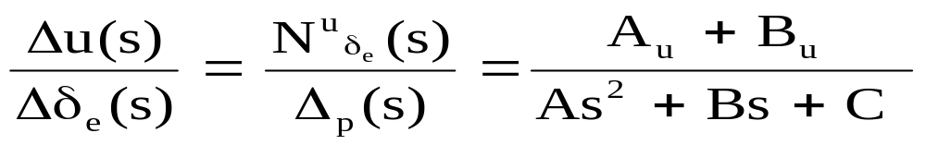
Long-Period Approximation Transfer Function
The transfer functions can be written in a symbolic form in the following manner

Slide 63
Short-Period Approximation
An approximation to the short-period mode of motion can be obtained by assuming and dropping the X-force equation.
If this mode has a high frequency and is heavily damped, then the airplane will respond rapidly to an elevator input without any undesirable overshoot.
When the short-period mode is lightly damped or has a relatively low frequency, the airplane will be difficult to control and in some cases may even he dangerous to fly.

Slide 64
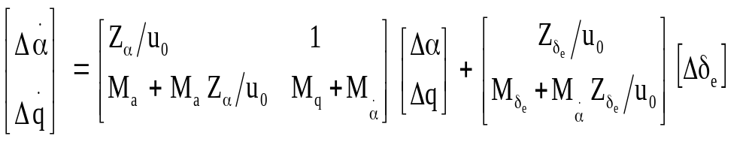
Short Period Approximation
State Space form
Lets see equation with control input from elevator in state space form

Slide 65
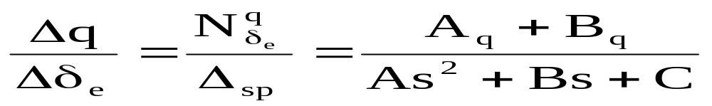
Short Period Approximation
Transfer Function
Transfer Function for Short Period is shown to be

Slide 66
Lateral Motion
The longitudinal motion of an airplane (control fixed) disturbed from its equilibrium flight condition is characterized by three oscillatory modes of motion.
Spiral Mode : A slowly convergent or divergent motion, called the spiral mode. An unstable spiral mode results in a turning flight trajectory
Rolling Mode : A highly convergent motion, called the rolling mode. The rolling motion usually is highly damped and will reach a steady state in a very short time
Dutch Roll Mode : A lightly damped oscillatory motion having a low frequency, called the Dutch roll mode. The combination of the yawing and rolling oscillations is called the Dutch roll motion

Slide 67
Lateral Motion Equation
As shown earlier The Y-force, rolling, and yawing moment equations form the lateral equations.

Slide 68
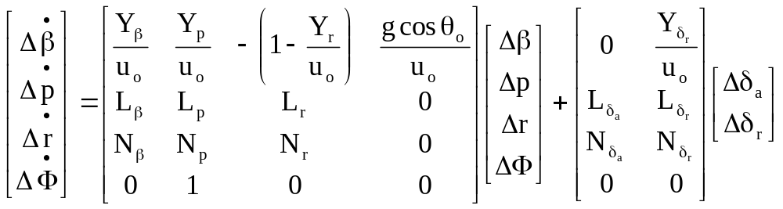
Lateral Motion Equation
State Space Form

Slide 69
Longitudinal Approximations
For
Spiral Mode
Roll Mode
Dutch Roll Mode

Slide 70
Spiral Mode Approximation
The spiral mode is characterized by changes in the bank angle and the heading angle .
The sideslip angle usually is quite small but cannot be neglected because the aerodynamic moments do not depend on the roll angle or the heading angle but on the sideslip angle , roll rate p, and yawing rate r.
The aerodynamic contributions due to and r usually are on the same order of magnitude. Therefore, to obtain an approximation of the spiral mode we shall neglect the side force equation and roll angle.

Slide 71
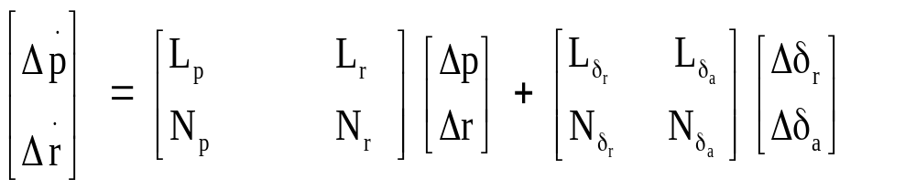
Spiral Mode Approximation
State space form

Slide 72
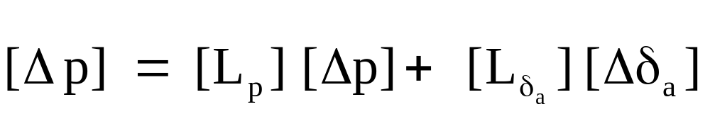
Roll Mode Approximation
State space form
This mode can be approximated by the single degree of freedom (pure) rolling motion

Slide 73


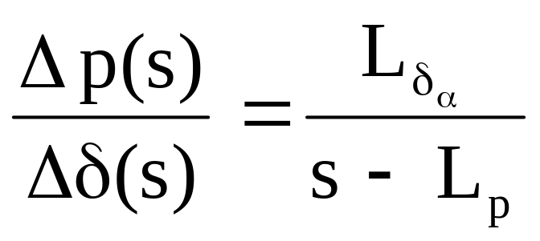
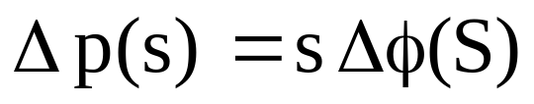
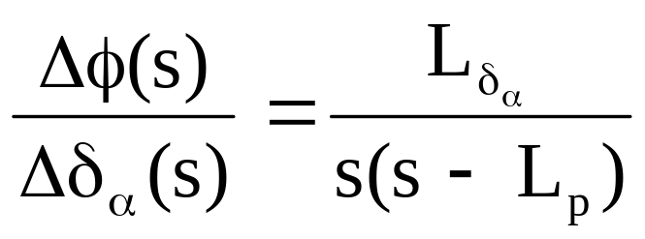
Roll Mode Approximation
Transfer function
Its Transfer function is and
Since

Slide 74
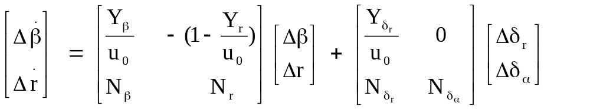
Dutch Roll Approximation
State Space Form
If we consider the Dutch roll mode to consist primarily of sideslipping and yawing motions, then we can neglect the rolling moment equation.

Slide 75
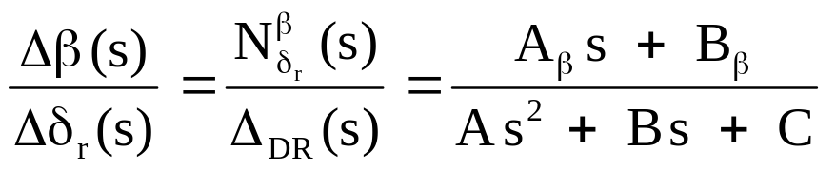
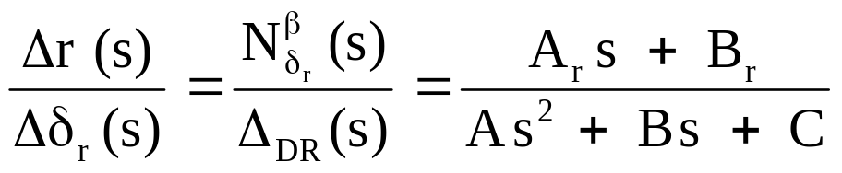
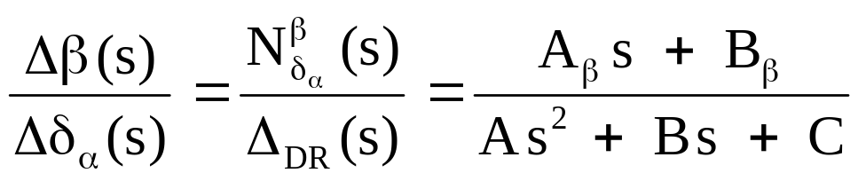
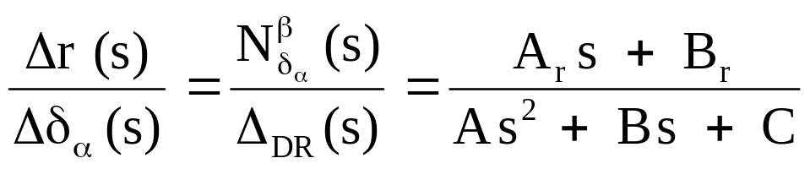
Dutch Roll Approximation
Transfer function

Slide 76
Flying qualities
Flying qualities Levels
Classification of airplane
Flight phase categories

Slide 77
Flying qualities
Flying qualities research provides the designer information to assess the flying qualities of a new design early in the design process.
If the flying qualities are found to be inadequate then the designer can improve the handing qualities by making design changes that influence the dynamic characteristics of the airplane.
A designer that follows the flying qualities guidelines can be confident that when the airplane is finally is built it will have flying qualities acceptable to its pilots.

Slide 78
The flying qualities are specified in terms of three levels
Level 1 Flying qualities clearly adequate for the mission flight phase.
Level 2 Flying qualities adequate to accomplish the mission flight phase but with some increase in pilot workload and or degradation in mission effectiveness or both.
Level 3 Flying qualities such that the airplane can be controlled safely but pilot workload is excessive and/or mission effectiveness is inadequate or both.

Slide 79
Classification of airplane
Aircraft are classified according to size and maneuverability.
Class I Small, light airplanes
Class II Medium-weight airplanes
Class III Large, heavy airplanes
Class IV High-maneuverability airplanes

Slide 80
Flight phase categories
The flight phase is divided into three categories
Category A Non-terminal flight phase that require rapid maneuvering, precision tracking, or precise flight-path control.
Category B Nonterminal flight phases that are normally accomplished using gradual maneuvers , precision tracking , although accurate flight path control may be required.
Category C Terminal flight phases are normally accomplished using gradual maneuvers and usually require accurate flight-path control.

Slide 81
Part 3
Autopilot Design
Application of Modern Control Theory in Autopilot Design
Optimal control Theory

Slide 82
Automatic Control Systems
Modern aircraft include variety of Automatic control that does following jobs.
Reduce pilot workload & Flight management (Attitude Altitude and speed controller is used)
Landing and Navigation aids (ILS is used)
Augmenting Stability characteristic of airplane (SAS is used)

Slide 83
Flight control system to reduce pilot workload
Attitude control systems to maintain pitch roll or heading also called displacement autopilot
Altitude-hold control systems to maintain a desired altitude
Speed control system to maintain a constant speed or Mach number

Slide 84
Displacement Autopilot
Very basic and earliest autopilot mechanism.
Used to control angular orientation like pitch, yaw & roll of Aircraft
Even used today as the basic building block.
The direction, climbing and turning of aircraft can be controlled simultaneously with this system.

Slide 85
Types of displacement autopilot
Pitch Displacement Autopilot
Roll Displacement Autopilot
Heading Displacement Autopilot

Slide 86
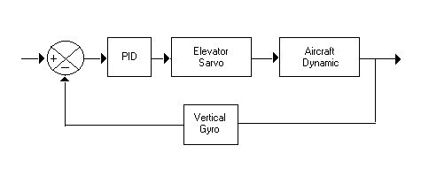
Pitch Displacement Autopilot
In Pitch displacement autopilot, the angle(pitch) is sensed by a vertical gyro.
The angle sensed is compared with the desired angle (pitch, roll, heading) to create an error angle.
The difference or error in pitch-attitude is used to produce proportional displacements of the elevator/r so that the error signal is reduced.

Slide 87
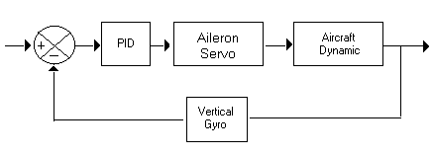
Roll Displacement Autopilot
In Roll displacement autopilot, the angle (roll) is sensed by a vertical gyro.
The angle sensed is compared with the desired angle ( roll) to create an error angle.
The difference or error in roll-attitude is used to produce proportional displacements of the aileron so that the error signal is reduced.

Slide 88
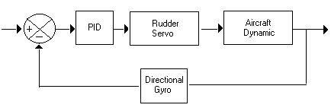
Heading Displacement Autopilot
In Roll displacement autopilot, the angle (heading) is sensed by a Directional gyro.
The angle sensed is compared with the desired angle (heading) to create an error angle.
The difference or error in heading-attitude is used to produce proportional displacements of the rudder so that the error signal is reduced.

Slide 89
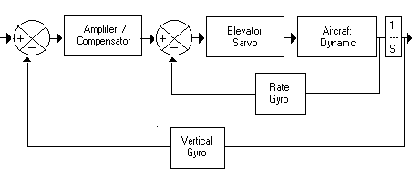
Pitch Displacement with rate feedback
If aircraft has low natural damping inner rate feedback is used.
Block diagram of a pitch displacement autopilot with rate feedback for improved damping is shown.
In the inner loop the rate is measured by rate gyro and feedback to be added with the error signal generated by the difference in pitch attitude.

Slide 90
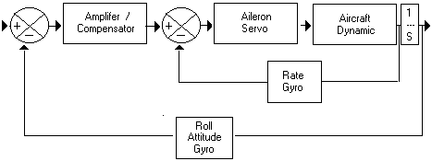
Roll Displacement with rate feedback
Block diagram of a roll displacement autopilot with rate feedback for improved damping is shown.
In the inner loop the rate is measured by rate gyro and feedback to be added with the error signal generated by the difference in roll attitude.

Slide 91
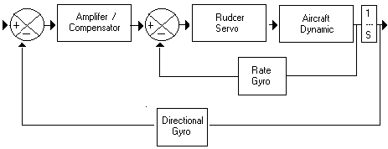
Heading Displacement with rate feedback
Block diagram of a Heading displacement autopilot with rate feedback for improved damping is shown.
In the inner loop the rate is measured by rate gyro and feedback to be added with the error signal generated by the difference in heading attitude.

Slide 92
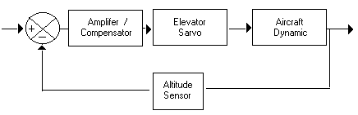
Altitude Hold Control system
The altitude of an aircraft can be maintained by an altitude hold autopilot.
A simplified altitude hold autopilot is shown.
Basically the autopilot is constructed to minimize the deviation between the actual altitude and the desired altitude.

Slide 93
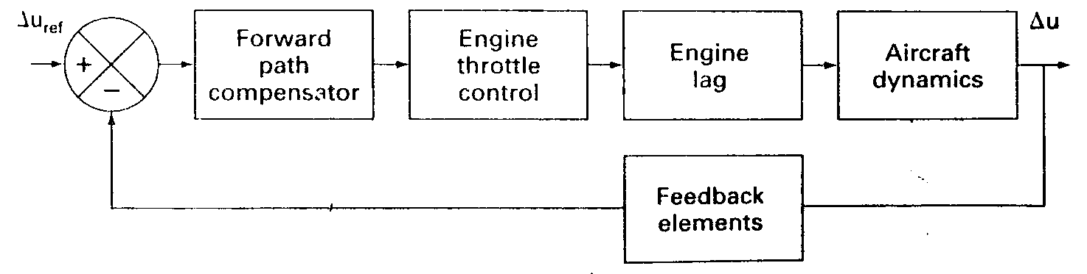
Velocity Hold Control System
The forward speed of an airplane can be controlled by changing the thrust produced by the propulsion system.
The function of the speed control system is to maintain some desired flight speed. This is accomplished by changing the engine throttle setting to increase or decrease the engine thrust.
The components that make up the system include a compensator, engine throttle, aircraft dynamics, and a feedback path consisting of the velocity and acceleration feedback.

Slide 94
Stability augmentation System
If an airplane is marginally stable or unstable automatic control systems can provide proper flight vehicle artificial stability.
Automatic control can be used to ensure an airplane has the appropriate handling qualities additional damping is incorporated by using a roll pitch or yaw damper

Slide 95
Why SAS ?
Since during flight , stability derivative changes so flying quality also changes. To keep effect of variable derivatives constant Stability Augmentation system is used.

Slide 96
How SAS works
Basically, a stability augmentation system is an electrome­chanical device that senses the undesirable motion and moves the appropriate controls to damp out the motion. This usually is accomplished with small control movements and, therefore, the pilot's control actions are not influenced by the system.

Slide 97
How SAS effects on control input
Another responsibility of the Stability Augmentation System (SAS) system is to refine the flight control inputs from the pilot provided to the hydro mechanical system. it precisely deflects the flight control surfaces to provide the pilot with exactly the inputs he requested based on the amount of force used to move the stick.

Slide 98
Instrument Landing System
The basic function of the ILS is to provide pilots with information that will permit them to guide the airplane down through the clouds to a point where the pilot re-establishes visual sighting of the runway. In other words ILS provides airplane guidance to down toward runway .
ILS is composed of ground based signal transmitters and on board receiving equipment.

Slide 99
Instrument Landing System
The ground based equipment includes
  Radio transmitter for localizer
  Glide path beacon
  Marker beacon
The equipment on the airplane includes
  Receivers for detecting the signals
  Indicators to display the status information

Slide 100
Step 1 How ILS Works
The localizer beam is used to position the aircraft on a trajectory so that it will intercept the centerline of the runway.
The purpose of this beam is to locate the airplane relative to a centerline of the runway .This is accomplished by creating azimuth guidance signals that are detected by the onboard localizer receiver.

Slide 101

localizer beam

Slide 102
Step 2 How ILS Works
Glide path beam's purpose is to guide the aircraft down a predetermined descent path.
The glide path or glide slope beam is located near the runway threshold
Radiates at a frequency in the range 329.3 - 335.0 MHz.
The glide slope is typically an angle of 2.5-3' to the horizontal.

Slide 103

Glide path beam

Slide 104

Glide path Controller
As the airplane descends along the glide path, its pitch attitude and speed must be controlled. This is accomplished by means of a Glide path controller.

Slide 105
Step 3 How ILS Works
Finally, as the airplane gets very close to the runway threshold, the glide path control system is disengaged and a flare maneuver is executed.
The flare maneuver is needed to decrease the vertical descent rate to a level consistent with the ability of the landing gear to dissipate the energy of the impact at landing.

Slide 106

Flare maneuver

Slide 107

Flare maneuver Controller

Slide 108
ILS Summary
A localizer to align the aircraft in the lateral direction with the runway centerline as the airplane descends down the glide slope
A glide slope control system to guide the airplane down an electronic beam to the runway
A flare control system that helps the aircraft make the transition from the glide slope to the runway

Slide 109
Modern Control System
& Autopilot
Unlike the classical control methods, modern control theory is ideally suited for synthesis of a control system with multiple input and determining optimal control strategies.
Modern control theory is based on the state space formulation of the differential equations that govern the system.
Higher order differential equations can be reduced to first order differential equations, using state space approach. These equations can be solved easily using a computer.

Slide 110
What's Wrong with Classical Control system
The classical control techniques are useful in designing many practical control systems. However, the design of control system by these techniques essentially is by trial and error. The major advantage of these design procedure is their simplicity and ease of use. This advantage disappears quickly as the complexity of the system increases.

Slide 111
What if states are not present
When some of the states are not available for feedback we can design a state observer to estimate or predict the states. The estimated states then can be used in place of the actual states in the feedback system

Slide 112
State feedback and SAS
State feedback is used to provide SAS to improve an aircraft’s longitudinal and lateral flying qualities.
In principle this technique permits the designer to completely specify the dynamic performance of the system. Means that mathematical standpoint the poles can be placed anywhere.
However, practical considerations such as signal noise and control actuator saturation place limitations on poles placement.

Slide 113
Optimal Control Theory
In the previous sections we examined the use of state feedback control for the placement of the closed-loop eigen values.
By placing the eigen values in the left half portion of the complex plane we can be sure that the system is stable.
However, as we move the eigen values farther to the left in the complex plane the gains may become large, resulting in excessive control- deflection. This where optimal control theory comes in.

Slide 114
Optimal control
Optimal control allows the designer to specify constrains on maximum allowable excursion of the states and control input . This accomplished by specifying weighting matrices for the states and control in an integral performance index. The optimal control gains are determined by solving the steady state Riccati equation.

Slide 115
If You are not sleeping by now
Thank you for Listening

