Slide 1

REST Overview
Steven Suing
Practice Manager / Lead Developer
@stsuing

Slide 2
Agenda
Talk about REST

Slide 3

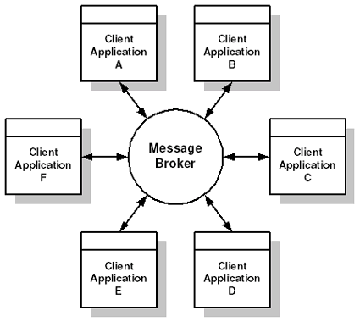
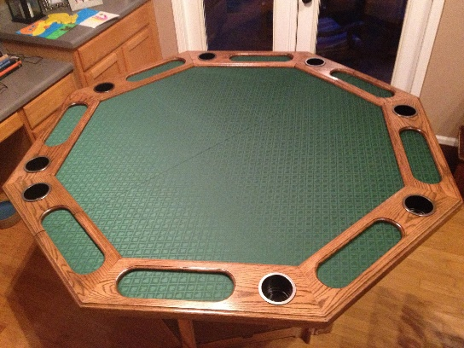
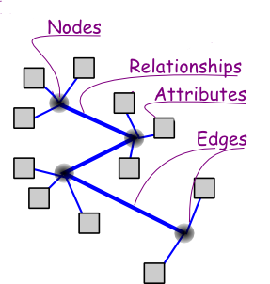



About Me

Slide 4
What is REST

Slide 5
What is REST
Term coined by Roy Fielding. Link
Representation State Transfer
A broadly accepted style of software architecture for distributed hypermedia systems
Why do we care about REST?
1 T. Commerce over systems designed with REST Principles.

Slide 6
What is a software architecture style?
An architecture Style:
Describes a class of architecture or signigicant architecture pieces
Is found repeatedly in practice
Is a coherent package of design decisions
Has known properties the permit reuse.
[Clements, Kazman, & Klein], “Evaluating Software Architecture”, 2002]
In other words, architecture styles are like “design patterns” for the structure and interconnection within and between software systems

Slide 7
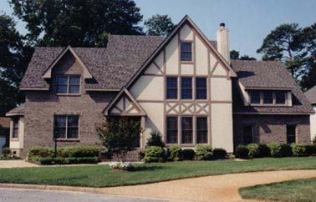
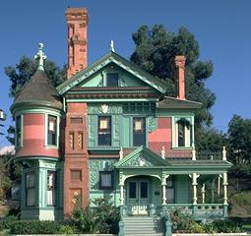
Architectural Style
Tudor Style
Victorian Style
Overlapping gables
Roofs are steeply pitched with front facing gables,
decorative timbers patterns in stucco or brick-veneered walls.
Bewildering excess
Textured surfaces on buildings
Rainbow of colors

Slide 8
Distributed System Architectural Style
Request / Response
Message Passing
Call Oriented
Usually synchronous in nature
Operations have an input parameter and output
Focus on operation being invoked
Three main types
Object-oriented
Resource-oriented
Service-oriented
Data oriented systems
Usually asynchronous in nature
Messages are constructed and sent to a destination
Focus on message payload , dispatching messages, and where to send them
No focus on getting a reply
http://www.slideshare.net/jthelin/3-architecture-styles-presentation
http://www.xfront.com/REST.html
http://martinfowler.com/articles/richardsonMaturityModel.html

Slide 9
REST Style Definition
Uniform Interface - Central feature
Client-Server - Separation of Concerns
Stateless - request from client to server must contain all of the information necessary to understand the request
Cache – data in response should be marked cacheable or non-cacheable
Layered System - Composed of hierarchical layers. knowledge of the system restricted to a single layer

Slide 10
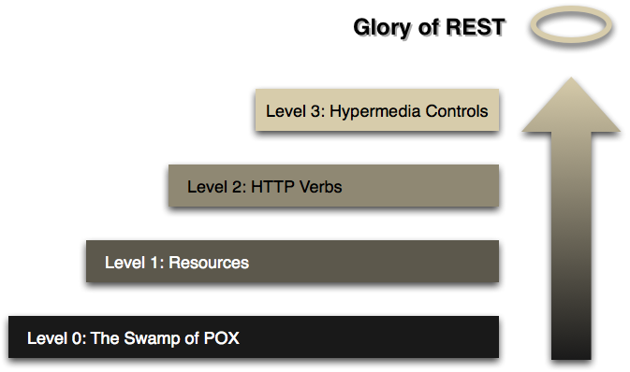
Richardson Maturity Model
http://martinfowler.com/articles/richardsonMaturityModel.html

Slide 11
HATEOAS
Hypermedia as the Engine of Application State
Constraint of the REST application architecture
Client interacts with a network application entirely through hypermedia provided dynamically by application servers

Slide 12




REST and Hypermedia Example

Slide 13
!REST
Pretty URI’s
Transactions
HTTP Protocol
Simply mapping CRUD to HTTP Verbs
Security

Slide 14
Hypermedia Demo 2

Slide 15
Thanks

