Slide 1

REST Overview
Steven Suing
Practice Manager / Lead Developer
@stsuing

Slide 2
Agenda
Talk about REST

Slide 3
What is REST

Slide 4
What is REST
Representation State Transfer
A broadly accepted style of software architecture for distributed hypermedia systems
Web is based on this.
Why do we care about REST?

Slide 5
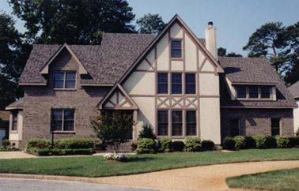
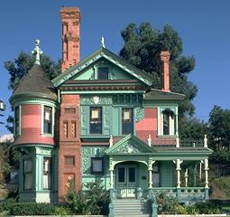
Architectural Style
Tudor Style
Victorian Style
Overlapping gables
Roofs are steeply pitched with front facing gables,
decorative timbers patterns in stucco or brick-veneered walls.
Bewildering excess
Textured surfaces on buildings
Rainbow of colors

Slide 6
HATEOAS
Hypermedia as the Engine of Application State
Constraint of the REST application architecture
Client interacts with a network application entirely through hypermedia provided dynamically by application servers

