Slide 1
REST and the Wcf Web API
Steven Suing
Applied Information Sciences
@stsuing

Slide 2
Agenda
Describe REST
How Wcf Web API helps implement REST style

Slide 3
What is REST
Representational State Transfer
A broadly accepted style of software architecture for distributed hypermedia systems
Web is based on this.
Why do we care about REST?

Slide 4
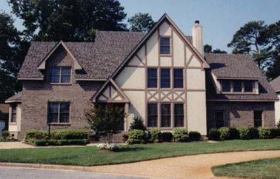
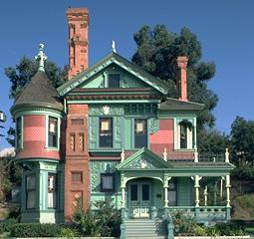
Architectural Style
Tudor Style
Victorian Style
Overlapping gables
Roofs are steeply pitched with front facing gables,
decorative timbers patterns in stucco or brick-veneered walls.
Bewildering excess
Textured surfaces on buildings
Rainbow of colors

Slide 5
REST Style definition
Uniform Interface - Central feature
Client-Server - Separation of Concerns
Stateless - request from client to server must contain all of the information necessary to understand the request
Cache – data in response should be marked cacheable or non-cacheable
Layered System - Composed of hierarchical layers. knowledge of the system restricted to a single layer
Notes:
URI is central feature,

Slide 6
HATEOAS
Hypermedia as the Engine of Application State
Constraint of the REST application architecture
Client interacts with a network application entirely through hypermedia provided dynamically by application servers

Slide 7
!REST
Pretty URI’s
Transactions
Http Protocol
Simply mapping CRUD to Http Verbs.

Slide 8
What is the Wcf Web API
A .net framework targeting the HTTP protocol to enable REST style architecture
Enable access to HTTP elements

Slide 9
Demo
Simple CRUD app using GET, PUT, POST and DELETE.
Dependency Injection
Content Negotiation

Slide 10
Other features
JSONP support
OData
Custom Mediatype formatters
Very Testable
Not limited to JSON, XML and forms url encoding

Slide 11
Resources
http://wcf.codeplex.com/
Roy Fielding Dissertation - http://www.ics.uci.edu/~fielding/pubs/dissertation/top.htm
@stsuing

