Slide 1

Introduction to messaging in applications
Steven Suing
Practice Manager / Lead Developer
@stsuing

Slide 2

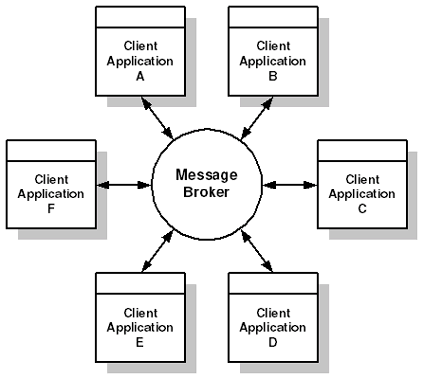
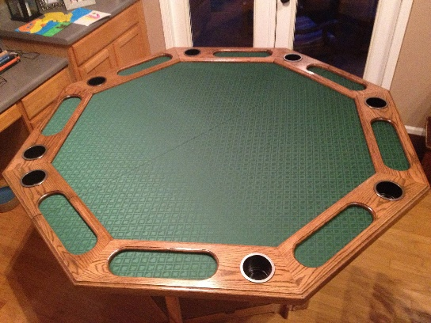
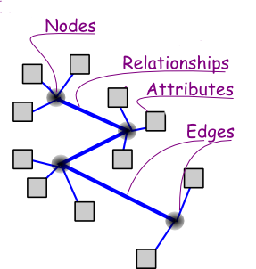



About Me

Slide 3
Agenda
Why did I get into messaging
What, Why, and When about Messaging
Broker vs. Bus arch styles
Framework Options
RabbitMQ and AMQP
C# Demo of EIPs
Wrap-up and questions

Slide 4
Why did I get into messaging
Notes:
Multiple Systems
Distributed
Legacy systems in play
Many variants of the same system.

Slide 5
What - Overview
Message-oriented middleware is an infrastructure that uses message exchange rather than function calls or shared memory
Typical Usages
Separate Layers in an architecture that run at different rates
Queue processes that take a long time.
EX: Video processing
Enable different styles of architecture
EX: CQRS, ES and Event Driven Architecture
Integration between heterogeneous systems

Slide 6
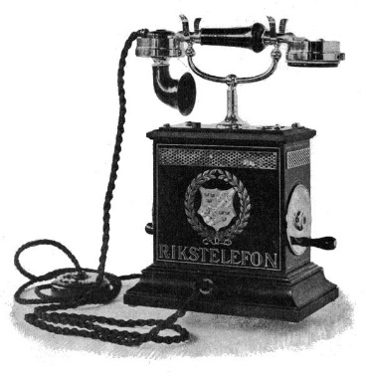

What – Asynchronous in nature
VS
RPC
Synchronous
Messaging
Asynchronous
High temporal coupling
Low temporal coupling
Tip: Use the real world to think about messaging

Slide 7
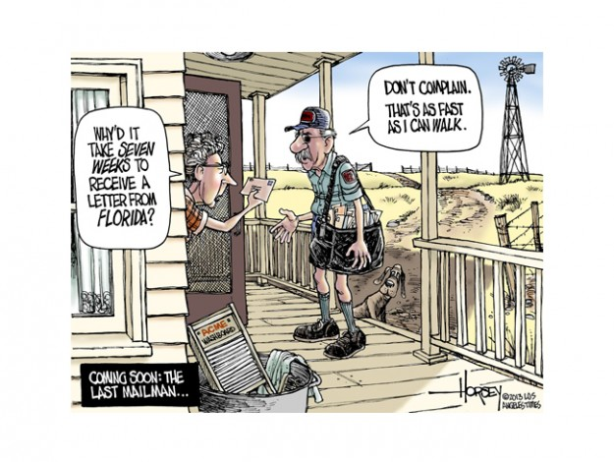
What – Reliable

Slide 8
Why
Remote Communication – Enable communication between two processes so the processes don’t have to.
Processes can function on their own time
Throttling – receiver can control consumption rate.
Reliable
Disconnected operation – Temporal Decoupling
Mediation –
Applications need only connect to messaging
Similar to Mediator Pattern GoF

Slide 9
When
Many systems to Integrate
Long running processes
Video processing
Database operation
File operations
Heterogeneous Platforms
Requirement for low temporal, low spatial and low platform coupling
Front-end and Back-end running at different rates

Slide 10
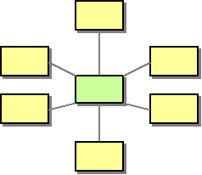
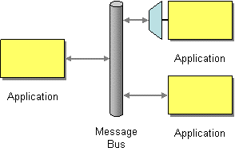
Broker vs Bus
Broker
Bus

Slide 11
Many Frameworks
Messaging Providers
ZeroMQ
RabbitMQ
MS Service Bus
StormMQ
MSMQ
CloudAMQP
Azure Service Bus
ActiveMQ
Apache Qpid
Messaging Abstractions
NServiceBus
EasyNetQ
SpringAMQP
MassTransit
Many more including ESB providers

Slide 12

Careful with That Axe, Eugene
Serialization
Ack
Idempotent Messages
Vendor Lock-In
Sequencing
Complex Programming Model
Synchronous Scenarios
Sagas
Retry
Dead letter
Performance Monitoring
Errors Handling
Time To Live
Logging

Slide 13
AMQP - RabbitMQ
AMQP
Advanced Message Queuing Protocol
Standard so implementations are interoperable
Message orientation, queuing, routing, point-to-point, fan out, other EIP
Synonymous with HTTP
RabbitMQ
Open Source Written in Erlang
Message Broker
Implemented AMQP 0.9.1
Plug in for AMQP 1.0 support
Synonymous with IIS

Slide 14

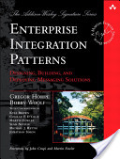

Demo 1 : One Way – aka Fire and Forget
Producer
Consumer
Notes:
Install RabbitMQ
Show the console
Create the 2 shell project
Install RabbitMQ .Nuget packages

Slide 15

Demo 3 : Publish and Subscribe
Use real world to understand messaging
Consumer
Producer
Consumer
Consumer
*Hohpe, Gregor, Enterprise Integration: Addison-Weesley, 2004, Print.
High-Speed
Asynchronous
Program-to-Program communication
Reliable

Slide 16
Scaling

Slide 17

Demo 2 : Send and Receive (aka RPC)
Producer
Consumer
Consumer
Producer
*Hohpe, Gregor, Enterprise Integration: Addison-Weesley, 2004, Print.
High-Speed
Asynchronous
Program-to-Program communication
Reliable

Slide 18
Wrap Up and Questions
Understand that it’s a huge paradigm shift.
Pick something non-critical to try.
Figure out operations first.
Start Simple
Prepare to learn a lot and to make mistakes
THANKS!!!
*Hohpe, Gregor, Enterprise Integration: Addison-Weesley, 2004, Print.
High-Speed
Asynchronous
Program-to-Program communication
Reliable

