Slide 1

Introduction to messaging in applications
Steven Suing
Practice Manager / Lead Developer
@stsuing

Slide 2
Agenda
What, Why, and When about Messaging
Broker vs Bus arch styles
Framework Options
RabbitMQ and AMQP
C# Demo of EIPs
Wrapup and questions

Slide 3

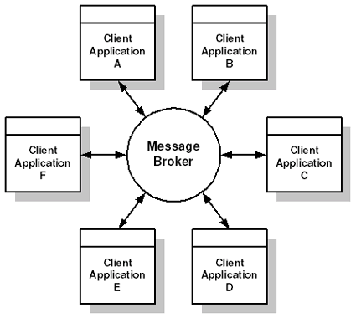
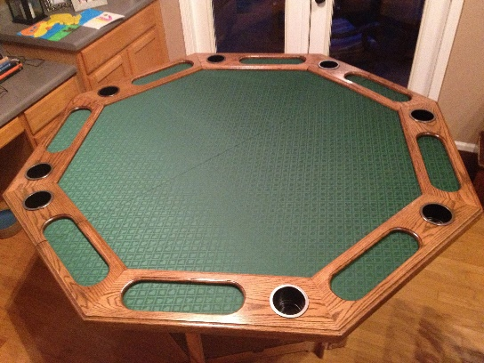
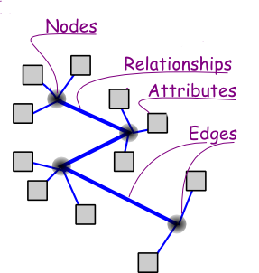



About Me

Slide 4
What - Overview
Messaging is an asynchronous reliable point-to-point approach to integration approach
Other Approaches
File Transfer
Shared database
Remote Procedure Invocation

Slide 5


What - Asynchronous
VS
RPC
Synchronous
Messaging
Asynchronous
High temporal coupling
Low temporal coupling
Tip: Use the real world to think about messaging

Slide 6

What – Reliable

Slide 7
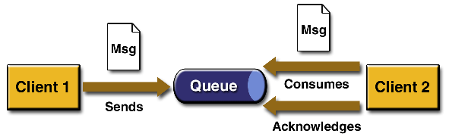
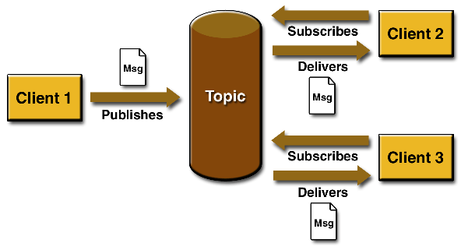
What – Point-to-Point
One way Send
Publish / Subscribe

Slide 8
Why user Messaging.
Remote Communication – Enable communication between two processes so the processes don’t have to.
Processes can function on their own time
Throttling – Receiver can control consumption rate.
Reliable
Disconnected operation
Mediation

Slide 9
When
Many systems to Integrate
Long running processes
Video processing
Database operation
File operations
Heterogeneous Platforms
Requirement for low temporal, low spatial and low platform coupling

Slide 10
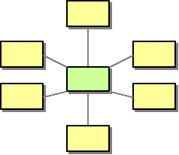
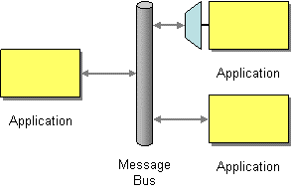
Broker vs Bus
Broker
Bus

Slide 11
Many Frameworks
Messaging Providers
ZeroMQ
RabbitMQ
MS Service Bus
StormMQ
MSMQ
CloudAMQP
Azure Service Bus
ActiveMQ
Apache Qpid
Messaging Abstractions
NServiceBus
EasyNetQ
SpringAMQP
MassTransit
Many Many Mor

Slide 12

Careful with That Axe, Eugene
Serialization
Ack
Idempotent Messages
Vendor Lock-In
Sequencing
Complex Programming Model
Synchronous Scenarios
Sagas
Retry
Dead letter
Performance Monitoring
Errors Handling
Time To Live
Logging

Slide 13
AMQP - RabbitMQ
AMQP
Advanced Message Queuing Protocol
Open standard application layer protocol
Message orientation, queuing, routing
Synonymous with HTTP
RabbitMQ
Open Source Written in Erlang
Message Broker
Implemented AMQP 0.9.1
Synonymous with IIS

Slide 14

Demo – One Way – aka Fire and Forget
Producer
Consumer
Notes:
Install RabbitMQ
Show the console
Create the 2 shell project
Install RabbitMQ .Nuget packages

Slide 15

Demo – 3 Publish Subscribe
Use real world to understand messaging
Publish / Subscribe
*Hohpe, Gregor, Enterprise Integration: Addison-Weesley, 2004, Print.
High-Speed
Asynchronous
Program-to-Program communication
Reliable

