Slide 1

Introduction to messaging in applications
Steven Suing
Practice Manager / Lead Developer
@stsuing

Slide 2
Agenda
What, Why, and When about Messaging
Broker vs Bus arch styles
Framework Options
RabbitMQ and AMQP
C# Demo of EIPs
Wrapup and questions

Slide 3

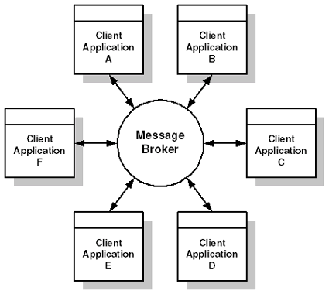
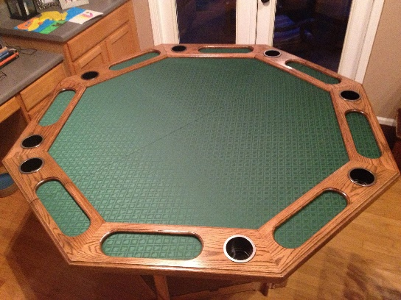
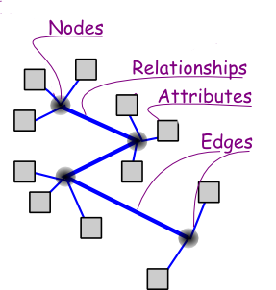



About Me

Slide 4
What - Overview
Messaging is an integration approach
Other Approaches
File Transfer
Shared database
Remote Procedure Invocation

Slide 5


What - Asyncronous
VS
RPC
Synchronous
Messaging
Asynchronous
Tip: Use the real world to think about messaging

Slide 6

What – Reliable

Slide 7
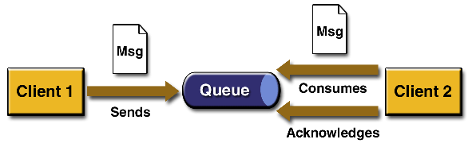
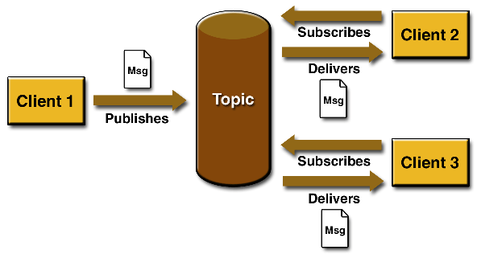
What – Point-to-Point

Slide 8
What
What is Messaging*
Asynchronous
Program-to-Program communication
Reliable
Note: the EIP book also says high-speed, but that is debatable.
*Hohpe, Gregor, Enterprise Integration: Addison-Weesley, 2004, Print.

Slide 9
Why
Remote Communication – Enable communication between two processes so the processes don’t have to.
Processes can function on their own time
Throttling – Receiver can control consumption rate.
Reliable
Disconnected operation
Mediation

Slide 10
When
Many systems to Integrate
Long running processes
Video processing
Database operation
File operations
Many Platforms
Requirement for low temporal, spatial and platform coupling

Slide 11
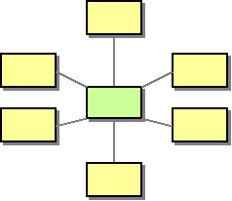
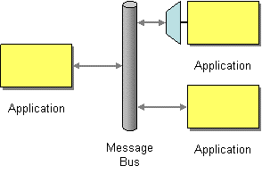
Broker vs Bus
Broker
Bus

Slide 12
Frameworks
ZeroMQ
RabbitMQ
MS Service Bus
StormMQ
MSMQ
CloudAMQP
Azure Service Bus
ActiveMQ
Apache Qpid
NServiceBus
EasyNetQ
SpringAMQP

Slide 13

Why
Use real world to understand messaging
Publish / Subscribe
Telephone {RPC} vs Voicemail {Messaging}
Snail Mail
Magazines
What is Messaging*
*Hohpe, Gregor, Enterprise Integration: Addison-Weesley, 2004, Print.
High-Speed
Asynchronous
Program-to-Program communication
Reliable

