Slide 1
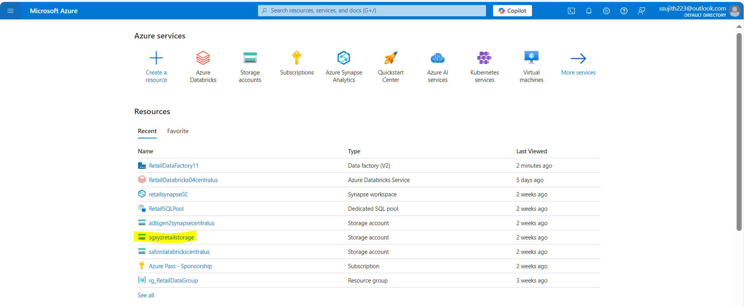
Case Study 1: Retail Sales Data Processing (using Azure blob storage and Azure Data Factory)
Azure Blob Storage

Slide 2
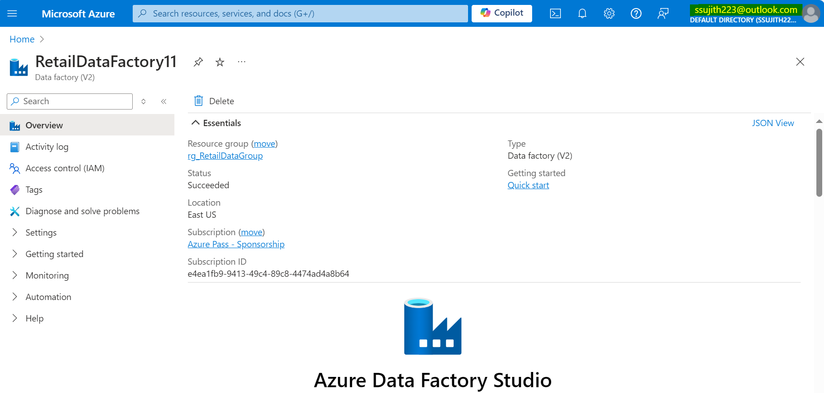
Azure Factory

Slide 3
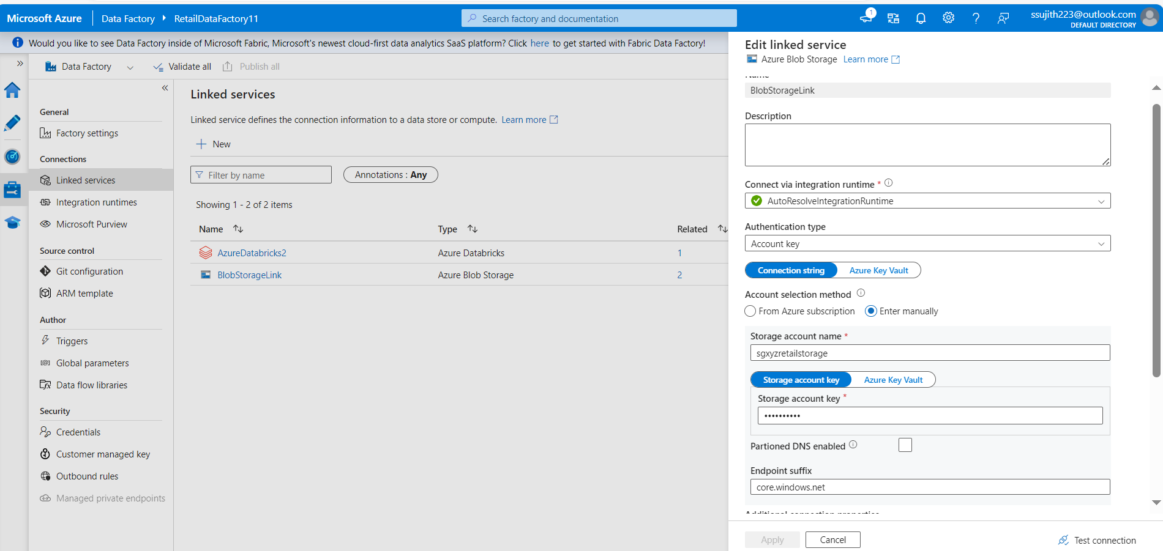
Linked Service

Slide 4
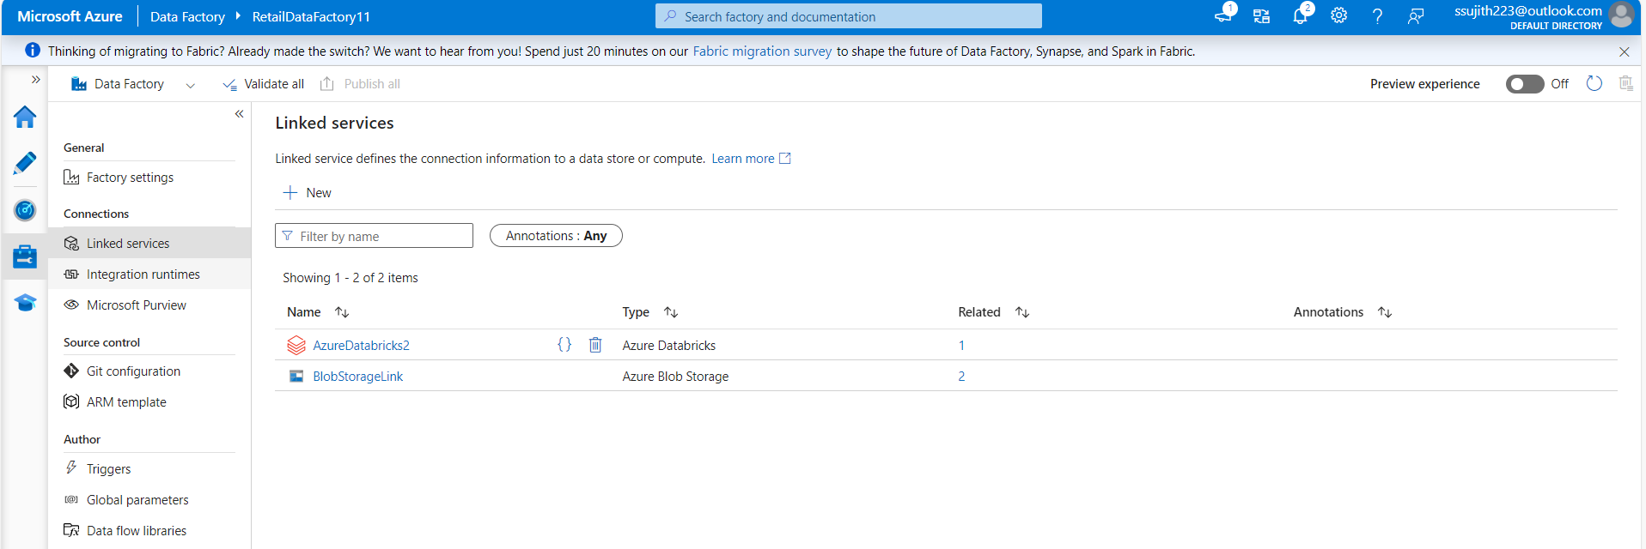
Azure Blob Storage Linked Service

Slide 5
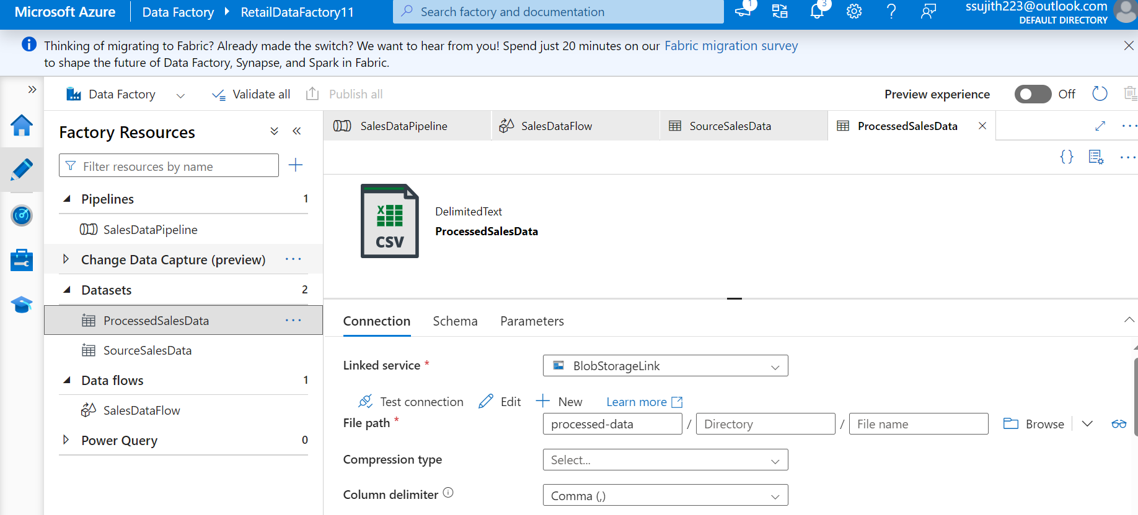
Source & Target Datasets

Slide 6
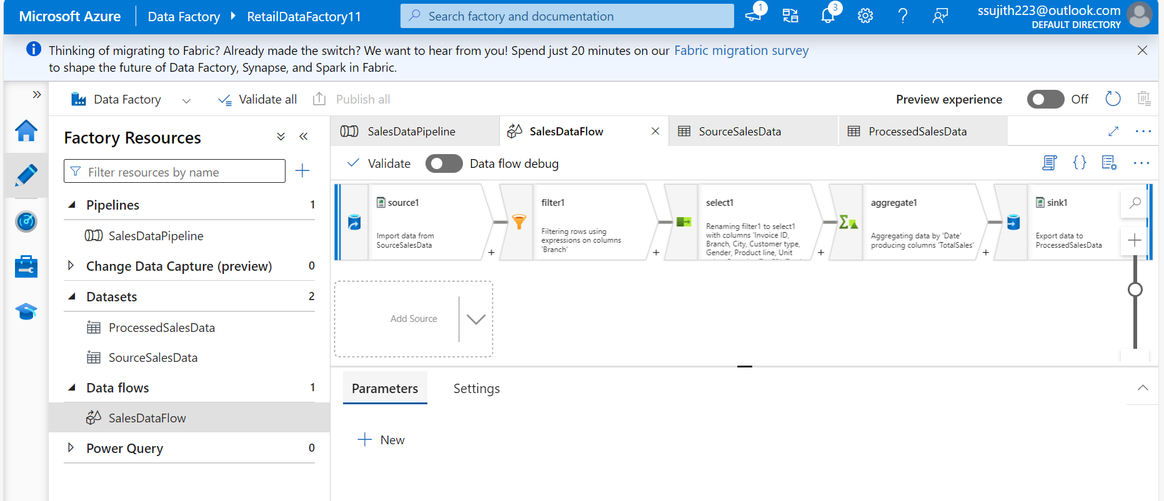
Data Flow

Slide 7
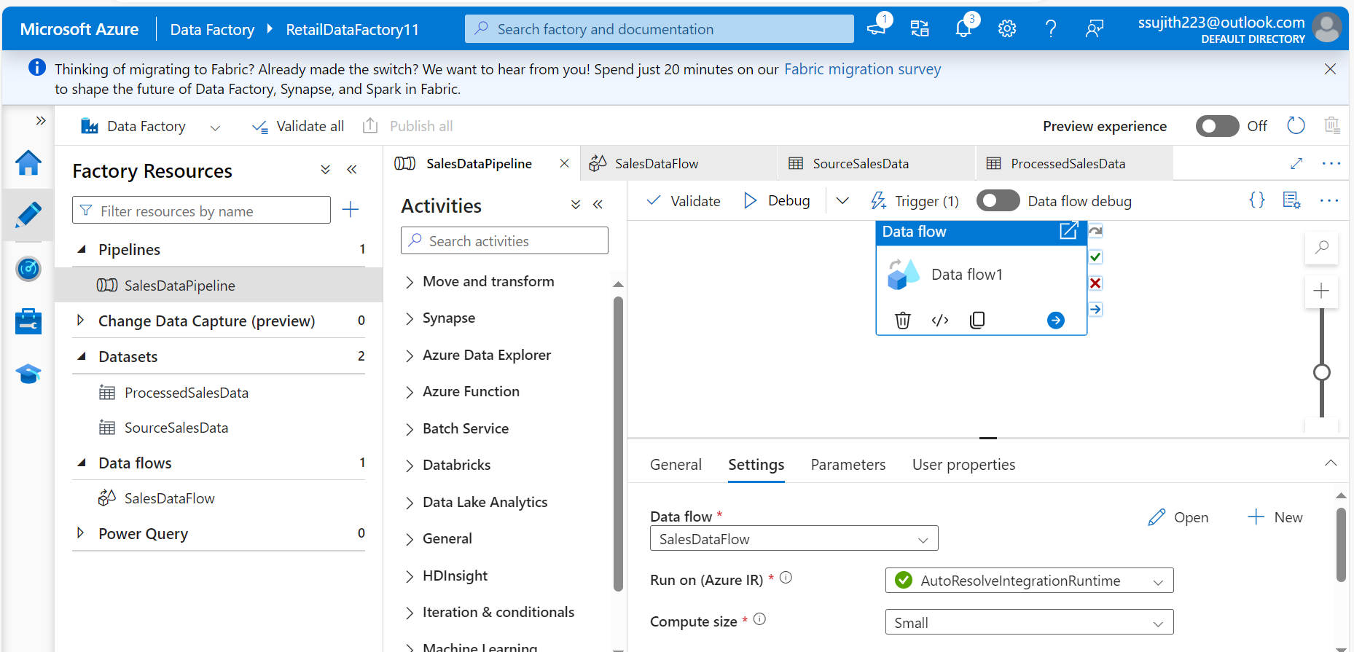
Pipeline

Slide 8
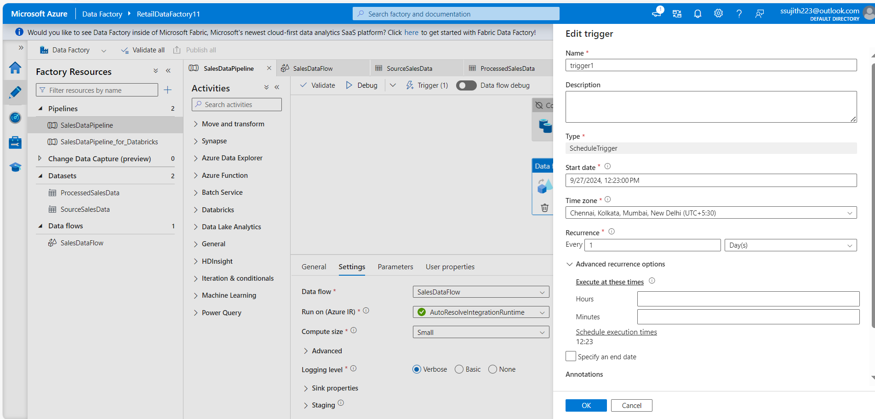
Trigger Creation

Slide 9
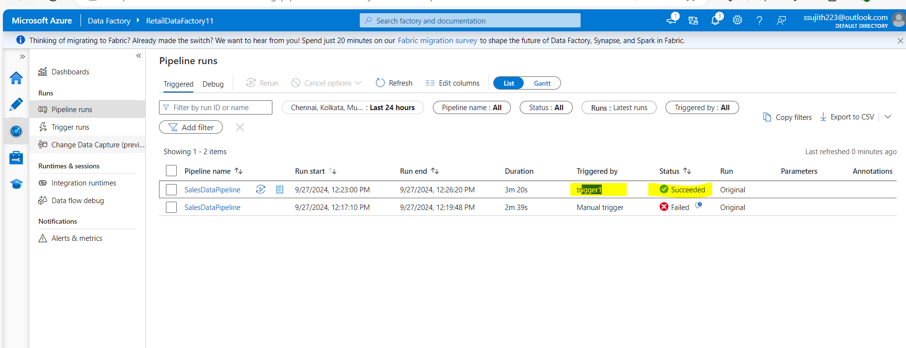

Slide 10
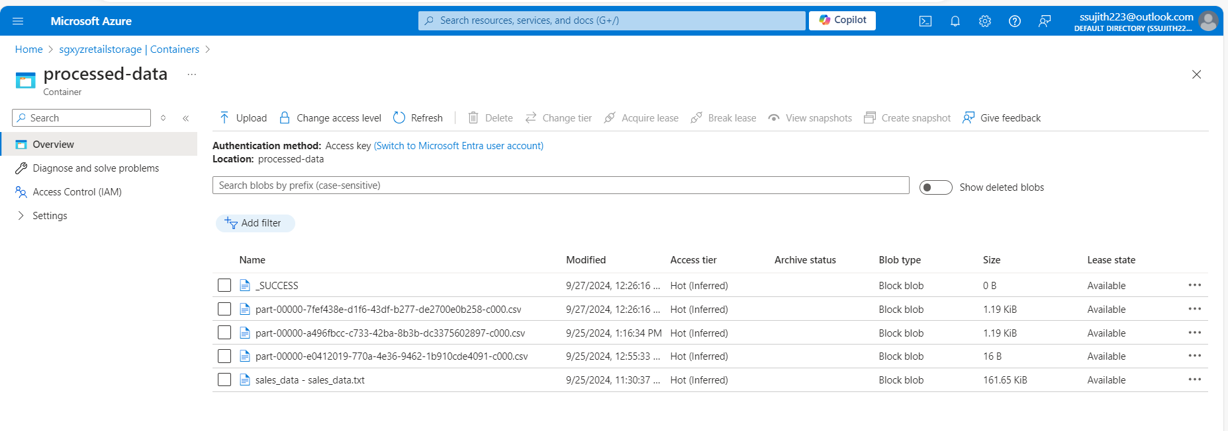

Slide 11
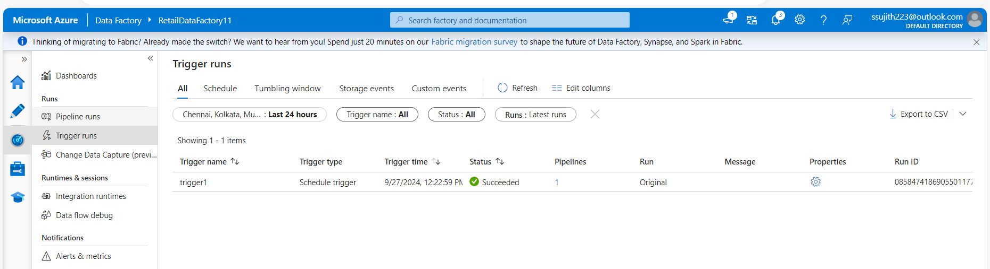
Trigger Status

Slide 12
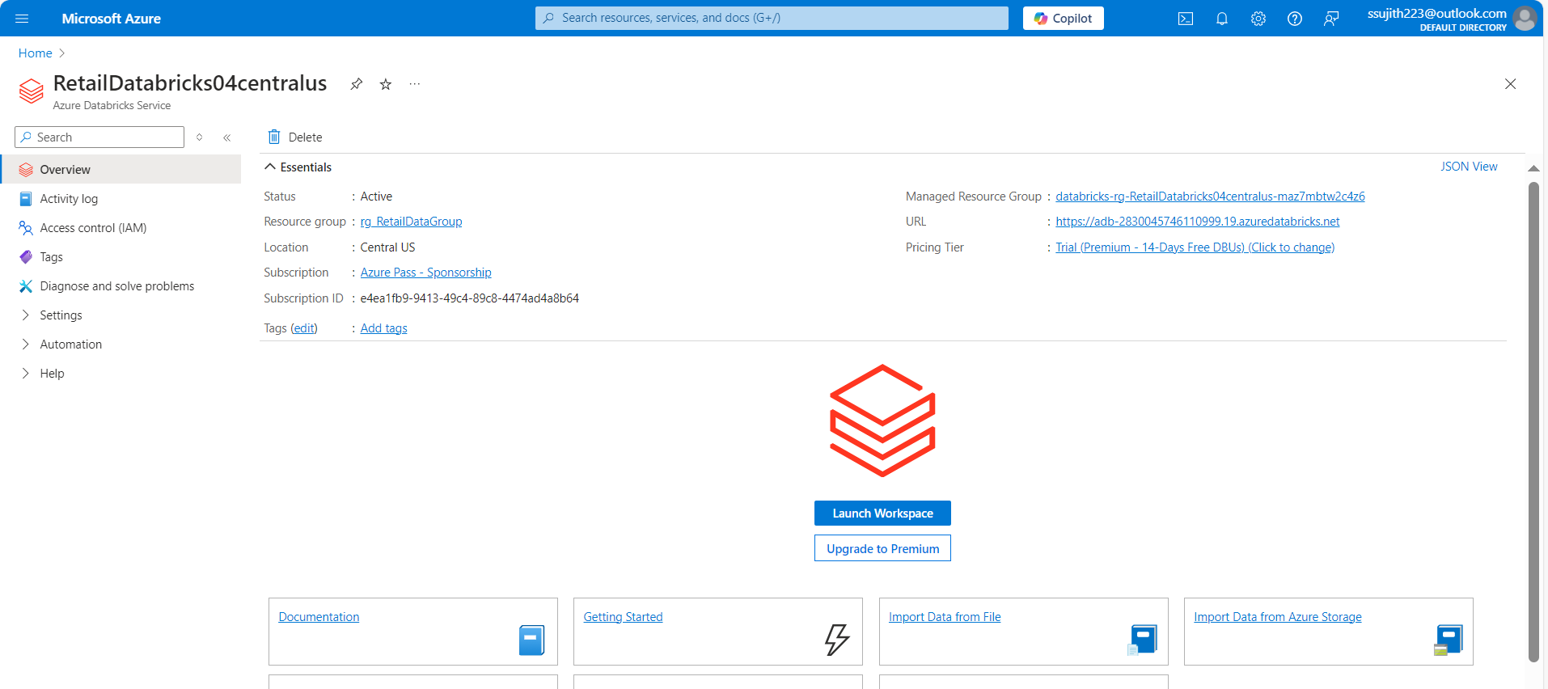
Case Study 2: Retail Sales Data Processing (using Azure DataBricks)
Create an Azure Databricks Workspace

Slide 13
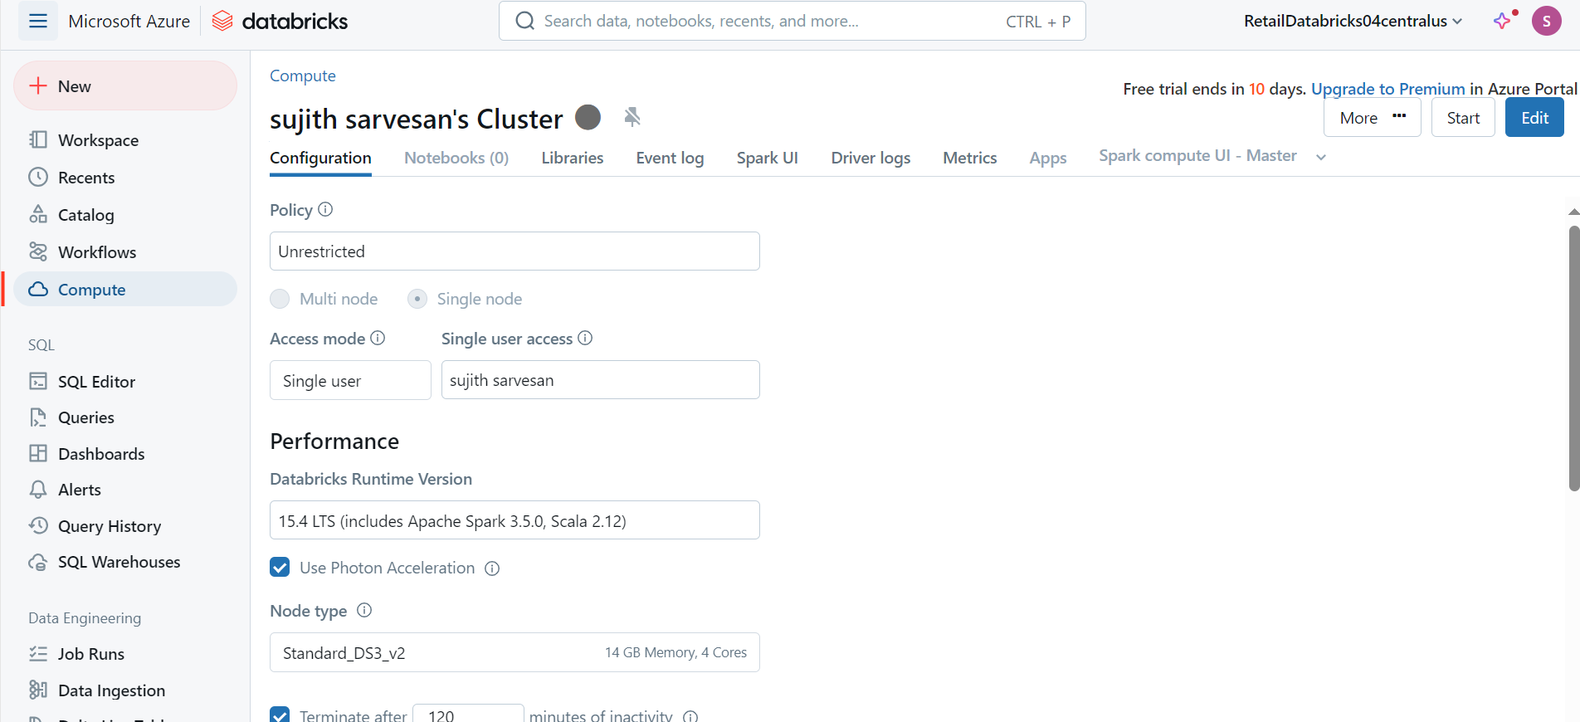
Cluster Creation

Slide 14
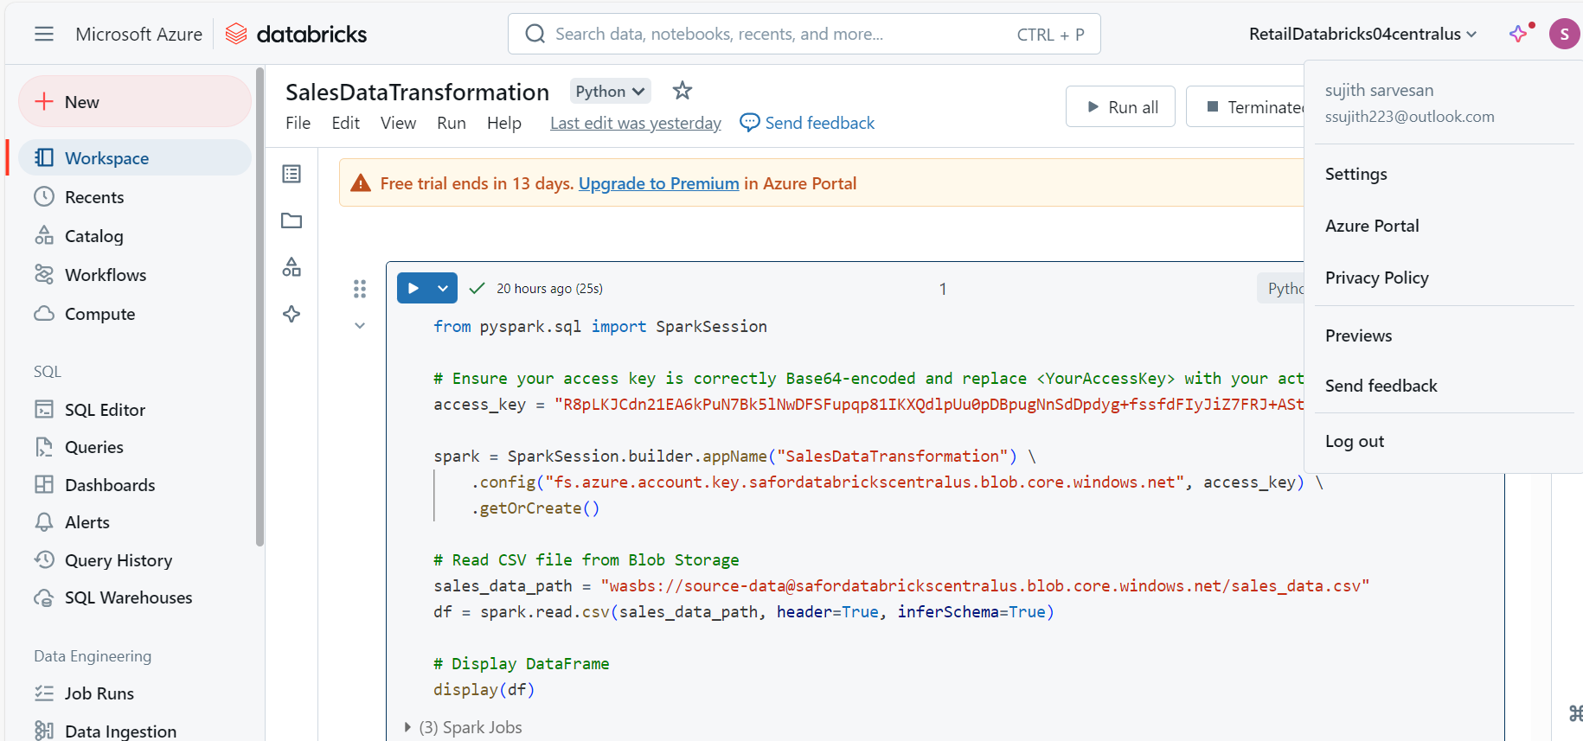
Creating a Databricks Notebook & transformations

Slide 15
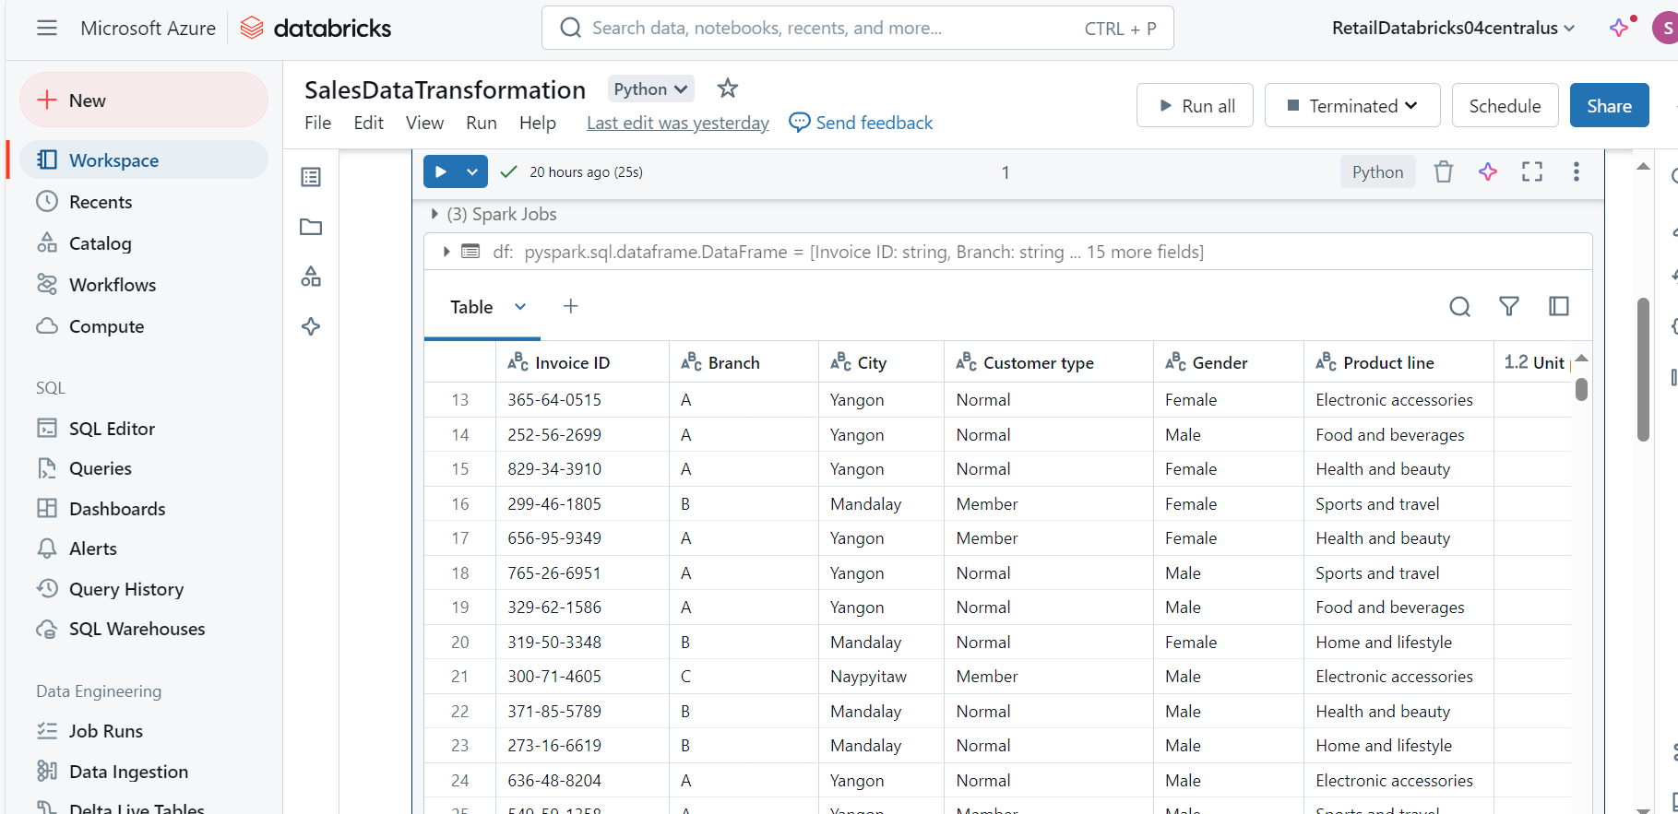

Slide 16
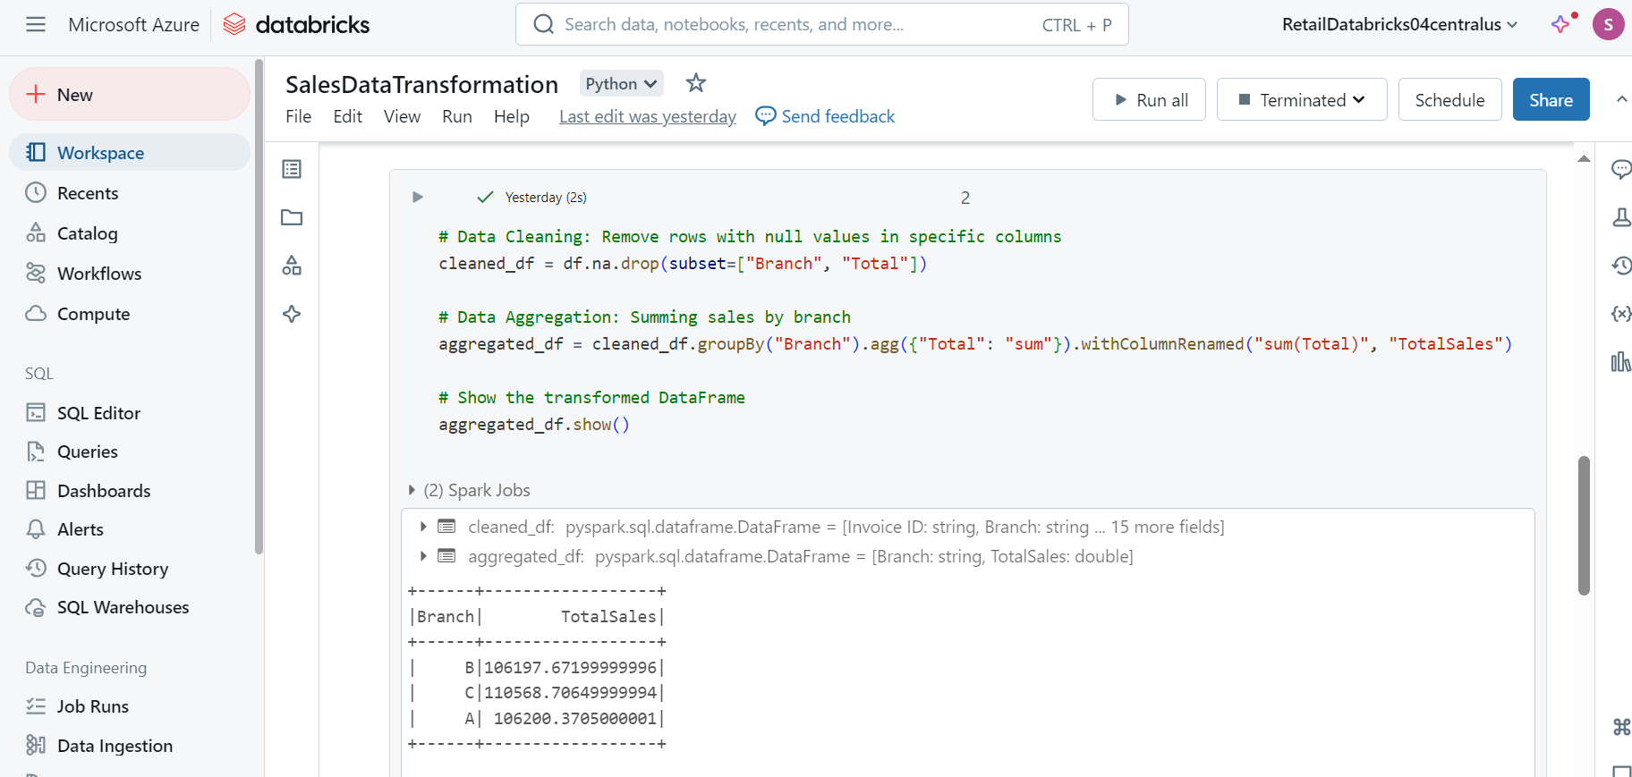

Slide 17
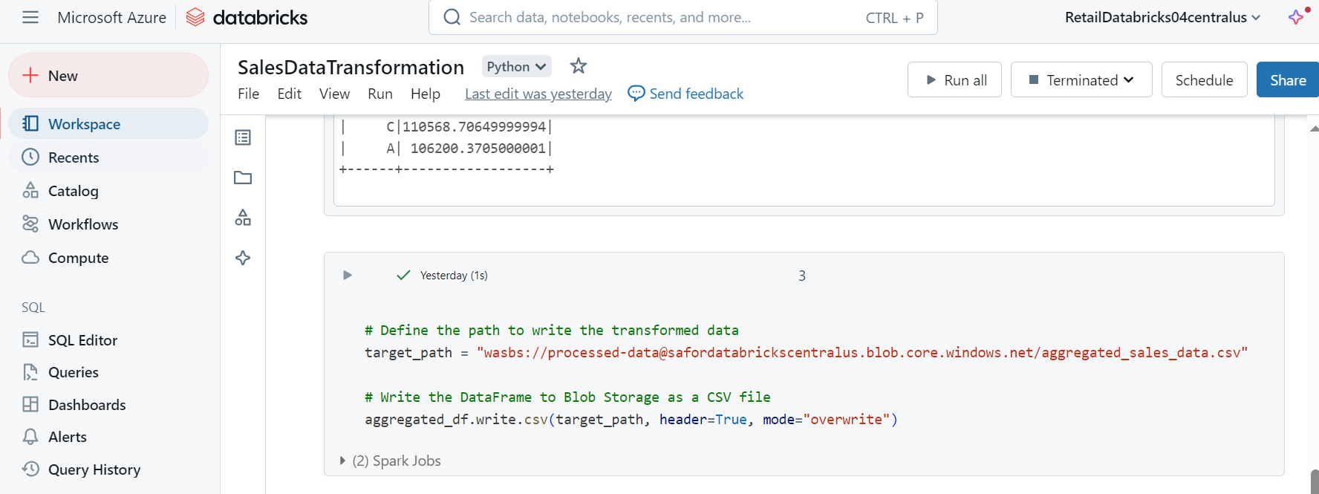

Slide 18
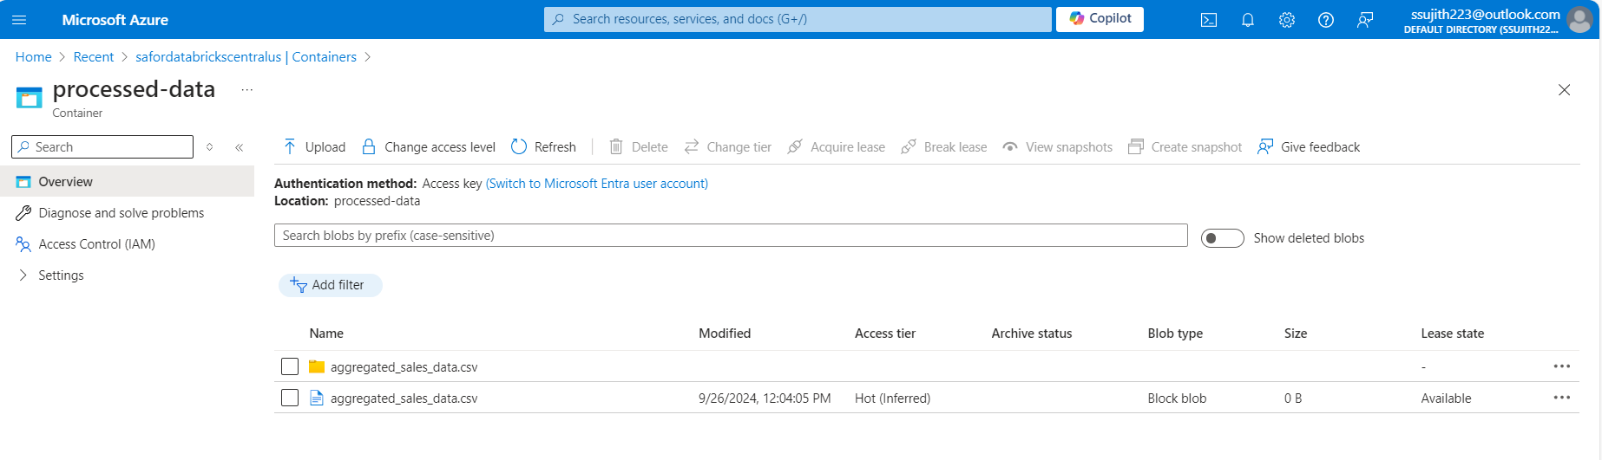

Slide 19
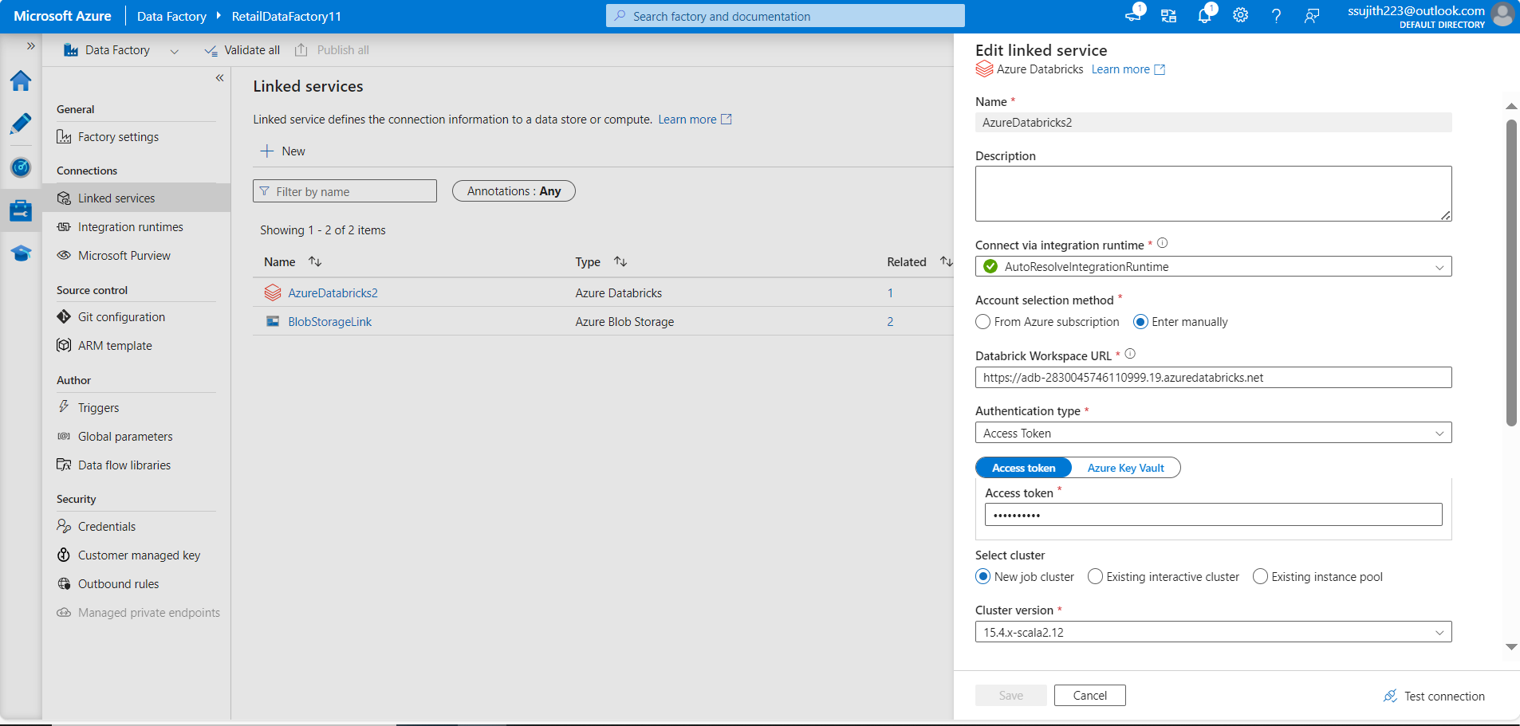
Linked Service connection for Databricks

Slide 20
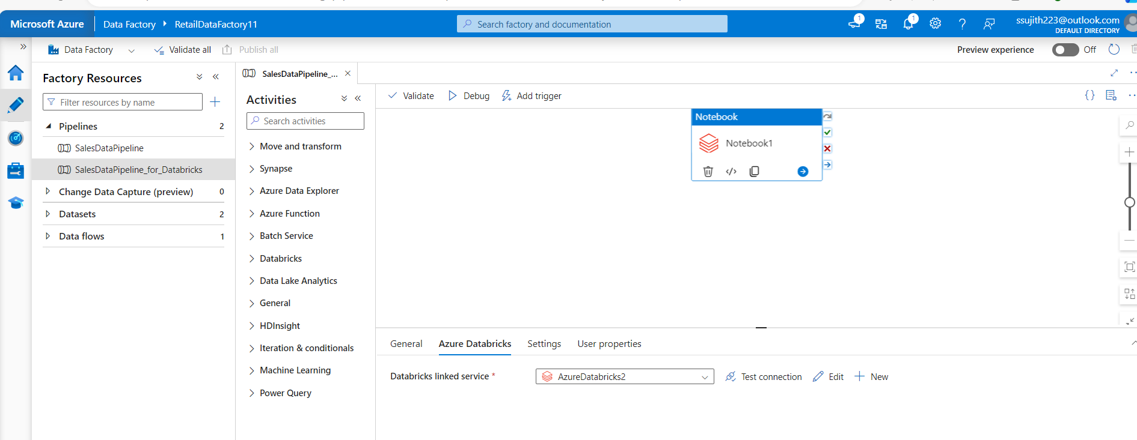
Notebook path URL

Slide 21
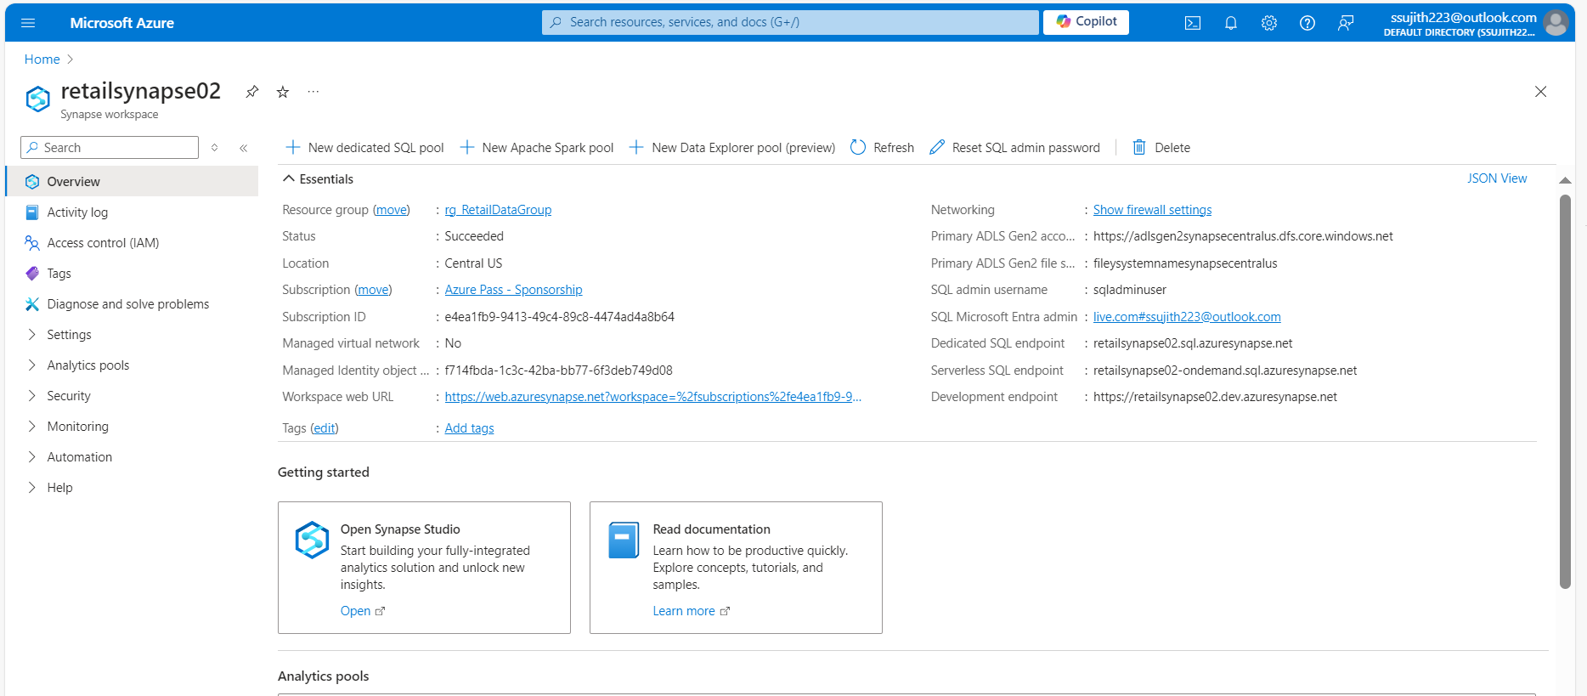
Case Study 3 : Analyzing Retail Sales Data with Azure Synapse Analytics
Creating an Azure Synapse Workspace

Slide 22
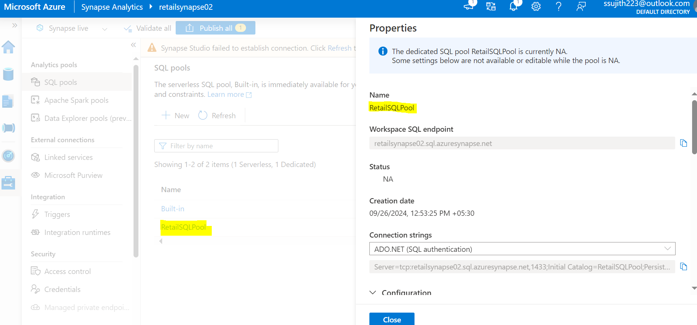
Creating a Dedicated SQL Pool

Slide 23
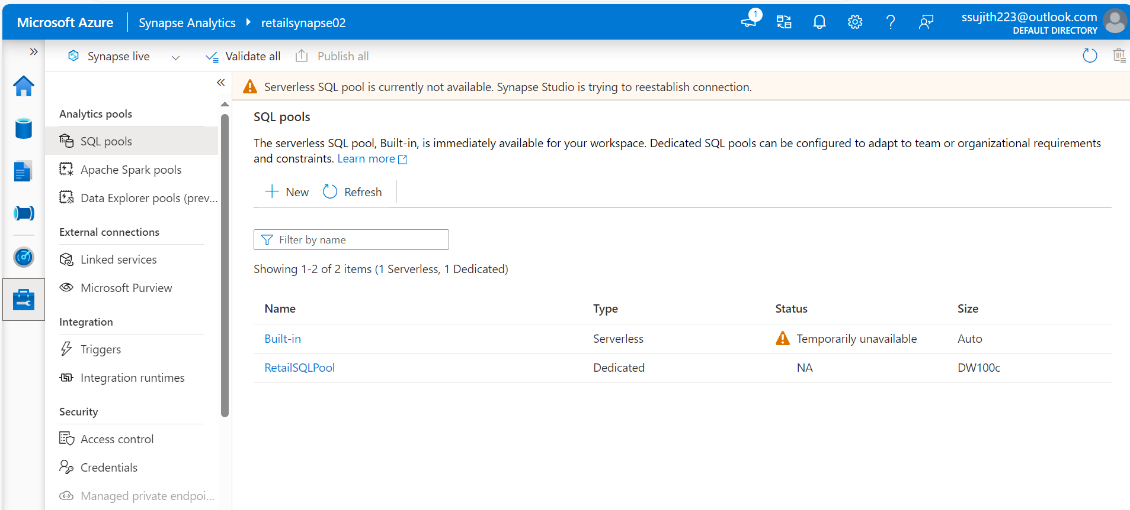

Slide 24
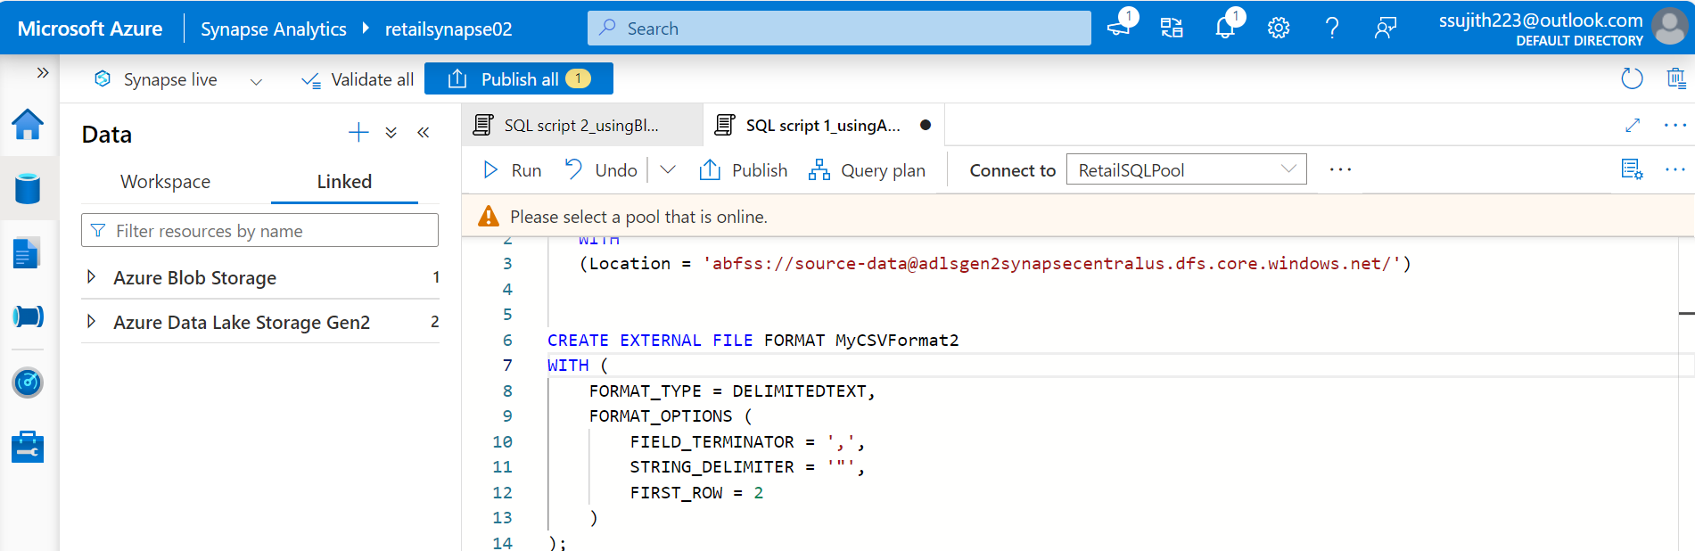
Creating Linked Service for Azure Blob Storage

Slide 25
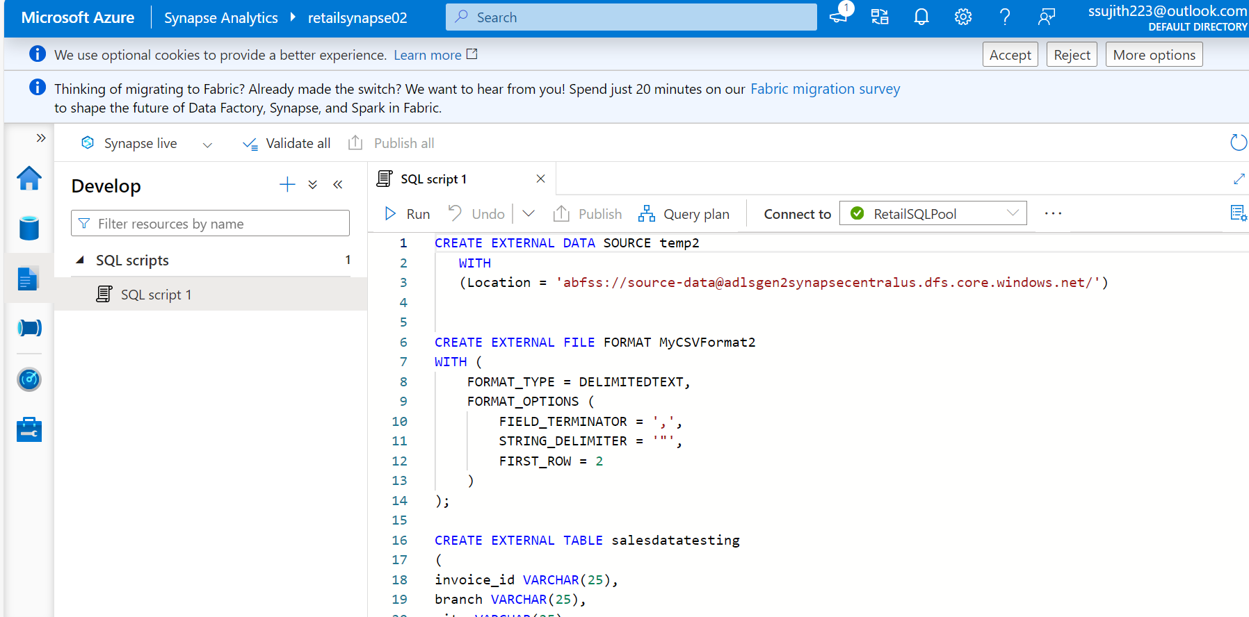
Creating external Data Source, File Format, Table

Slide 26
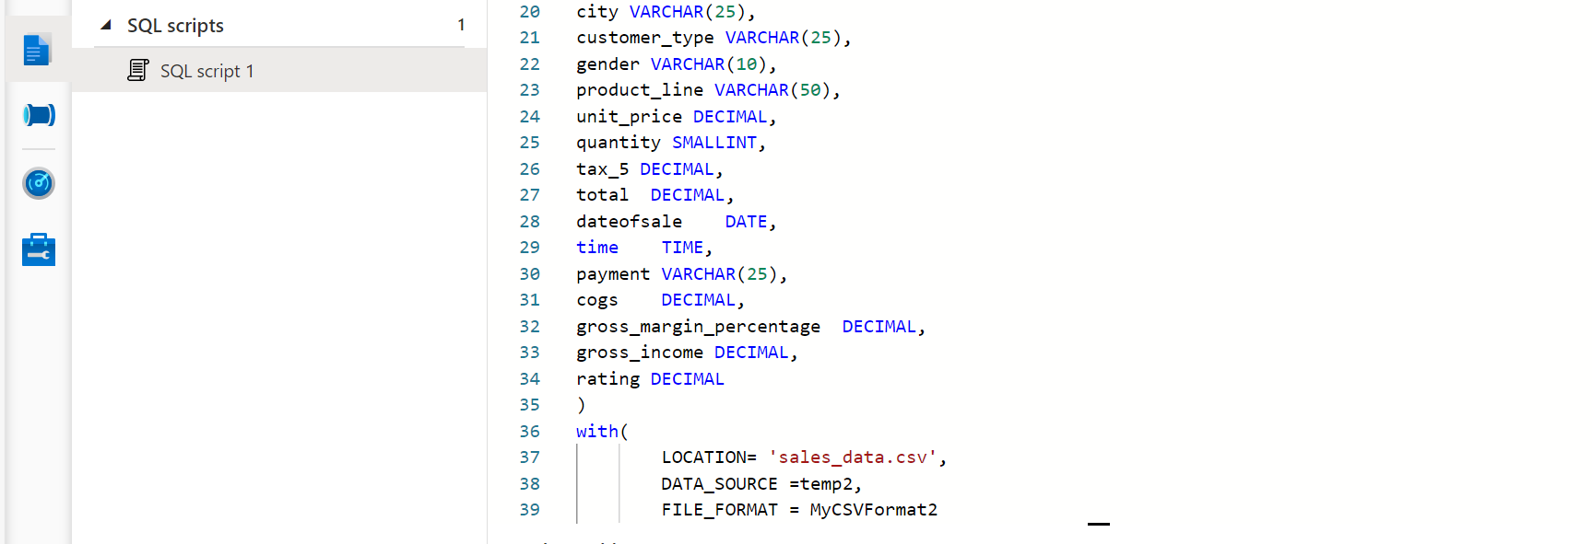

Slide 27
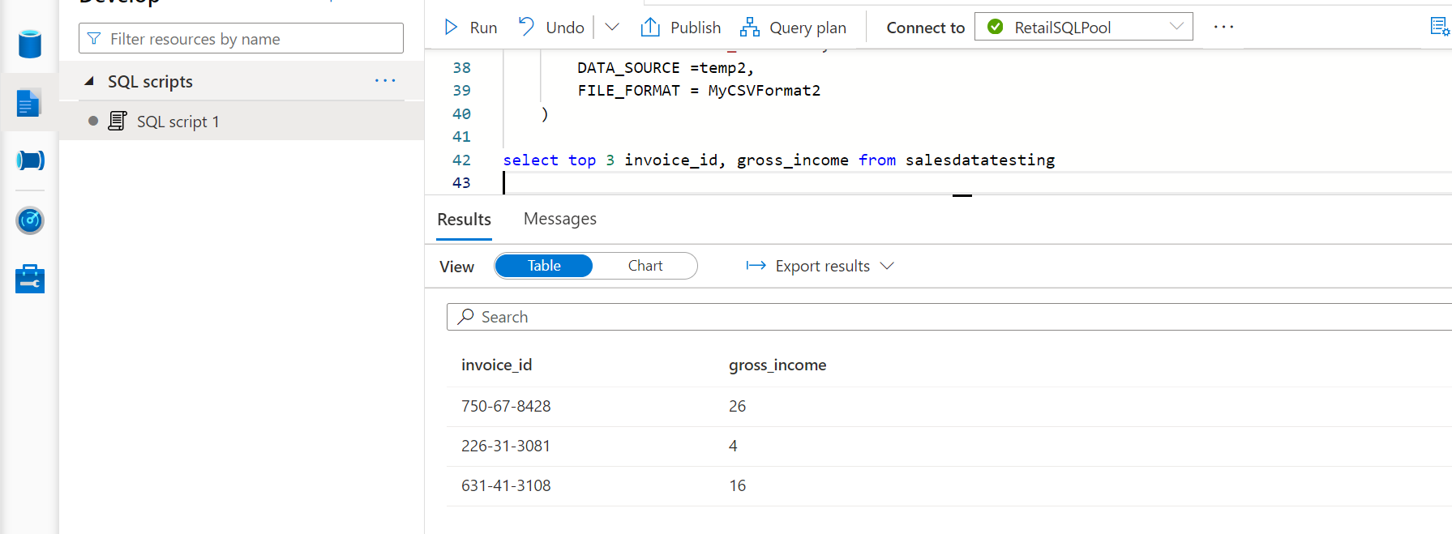

Slide 28
