Slide 1
Customer Behaviour Modelling
Group Members:
Adarsh Baldawa
Devendra Deshmane
Harsh Junagade
Neeyati Satgounda
Parag Jadhav
Sukhada Sakhalkar
Mentor:
Dr. Pradnya Khandeparkar

Slide 2
Background:
In this era, when every organization competes to stay on the top in the market, organizations need to ensure that they should consider all the factors that will result in their long-term success.
By segmenting customers into different groups, analysts can build tailored strategies for customers. This project aims to segment customers into groups and Predict Customer Lifetime Value.
Customer Lifetime Value is an important factor that helps in understanding customers behavior . It allows organizations to understand the importance level of each customer.

Slide 3
Motivation
Blindly trying to target customers is unfeasible for a businesses to increase their sales, therefore, we should know which customers to target and which we should not target.
Calculating retention rates for non-contractual relationships is unfeasible, so we need to devise a method for the marketing team to properly target these customers.
To target these customers Customer lifetime values has been used.

Slide 4
Objectives:
To determine current customer value using RFM method.
To segment customers into small groups and addressing individual customers based on actual purchasing behaviors.
To predict future Customer Lifetime Values for 3, 6 and 12 months and creating loyalty segments using those values.

Slide 5
Process Flow
Data description and preparation
Calculating the RFM scores
Customer Segmentation using RFM
Conclusion
Calculating CLTV values
Exploratory Data Analysis

Slide 6
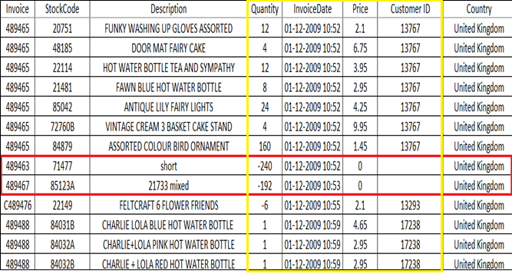
Data Description:
Transactional data set that contains all the transactions occurring between 01/12/2010 & 09/12/2011 for a UK-based online retail store.
There are 8 columns present in the data but we mainly used 4 column for further prediction.
Size: 5,25,462
Variable Descriptions:
InvoiceNo: This is invoice number for the products purchased by customer.
Description: This is product name.
Quantity: This is the quantities of each product per transaction.
InvoiceDate: The day and time when each transaction was generated.
StockCode: This is product code.
Price: Product price per unit is in pounds.
CustomerID: A 5-digit integral number uniquely assigned to each customer.
Country: The name of the country where each customer resides

Slide 7
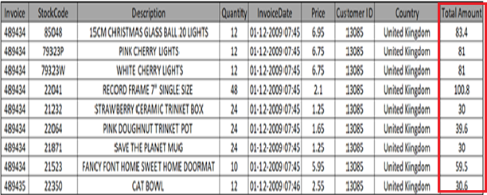
Data Preprocessing:
There is no “Total Amount ” column present in the dataset, so we added “Total Amount” column by multiplying quantity and unit price columns.
Since our objective is to identify customer groups, there should not be any missing values in ‘CustomerID’ column. Hence, we removed the missing values
There were some negative values present in the dataset. They were removed since they represent returns and refunds and are not the topic of interest.
Data size: 4,17,534

Slide 8
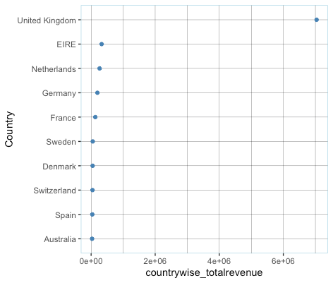
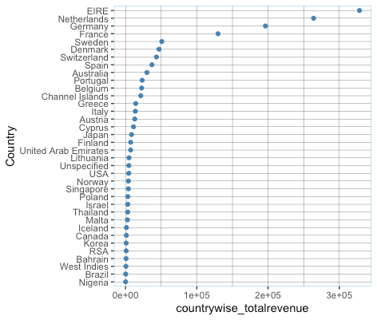
Exploratory Data Analysis:
Total sales (in £) of top 10 countries
Total sales (in £)of the countries
(excluding U.K.)

Slide 9
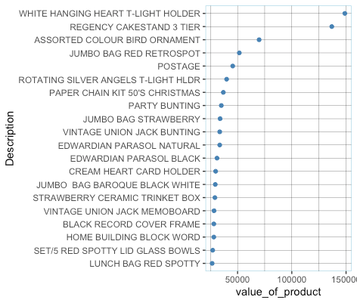
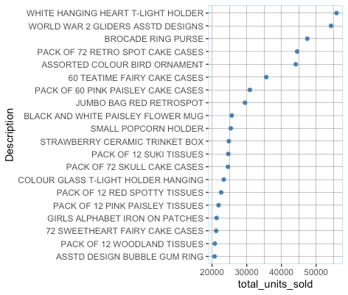
Total Revenue per product (in £)
(Most valued products)
Top 20 most sold products
(Count)

Slide 10
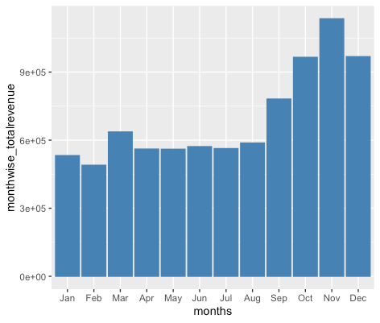
Total Revenue (in £) (Month-wise)

Slide 11
Understanding the RFM values:
What is RFM?
RFM stands for Recency , Frequency, Monetary, It is method used for measuring customer value.
Recency : It represents the interval between the latest buying date of a customer and the last date of the dataset.
Frequency: It represents the number of times a customer buys within a particular period given in the dataset.
Monetary: It is the total value of transacted sales by each customer.

Slide 12
Scoring Model:
We use scoring model to find the most valuable customers based on the composite score of RFM values.
Each of the R, F and M values is divided in five equal quintiles each containing 20% of customers. This is known as quintile discretization method. We ranked these customers from 1-5, 1 being the lowest and 5 being the highest which gives us R, F and M ranks.
For recency, rank 5 is given to the customer with lowest recency and 1 is given to the customer with highest recency.
For frequency/monetary, rank 5 is given to the customer with highest frequency/monetary values and rank 1 is given to the customer with lowest frequency/monetary values.
Customer behaviour is represented by combined RFM code 555, 554, 553, …, 111, which thus creates 125 (5×5×5) R,F, M cells.
We used R F and M ranks to get a composite score with a minimum value of 3 (R=1, F=1, M=1) and maximum value of 15 (R=5, F=5, M=5).

Slide 13
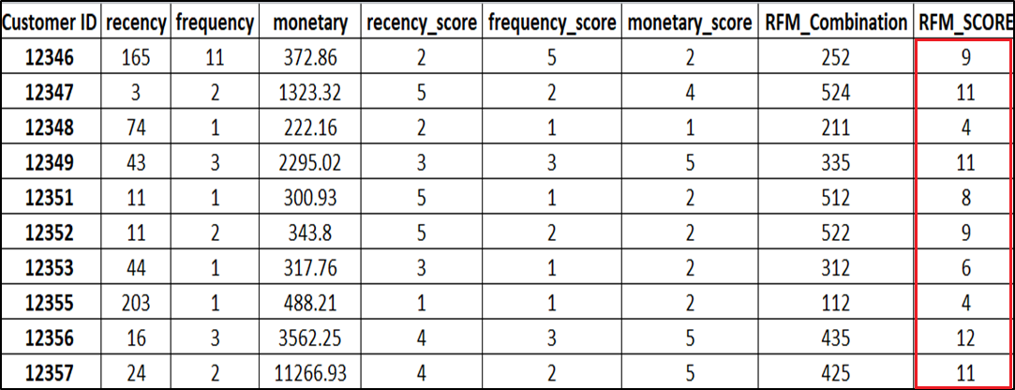
Scoring Model Table:

Slide 14
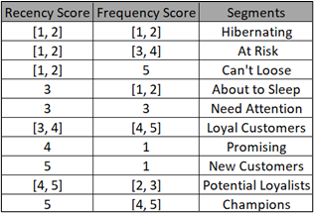
Segmentation using R,F,M:
First, using R and F ranks, we divided our customers into 10 small segments named ‘Hibernating', 'At Risk', 'Can't Lose', 'About to Sleep’, 'Need Attention', 'Loyal Customers', 'Promising', 'New Customers', 'Potential Loyalists', 'Champions'.
Secondly, we used R F and M ranks to get a composite score with a minimum value of 3 (R=1,F=1, M=1) and maximum value of 15 (R=5, F=5, M=5) which are then divided into 4 bins of composite scores of equal lengths which we call as loyalty levels, i.e. Platinum, Gold, Silver and Bronze.

Slide 15
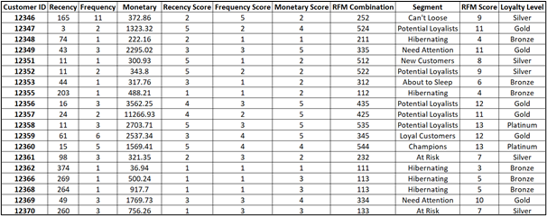
Segmentation Table:

Slide 16
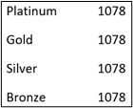
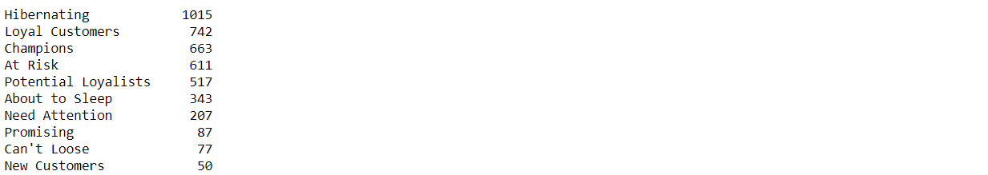
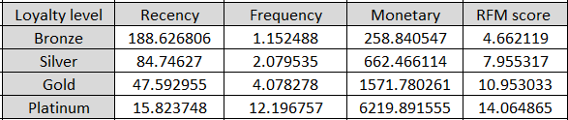
Results:
Then the sum of R, F and M scores was taken to get the composite scores which were segmented into 4 (arbitrary) parts:
We get an average values of R, F and M for different loyalty levels :
RFM Model:
Using definitions of R, F and M we assigned R, F and M scores to each customer. A combination of the R and F scores was segmented into ten categories (industry standard):

Slide 17
Customer Lifetime Value
CLTV is a measurement of how valuable a customer is to your company, not just on a purchase-by-purchase basis but across the whole relationship.
Formula for CLTV: Expected no. of Transactions * Expected Average Profit
We will estimate the “Expected Number of Transaction” part using the BG/NBD model and the “Expected Average Profit” part using the gamma-gamma sub-model.

Slide 18
BG/NBD Model:
BG/NBD model is known as Beta Geometric/Negative Binomial Distribution model. It belongs to the “Buy Till You Die” family of models. It gives us the expected number of transactions for an individual in a future period of length t.
BTYD aims to jointly model two processes:
(1) A repeat purchase process, that explains how frequently customers make purchases while they are still “alive”.
(2) A dropout process, which models how likely a customer is to churn in any given time period.

Slide 19
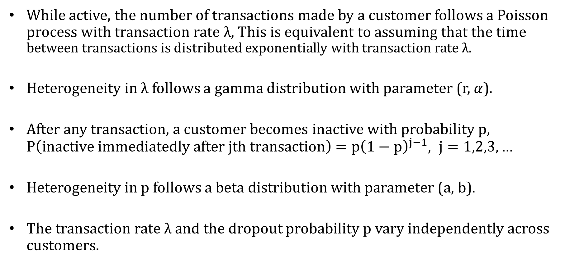
Assumption:
While active, the number of transactions made by a customer follows a Poisson process with transaction rate λ, This is equivalent to assuming that the time between transactions is distributed exponentially with transaction rate λ.
Heterogeneity in λ follows a gamma distribution with parameter (r, $α$).
After any transaction, a customer becomes inactive with probability p, $P\left(inactive immediatedly after jth transaction\right)$ $={\text{p}\left(1−p\right)}^{j−1}, j=1,2,3,…$
Heterogeneity in p follows a beta distribution with parameter (a, b).
The transaction rate $λ$ and the dropout probability p vary independently across customers.

Slide 20
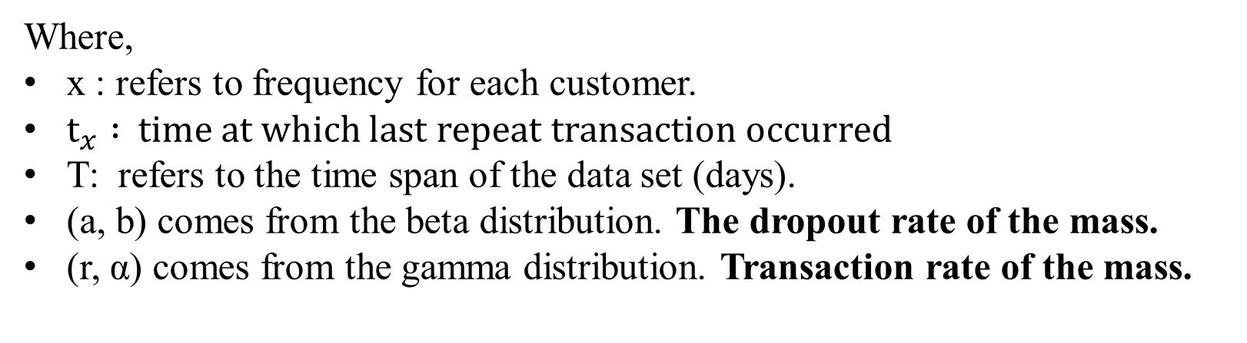
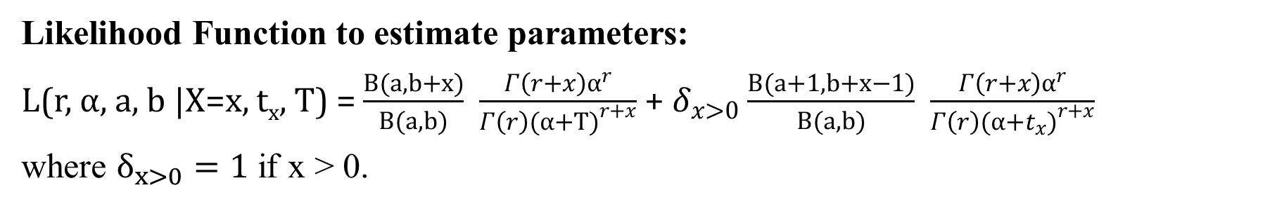
Parameter Estimation:
Likelihood Function to estimate parameters:
L(r,$α$, a, b |X=x, t_{x}, T) = $\frac{B(a, b+x)}{B(a, b)}$ $\frac{Γ\left(r+x\right)α^{r}}{Γ\left(r\right){(α+T)}^{r+x}}$ + $δ_{x>0}$ $\frac{B(a+1, b+x−1)}{B(a, b)}$ $\frac{Γ\left(r+x\right)α^{r}}{Γ\left(r\right){(α+t_{x})}^{r+x}}$
where $δ_{x>0}=1$ if x > 0.
Where,
x : refers to frequency for each customer.
${\text{t}}_{x} :$ time at which last repeat transaction occurred
T: refers to the time span of the data set (days).
(a, b) comes from the beta distribution. The dropout rate of the mass.
(r, α) comes from the gamma distribution. Transaction rate of the mass.

Slide 21
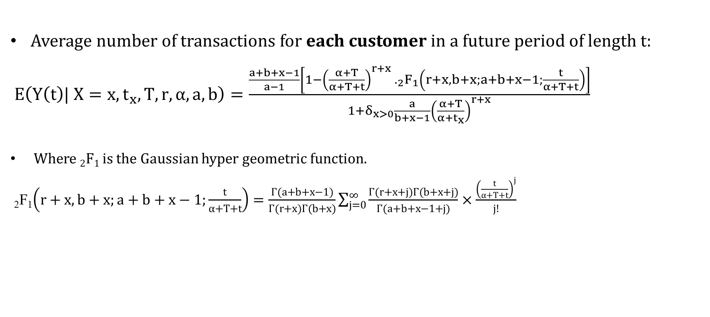
Average number of transactions:
Average number of transactions for each customer in a future period of length t:
$E\left(Y\left(t\right)| X=x,t_{x},T,r,α,a,b\right)=\frac{\frac{a+b+x−1}{a−1}\left[1−{\left(\frac{α+T}{α+T+t}\right)}^{r+x} {._{2}F}_{1}\left(r+x,b+x;a+b+x−1;\frac{t}{α+T+t}\right)\right]}{1+δ_{x>0}\frac{a}{b+x−1}{\left(\frac{α+T}{α+t_{x}}\right)}^{r+x}}$
Where ₂F₁ is the Gaussian hyper geometric function.
₂F₁$\left(r+x,b+x;a+b+x−1;\frac{t}{α+T+t}\right)=\frac{Γ(a+b+x−1)}{Γ(r+x)Γ(b+x)}\sum_{j=0}^{∞}{\frac{Γ(r+x+j)Γ(b+x+j)}{Γ(a+b+x−1+j)}×\frac{{\left(\frac{t}{α+T+t}\right)}^{j}}{j!}}$

Slide 22
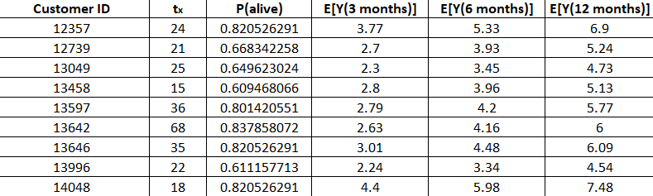
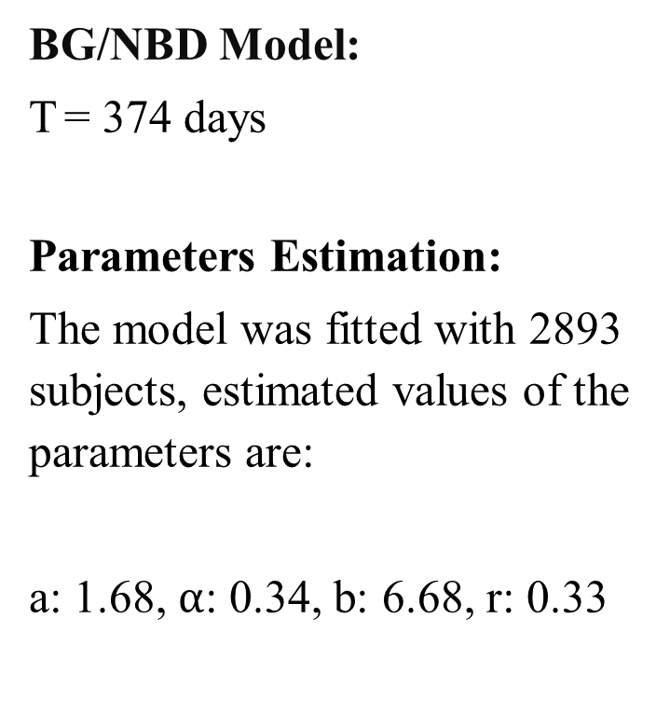
Results:
BG/NBD Model:
T = 374 days
Parameters Estimation:
The model was fitted with 2893 subjects, estimated values of the parameters are:
a: 1.68,$α$: 0.34, b: 6.68, r: 0.33

Slide 23
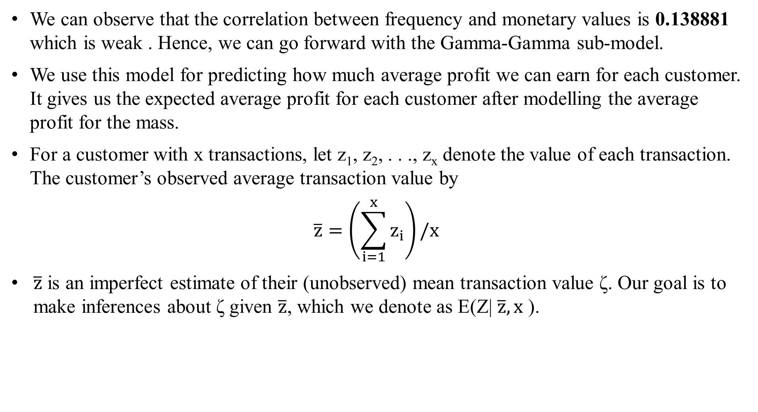
Gamma-Gamma sub model:
We can observe that the correlation between frequency and monetary values is 0.138881 which is weak . Hence, we can go forward with the Gamma-Gamma sub-model.
We use this model for predicting how much average profit we can earn for each customer. It gives us the expected average profit for each customer after modelling the average profit for the mass.
For a customer with x transactions, let z₁, z₂, . . ., z_{x} denote the value of each transaction. The customer’s observed average transaction value by
$$\overline{z}=\left(\sum_{i=1}^{x}{z_{i}}\right)/x$$
$\overline{z}$ is an imperfect estimate of their (unobserved) mean transaction value ζ. Our goal is to make inferences about ζ given $\overline{z}$, which we denote as E(Z| $\overline{z},x$ ).

Slide 24
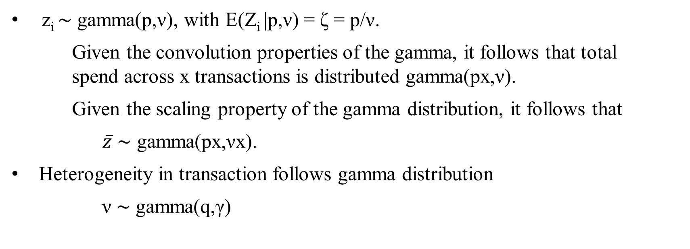
Assumptions:
z_{i} ∼ gamma(p,ν), with E(Z_{i} |p,ν) = ζ = p/ν.
Given the convolution properties of the gamma, it follows that total spend across x transactions is distributed gamma(px,ν).
Given the scaling property of the gamma distribution, it follows that
$\overline{z}$ ∼ gamma(px,νx).
Heterogeneity in transaction follows gamma distribution
ν ∼ gamma(q,γ)

Slide 25

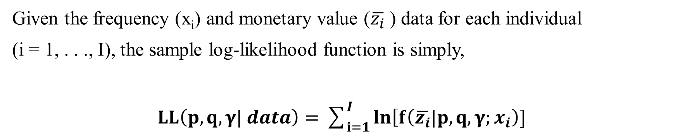
Parameter Estimation:
Given the frequency (x_{i}) and monetary value ($\overline{z_{i}}$) data for each individual
(i = 1, . . ., I), the sample log-likelihood function is simply,
$LL\left(p,q,γ| data\right)=\sum_{i=1}^{I}{ln\left[f\left(\overline{z_{i}}|p,q,γ;x_{i}\right)]\right.}$
Where,
$$f\left(\overline{z_{i}}|p,q,γ;x\right)=\frac{1}{\overline{z_{i}}B\left(px,q\right)}{\left(\frac{γ}{γ+x\overline{z_{i}}}\right)}^{q}{\left(\frac{x\overline{z_{i}}}{γ+x\overline{z_{i}}}\right)}^{px}$$

Slide 26
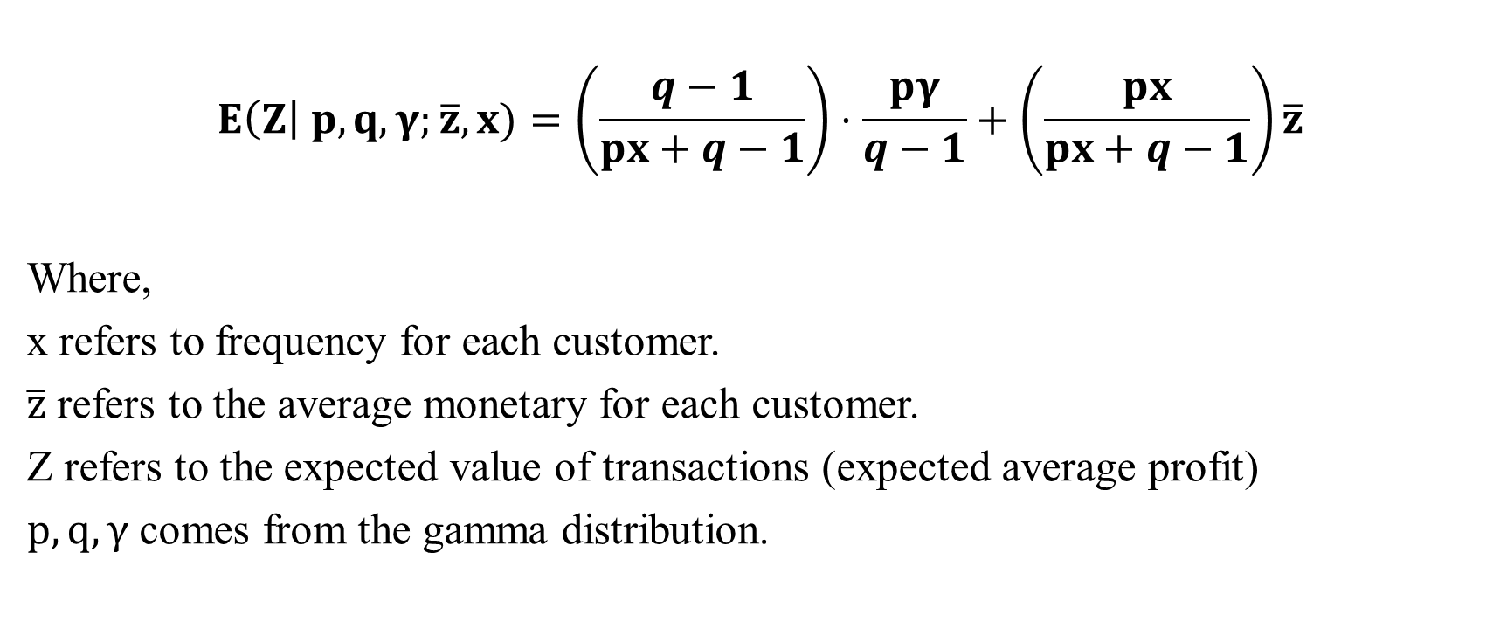
Average transaction profit:
$$E\left(Z\right| p,q,γ;\overline{z},x)=\left(\frac{q−1}{px+q−1}\right)⋅\frac{pγ}{q−1}+\left(\frac{px}{px+q−1}\right)\overline{z}$$
Where,
x refers to frequency for each customer.
$\overline{z}$ refers to the average monetary for each customer.
Z refers to the expected value of transactions (expected average profit)
$p,q,γ$ comes from the gamma distribution.

Slide 27
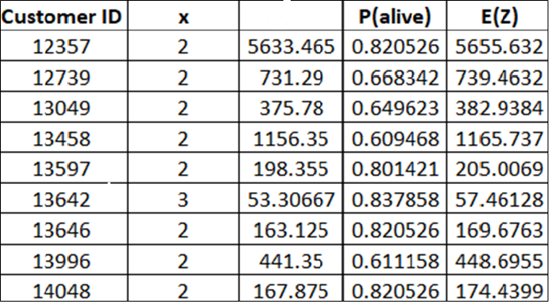
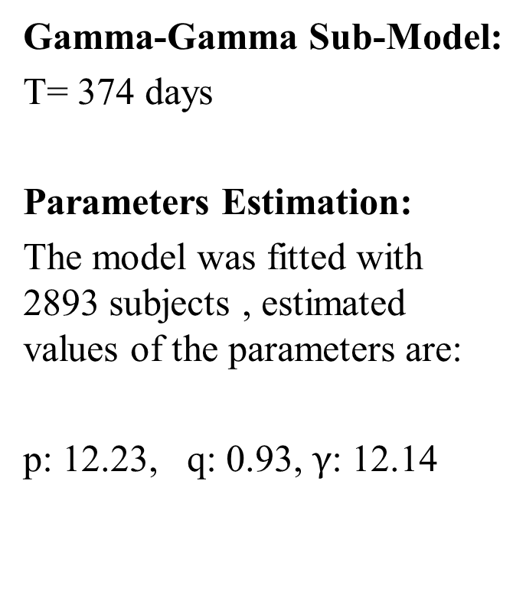

Result:
Gamma-Gamma Sub-Model:
T= 374 days
Parameters Estimation:
The model was fitted with 2893 subjects , estimated values of the parameters are:
p: 12.23, q: 0.93, $γ$: 12.14
$$\overline{z}$$

Slide 28
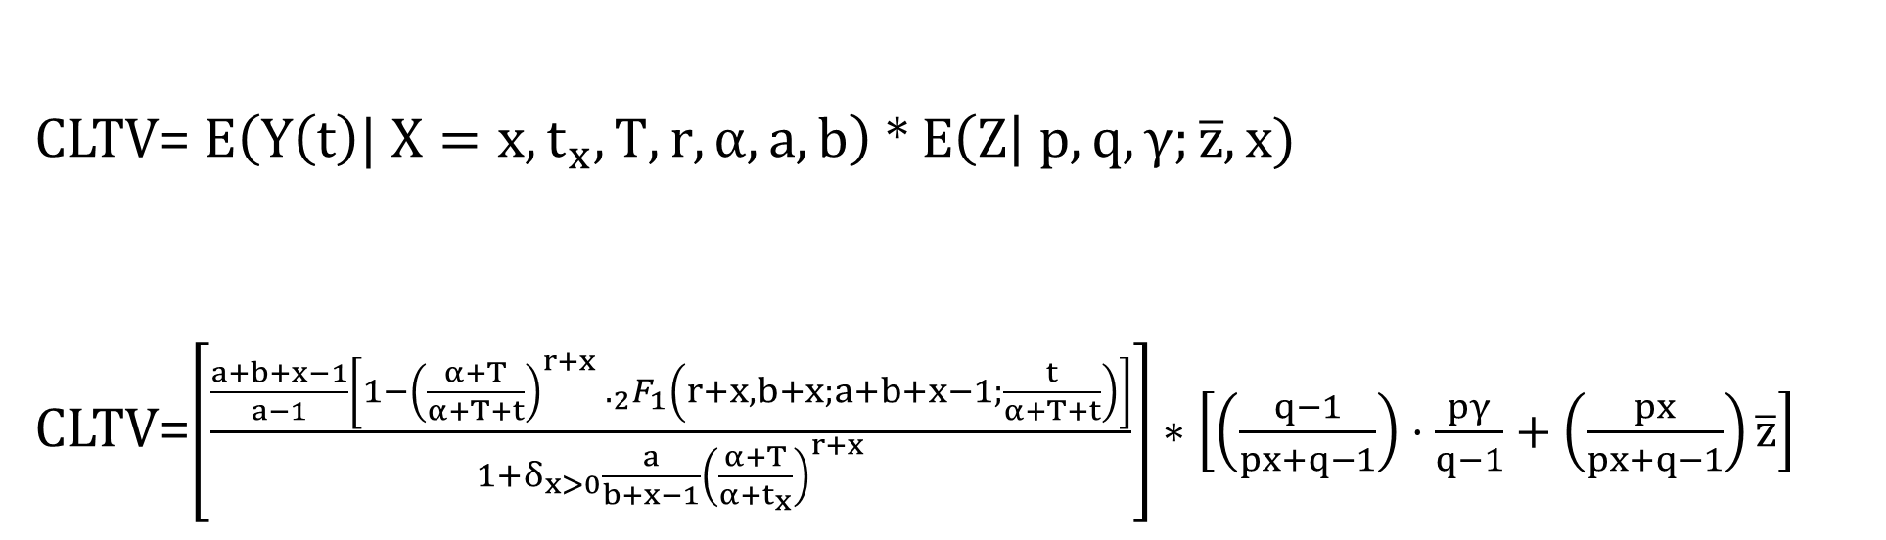
Final formula for CLTV:
CLTV= $E\left(Y\left(t\right)| X=x,t_{x},T,r,α,a,b\right)$ * $E\left(Z\right| p,q,γ;\overline{z},x)$
CLTV=$\left[\frac{\frac{a+b+x−1}{a−1}\left[1−{\left(\frac{α+T}{α+T+t}\right)}^{r+x} ._{2}F_{1}\left(r+x,b+x;a+b+x−1;\frac{t}{α+T+t}\right)\right]}{1+δ_{x>0}\frac{a}{b+x−1}{\left(\frac{α+T}{α+t_{x}}\right)}^{r+x}}\right]∗\left[\left(\frac{q−1}{px+q−1}\right)⋅\frac{pγ}{q−1}+\left(\frac{px}{px+q−1}\right)\overline{z}\right]$

Slide 29
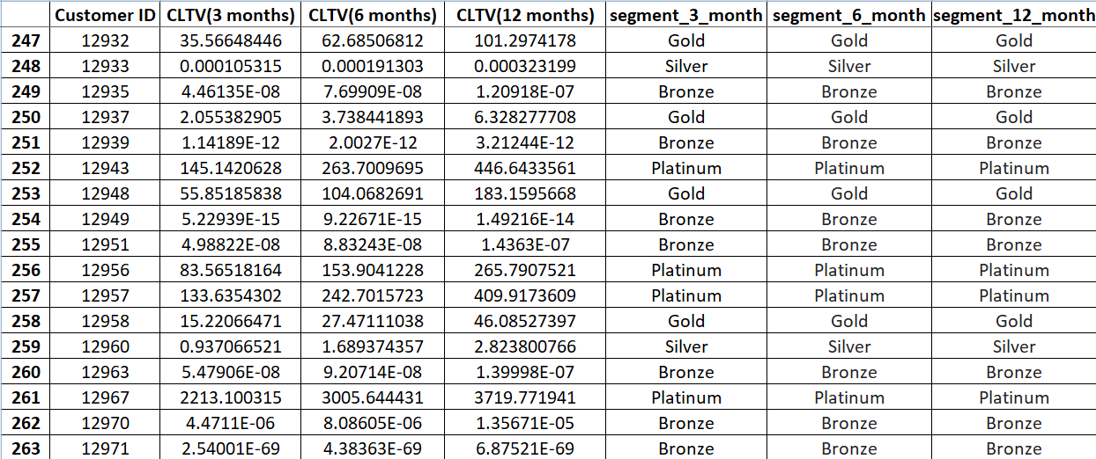
CLTV Table:
Therefore, we have predicted CLTV for 3, 6 and 12 months. Using these CLTV values we segment customers using the same method that we used for RFM.

Slide 30
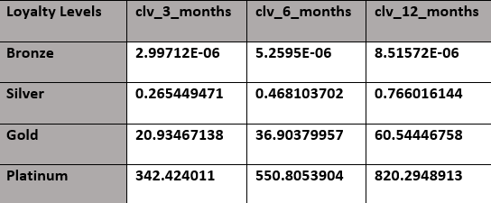
Segmentation using CLTV values (t=3, 6 & 12 months)
As we can see each segment contains equal number of customers since we have given equal weightage to each loyalty level, these segments will vary from business to business, depending upon their needs.
Loyalty levels according to their average CLTV (in pounds) values is shown below
Bronze | 724
Silver | 723
Gold | 723
Platinum | 723

Slide 31
Conclusion:
Using R and F scores we have segmented customers into 10 categories, this will help the marketing department to form their specific strategies tailor-made for each customer.
Using R, F and M composite score and future CLTV scores, we can form loyalty levels and marketing team can focus on those customers and give them deals, offers and discounts accordingly.
Making a distinction between alive and dead customers is one of the most important applications of CLTV.
Marketing team can use dynamic pricing models to target customer as per their discretion.

Slide 32
Future Scope:
More empirical studies should be performed, specifically some that would study datasets from outside the Western European area, in order to see if the same results are replicated on a global scale.
Studies that would focus on a comparison of recently researched models (like Pareto/GGG, Retina CLTV) from both performance and feature perspectives, resulting in a development of more robust yet customizable general CLTV models.
Clustering techniques can also be used to create loyalty segment and their output can be compared to our segments.

Slide 33
References:
Jo-Ting Wei, Shih-Yen Lin and Hsin-Hung Wu (2010). “A review of the application of RFM model” African Journal of Business Management Vol. 4(19), pp. 4199-4206, December Special Review.
Fader, P.S., Hardie B.G.S., Lee K.L. (2005) "Counting Your Customers” the Easy Way: An Alternative to the Pareto/NBD Model. Marketing Science, 275-284.
Fader, P.S., Hardie B.G.S. (2013) The Gamma-Gamma Model of Monetary Value.

Slide 34
Q&A

