Slide 1
SARAH SUKIN
PORTFOLIO
STYLE GUIDE
A
Product strategy × UX design
Working brand system — Draft 01

Slide 2
02 / VISION + VALUES
Accomplished without feeling distant.
VISION
Turn complex systems into clear, trusted experiences — combining strategic thinking, user empathy, and disciplined design craft.
Strategic
Connect user needs, business goals, and execution.
Precise
Make complexity legible through clear choices.
Human
Design for real people, not abstract personas.
Confident
Lead with a point of view and support it with evidence.
Crafted
Treat details as part of the strategy, not decoration.
Warm
Be polished and approachable rather than corporate or cold.

Slide 3
03 / LOGO
Working identity
PRIMARY MARK
Use the simple wordmark + rust dot as the working identity.
Keep generous whitespace around it; avoid decorative containers.
SARAH SUKIN

Slide 4
04 / COLOR
Warm editorial base + restrained signal colors
Warm Ivory
Deep Ink
Rust
#F7F4EF
#1D2726
#BF4B28
Primary
Text
Accent
Soft Blue
Blush
Signal Purple
#D2E0E6
#DAC2B8
#6F2F93
Support
Support
Project

Slide 5
05 / TYPOGRAPHY
Editorial authority, product clarity
DISPLAY / HEADLINES
Georgia
I turn tangled systems into things people trust.
BODY / UI
Aptos / Arial / Inter
Use a restrained sans serif for navigation, labels, metadata, buttons, and supporting copy. Keep tracking slightly open for small uppercase labels.

Slide 6
06 / VOICE + TONE
Smart, clear, human
DO
DON’T
• Lead with the point.
• Hide behind jargon.
• Explain complexity plainly.
• Overstate impact.
• Show evidence and outcomes.
• Make every line sound like marketing.
• Sound confident without overselling.
• Use generic design language.
• Use short, memorable sentences.
• Let polish substitute for substance.
“I turn tangled systems into things people trust.”

Slide 7

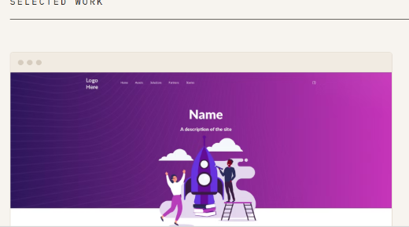
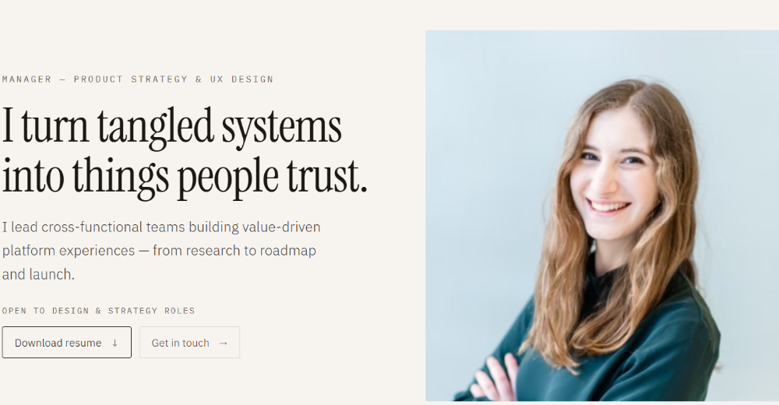
07 / IMAGERY + ICONOGRAPHY
Human proof + product evidence
Portraits: natural, credible, confident — not overly posed.
Work: show systems, outcomes, interfaces, and evidence of craft.
Layouts: editorial whitespace with strong hierarchy and quiet detail.

Slide 8
08 / UX GUIDELINES
Make strategic thinking visible in the experience
01
Orient quickly
The visitor should understand role, value, and credibility within seconds.
02
Show the thinking
Case studies should reveal decisions, tradeoffs, and outcomes — not just final screens.
03
Reduce cognitive load
Use hierarchy, whitespace, and progressive disclosure to make complex work easy to scan.
04
Build trust
Use evidence, metrics, artifacts, and specific language wherever possible.
05
Keep interaction purposeful
Motion and interaction should clarify relationships or create delight, never distract from the work.
06
Make contact easy
The path from interest to resume, LinkedIn, or conversation should be obvious.

Slide 9
09 / UI COMPONENTS
Quiet interface, strong hierarchy
PRIMARY
SECONDARY
Interaction rule
View selected work
Get in touch →
Use motion sparingly. Prioritize legibility, continuity, and a sense of intentional craft.
NAVIGATION
Work About Get in touch
CASE STUDY LABEL
01 / ENTERPRISE PLATFORM

Slide 10
10 / ASSESSMENT
Questions to use as the system evolves
01
Does the portfolio feel accomplished without becoming self-congratulatory?
02
Can a hiring manager understand the strategic value behind the design work?
03
Do the visuals make the work feel specific, credible, and memorable?
04
Does every decorative choice support clarity or personality?
05
Can another designer use this guide to create a consistent new page?
This is a working system. Revisit it as the portfolio, case studies, and target roles become clearer.

