Slide 1
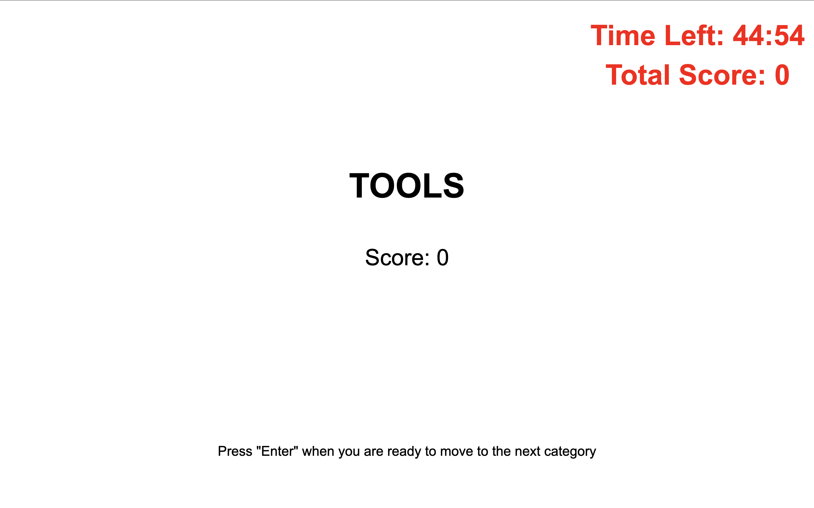
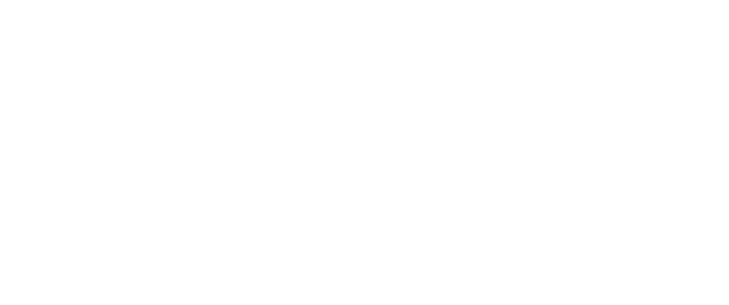
TYPES OF PIE

Slide 2
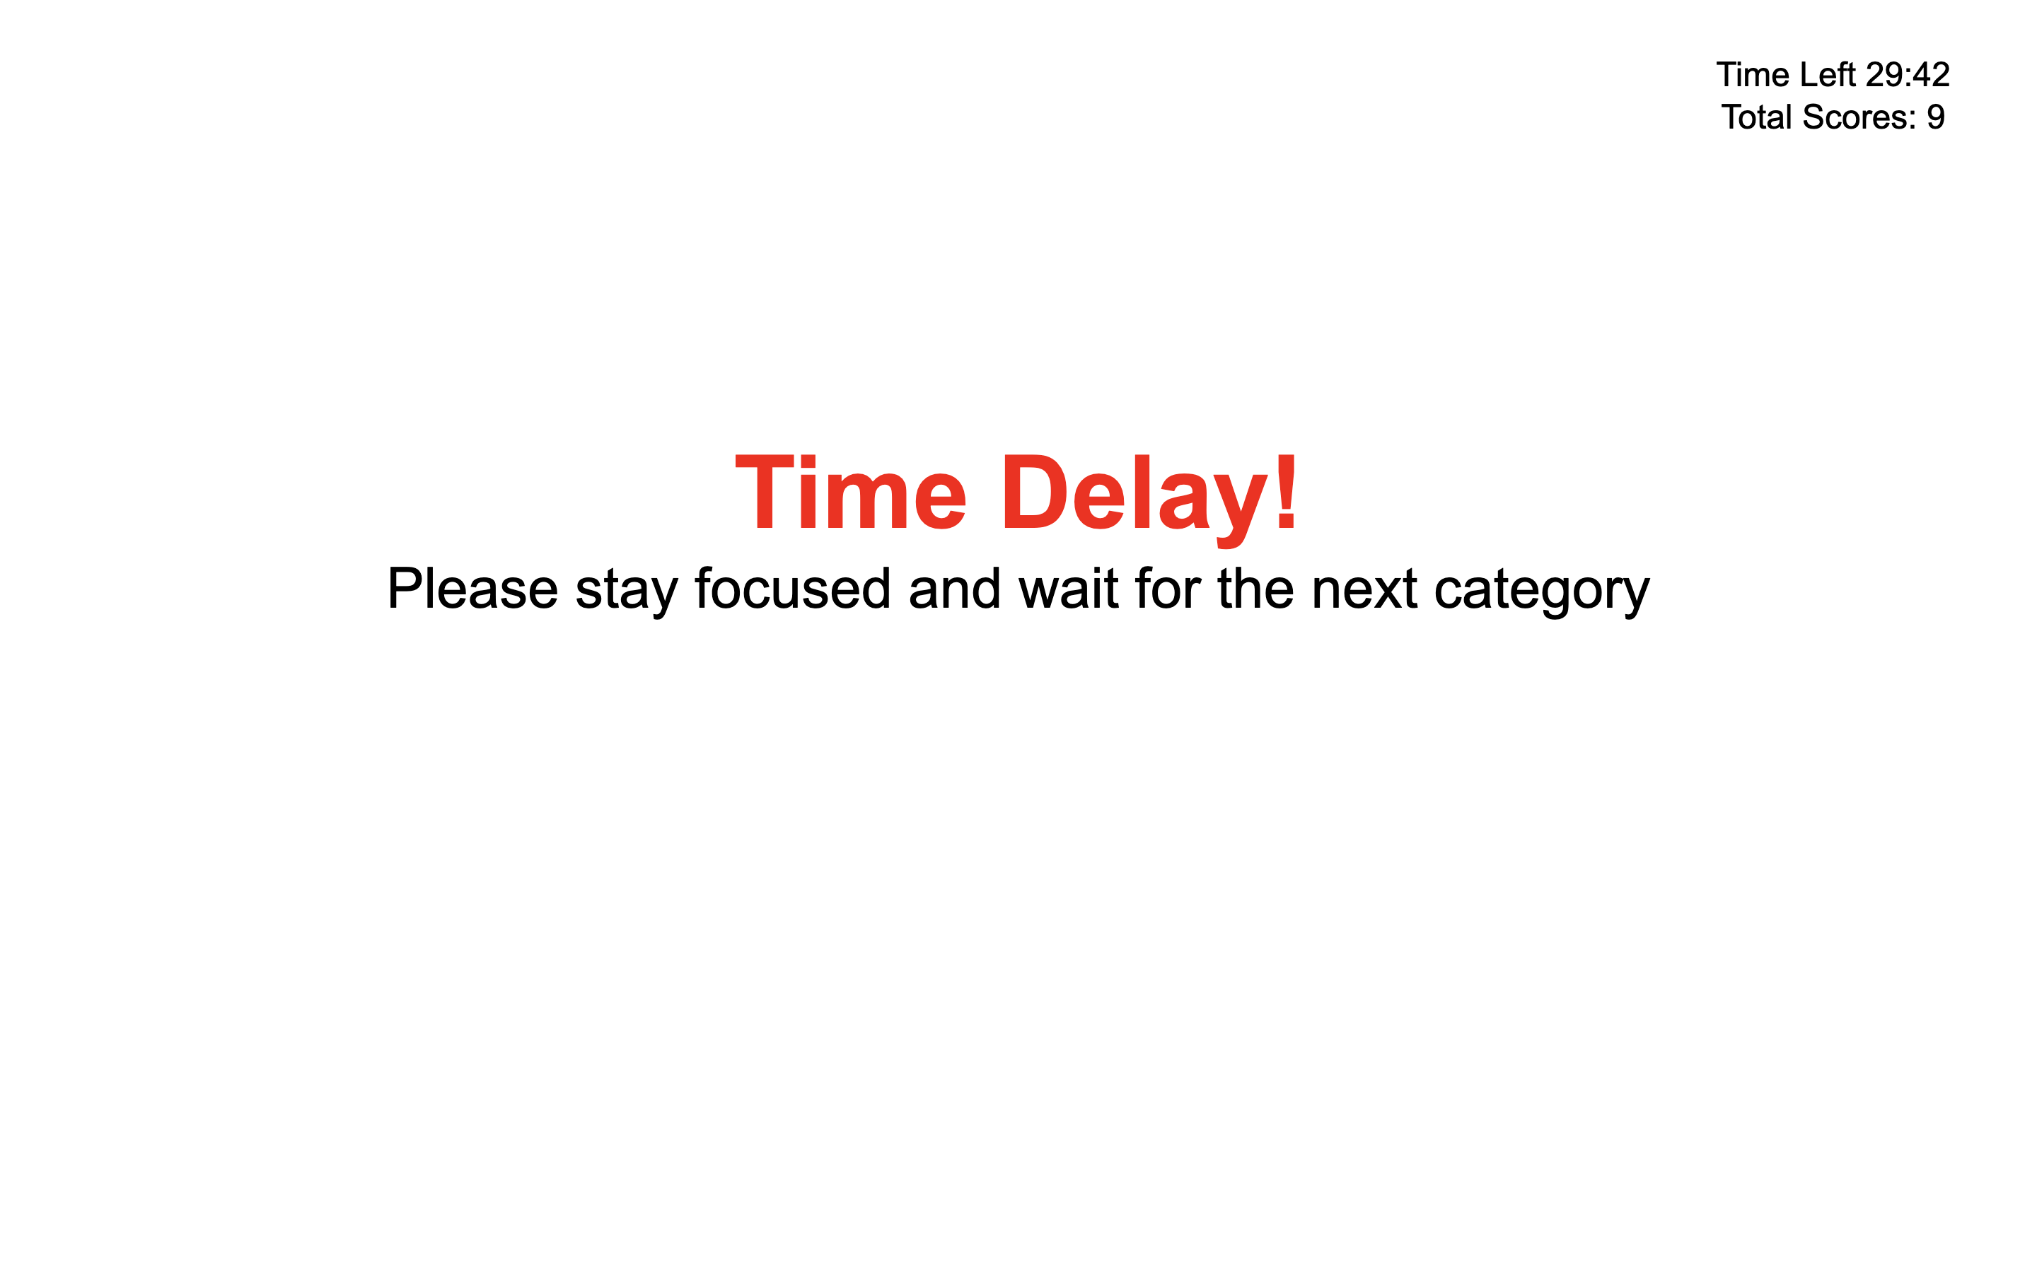
5. After pressing the Enter key, there will be a time delay.
During this delay, you will not be able to recall any words or score points. Stay focused and wait for the next category.

Slide 3
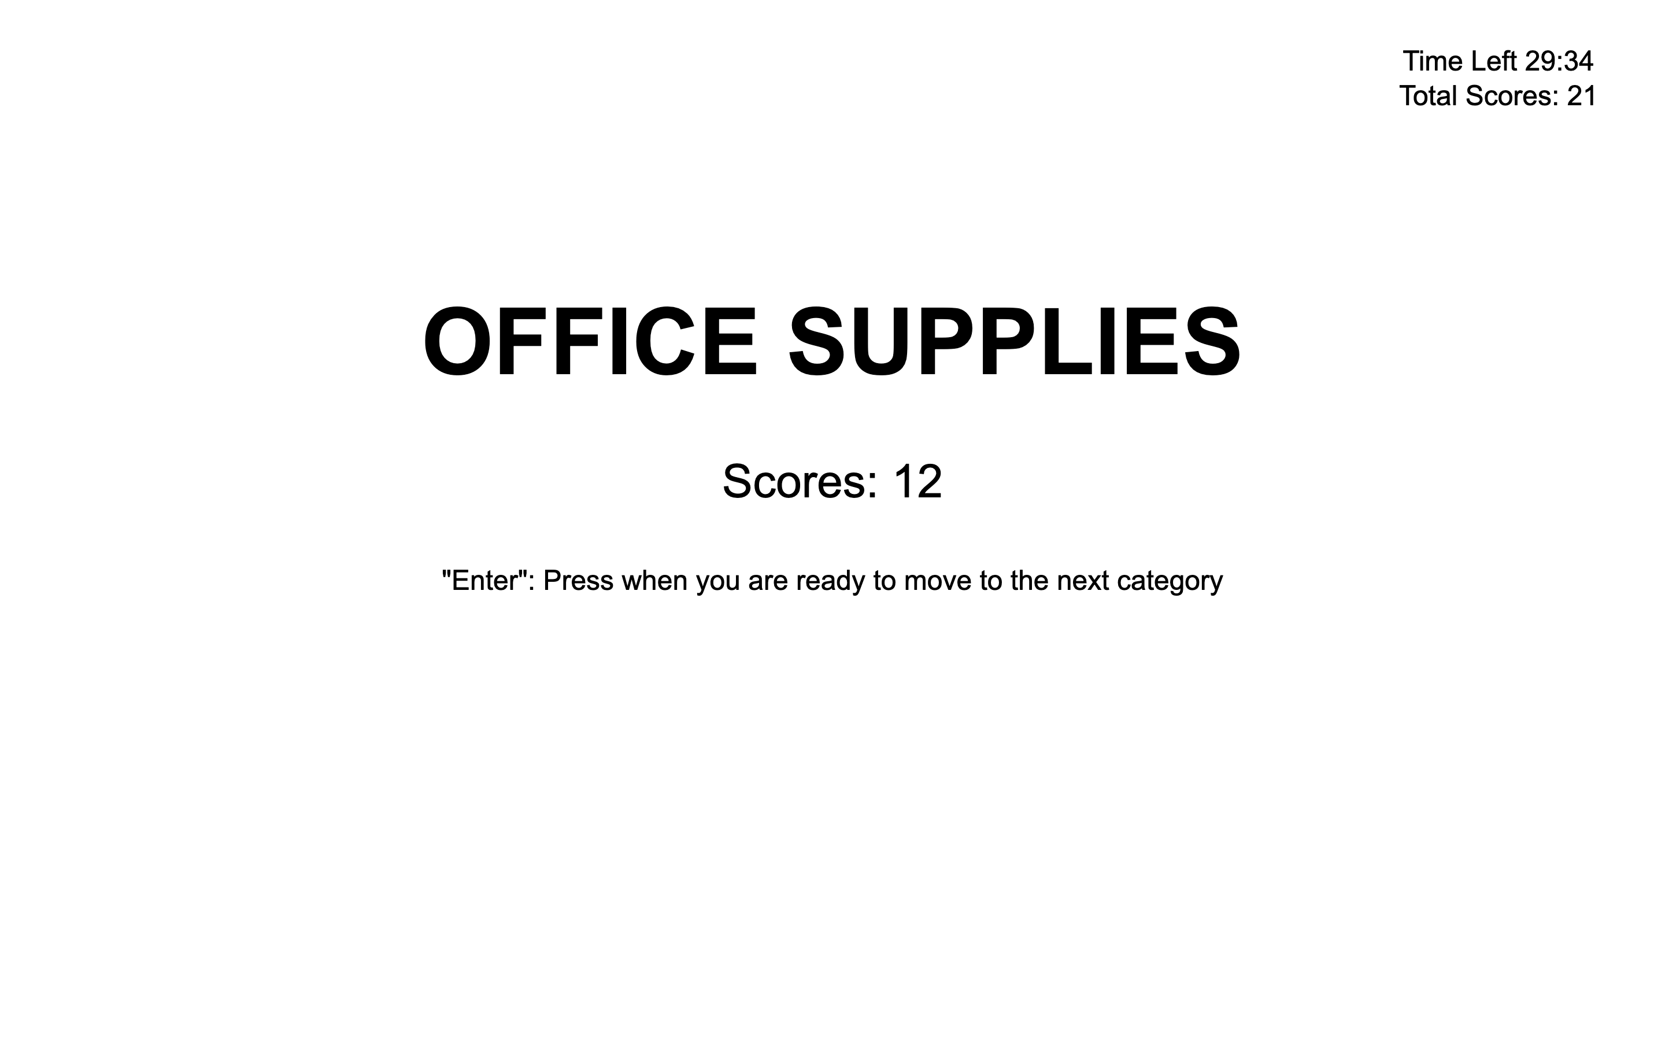
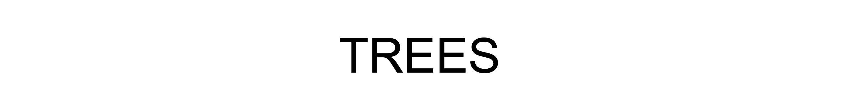
7. You can see the total words that you recalled in real time.
6. When the delay ends, a new category will appear.
8. Your goal is to recall as many as words possible in total during the 30 minutes.
9. Type the word “xwx” as the code in next page to begin the experiment.

Slide 4
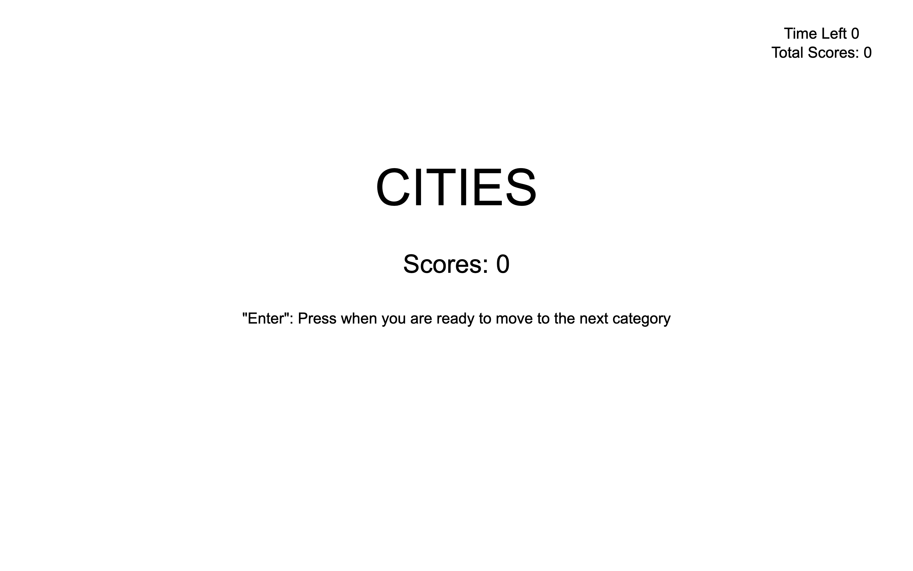
The practice trial is designed to help you familiarize yourself with the task.
The time and total scores from this practice will not be recorded.
However, you can view your scores for this practice session.
Please begin recalling IMMEDIATELY when you see the category coming up.
Keep going until you can no longer think of any additional words or are ready to move on.

Slide 5
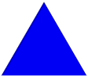
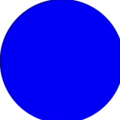


Z =
; V =
; M =

