Slide 1
OpenID Connect Orlando Backend Meetup 2019

Slide 2
Hi Orlando!
Surya Suluh
https://github.com/ssuluh
https://speakerdeck.com/ssuluh
Notes:
Startrek joke
Accent joke

Slide 3
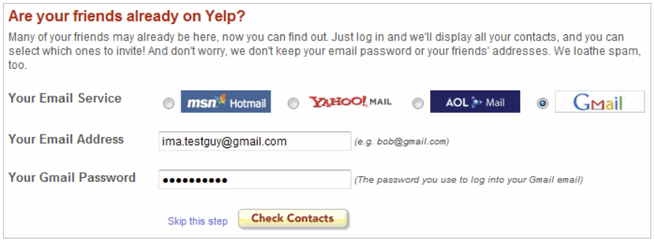
Yelp Circa 2008

Slide 4
Security Is Hard
A Lot Of Protocols And Standards (Oauth, WS-*, Kerberos, SAML, etc.)
Reading Specification Is Hard
Conflicting Information In The Internet
Not Easy To Implement Correctly
Evolving Technique, New Exploit, Vulnerability

Slide 5
OpenID Connect
OAuth 2.0
OpenID Foundation
February 2014
Authentication
Built on top of OAuth 2.0
IETF (RFC 6749)
October 2012
Authorization
Notes:
Maybe many of you already do openid without realizing it
Authentication vs. Authorization

Slide 6
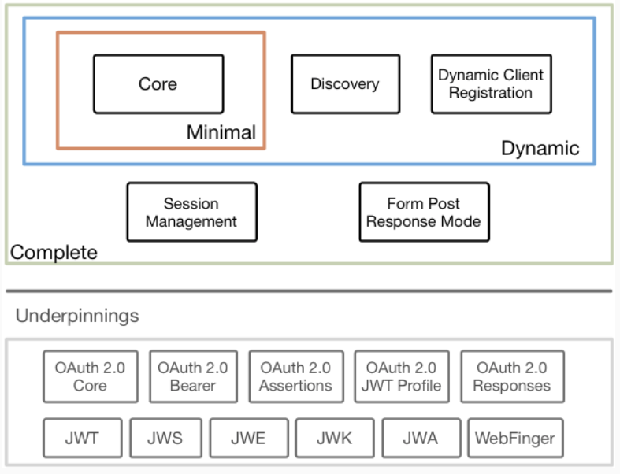
OpenID Connect

Slide 7
Important Terms
Client, Relying Party
Resource Owner
Authorization Server, STS, IAM
Resource Server
Authorization Grant
Redirect URI
Access Token

Slide 8
Public Client
Confidential Client
Can’t safely store secret
Exists in client machine
Typically 1-many clientid-client
Dynamic registration to convert to unique clientid
Can safely store secret
Exists in our server
Typically 1-1 client-client id

Slide 9
Public Client
Confidential Client
Front Channel
SPA (Angular, React)
Mobile App (Native, Cordova)
PC App (Native, Electron)
Back channel and front channel
Server to Server
Server side web application (Asp.Net MVC)

Slide 10
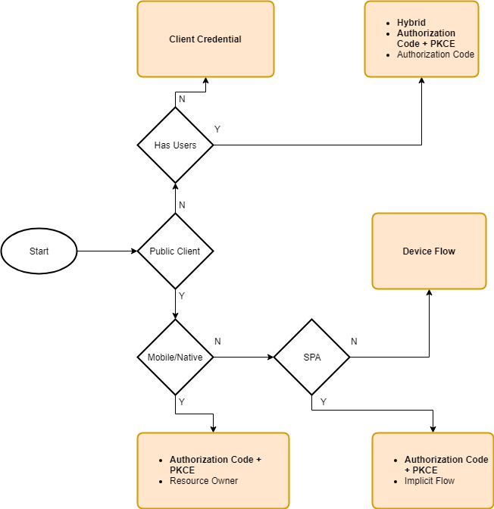

Slide 12
Client Credential Flows
Confidential Client
Use Only Server To Server Communication Only
Send ClientID, ClientSecret and Scope, get back access token

Slide 13
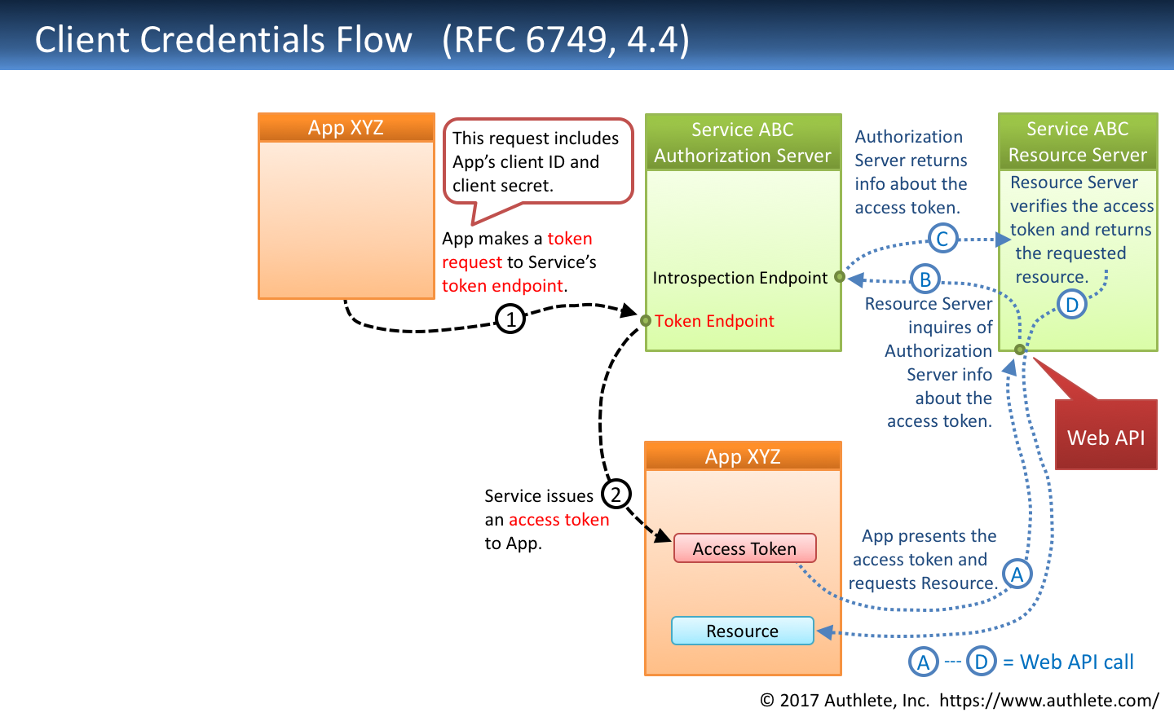

Slide 15
Authorization Code Flow
Confidential Client
Front Channel: Authorization Code
Back Channel: Identity Token, Access Token
Refresh Token can be provided
Other name: 3 Legged OAuth

Slide 16
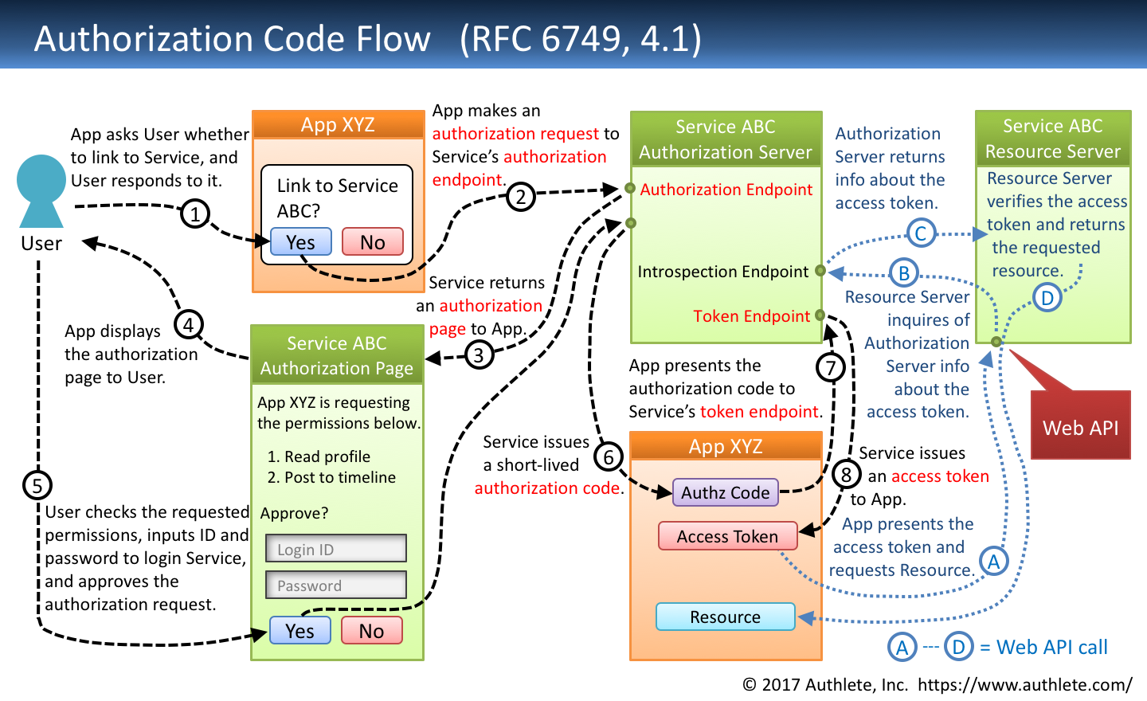

Slide 17
Authorization Code Flow
Problem:
Code substitution attack
OpenID Connect mitigates this threat with Hybrid Flow
OAuth mitigates this threat with PKCE

Slide 18
Hybrid Flow
During step 6 in diagram, authorization code is accompanied by id_entity token and there’s a hash (chash) that making sure the authorization code and identity token belong together
Problems:
Heavy
Client library more complex
Check the provider for Hybrid Flow support
Identity token may leak personal information

Slide 20
Code Flow + PKCE
Client create code verifier, a strong cryptographic random string, save it on the device
Transform this code verifier to get code challenge
codechallenge = Base64(Sha256(codeverifier)))
Send code challenge and the transformation method during the code flow authorization request
STS saves this code challenge
When client request access token it sends clientid, code and codeverifier
STS transform codeverifier into codechallenge, and compared them to the original code challenge, if it’s not the same, deny the request.
Detail: RFC7836 (https://tools.ietf.org/html/rfc7636)

Slide 21
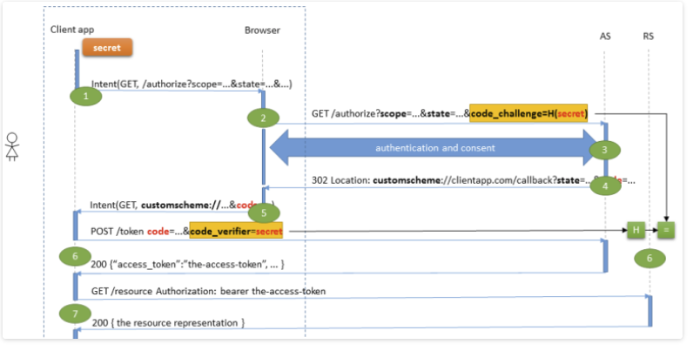
Native/Mobile Client

Slide 22
Native/Mobile Client
Can’t store client secret safely, don’t use it
ClientID is identical for the same app, use dynamic client registration
OAuth 2.0 for Native Apps (https://tools.ietf.org/html/rfc8252)
Do not build your own login form
A lot of provider deprecate this flow
Use system browser !
Register custom URI handler for your app to received authorization redirect
Store access and refresh token in secure storage

Slide 23
Native/Mobile Client
Client Library
AppAuth library ! (https://appauth.io/), available in ios, android and JS
C# .Net IdentityModel.OidcClient2 (https://github.com/IdentityModel/IdentityModel.OidcClient2)

Slide 25
SPA
React, Angular, etc.
Most common client but…
The most difficult to secure
Implicit Flow is widely adopted

Slide 26
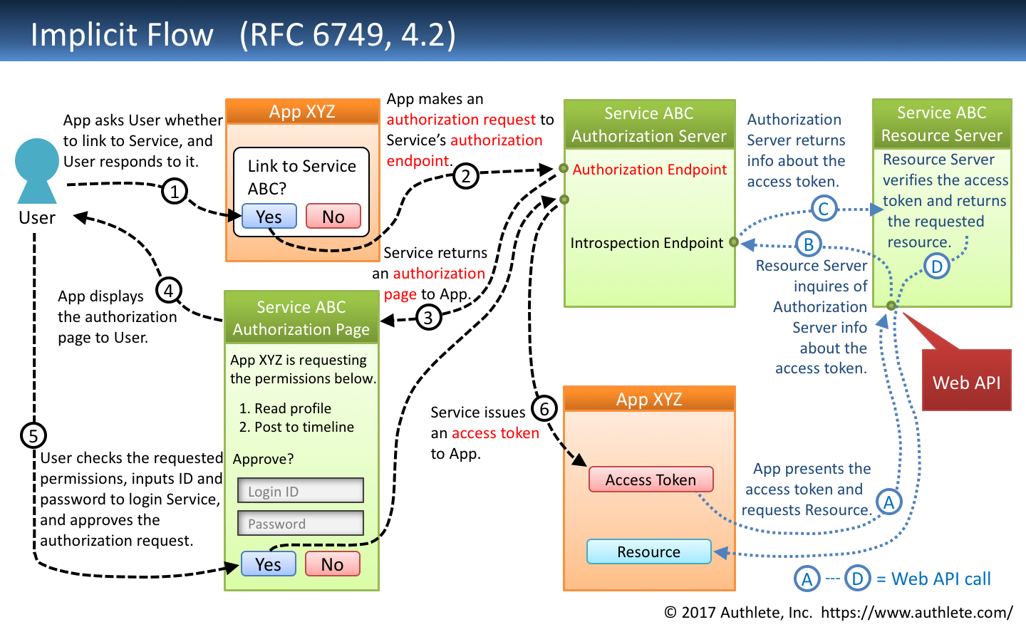

Slide 27
SPA
Problem with SPA and OAuth
Access token is sent on the front channel
Must use hash fragment in the URL
XSS, XRF can cause access token exfiltration
How to prevent \token substitution attack ?
OpenID Implicit Flow added (at hash) claim

Slide 28
RFC 6819
January 2019
OAuth 2.0 Threat Model and Security Considerations (https://tools.ietf.org/html/rfc6819)
Is Implicit Flow anti pattern ?
What’s the solution ?

Slide 29
Authorization Code + PKCE
Unified Flow for 3 type of clients !
Use library that support PKCE
Most good client library is just a matter of configuration change

Slide 30
Securing SPA
Use a certified OpenID library
Don’t use unsafe DOM manipulation:
Angular DomSanitizer.bypass*()
Watch out on using non-reputable package from NPM !
Utilize CSP !
Use silent token renewal instead rather than refresh token
Alternate:
Use same site cookie for same domain application
BFF

Slide 31
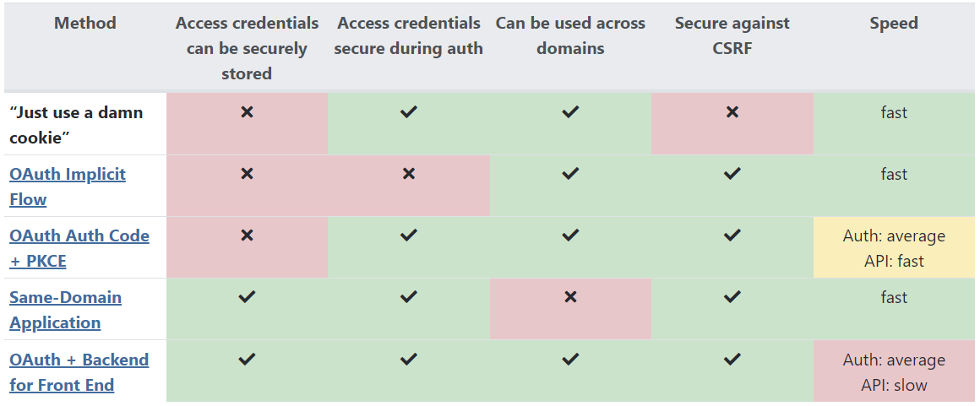
Securing SPA
https://www.scottbrady91.com/OAuth/Cheat-Sheet-OAuth-for-Browser-Based-Applications

Slide 32
SPA OIDC Library
oidc-client (https://www.npmjs.com/package/oidc-client) aka. oidc-client-js
AuthJS (https://www.npmjs.com/package/@openid/appauth)
angular-oauth2-oidc (https://github.com/manfredsteyer/angular-oauth2-oidc)
Vendor specific (Octa, auth0, etc.)

Slide 34
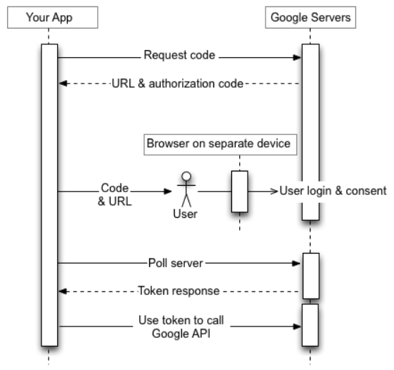
Device Flow

Slide 35
IDaaS
Okta (https://www.okta.com/)
Auth0 (https://auth0.com/)
OneLogin (https://www.itcentralstation.com/products/onelogin-reviews)
SailPoint(https://www.sailpoint.com/?elqct=Website&elqchannel=OrganicDirect)
AWS (Cognito)
Azure (Azure AD B2C)
GCP (Identity Platform)_

Slide 36
OSS
IdentityServer4 (.NET, http://docs.identityserver.io/en/latest/)
Gluu (Java, https://www.gluu.org/)
Both are OpenID Foundation Certified

Slide 37
Libraries
https://openid.net/developers/libraries/

Slide 38
IETF
JWT (https://tools.ietf.org/html/rfc7519)
OAuth 2.0 for Browser-Based Apps (https://tools.ietf.org/html/draft-parecki-oauth-browser-based-apps-02)
OAuth 2.0 Security Best Current Practice (https://tools.ietf.org/html/draft-ietf-oauth-security-topics-12)
OAuth 2.0 for Native Apps (https://tools.ietf.org/html/rfc8252)

