Slide 1







FlipZon Online Shopping Portal
Shaunak Sheth
Viral Goradia
Chandrabhan Chouhan

Slide 2

Problem Statement
We Flipzone Corporation has major presence across the country with physical stores. With current trend of Online shopping, we have decided to develop our own Online Shopping portal. This will help us in:
Increase Customer base by reaching to the remotest customer and not only store based
Saving on Third Party Service Providers (Amazon, Flipkart etc..) Charges
Efficient utilization of our Inventory by storing in our own Stores/warehouses.
User can browse through the product catalog and add the items to shopping cart.
User can proceed to Order as long as the shopping cart is not empty.
New user has to login into application if user wants to buy any product.
User can Login and view the Previous Orders and related details.

Slide 3
Assumptions and Scope of project
Assumptions:
Payment Gateway integration will be working based on service subscription
All Payment and User Details provided are Valid
All the Products will be entered using Database Scripts till our System is linked to Inventory management System and Admin Module gets ready
Scope:
User Registration
Login Authentication
Browse Product Catalog
Add to Cart
View & Update Cart
Place Order
Order Summary

Slide 4
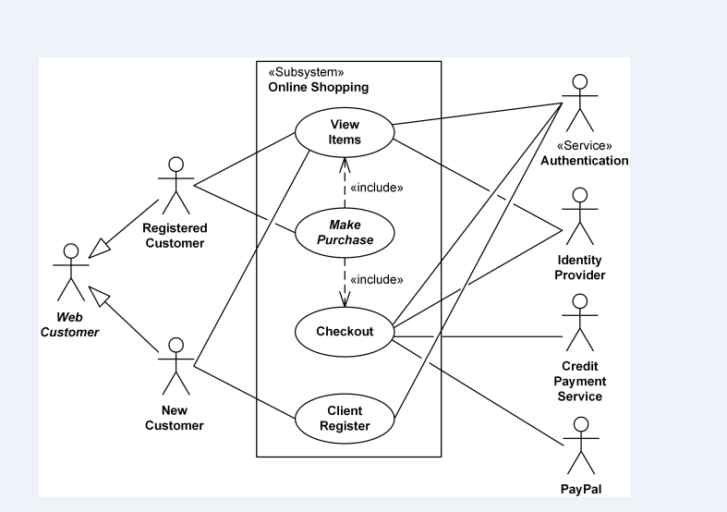
Use case diagrams

Slide 5
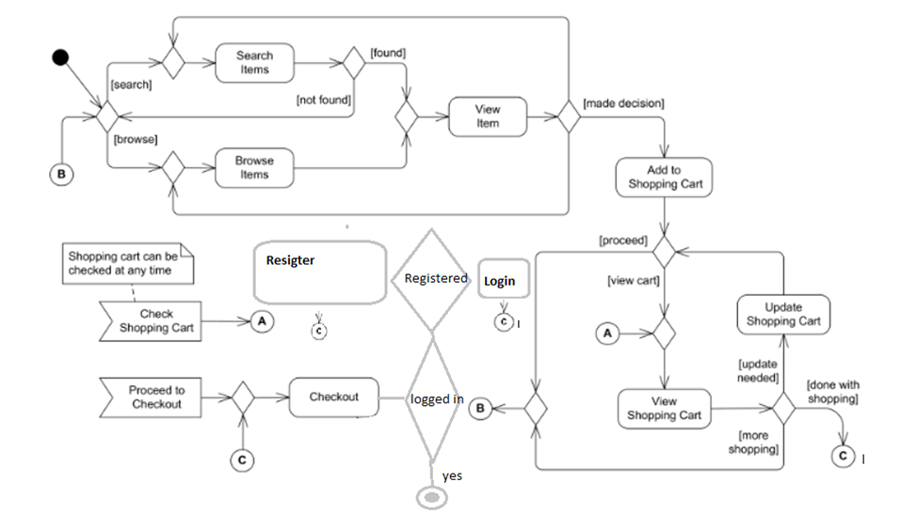
Activity diagram

Slide 6


Technologies, tools, frameworks with versions used in the project
Technologies
Java 1.8
Spring Boot 2.0
JPA 2.1
Oracle SQL V 11
Angular 7
HTML 5
Boot Strap 3.0
Tools:
Eclipse
Microsoft Visual Code
Star UML
Oracle SQL Developer
Postman

Slide 7
Salient features of the project
HTML 5 local Storage
Token based Authentication
Client Side Validation
Bootstrap Carousel & Bootswatch
Association (One to Many)
Remote Hosting

Slide 8
Application Architecture
APPLICATION ARCHITECTURE
APPLICATION ARCHITECTURE
APPLICATION ARCHITECTURE
R
E
S
T
C
O
N
T
R
O
L
L
E
R
SERVICE
LAYER
D
A
O
LAYER
MVC
DB
JSON CORS
JPA

Slide 9

What next? Future Sprints
Functional Enhancements:
Admin for Product Management
Category wise Product Search and Details.
User Profile Management
Order Status Management & Tracking
Payment Gateway integration
Technology Enhancements/Upgrades
Spring Boot Security
Cloud based microservices
Mobile App

Slide 10

Project Demo & Feed Back

Slide 11


Thank you

