Slide 1
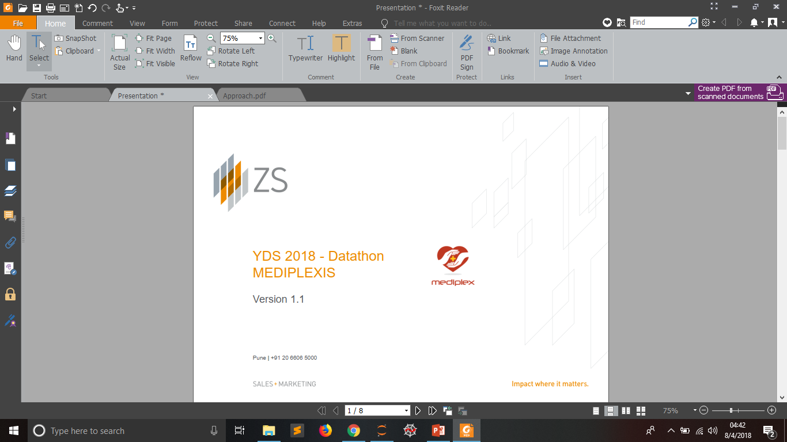
ZS DATA SCIENCE CHALLENGE-2019
CHRISTIANO RONALDO

Slide 2
Pipeline Used For The Given Problem:
Import Python Library
Load The Dataset
Apply Pre-Eliminary Data Analysis
Observe Key Trends
Construct New Features (If Possible)
Take The Model Which Gives Best Result
Optimized The Model Using Validation Set and Given Evaluation Metric
Try Different ML Algorithms

Slide 3
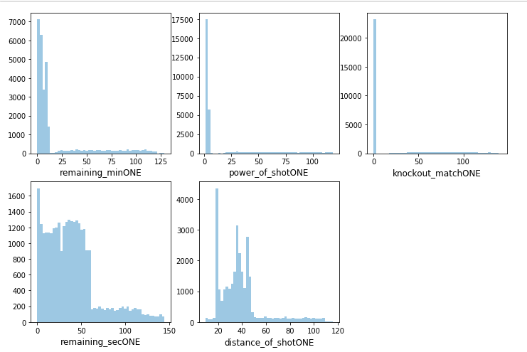
Quality Checks Performed / Error Found:
I have found that there is duplicacy in the features as features are repetaed.
Most of the features like remaining_min,power_of_shot,knockout_match,remaining_sec,distance_of_shot are right skewed .

Slide 4
Data Preprocessing Steps:
Found highest missing value percentage for :
type_of_shot 49.776851%
type_of_combined_shot 50.223149%
Preprocessed Data Column home/away:
MANU vs POR
MANU @ POR
If Label Encoded(which is done later) above two will be treated as different category so replaced all ‘@’ symbol with ‘vs’

Slide 5
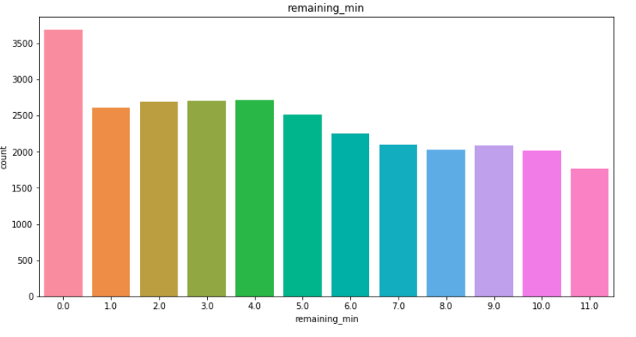
EDA(Exploratory Data Analysis):
Univariate Analysis
remaining_min has 11 Categorical values .

Slide 6
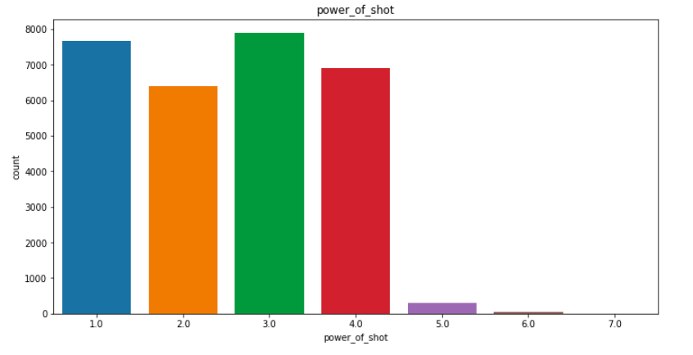
EDA(Exploratory Data Analysis):
power_of_shot has 7 unique categories

Slide 7
EDA(Exploratory Data Analysis):
power_of_shot has 7 unique categories

Slide 8
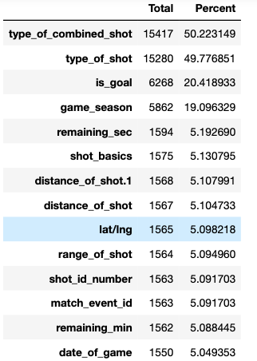
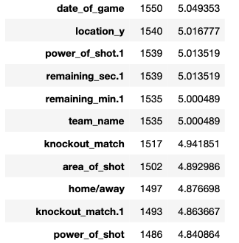
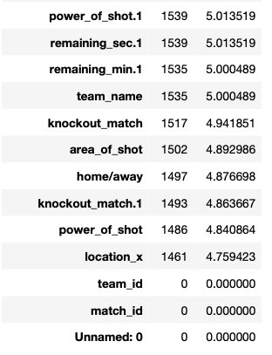
EDA(Exploratory Data Analysis):
Treating Missing V values varying o from 5%-50%.

Slide 9
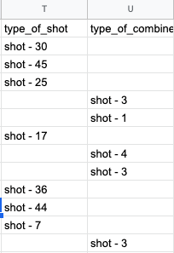
EDA(Exploratory Data Analysis):
Treating Missing Value:
Filling type_of_shot and type_of_combined_shot by BINNING.(Filling approximation)
type_of_shot = type_of_combined_shot *10+5
type_of_combined_shot = type_of_shot /10

Slide 10
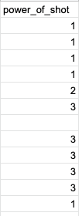

EDA(Exploratory Data Analysis):
Treating Missing Value:
Filling power_of_shot by downscaling(eg, 78:=(78/10=7.8) => give to 7) and alotting to one of the unique category.(Filling approximation)
power_of_shot= power_of_shot(Duplicate one)/10
If there are columns which is null to both then fill by Mode

Slide 11
EDA(Exploratory Data Analysis):
Treating Missing Value:
Filling remaining_min by downscaling(eg, 78:=(78/10=7.8) => give to 7) and alotting to one of the unique category.(Filling approximation)
remaining_min= remaining_min(Duplicate one)/10
If there are columns which is null to both then fill by Mode
Filling knockout_match by replacing one which has NULL with which do not have NULL values.
If there are columns which is null to both then fill by Mode

Slide 12
EDA(Exploratory Data Analysis):
Treating Missing Value:
Filling distance_of_shot by rounding off and replacing one which has NULL with the duplicate column which do not have NULL values.
distance_of_shot = ROUND(distance_of_shot (Duplicate one))
If there are columns which is null to both then fill by Median
Filling remaining_sec by replacing one which has NULL with the duplicate column which do not have NULL values.
If there are columns which is null to both then fill by Median

Slide 13
EDA(Exploratory Data Analysis):
Treating Missing Value:
Filling
location_x : Mean
home/away: Mode
area_of_shot: Mode
team_name :Mode
location_y ;Median
'year','month','date'(Compositely date_of_game):Mode
match_event_id: Median
range_of_shot: Mode
lat/lng: Mode
shot_basic: Mode

Slide 14
EDA(Exploratory Data Analysis):
Feature Generation:
Build the date, month, year feature from date_of_game.

Slide 15
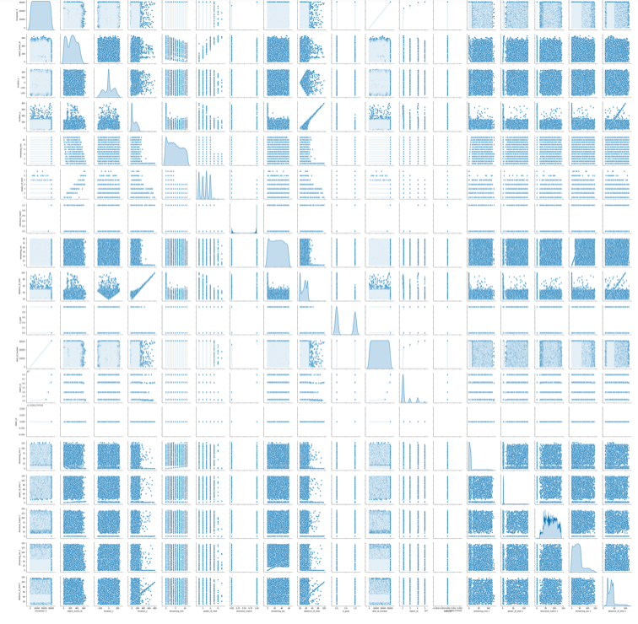
Key Observation and Trends:
Continuos vs Continuos PairPlot

Slide 16
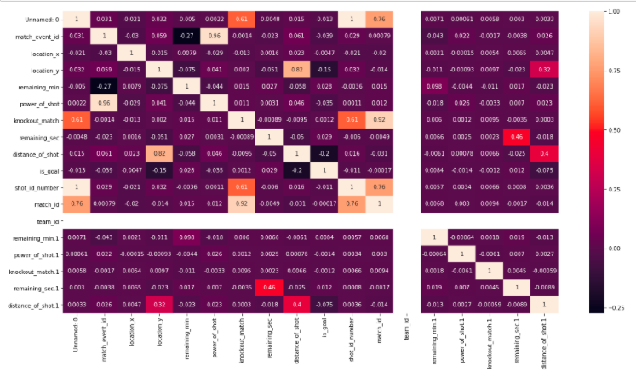
Key Observation and Trends:
Heatmap show that there is a little bit correlation between variables but its not up to the mark.(some are having correlation>0.5)

Slide 17
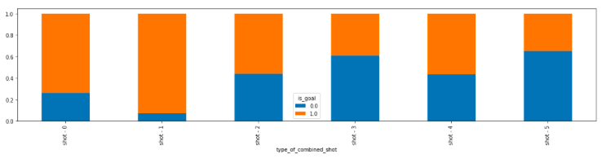
Key Observation and Trends:
is_goal probability is more with shot_1

Slide 18
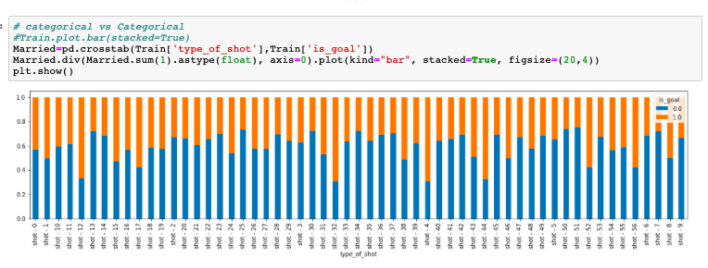
Key Observation and Trends:
This distribution shows that more doctors are from Urban region than Rural region.
is_goal probability is greater with shot-12 and shot-32

Slide 19
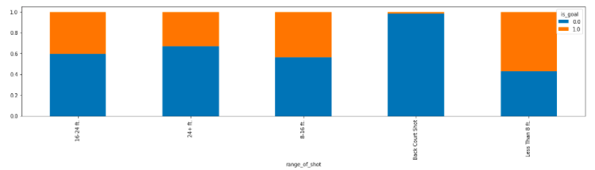
Key Observation and Trends:
is_goal probability is greater with less than 8 ft rang_of_shot

Slide 20
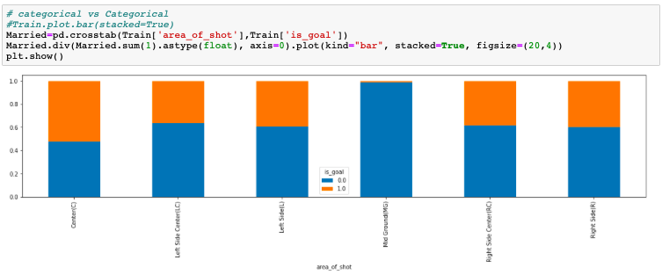
Key Observation and Trends:
is_goal probability is greater with Center area_of_shot

Slide 21
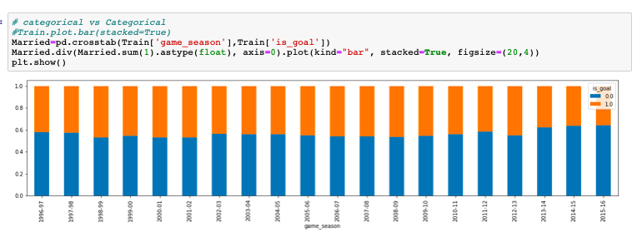
Key Observation and Trends:
is_goal probability is greater with almost equal for all game_season (Not Significant observation can be done)

Slide 22
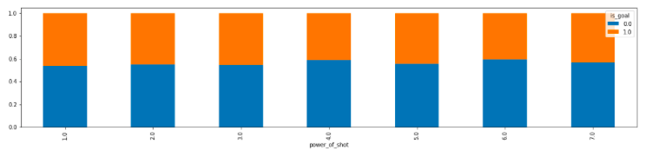
Key Observation and Trends:
is_goal probability is not significant to infer here

Slide 23
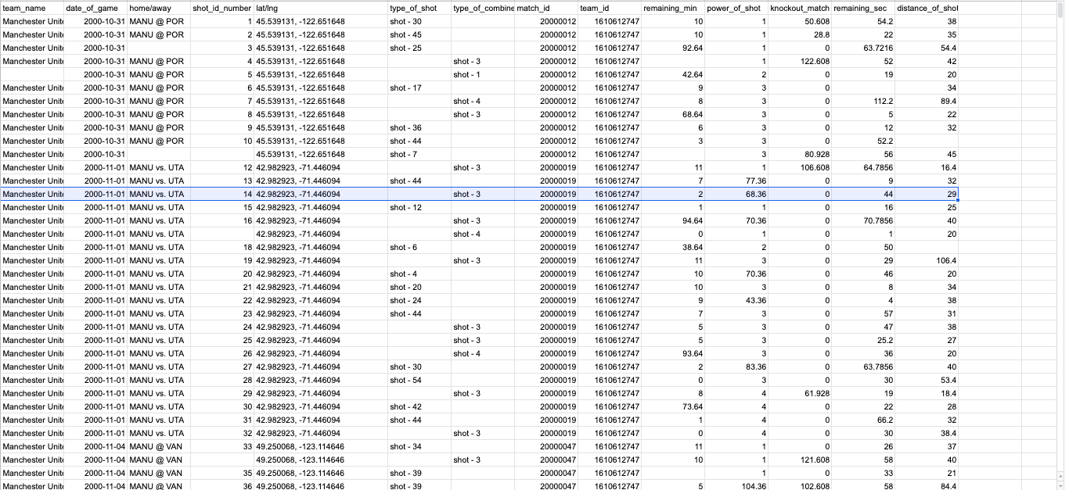
Key Observation and Trends:
There is a pattern to fill NaN Values.

Slide 24
Model Building:
I have used Label Encoding technique in order to deal with categorical features like:
shot_basics
area_of_shot
game_season
range_of_shot
home/away
lat/lng
type_of_combined_shot
# type_of_shot columns was not label encode in order to ensure its ordinality.
# shot_id_number was unique attribute with missing values but there was a simple trend as it was a series of continuous Natural Numbers.

Slide 25
Model Choice Explanation:
Used different Machine Learning Algorithms :
Random Forest
Logistic Regression
Light GBM
Used Random Forest as it is a version of ensemble learning
Then applied CatBoost algorithm to predict the NULL values in the 3 columns – P2P, OLV, OLA
Light GBM and Logistic Regression(solver=lbfgs) works very well we have categorical features so I thought using it.

Slide 26
Other Model Choices:
We can use other models like ensemble of random forest with extra tree regressor.
we can also use models like XgBoost to solve the problem.
I have used Logistic Regression in my final submission because it was giving decent score, when I was computing it using the MAE metric.

Slide 27
Thank You

