Slide 1
OAuth 2.0 Component
2. Send ID/Password
& Request
User
Application
Service Provider
1. Input ID/Password
API Server
3. Response

Slide 2
OAuth 2.0 Component
Application
(Web Server)
Service Provider
User
(Resource Owner)
User Agent
(Web Browser)
Resource Server
(API Server)
Authorization
Server

Slide 3
OAuth 2.0 Flow - Access Token
User
(Resource Owner)
User Agent
(Web Browser)
Application
(Web Server)
Authorization
Server
Resource Server
(API Server)
1. Enter URL
2. Goto URL
3. Redirect to Auth Server with Client ID, Scope, Callback URL
4. Goto Auth Server with Client ID, Scope, Callback URL
5. Present Authorization UI
6. Show Authorization UI
7. Agree
8. Send Authentication and Authorization Info
9. Redirect to Callback URL with Authorization Code
10. Return to Callback URL with Authorization Code
11. Send Authorization Code, Client ID, Client Secret
12. Send Access Token (& Refresh Token)

Slide 4
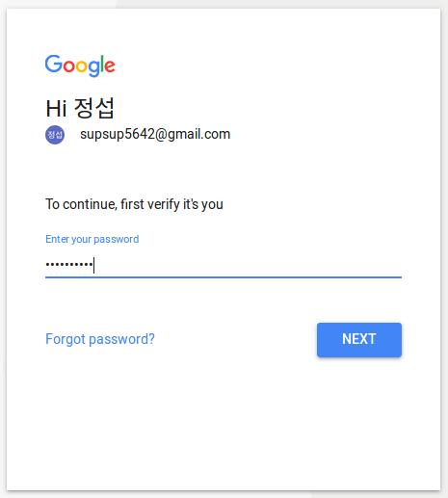
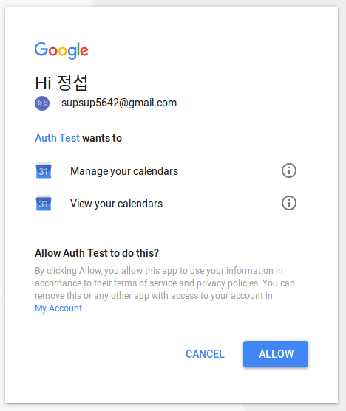
OAuth 2.0 Goole Auth UI

Slide 5
OAuth 2.0 Flow - Resource Access
User
(Resource Owner)
User Agent
(Web Browser)
Application
(Web Server)
Authorization
Server
Resource Server
(API Server)
1. Click Resource URL
2. Goto URL
3. Request Resource with Access Token
4. Send Access Token
5. Agree
6. Send Resource
7. Present Resource
8. Show Resource

Slide 6
OAuth 2.0 Flow - Refresh Token
User
(Resource Owner)
User Agent
(Web Browser)
Application
(Web Server)
Authorization
Server
Resource Server
(API Server)
1. Enter URL
2. Goto URL
3. Request Resource with Access Token
4. Send Access Token
5. Invalid
6. Send Invaild Token Error
7. Send Client ID, Client Secret, Refresh Token
8. Send New Access Token
9. Request Resource with New Access Token
10. Send Access Token
11. Invalid
12. Send Resource
13. Present Resource
14. Show Resource

Slide 8
OAuth 2.0 Flow - Access Token
User
(Resource Owner)
User Agent
(Web Browser)
Application
(Web Server)
Authorization
Server
Resource Server
(API Server)
1. Enter URL
2. Goto URL
3. Redirect to Auth Server with Client ID, Scope, App URL
4. Goto Auth Server with Client ID, Scope, App URL
5. Present Authorization UI
6. Show Authorization UI
7. Agree
8. Send Authentication and Authorization Info
9. Redirect to App URL with Authorization Code
10. Goto to App with Authorization Code
11. Send Authorization Code, Client ID, Client Secret
12. Send Access Token (& Refresh Token)

Slide 9
OAuth 2.0 Component
2. Send ID/Password
User
1. Input ID/Password
Application
Server
3. Send Resource

