Slide 1
Cilium Component
Host
Host
Key-values Storage (etcd)
cilium-agent Pod
(Host Network
Namespace)
Host
cilium-agent Pod
(Host Network
Namespace)
cilium-agent
cilium (CLI)
cilium-agent Pod
(DeamonSet,
Host Network
Namespace)
cilium-agent
cilium (CLI)
cilium-agent
cilium (CLI)
K8s API Server
cilium-operator Pod
Kernel
Kernel
cilium-operator Pod
Network eBPF
Network eBPF
cilium-operator
Kernel
cilium-operator Pod
(Deployment)
Network eBPF
Network eBPF
cilium-operator
cilium-operator
cilium-operator
Network eBPF Program
eBPF Map
eBPF Map
Network eBPF Program

Slide 2
Cilium Network with VXLAN
Host 1
(192.167.2.0/24)
Host 2
(192.167.3.0/24)
Pod A
192.167.2.10
Pod B
192.167.2.11
Pod C
(Host Net NS)
Pod D
(Host Net NS)
Pod E
192.167.3.10
Pod F
192.167.3.11
eth0
eth0
eth0
eth0
lxcxxxx
lxcxxxx
lxcxxxx
lxcxxxx
SCHED_CLS Ingress
SCHED_CLS Ingress
SCHED_CLS Ingress
SCHED_CLS Ingress
10.0.0.0/24 | 10.0.0.1 | eth0
192.167.2.0/24 | 192.167.2.1 | cilium_host
192.167.3.0/24 | 192.167.2.1 | cilium_host
192.167.2.1/32 | 0.0.0.0 | cilium_host
10.0.0.0/24 | 10.0.0.1 | eth0
192.167.2.0/24 | 192.167.3.1 | cilium_host
192.167.3.0/24 | 192.167.3.1 | cilium_host
192.167.3.1/32 | 0.0.0.0 | cilium_host
SCHED_CLS Egress
SCHED_CLS Egress
cilium_host
cilium_host
SCHED_CLS Ingress
192.167.2.1
192.167.3.1
SCHED_CLS Ingress
cilium_vxlan
cilium_net
cilium_net
cilium_vxlan
eth0 (Default GW)
eth0 (Default GW)
10.0.0.20
10.0.0.30
Host Network : 10.0.0.0/24
Container Network 192.167.0.0/24

Slide 3
Cilium Network with Host L3
Host 1
(192.167.2.0/24)
Host 2
(192.167.3.0/24)
Pod A
192.167.2.10
Pod B
192.167.2.11
Pod C
(Host Net NS)
Pod D
(Host Net NS)
Pod E
192.167.3.10
Pod F
192.167.3.11
eth0
eth0
eth0
eth0
lxcxxxx
lxcxxxx
lxcxxxx
lxcxxxx
SCHED_CLS Ingress
SCHED_CLS Ingress
SCHED_CLS Ingress
SCHED_CLS Ingress
10.0.0.0/24 | 10.0.0.1 | eth0
192.167.2.0/24 | 192.167.2.1 | cilium_host
192.167.2.1/32 | 0.0.0.0 | cilium_host
10.0.0.0/24 | 10.0.0.1 | eth0
192.167.2.0/24 | 192.167.3.1 | cilium_host
192.167.3.1/32 | 0.0.0.0 | cilium_host
SCHED_CLS Egress
SCHED_CLS Egress
cilium_host
cilium_host
192.167.2.1
192.167.3.1
cilium_net
cilium_net
eth0 (Default GW)
eth0 (Default GW)
10.0.0.20
10.0.0.30
Host Network : 10.0.0.0/24
Container Network 192.167.0.0/24

Slide 4
Cilium Service with VXLAN
Pod A
Pod B
Pod C
(Host Net NS)
eth0
eth0
1
1
lxcxxxx
lxcxxxx
DNAT / DNAT
IPTables / IPVS / /___________
Service B → Pod B
Service D → Pod D
SCHED_CLS Ingress
DNAT / DNAT
SCHED_CLS Ingress
SNAT / SNAT
2
1
2
CGROUP_SOCK_ADDR
1
5
2
Pod A → Service B
Pod A → Service D
Routing Table
Pod C → Service B
3
6
3
9
5
4
Pod C → Service D
SCHED_CLS Ingress
SNAT
4
SCHED_CLS Egress SNAT
10
7
cilium_host
cilium_net
8
cilium_vxlan
5
7
2
4
eth0
3
6
Pod D

Slide 5
Cilium Service with Host L3
Pod A
Pod B
Pod C
(Host Net NS)
eth0
eth0
1
1
lxcxxxx
lxcxxxx
DNAT / DNAT
IPTables / IPVS / /___________
Service B → Pod B
Service D → Pod D
SCHED_CLS Ingress
DNAT / DNAT
SCHED_CLS Ingress
SNAT / SNAT
2
1
2
CGROUP_SOCK_ADDR
1
5
2
Pod A → Service B
Pod A → Service D
Routing Table
Pod C → Service B
2
5
3
6
3
6
4
Pod C → Service D
6
SCHED_CLS Egress SNAT / SNAT
7
7
cilium_host
cilium_net
4
5
eth0
3
4
Pod D

Slide 6
Cilium Prefilter
Host - Host L3
Host - VXLAN
SCHED_CLS Ingress
10.0.0.0/24 | 10.0.0.1 | eth0
192.167.3.0/24 | 192.167.3.1 | cilium_host
192.167.3.1 | 0.0.0.0 | cilium_host
cilium_vxlan
Generic XDP
or Native XDP
Generic XDP
or Native XDP
eth0
eth0

Slide 8
Cilium Component
etcd
API
Host
cilium Pod
(Host Network
Namespace)
cilium (CLI)
cilium-agent
cilium-health
cilium-node- monitor
Kernel
Network BPF
Network BPF

Slide 9
Cilium Network with VXLAN
Host 1
(192.167.2.0/24)
Host 2
(192.167.3.0/24)
Pod A
192.167.2.10
Pod B
192.167.2.11
Pod C
192.167.3.10
Pod D
192.167.3.11
eth0
eth0
eth0
eth0
lxcxxxx
lxcxxxx
lxcxxxx
lxcxxxx
act ingress
act ingress
act ingress
act ingress
10.0.0.0/24 | 10.0.0.1 | eth0
192.167.2.0/24 | 192.167.2.1 | cilium_host
192.167.3.0/24 | 192.167.2.1 | cilium_host
192.167.2.1/32 | 0.0.0.0 | cilium_host
10.0.0.0/24 | 10.0.0.1 | eth0
192.167.2.0/24 | 192.167.3.1 | cilium_host
192.167.3.0/24 | 192.167.3.1 | cilium_host
192.167.3.1/32 | 0.0.0.0 | cilium_host
act engress
act engress
act ingress
cilium_host (veth)
cilium_host (veth)
act ingress
cilium_vxlan
192.167.2.1
192.167.3.1
cilium_vxlan
eth0
eth0
10.0.0.20
10.0.0.30
Host Network : 10.0.0.0/24
Container Network 192.167.0.0/24

Slide 10

Cilium Network with Host L3
Host 1
(192.167.2.0/24)
Host 2
(192.167.3.0/24)
Pod A
192.167.2.10
Pod B
192.167.2.11
Pod C
192.167.3.10
Pod D
192.167.3.11
eth0
eth0
eth0
eth0
lxcxxxx
lxcxxxx
lxcxxxx
lxcxxxx
act ingress
act ingress
act ingress
act ingress
10.0.0.0/24 | 10.0.0.1 | eth0
192.167.2.0/24 | 192.167.2.1 | cilium_host
192.167.2.1/32 | 0.0.0.0 | cilium_host
10.0.0.0/24 | 10.0.0.1 | eth0
192.167.3.0/24 | 192.167.3.1 | cilium_host
192.167.3.1/32 | 0.0.0.0 | cilium_host
act engress
act engress
cilium_host (veth)
cilium_host (veth)
192.167.2.1
Router
192.167.3.1
eth0
eth0
10.0.0.20
10.0.0.30
Host Network : 10.0.0.0/24
Container Network 192.167.0.0/24

Slide 11
Cilium Load Balacner
Host - Host L3
10.0.0.0/24 | 10.0.0.1 | eth0
192.167.3.0/24 | 192.167.3.1 | cilium_host
192.167.3.1 | 0.0.0.0 | cilium_host
act ingress
eth0

Slide 12
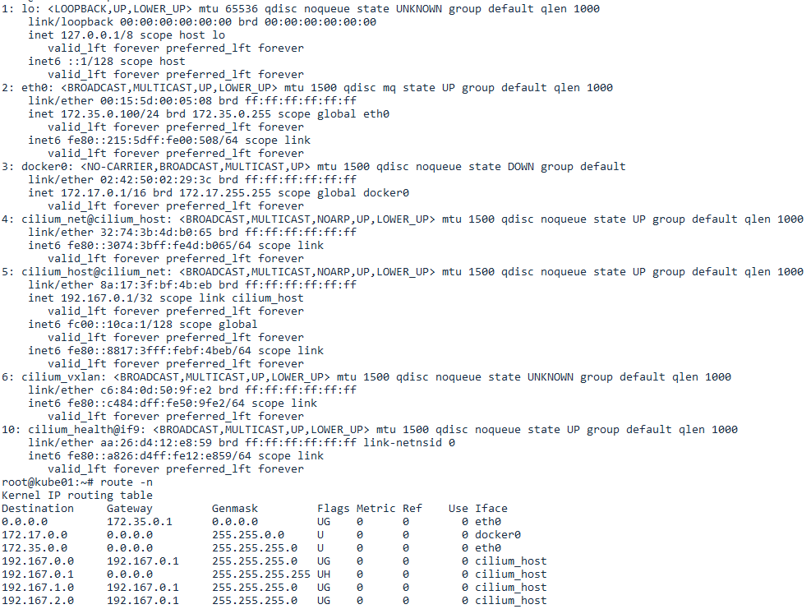

Slide 13
Cilium Network with VXLAN
Host 1
(192.167.2.0/24)
Host 2
(192.167.3.0/24)
Pod A
192.167.2.10
Pod B
192.167.2.11
Pod C (Host Net NS) / Host Process
Pod D (Host Net NS) / Host Process
Pod E
192.167.3.10
Pod F
192.167.3.11
eth0
eth0
eth0
eth0
lxcxxxx
lxcxxxx
lxcxxxx
lxcxxxx
SCHED_ACT Ingress
SCHED_ACT Ingress
SCHED_ACT Ingress
SCHED_ACT Ingress
10.0.0.0/24 | 10.0.0.1 | eth0
192.167.2.0/24 | 192.167.2.1 | cilium_host
192.167.3.0/24 | 192.167.2.1 | cilium_host
192.167.2.1/32 | 0.0.0.0 | cilium_host
10.0.0.0/24 | 10.0.0.1 | eth0
192.167.2.0/24 | 192.167.2.1 | cilium_host
192.167.3.0/24 | 192.167.2.1 | cilium_host
192.167.3.1/32 | 0.0.0.0 | cilium_host
SCHED_ACT Engress
SCHED_ACT Engress
SCHED_ACT Ingress
cilium_host (veth)
cilium_host (veth)
SCHED_ACT Ingress
cilium_vxlan
192.167.2.1
192.167.3.1
cilium_vxlan
eth0
eth0
10.0.0.20
10.0.0.30
Host Network : 10.0.0.0/24
Container Network 192.167.0.0/24

Slide 14
Cilium Network with Host L3
Host 1
(192.167.2.0/24)
Host 2
(192.167.3.0/24)
Pod A
192.167.2.10
Pod B
192.167.2.11
Pod C (Host Net NS) / Host Process
Pod D (Host Net NS) / Host Process
Pod E
192.167.3.10
Pod F
192.167.3.11
eth0
eth0
eth0
eth0
lxcxxxx
lxcxxxx
lxcxxxx
lxcxxxx
SCHED_ACT Ingress
SCHED_ACT Ingress
SCHED_ACT Ingress
SCHED_ACT Ingress
10.0.0.0/24 | 10.0.0.1 | eth0
192.167.2.0/24 | 192.167.2.1 | cilium_host
192.167.3.0/24 | 192.167.2.1 | cilium_host
192.167.2.1/32 | 0.0.0.0 | cilium_host
10.0.0.0/24 | 10.0.0.1 | eth0
192.167.2.0/24 | 192.167.2.1 | cilium_host
192.167.3.0/24 | 192.167.2.1 | cilium_host
192.167.3.1/32 | 0.0.0.0 | cilium_host
SCHED_ACT Engress
SCHED_ACT Engress
cilium_host (veth)
cilium_host (veth)
192.167.2.1
192.167.3.1
eth0
eth0
10.0.0.20
10.0.0.30
Host Network : 10.0.0.0/24
Container Network 192.167.0.0/24

