Slide 1

Calico Component
Host
BGP Route
Reflector
(bird)
calico-node Pod
(Host Network Namespace)
bird
confd
Router
calico-felix
etcd

Slide 2
Calico Network with IP-in-IP
Host 1
(192.168.2.0/24)
Host 2
(192.168.3.0/24)
Pod A
Pod B
eth0
192.168.2.10
eth0
192.168.3.10
calixxx
caliyyy
10.0.0.0/24 | 10.0.0.1 | eth0
192.168.3.0/24 | 10.0.0.30 | tunl0
192.168.2.0/24 | 0.0.0.0 | *
192.168.2.10/32 | 0.0.0.0 | calixxx
10.0.0.0/24 | 10.0.0.1 | eth0
192.168.2.0/24 | 10.0.0.20 | tunl0
192.168.3.0/24 | 0.0.0.0 | *
192.168.3.10/32 | 0.0.0.0 | caliyyy
tunl0
192.168.2.1
192.168.3.1
tunl0
eth0
eth0
10.0.0.20
10.0.0.30
Host Network : 10.0.0.0/24
Pod Network 192.168.0.0/24

Slide 3
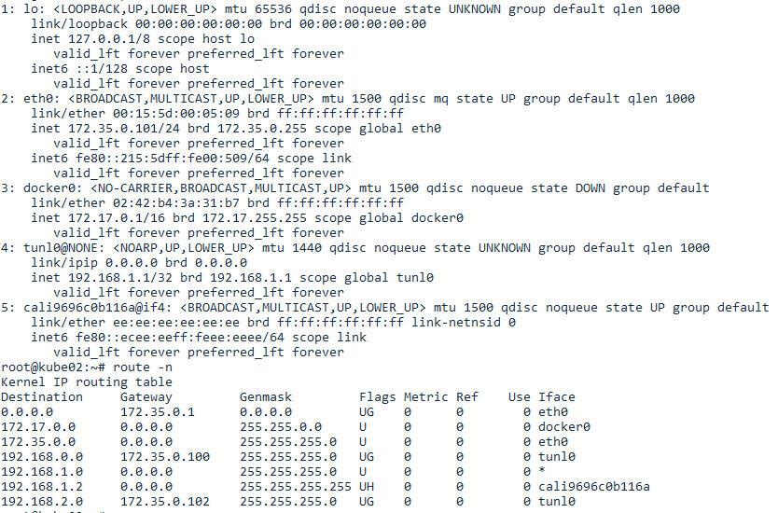

Slide 5
Calico Network with IP-in-IP
Host 1
(192.168.2.0/24)
Host 2
(192.168.3.0/24)
Pod A
Pod B
eth0
192.168.2.10
eth0
192.168.3.10
calixxx
caliyyy
10.0.0.0/24 | 0.0.0.0 | eth0
192.168.3.0/24 | 10.0.0.30 | tunl0
192.168.2.10 | 0.0.0.0 | calixxx
10.0.0.0/24 | 0.0.0.0 | eth0
192.168.2.0/24 | 10.0.0.20 | tunl0
192.168.3.10 | 0.0.0.0 | caliyyy
tunl0
192.168.2.1
192.168.3.1
tunl0
eth0
eth0
10.0.0.20
10.0.0.30
Host Network : 10.0.0.0/24
Container Network 192.168.0.0/24

