Slide 1
Meetup Data Analysis
By,
Sushmanth Sagala
Spark Project – Upx Academy (6 Month Certificate Programme in Big Data)

Slide 2
Project Information
Domain: Social
Technology use: Spark streaming, Spark SQL, Spark MLlib
Dataset: http://stream.meetup.com/2/open_events
Meetup is an online social networking portal that facilitates offline group meetings in various localities around the world. Meetup allows members to find and join groups unified by a common interest, such as politics, books and games.

Slide 3
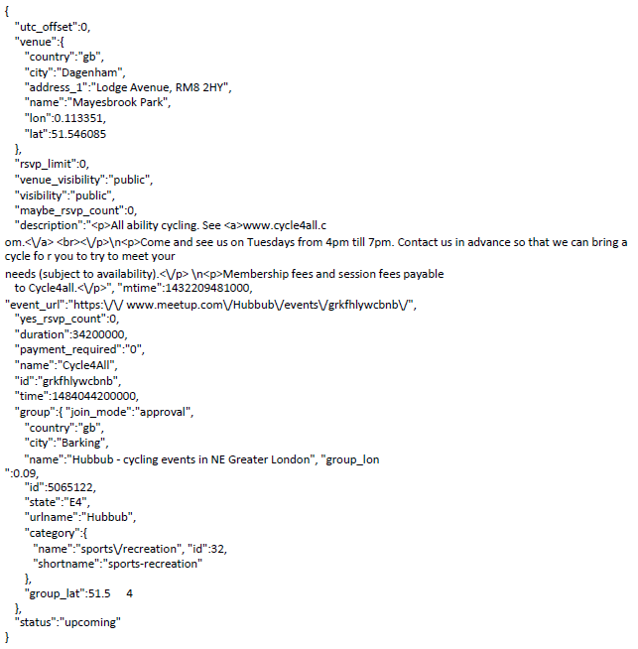
Sample Events Dataset

Slide 4
Business Questions
Streaming/Spark Sql
Load the streaming data
Count the number of events happening in a city eg. Hyderabad
Count the number of free events
Count the events in Technology category
Count the number of Big data events happening in US
Find the average duration of Technology events
Spark MLLIB
Group the events by their category (k-means clustering)

Slide 5
Q1. Load the streaming data
Custom receiver to load data from external URL.
Asynchronous HTTP request to read the data from streaming URL.
def onStart() {
val cf = new AsyncHttpClientConfig.Builder()
cf.setRequestTimeout(Integer.MAX_VALUE)
cf.setReadTimeout(Integer.MAX_VALUE)
cf.setPooledConnectionIdleTimeout(Integer.MAX_VALUE)
client= new AsyncHttpClient(cf.build())
inputPipe = new PipedInputStream(1024 * 1024)
outputPipe = new PipedOutputStream(inputPipe)
val producerThread = new Thread(new DataConsumer(inputPipe))
producerThread.start()
client.prepareGet(url).execute(new AsyncHandler[Unit]{
def onBodyPartReceived(bodyPart: HttpResponseBodyPart) = {
bodyPart.writeTo(outputPipe)
AsyncHandler.STATE.CONTINUE
}
….
})
}

Slide 6
Q1. Load the streaming data
Class DataConsumer extends Runnable to read the stream data and store.
val bufferedReader = new BufferedReader( new InputStreamReader( inputStream ))
var input=bufferedReader.readLine()
while(input!=null){
store(input)
input=bufferedReader.readLine() }
Defining the case classes to extract respective data.
case class EventDetails(id: String, name: String, city: String, country: String, payment_required: Int, cat_id: Int, cat_name: String, duration: Long)
case class Venue(name: Option[String], address1: Option[String], city: Option[String], state: Option[String], zip: Option[String], country: Option[String], lon: Option[Float], lat: Option[Float])
case class Event(id: String, name: Option[String], eventUrl: Option[String], description: Option[String], duration: Option[Long], rsvpLimit: Option[Int], paymentRequired: Option[Int], status: Option[String])
case class Group(id: Option[String], name: Option[String], city: Option[String], state: Option[String], country: Option[String])
case class Category(name: Option[String], id: Option[Int], shortname: Option[String])

Slide 7
Q1. Load the streaming data
parseEvent method uses Json4s lib to extract the json data and define the EventDetails type.
val json=parse(eventJson).camelizeKeys
val event=json.extract[Event]
val venue=(json \ "venue").extract[Venue]
val group=(json \ "group").extract[Group]
val category=(json \ "group" \ "category").extract[Category]
EventDetails(event.id, event.name.getOrElse(""), venue.city.getOrElse(""), venue.country.getOrElse(""), event.paymentRequired.getOrElse(0), category.id.getOrElse(0), category.shortname.getOrElse(""), event.duration.getOrElse(10800000L))
Starting the event stream with Batch Interval of 2 secs,
val ssc=new StreamingContext(conf, Seconds(2))
val eventStream = ssc.receiverStream(new MeetupReceiver("http://stream.meetup.com/2/open_events")).flatMap(parseEvent)

Slide 8
Stateful Stream
Using Window stream to do aggregations across Intervals of stream.
Window and Slide interval = 10 sec
Batch interval = 2 sec
val windowEventStream = eventStream.window(Seconds(10),Seconds(10)) windowEventStream.cache()
Custom Functions to sum aggregations while using updateStateByKey.
def updateSumFunc(values: Seq[Int], state: Option[Int]): Option[Int] = { val currentCount = values.sum val previousCount = state.getOrElse(0) Some(currentCount + previousCount) }
def updateSumFunc2f(values: Seq[Double], state: Option[Double]): Option[Double] = { val currentCount = values.sum val previousCount = state.getOrElse(0.0) Some(currentCount + previousCount) }

Slide 9
Q2. Count the number of events happening in a city eg. Hyderabad
Filtering the list of events happening in a city say “New York”.
Reducing the events to get the number of events happening in this city for the current Window computation.
Aggregating the events count across the Window intervals using updateStateByKey.
val cityEventsStream = windowEventStream.filter{event => event.city == "New York"}.map{event => (event.city,1)}.reduceByKey(_+_).updateStateByKey(updateSumFunc _)
Printing the count of number of events happening in “New York” during each Window interval.
cityEventsStream.foreachRDD(rdd => {rdd.foreach{case (city, count) => println("No. of Events happening in %s city::%s".format(city, count))}})

Slide 10
Q3. Count the number of free events
Filtering the list of free events happening by using condition when ever payment_required value is 0.
Reducing the events to get the number of free events happening for the current Window computation.
Aggregating the events count across the Window intervals using updateStateByKey.
val freeEventsStream = windowEventStream.filter{event => event.payment_required == 0}.map{event => ("Free",1)}.reduceByKey(_+_).updateStateByKey(updateSumFunc _)
Printing the count of number of free events happening during each Window interval.
freeEventsStream.foreachRDD(rdd => {rdd.foreach{case (free, count) => println("No. of Free Events happening::%s".format(count))}})

Slide 11
Q4. Count the events in Technology category
Filtering the list of Technology events happening.
Reducing the events to get the number of Technology events happening for the current Window computation.
Aggregating the events count across the Window intervals using updateStateByKey.
Reusing the Technology category events for another question by storing the count in a stateless variable.
val techEventsStream = windowEventStream.filter{event => event.cat_name == "tech"}
var techCount = 0
val countTexhEventsStream = techEventsStream.map{event => (event.cat_name,1)}.reduceByKey(_+_).updateStateByKey(updateSumFunc _)
Printing the count of number of Technology events happening during each Window interval.
countTexhEventsStream.foreachRDD(rdd => {rdd.foreach{case (cat_name, count) => techCount = count; println("No. of %s Events happening::%s".format(cat_name,count))}})

Slide 12
Q5. Count the number of Big data events happening in US
Filtering the list of Big data events happening in “US”.
Reducing the events to get the number of Big data events happening in US for the current Window computation.
Aggregating the events count across the Window intervals using updateStateByKey.
val bigDataUSEventsStream = windowEventStream.filter{event => event.country == "us" && event.name.toLowerCase.indexOf("big data") >= 0}.map{event => ("Big Data",1)}.reduceByKey(_+_).updateStateByKey(updateSumFunc _)
Printing the count of number of Big data events happening in “US” during each Window interval.
bigDataUSEventsStream.foreachRDD(rdd => {rdd.foreach{case (name, count) => println("No. of %s Events happening in US::%s".format(name,count))}})

Slide 13
Q6. Find the average duration of Technology events
Reducing the Technology events to get the event duration for the current Window computation.
Aggregating the events duration across the Window intervals using updateStateByKey.
Computing the Average duration and Printing the Average duration for Technology events happening during each Window interval.
val sumDurTechEventsStream = techEventsStream.map{event => (event.cat_name + " Events", event.duration.toDouble / 60000.0)}.reduceByKey(_+_).updateStateByKey(updateSumFunc2f _)
sumDurTechEventsStream.foreachRDD(rdd => {
rdd.map{case(x:String, y:Double) => (x, y / techCount.toDouble)}.foreach{case (cat_name:String, avg:Double) => {
val hrs = (avg / 60.0).toInt
val min = (avg % 60).toInt
println("Avg duration of %s happening::%d hours %d minutes".format(cat_name,hrs,min)) }
} })

Slide 14
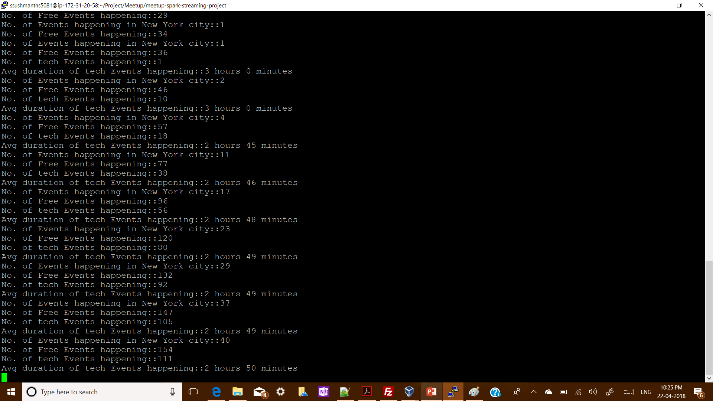
Sample output screenshot

Slide 15
Q7. Group the events by their category (k-means clustering)
Building a recommendation model by using k-means clustering on events.
Recommendation of group members is done based on clustering the event categories and rsvp’s responses respect to events.
Parsing history Events.
val eventsHistory = ssc.sparkContext.textFile("data/events/events.json", 1).flatMap(parseHisEvent)
Parsing history Rsvps.
case class Member(memberName: Option[String], memberId: Option[String])
case class MemberEvent(eventId: Option[String], eventName: Option[String], eventUrl: Option[String], time: Option[Long])
val json=parse(rsvpJson).camelizeKeys
val member=(json \ "member").extract[Member]
val event=(json \ "event").extract[MemberEvent]
val response=(json \ "response").extract[String]
(member, event, response)
val rsvpHistory = ssc.sparkContext.textFile("data/rsvps/rsvps.json", 1).flatMap(parseRsvp)

Slide 16
Q7. Group the events by their category (k-means clustering)
Broadcasting Dictionary to load list of English dictionary words.
val localDictionary = Source.fromURL(getClass.getResource("/wordsEn.txt")).getLines.zipWithIndex.toMap
val dictionary= ssc.sparkContext.broadcast(localDictionary)
Feature Extraction to get the 10 most popular words from the event description, to form the event category vectors for each event.
def eventToVector(dictionary: Map[String, Int], description: String): Option[Vector]={
val wordsIterator = breakToWords(description)
val topWords=popularWords(wordsIterator)
if (topWords.size==10) Some(Vectors.sparse(dictionary.size,topWords)) else None }
val eventVectors=eventsHistory.flatMap{ event=>eventToVector(dictionary.value,event.description.getOrElse("")) }

Slide 17
Q7. Group the events by their category (k-means clustering)
Training the history events based on k-means clustering model.
val eventClusters = KMeans.train(eventVectors, 10, 2)
Creating the Event History Ids and RSVP Member Event Id to join based on the Event ID.
val eventHistoryById=eventsHistory.map{event=>(event.id, event.description.getOrElse(""))}.reduceByKey{(first: String, second: String)=>first}
val membersByEventId=rsvpHistory.flatMap{ case(member, memberEvent, response) => memberEvent.eventId.map{id=>(id,(member, response))} }
val rsvpEventInfo=membersByEventId.join(eventHistoryById)
Example: (eventId, ((member, response), description))
(221069430, ((Member(Some(Susan Beck),Some(101089292)), yes), ‘…’))
(221149038, ((Member(Some(Tracy Ramey),Some(153724262), no), ‘…’))

Slide 18
Q7. Group the events by their category (k-means clustering)
Predicting the Event cluster based on the trained model.
val memberEventInfo = rsvpEventInfo.flatMap{ case(eventId, ((member, response), description)) => {eventToVector(dictionary.value,description).map{ eventVector=> val eventCluster=eventClusters.predict(eventVector) (eventCluster,(member, response)) } } }
Clustering members into groups based on the predictions.
val memberGroups = memberEventInfo.filter{case(cluster, (member, memberResponse)) => memberResponse == "yes"}.map{case(cluster, (member, memberResponse)) => (cluster,member)}.groupByKey().map{case(cluster,memberItr) => (cluster,memberItr.toSet)}

Slide 19
Q7. Group the events by their category (k-means clustering)
Member Recommendations based on the clustering.
val recommendations = memberEventInfo.join(memberGroups).map{case(cluster, ((member, memberResponse), members)) => (member.memberName, members-member)}
Example: (member.memberName, members)
(Some(Rosie),Set(Member(Some(Derek),Some(84715352)), Member(Some(Pastor Jim Billetdeaux),Some(7569836)), Member(Some(Tom),Some(11503256)), Member(Some(Haeran Dempsey),Some(10724391)), Member(Some(Jane),Some(130609252)), Member(Some(Cathy),Some(42921402))))

Slide 20
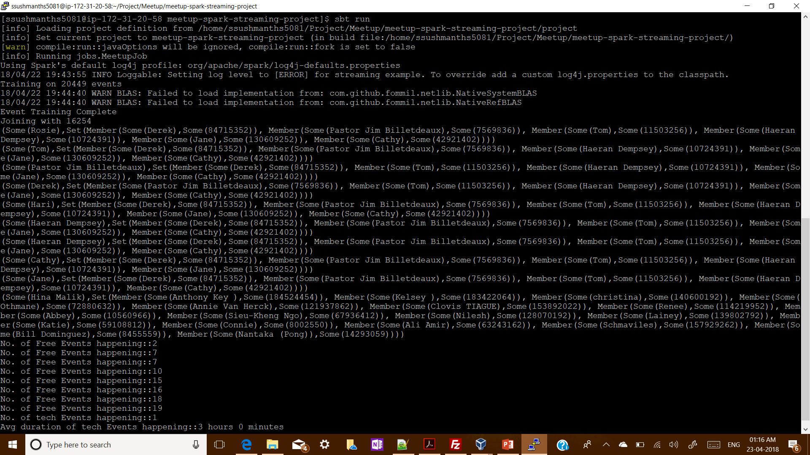
Sample output screenshot

Slide 21
Conclusion
Meetup Streaming data loaded and analysed successfully.
Streaming events data loaded through Spark Streaming using Custom Receivers and handled as Asynchronous HTTP requests.
History Events and Rsvp data analysed through Spark MLlib to build an Group member recommendations based on K-means clustering model.
Code: https://github.com/ssushmanth/meetup-stream

