Slide 1


UAE-FIRST | B2B SAAS | VOICE + LIVE CONTEXT + COMPANY SOPS
HeatSafe
Voice Copilot
Hands-free operational safety intelligence for construction teams.
Business model, technology architecture and Meridian Construction demo
Weather apps tell you the conditions. HeatSafe tells you what they mean for this team, this task, this location and this moment.
August 2026
Notes:
Introduce HeatSafe Technologies and the product. The company builds voice-first operational safety copilots for frontline teams. The key distinction is that HeatSafe combines company rules, live site conditions and verified external guidance. It does not replace the supervisor.

Slide 2
Construction teams lose time before they lose control
The information exists, but it is fragmented, delayed and difficult to use at the point of work.
5.5 hrs
per week searching for
project data
41%
of decisions affected by
bad project data
$88.7B
rework linked to bad data
globally in 2020
A 40-hour construction week
5.5h
4.7h
25.9h
Search: 5.5h/week
Conflict: 4.7h/week
Mistakes / rework: 3.9h/week
HeatSafe does not claim to recover all of this time. It targets a narrow, high-value moment: finding the correct rule and acting on it without stopping work to search through documents.
HeatSafe Technologies | Business model & demo
Sources: PlanGrid/FMI, Construction Disconnected (2018); Autodesk/FMI, Harnessing the Data Advantage (2021).
Notes:
The industry problem is not a lack of information. It is access, interpretation and timing. Research found 5.5 hours per week spent searching for project information, while bad data contributes to poor decisions and rework. HeatSafe focuses on the frontline moment when a worker or supervisor needs the correct answer immediately.

Slide 3
UAE worksites face changing conditions and explicit obligations
Heat, wind and compliance are operational variables, not background information.
12:30–15:00
15 Jun–15 Sep
AED 5K
Daily outdoor work restriction
Annual heat-stress policy period
Per worker; up to AED 50K
☀
Why live context matters
2.2%
of global working hours could be lost to heat stress by 2030
Wind and gusts can change access, lifting and work-at-height plans.
Heat and humidity change work-rest, hydration and scheduling requirements.
Static PDFs cannot combine live conditions with company-specific limits.
When data cannot be verified, the correct answer is to stop and escalate.
Equivalent to 80 million full-time jobs. Construction is one of the sectors most exposed because work is physical and often outdoors.
HeatSafe surfaces the rule and the evidence. The supervisor remains accountable for the decision.
HeatSafe Technologies | Business model & demo
Sources: UAE MoHRE Occupational Heat Stress Prevention Policy (2026); ILO, Working on a Warmer Planet; World Bank CCKP.
Notes:
In the UAE, outdoor work is regulated during the hottest months. Conditions also vary during the day, especially wind, gusts, humidity and temperature. HeatSafe connects live conditions with the relevant company or regulatory rule, then presents the prescribed action and asks for supervisor confirmation.

Slide 4
Two use cases, one voice interface
The product answers two operational questions: “Should we do this now?” and “How do I do this?”
USE CASE 1
USE CASE 2
Should we do this job right now?
How do I do this job correctly?
Live environment + company rules
●
Company procedure + verified knowledge
Checks wind, gusts, temperature, humidity and forecast.
Retrieves Meridian’s relevant threshold from the SOP.
States the conditions, the threshold and the prescribed action.
Defers the final operational decision to the supervisor.
Searches the company SOP, checklist and safety manual.
Provides steps with the document and section named aloud.
Uses official or manufacturer guidance only when the SOP is silent.
Refuses to answer when no reliable source covers the procedure.
ASK
HEATSAFE
Example: “Can we use the scaffold this morning?”
Example: “Walk me through the scaffold inspection.”
HeatSafe Technologies | Business model & demo
Notes:
Use Case 1 is about timing and conditions. Use Case 2 is about procedure. They can happen in one continuous conversation, which makes the demo feel natural and proves the product is useful at the point of work.

Slide 5
Data model and safety logic
HeatSafe retrieves, classifies, verifies and cites. It never guesses and it never becomes the decision-maker.
SOURCE PRECEDENCE
1
Company SOP / safety manual
Uploaded Meridian documentation
AGENT REASONING
EVERY SAFETY RESPONSE CONTAINS
RETRIEVE
1
FACT
Regional law / official guidance
Current condition or verified procedure
2
UAE MoHRE and official HSE sources
CLASSIFY SOURCE
2
SOURCE
Document, section or external authority
APPLY PRECEDENCE
POLICY IMPLICATION
3
Manufacturer documentation
3
What the source requires or recommends
Equipment manuals and bulletins
VERIFY
4
HUMAN ESCALATION
ANSWER OR REFUSE
Supervisor confirmation before action
4
General web
Only if stronger sources are unavailable
Never invent thresholds. Never let the web override a company SOP. Never decide for the supervisor.
HeatSafe Technologies | Business model & demo
Notes:
This slide is the trust architecture. The model does not simply read documents and improvise. It applies a source hierarchy, verifies the evidence and produces a structured response. The strongest guardrail is refusal: when HeatSafe cannot verify the answer, it says so clearly and escalates.

Slide 6
Technology architecture: each sponsor tool has one job
A focused stack makes the product easier to build, explain and evaluate.
VOICE LAYER
FRESH EXTERNAL CONTEXT
ENGINEERING EXECUTION
ElevenLabs
Context.dev
Devin
Hands-free speech input and output
Turn-taking and interruption handling
200+ languages available from the pilot
Natural spoken source attribution
Retrieve live regulation and safety bulletins
Convert web pages and documents to clean Markdown
Parse PDF, DOCX and XML into LLM-ready text
Fetch manufacturer guidance when SOPs are silent
Build, run and test the application
Parallel sessions for voice, retrieval and evals
Playbooks encode the product and safety rules
Commits code, tests, README and reproducible setup
Worker voice
ElevenLabs
HeatSafe agent
SOP store
Weather API
Context.dev
Voice answer
Production recommendation: use a structured weather API for live readings; use Context.dev for fresh, unstructured web and document context.
HeatSafe Technologies | Business model & demo
Sources: official ElevenLabs, Context.dev and Devin product documentation and pricing pages, accessed August 2026.
Notes:
ElevenLabs is the interface. Context.dev is the live external knowledge layer. Devin is the engineering partner that builds and tests the product. A dedicated weather API remains the best production source for structured wind and temperature data. This separation makes the architecture credible.

Slide 7
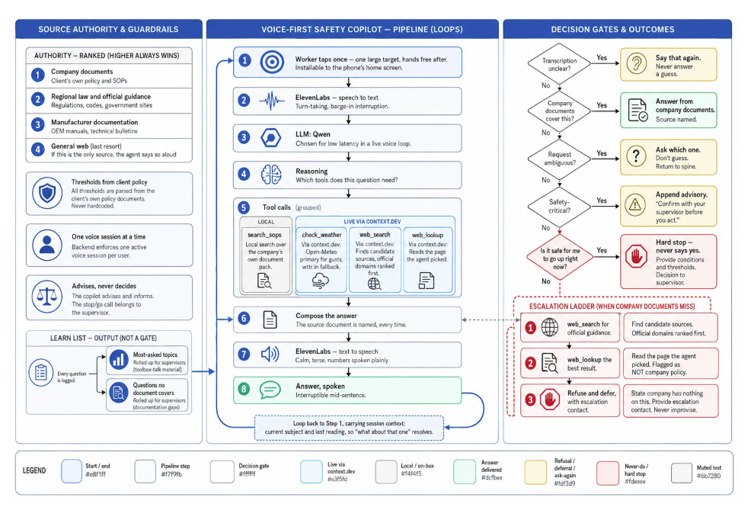
Notes:
Introduce HeatSafe Technologies and the product. The company builds voice-first operational safety copilots for frontline teams. The key distinction is that HeatSafe combines company rules, live site conditions and verified external guidance. It does not replace the supervisor.

Slide 8
Demo: HeatSafe Technologies × Meridian Construction LLC
One fictional customer, three company documents and two use cases.
OUR COMPANY
WHAT THE DEMO PROVES
HeatSafe
MERIDIAN SITE • DUBAI
HeatSafe Technologies
Hands-free Q&A
1
Worker speaks while hands are occupied.
Voice layer, source logic, live context and safety guardrails.
“What should we be working on this morning?”
2
Live context
Wind changes the operational answer.
FICTIONAL CLIENT
Wind is 34 km/h. Meridian’s Working at Height SOP sets the scaffold limit at 30 km/h. External guidance is less strict, so I am following Meridian’s policy. Scaffold work should be suspended. Confirm with your supervisor.
SOP overrides the web
Meridian Construction LLC
3
Meridian’s stricter threshold wins.
500 workers
Dubai construction site
3 pre-loaded SOPs
Strict 30 km/h scaffold limit
4
Source named aloud
The answer states the exact document.
Source: Meridian Working at Height SOP, section 4.2
5
Refusal and escalation
Unknown procedures are not invented.
Unknown answer → ask the supervisor
HeatSafe Technologies | Business model & demo
Demo data is fictional and designed to test retrieval, precedence and refusal behaviour.
Notes:
The demo is deliberately narrow. Meridian has three fake SOPs, including a wind threshold that is stricter than the general web guidance. The strongest moment is when HeatSafe states that it is following Meridian’s rule. The second strongest moment is refusal.

Slide 9
Business model: per worker, protected by a site minimum
A B2B SaaS model aligns pricing with workforce scale while preserving healthy contract value.
PILOT
STANDARD
ENTERPRISE
AED 5,000
AED 35
AED 25–30
per site / month
per worker / month
per worker / month
Up to 100 workers
One site
3 SOPs + 200+ languages
60-day paid pilot
Minimum 250 workers per site
Voice + weather + SOP retrieval
Basic usage and source logs
Annual contract after pilot
1,000+ workers
Multi-site deployment
SSO, audit logs and APIs
Advanced governance and custom rules
CORE OFFER
One-time onboarding: AED 15,000–50,000 depending on SOP volume, language packs, integrations and site configuration.
Buyer: Head of HSE • Operations Director • Site Director • COO
HeatSafe Technologies | Business model & demo
Illustrative pricing for the business model. Final pricing should be validated through UAE pilot interviews.
Notes:
The recommended commercial model is per worker, but with a site minimum. The minimum avoids small, unprofitable contracts. The pilot is paid and narrow. Onboarding is a separate fee because the company documentation, rules and integrations create real implementation work.

Slide 10
Illustrative economics: Meridian at 500 workers
A conservative usage model produces strong platform margins and measurable customer value.
HEATSAFE UNIT ECONOMICS
CUSTOMER ROI
Monthly revenue
AED 17,500
10 min
saved per worker per day
Runtime COGS
AED 3,016
This is only around 15% of the 5.5 hours per week observed in industry research.
Gross profit
AED 14,484
Hours recovered / month
1,833
Platform gross margin
83%
AED 55,000
Blended labour value
Annual recurring revenue
AED 210,000
HeatSafe subscription
AED 17,500
Value / subscription
3.1×
Estimated monthly platform cost
AED 1,469 ElevenLabs • AED 547 Context.dev • AED 1,000 weather, LLM and hosting
Before avoided incidents, rework, fines and schedule disruption.
HeatSafe Technologies | Business model & demo
Assumptions: 500 workers; AED 35/worker/month; 10 voice min/worker/month; ElevenLabs $0.08/min; Context.dev Pro $149/month.
Notes:
This is an illustrative model, not a forecast. At 500 workers and AED 35 per worker, Meridian generates AED 17,500 in monthly revenue. With 10 voice minutes per worker, current vendor pricing and modest infrastructure, platform gross margin is approximately 83 percent. The customer ROI model only assumes 10 minutes saved per day.

Slide 11
Go-to-market: prove value on one site, then expand
The fastest route is a paid UAE pilot with a clear HSE owner and measurable operating outcomes.
01
PILOT
02
SCALE
03
EXPAND
One UAE contractor
One site, 100–500 workers
3 SOPs and 2 use cases
60 days + 200+ languages
Multi-site rollout
Expanded SOP coverage
Audit logs and analytics
System integrations
GCC construction
Oil & gas and ports
Utilities and logistics
Extreme-condition safety copilot
PILOT SCORECARD
Accuracy
Speed
Adoption
Efficiency
Safety
Eval pass rate
Time to verified answer
Supervisors and workers active
Minutes saved per query
Escalations and policy adherence
Weather apps tell you it is 42°C. HeatSafe tells you what 42°C means for this team, this task, this location and this moment.
HeatSafe Technologies | Business model & demo
Next step: secure one pilot partner, one site and one accountable HSE sponsor.
Notes:
Close with a specific ask. HeatSafe does not need a broad enterprise rollout first. It needs one site, one HSE sponsor and two measurable use cases. The pilot should validate accuracy, speed, adoption and time saved before the product expands into more sites and sectors.

