Slide 1
FoodHub Case Study
FoodHub Exploratory Data Analysis
1/3/2025 by Vishnu Yadavalli

Slide 2
Contents / Agenda
Executive Summary
Business Problem Overview and Solution Approach
Data Overview
EDA - Univariate Analysis
EDA - Multivariate Analysis

Slide 3
Executive Summary
Conclusions:
There are 736 records with no ratings provided. In terms of percentage, it is around 38.77%.
Majority of the customers appx 65% (784 customers) have only placed a single order and appx 22% (267 customers) have only placed 2 orders.
There are 178 unique restaurants and the most popular among them with highest number of orders is "Shake Shack".
The top 4 popular cuisine type customer orders are American, Japanese, Italian and Chinese weighing 82.55% orders.
There are more customers ordering on weekends than weekdays.
Customer ratings are higher for shorter delivery and preparation times.

Slide 4
Executive Summary contd..
Recommendations:
FoodHub should make some efforts in understanding the customers who ordered less than 3 times. They should focus on these customers on what made them not to order more often.
FoodHub should investigate the reason for low customer rating counts. They should attract customers to provide ratings by giving some discounts or special entry prize coupons.
FoodHub should invest in infrastructure to reduce delivery times , enhance customer satisfaction by encouraging restaurants to shorten food preparation time and, they should focus on promoting trending cuisines to drive growth.

Slide 5
Business Problem Overview and Solution Approach
FoodHub is a food aggregator company that offers access to customers to place online orders for multiple restaurants through their app. The company revenue is based on charging the orders of each restaurant depending on order price.
The company wants to enhance the customer experience through analyzing the dataset which has information about the orders made by the registered customers
FoodHub revenue is based on the customers orders. A customer order is based on the ratings of the restaurants. So FoodHub wants to improve their revenue by identifying the areas of growth and improvements for a better customer experience.

Slide 6
Data Overview
The data contains the different data related to a food order. The detailed data dictionary is given below.
order_id: Unique ID of the order
customer_id: ID of the customer who ordered the food
restaurant_name: Name of the restaurant
cuisine_type: Cuisine ordered by the customer
cost_of_the_order: Cost of the order
day_of_the_week: Indicates whether the order is placed on a weekday or weekend (The weekday is from Monday to Friday and the weekend is Saturday and Sunday)
rating: Rating given by the customer out of 5
food_preparation_time: Time (in minutes) taken by the restaurant to prepare the food. This is calculated by taking the difference between the timestamps of the restaurant's order confirmation and the delivery person's pick-up confirmation.
delivery_time: Time (in minutes) taken by the delivery person to deliver the food package. This is calculated by taking the difference between the timestamps of the delivery person's pick-up confirmation and drop-off information

Slide 7
Data Overview cont..
There are a total of 1898 entries and 9 columns in the dataset
There are 3 different data types:
float64(1) : cost_of_the_order
int64(4) : order_id , customer_id , food_preparation_time , delivery_time
object(4) : restaurant_name , cuisine_type , day_of_the_week , rating
There are 736 observations with rating as “Not given”. These are the only missing values

Slide 8
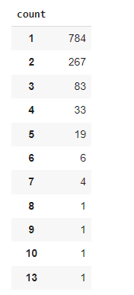
Univariate Analysis
EDA – Customer’s Order
There are a total of 1898 orders .The count of unique customerID is 1200.
Order count frequency range between 1 to 13
As per stats , many of the customers placed either one or two orders.

Slide 9
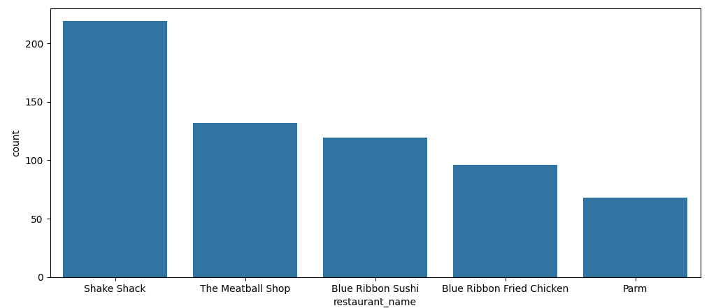
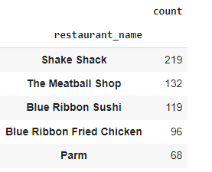
EDA – Restaurants
There are 178 Unique restaurants in the dataset
The top restaurant is Shake Shack with 219 orders
The other top orders restaurants are :
The Meatball Shop – 132 orders
Blue Ribbon Sushi – 119 orders
Blue Ribbon Fried Chicken – 96 orders
Parm – 68 orders

Slide 10
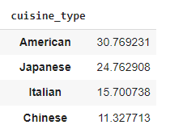
EDA – Cuisine type
There are 14 Unique cuisines.
There are more customer orders for the American cuisine (30% orders)
Followed by Japanese , Italian and Chinese.
The top 4 restaurants order weigh 82 %

Slide 11
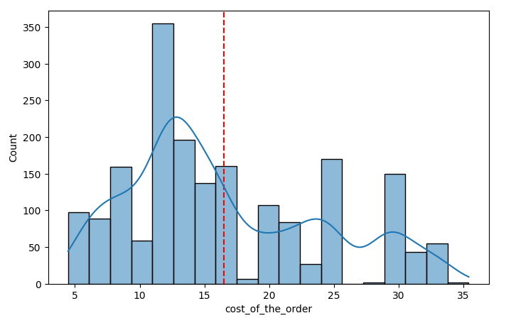
EDA – Cost of the order
The average order cost is about 16 USD
The cost of the order is right skewed as seen
In histogram a long right tail.
The peak order values are between 10 and 15 USD
There are some orders above 20 USD
Which can be an expensive cuisine. The percentage of orders
Above 20 USD is 29.24%

Slide 12
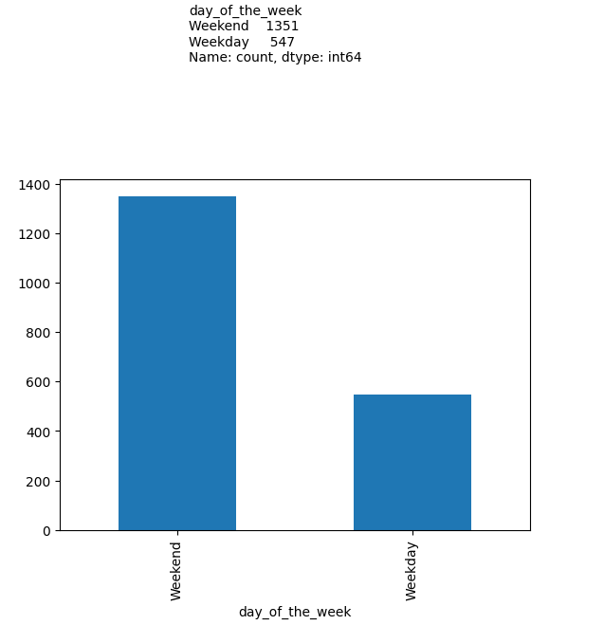
EDA – Day of the week
There are more orders placed on weekend.
Weekday has 547 orders (29% of all orders)
Weekend has 1351 orders (71% of all orders)

Slide 13
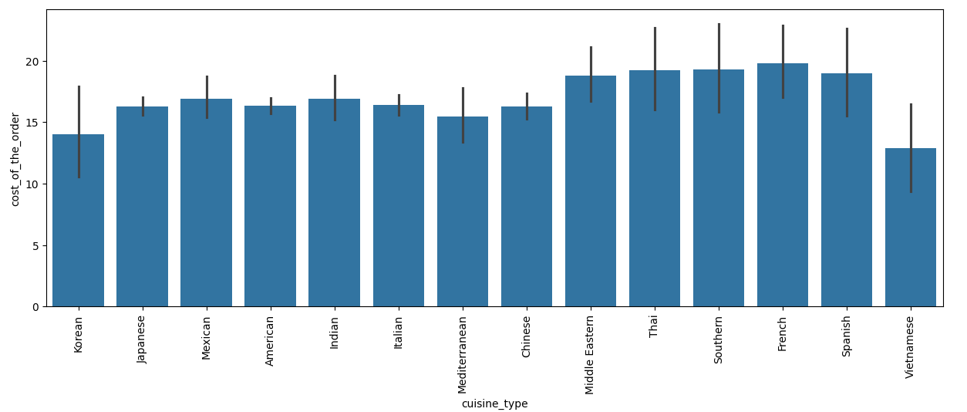
Multivariate Analysis
EDA – Cuisine type / Cost of order
Vietnamese cuisine cost less and French cuisine cost more

Slide 14
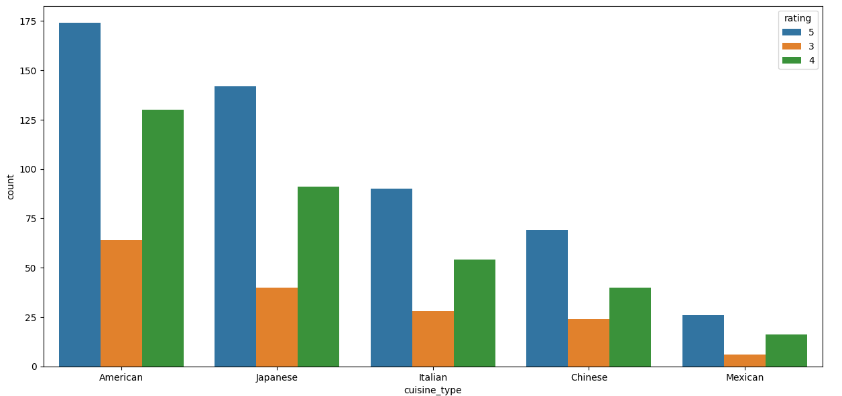
EDA – Cuisine Type / Rating
American , Japanese , Italian and Chinese are the top 4 highly rated cuisines.

Slide 15
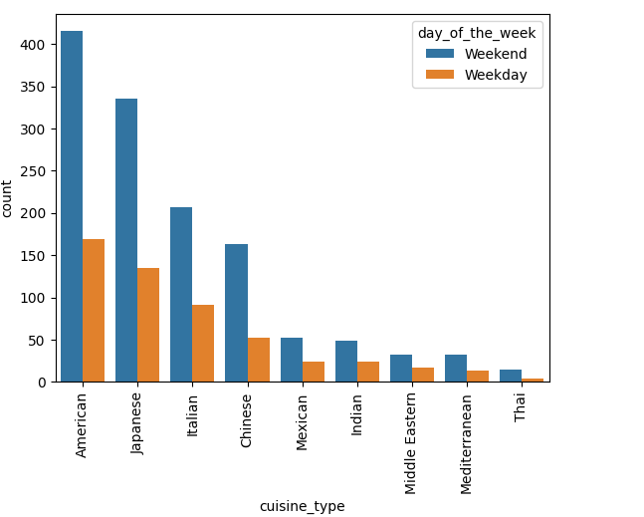
EDA – Cuisine type / day of the week
Day of the week has no influence on the selection of cuisine type.
American , Japanese , Italian and Chinese cuisines are the most popular
throughout the week.

Slide 16
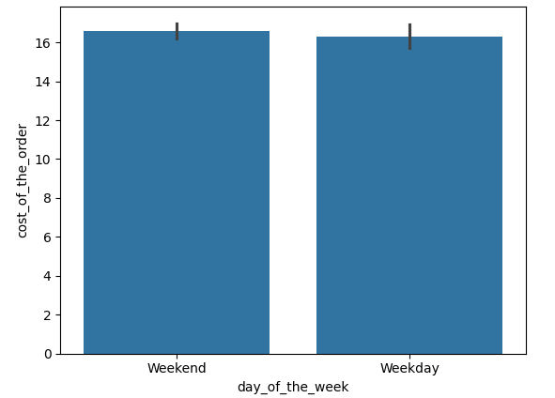
EDA – Day of the week / cost of the order
The cost of the order is higher on the weekends

Slide 17
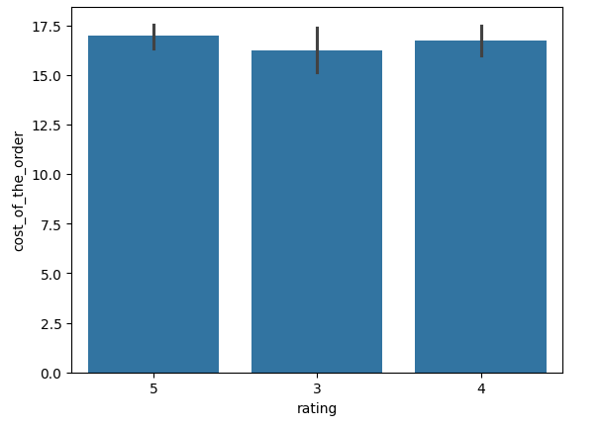
EDA – Rating / Cost of the order
Higher ratings indicate a higher order cost (Average cost)

