Slide 1
A Car Racing Based Strategy for the Dynamic Voltage and Frequency Scaling Technique
David Cohen, Eduardo Valentin, Raimundo Barreto, Horácio Oliveira, and Lucas Cordeiro
Institute of Computing
Federal University of Amazonas
Brazil

Slide 2
Outline
Introduction
Dynamic Voltage and Frequency Scaling
Establishment of a Optimum Frequency Set
Car Racing Analogy
Example
Performance Evaluation
Conclusions and Future Works

Slide 3
Introduction

Slide 4
Introduction
Main Aim
Application of a car racing analogy to develop real-time applications with low energy consumption using the Dynamic Voltage and Frequency Scaling (DVFS) technique.

Slide 5
Introduction
Contributions
1) Establishment of a optimum frequency set to execute real-time tasks on the DVFS technique
2) DVFS with multiple preemptable real-time
tasks
3) Energy consumption optimization even when
the WCEP is taken

Slide 6
Dynamic Voltage and
Frequency Scaling

Slide 7
Dynamic Voltage and
Frequency Scaling
Modern processors can change the frequency/voltage at runtime.
Dynamically control the supply voltage (and its corresponding clock frequency) to the lowest possible level while meeting the task’s timing constraints.

Slide 8
Optimum Frequency Set

Slide 9
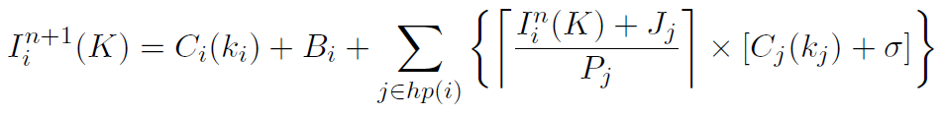

Optimum Frequency Set
K = ⟨k₁, k₂, …, k_{n}⟩, where k_{i} is a specific frequency for executing task T_{i}.
New schedulability analysis based on response time
and mutual exclusion (Priority Ceiling Protocol)
I_{i}(K) = interference of task T_{i} on K;
C_{i}(k_{i}) = WCET of task T_{i} on k_{i};
B_{i} = blocking time of task T_{i};
J_{j} = jitter time of task T_{j};
P_{j} = period of task T_{j}
σ = DVFS overhead.

Slide 10
Optimum Frequency Set
Method: Branch-and-Bound Algorithm
Explicit Enumeration and
Pruning (unschedulable nodes)
Constraint: ∀i, R_{i}(K) ≤ D_{i}
Optimality: lowest idle time

Slide 11
Car Racing Method

Slide 12
Car Racing Method
Analogy between
DVFS and a Car Racing.

Slide 13
Car Racing Method
This car racing is different...
The car has to finish the race not after the maximum time (deadline) and as close as possible to that time.

Slide 14
Car Racing Method
Concepts
Race distance = 10,000m (WCEP = 10,000 cycles)
Maximum timing constraint (deadline) = 200s.
Main Car corresponds to a task.
0Km
10Km

Slide 15
Car Racing Method
Concepts
Available frequencies
20Hz, 40Hz, 60Hz, and 100Hz.
Reference car constant speeds:
20m/s, 40m/s, 60m/s, and 100m/s
100m/s
60m/s
? m/s
40m/s
20m/s
-10Km
-2Km
0Km
2Km
10Km
fairness

Slide 16
Car Racing Method
Concepts
Speed (frequency) of the main car (task) was calculated
considering all possibilities of pit-stops (preemptions).
100m/s
60m/s
60m/s
40m/s
20m/s
-10Km
-2Km
0Km
2Km
10Km

Slide 17
Car Racing Method
Concepts
The main car may change its speed when it overtakes any reference car.
But, for race control, this can only happen at specific control points.
Besides that, the main car has to pay a fee (timing overtaking fee).

Slide 18
Example

Slide 19
Example
Two Events:
(1) initial space increment (bonus) by 500m (analogously to not execute 500 cycles) at position S_{M} = 3000m; and
(2) a pit stop (analogously to a preemption) taking 20 seconds at position S_{M} = 6000m.

Slide 20
Example
Let us suppose we have a control point in each 500m;
The timing overtaking fee is 1s;

Slide 21
Example
Initial Space Increment // Saved Execution Cycle
60m/s
0m
t=0s
10000m
bonus
0m
3000m
t=50s
10000m
60m/s
0m
3500m
t=50s
10000m
It is equivalent to change the S_{0M} from 0 to 500

Slide 22
Example
Next overtaking point
0m
5500m
10000m
S_{meet}(M-3) = S_{0M} + V_{M} (((S₀₃ – S_{0M}) + (V₃ * σ)) / (V_{M} – V₃))
Timing overtaking fee

Slide 23
Example
Next overtaking point
0m
5500m
10000m
S_{meet}(M-3) = S_{0M} + V_{M} (((S₀₃ – S_{0M}) + (V₃ * σ)) / (V_{M} – V₃))
S_{meet}(M-3) = 500 + 60 ((1500 + 40) / 20)
S_{meet} = 5120m
Next Control Point = 5500m
V_{M} = V₃ = 40m/s

Slide 24
Example
Pit-stop at position 6000m
0m
6000m
10000m
T_{pitstop} = 20s

Slide 25
Example
Pit-stop at position 6000m
0m
6000m
6800m
10000m
However, after 20s, the Main Car has been overtaken by Car 3.
So, V_{M} = 60m/s

Slide 26
Example
Next overtaking point.
0m
9000m
10000m
S_{meet}(M-3) = S_{0M} + V_{M} (((S₀₃ – S_{0M}) + (V₃ * σ)) / (V_{M} – V₃))
S_{meet}(M-3) = 6000 + 60 ((800 + 40) / 20)
Overtaking point = 8520m
Next Control Point = 9000m
V_{M} = V₃ = 40m/s

Slide 27
Example
What about meeting the timing constraints?
60m/s
***
60m/s
40m/s
60m/s
40m/s
0m
3Km
3.5Km
5,5Km
6Km
9Km
10000m
t_{total} = t₆₀+t₄₀+t_{preemp} + t_{fee}, where
t₆₀ = 8000/60 = 133.33s,
t₄₀ = 1500/40 = 37.5s,
t_{preemp} = 20s, and t_{fee} = 2s.
Thus: t_{total} = 192.83s, (<200s)
which meets timing constraint.

Slide 28

Example
What about the energy consumption?
Frequency/voltage:
100Hz (5V); 60Hz (3V); 40Hz (2V); and 20Hz (1V).
E_{DVFS} = (8000*3²) + (1500*2²) + (2*100*3²) = 79,800
E_{no} = (9500*3²) = 85,500

Slide 29
Example
What about the energy consumption?
Frequency/voltage:
100Hz (5V); 60Hz (3V); 40Hz (2V); and 20Hz (1V).
E_{DVFS} = (8000*3²) + (1500*2²) + (2*100*3²) = 79,800
E_{no} = (9500*3²) = 85,5000
Energy Overhead

Slide 30
Example
What about the energy consumption?
Frequency/voltage:
100Hz (5V); 60Hz (3V); 40Hz (2V); and 20Hz (1V).
E_{DVFS} = (8000*3²) + (1500*2²) + (2*100*3²) = 79,800
E_{no} = (9500*3²) = 85,5000
6.6% of energy reduction

Slide 31
Performance Evaluation

Slide 32
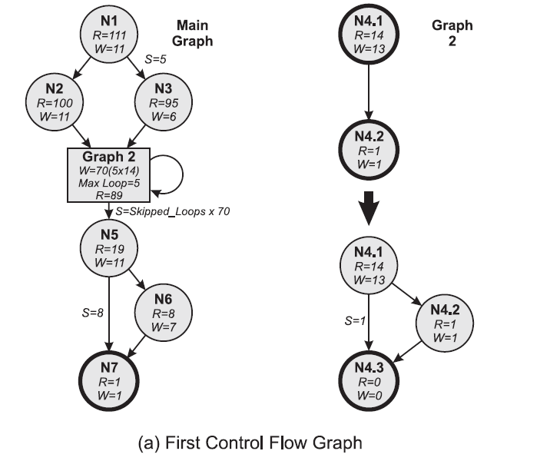
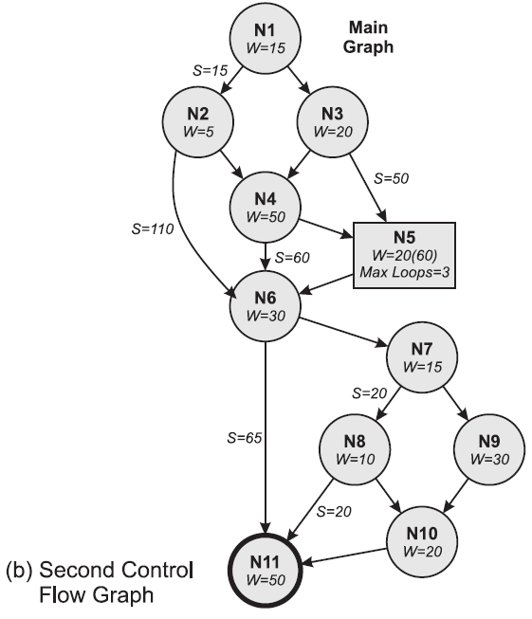
Performance Evaluation

Slide 33
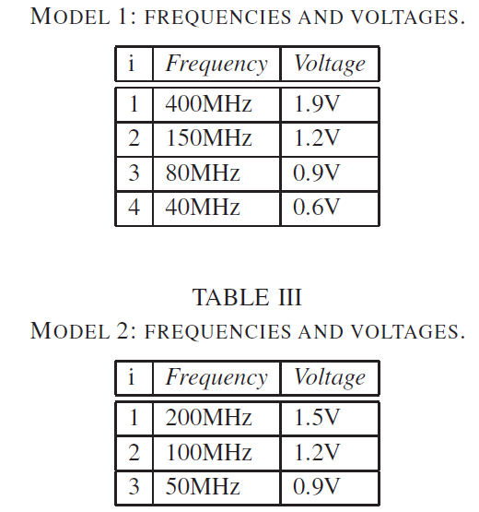
Performance Evaluation

Slide 34
Performance Evaluation
Comparison
(1) The intra-task DVFS proposed by Shim, Kim, and Lee*
(SKL method); and
(2) A naive method which does not change frequency/voltage.
* D. Shin, J. Kim, and S. Lee. Intra-task voltage scheduling for low-energy,
hard real-time applications. IEEE Des.&Test Comp., 18:20–30, Mar 2001.

Slide 35
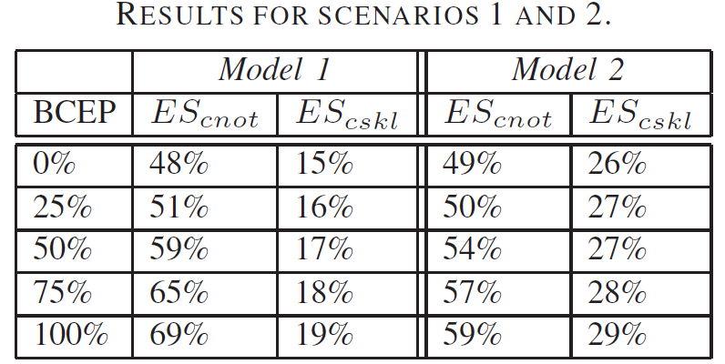
Performance Evaluation
Without preemption
WCEP
BCEP
From worst-case to best-case

Slide 36
Performance Evaluation
Without preemption
WCEP
BCEP
Best-case is better than worst-case.
Model2 is better than Model1 since it has more frequencies.

Slide 37
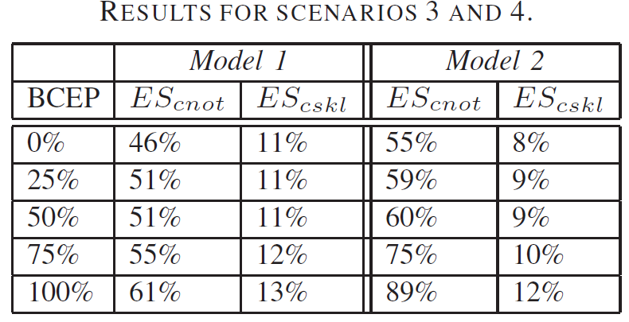
Performance Evaluation
With preemption
WCEP
BCEP
From worst-case to best-case

Slide 38
Performance Evaluation
With preemption
WCEP
BCEP
Energy savings is less evident when comparing to the SKL

Slide 39
Conclusions and Future Works

Slide 40
Conclusions and Future Works
It is common to adopt things of our daily lives in
computing methods.
Examples: Simulated annealing, Ant Colony
Optimization, etc.
Hard to understand?
Make it possible to obtain important contributions.

Slide 41
Conclusions and Future Works
Contributions:
1
Establishment of a optimum frequency set
2
Multiple preemptable real-time tasks
3
Energy optimization even when WCEP is taken.

Slide 42
Conclusions and Future Works
Results
Energy savings in the range of 48% to 69% when compared to solutions that do not use DVFS, and in the range of 8% to 29% when compared to a modified preemption-aware version of the SKL method.

Slide 43
Conclusions and Future Works
Future Works
1) To experiment on industrial real-world case study; and
2) To implement the proposed method in a real platform.

Slide 44
Thank you for your attention!
rbarreto@icomp.ufam.edu.br

