Slide 1

 | S.S.V.P.S’s B. S. Deore Polytechnic, Dhule Department of Computer Engineering Academic Year : 2026-2027
SEMINAR AND PROJECT INITIATION COURSE
Sem : CO 5 K |  | SPI – 315003 | Date :
Topic : AI BASE - Waste Management System
Roll No. |  | Name of Student
33 |  | Vaishavi Ravindra kathale
52 |  | Divya Ashok Patil
59 |  | Kalpesh Sanjay Patil
64 |  | Komal Chandrashekhar Patil

Slide 2
Contents
Certificate
Abstract
Introduction
Literature Review
Information to Seminar topic
Advantages and Disadvantages
Conclusion
Project Initiation :
  Description of problem statement.
  Scope and objectives.
  Stake holder
  seminar exsicussion plan
  Platform/ Equipment/ Resources identification.
Bibliography
References
2

Slide 3
Abstract
Waste management is a major challenge in cities, towns, campuses and public places. Overflowing bins, mixed waste, irregular collection and limited monitoring can cause pollution and health risks. An AI-Based Waste Management System uses technologies such as cameras, sensors, machine learning and data analytics to support waste segregation, bin-level monitoring and collection planning. It can improve cleanliness and resource use when supported by proper infrastructure, human supervision and responsible data handling. Keywords: Artificial Intelligence, Smart Bin, Waste Segregation, IoT, Machine Learning, Route Optimization.
 | 3

Slide 4
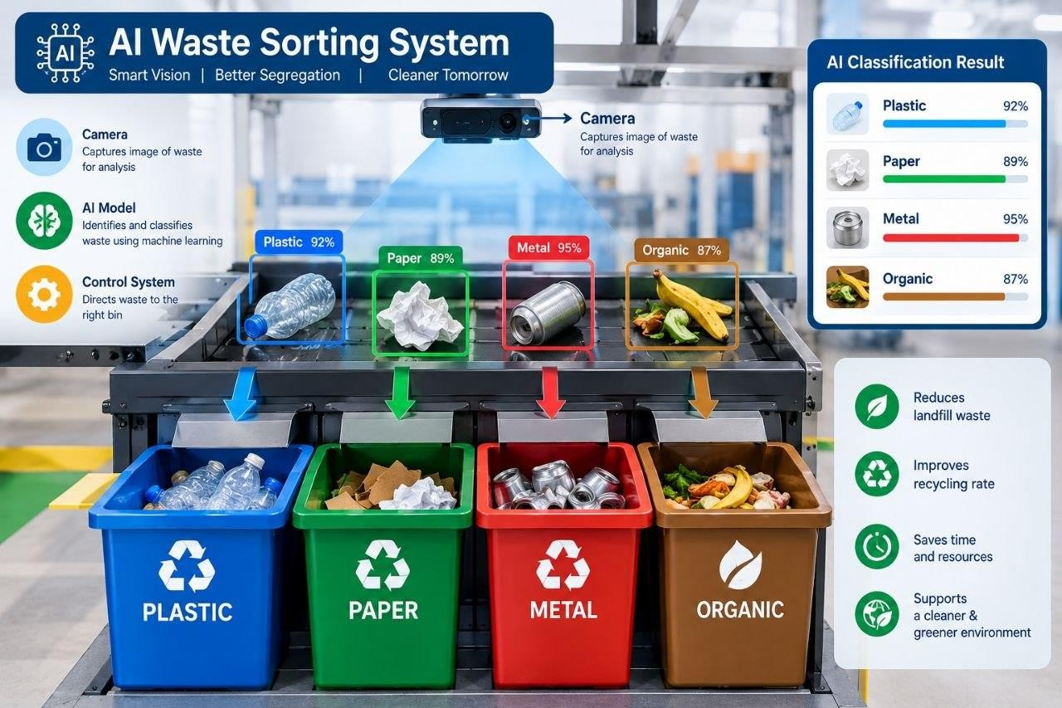
1. Introduction
Fig 1.1 Smart Dustbin
The proposed system is a decision-support tool. Final disposal, safety checks and hazardous-waste handling still require trained people and approved procedures.

Slide 5
2.Literature Survey
Sr. No | Approach Type | Technologies Used | Dataset | Key Objective | Limitations
1 | AI waste management | AI, Smart Bins, Route Optimisation | Not stated | Identify waste, monitor bins, optimise routes | High cost, technical difficulty
2 | CNN waste segregation | Computer Vision, CNN, Sensors, Motors | Not stated | Separate waste into 3 categories automatically | Needs sensor and motor hardware
3 | IoT and AI smart bins | IoT, Sensors, Cloud, AI | Not stated | Predict waste, cut collection trips by up to 40% | Depends on connectivity

Slide 6
Sr. No | Approach Type | Technologies Used | Dataset | Key Objective | Limitations
4 | Smart waste collection | AI, ML, IoT, Computer Vision | Not stated | Monitor bins, optimise routes | High cost, network issues
5 | ML, DL and IoT bins | ML, Deep Learning, IoT | Not stated | Monitor bins, save fuel and cost | Needs future technology
6 | TrashNet dataset | Image Classification | ~2,500 images, 6 classes | Dataset to train AI models | Few images, plain background
7 | MobileNetV2 | Lightweight Deep Learning | Not stated | Low-memory model for smart bins | Needs good training images

Slide 7
Sr. No | Approach Type | Technologies Used | Dataset | Key Objective | Limitations
8 | AI waste review | AI, Route Optimisation | Review paper | 94% accuracy | High cost, limited data
9 | Smart waste with AI | AI, Smart Bins | Not stated | Save time, fuel and effort | High cost, limited data
10 | AI in smart cities | AI, IoT, Sensors | Not stated | 94.3% accuracy, 32% less fuel | High cost, maintenance
11 | AI-based waste management | AI, IoT, Sensors | Not stated | Identify waste, optimise routes | High cost, technical issues
12 | AI smart waste segregation | Computer Vision, CNN, IoT | Not stated | Send waste to correct bin | Not stated

Slide 8
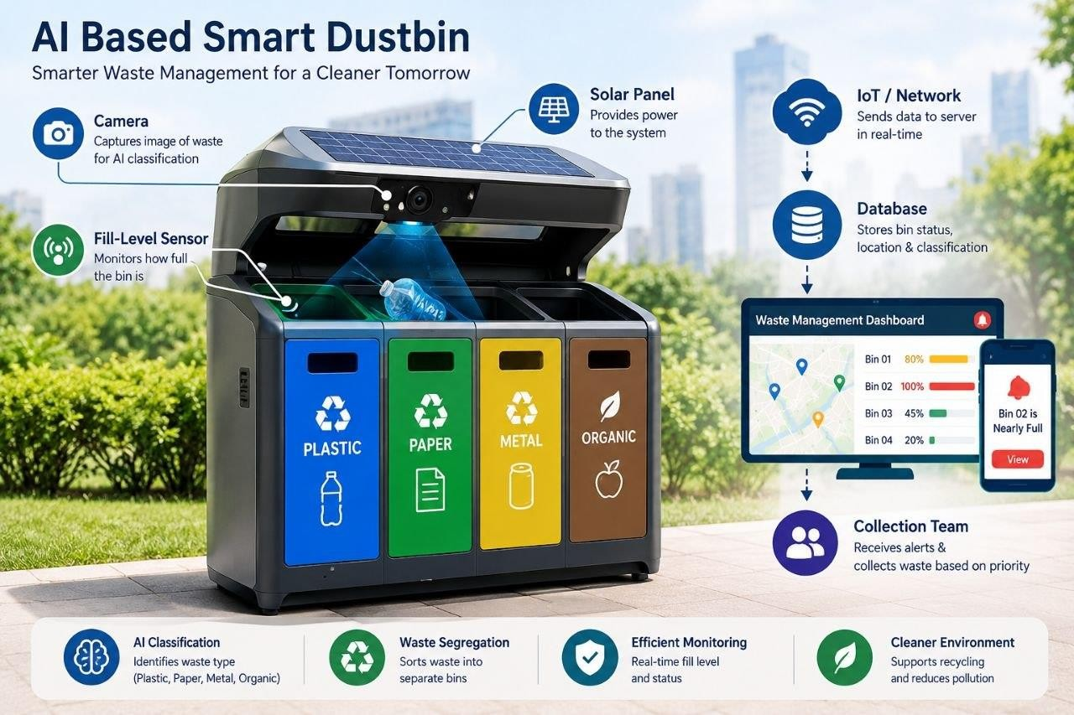
2. Literature Survey
Fig2.1 AI Waste Sorting
Computer vision and machine-learning models can classify visible waste into categories such as paper, plastic, metal and organic waste. Accuracy depends on lighting, camera angle, image quality and the training dataset.

Slide 9
3. Information to seminar topic
Data collection: a camera captures an image of waste, and sensors estimate the bin's fill level.
AI analysis: a trained image-classification model predicts a waste category. The system may show a confidence score for review.
Smart monitoring: sensor readings and AI results are sent to a
database or szerver.
Dashboard and alerts: staff can view bin status, identify near-full bins and receive notifications.
Collection planning: locations needing service can be prioritised to support efficient route planning.

Slide 10
System Architecture
Component Purpose
Camera / Input Captures a waste image for classification.
Fill-level sensor
Estimates whether the bin is empty, partly full or nearly full.
AI model
Classifies visible waste based on the model's training
data.
loT / Network
Transfers readings and results to the server.
Database
Stores bin IDs, locations, readings, timestamps and
classifications.
Dashboard
Displays status, alerts and collection priorities.
Collection team
Verifies alerts, collects waste and reports maintenance
issues
0
1

Slide 11
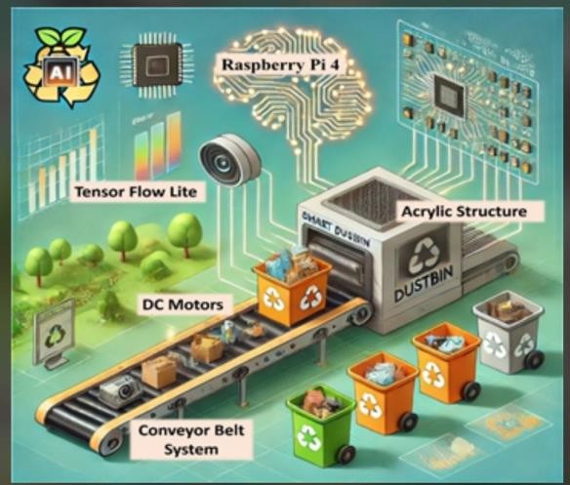
Working of the Proposed System
Step 1: A user or camera provides an image of waste, and the sensor measures the bin's fill level.
Step 2: The AI model analyses the image and predicts the likely waste category.
Step 3: The sensor and classification results are transmitted to the server.
Step 4: The dashboard updates bin status and raises an alert when the bin reaches a defined threshold.
Step 5: The collection team reviews priorities and collects waste according to local operating rules.
Step 6: Staff feedback is recorded to help evaluate system performance and improve the model.
Fig 3.1 Camera+Sensor +Smart Bin

Slide 12
4. Advantages / Disadvantages
Advantages Disadvantages
Can help identify waste categories.
AI predictions may be incorrect for dirty, hidden or mixed waste.
Can alert staff when bins are nearly full.
Sensors, cameras and network devices need maintenance.
Can support more efficient collection planning.
Initial installation and operating costs may be high.
Provides status data for planning and
reporting.
Performance depends on connectivity,
power and data quality.
May improve cleanliness and recycling workflows.
Privacy, security and responsible data handling must be considered.

Slide 13
5. Conclusion
An AI-Based Waste Management System can combine AI, IoT sensors and a dashboard to support waste classification, bin monitoring and collection planning.
The system may reduce unnecessary manual inspections and help staff respond to full bins more quickly.
Its success depends on reliable sensors, locally relevant training data, regular maintenance, safe waste-handling practices and human verification.
The project can be developed in stages, starting with a small prototype and testing it with sample images and simulated bin- level data.

Slide 14
6. Project Initiation
Project Title: AI-Based Smart Waste Management System. Problem Statement: Traditional waste management systems face improper waste segregation, and inefficient waste collection. Project Objective: To identify waste and improve segregation and collection using AI. Scope: The system focuses on smart dustbins, waste classification, and efficient waste monitoring. Proposed Solution: Use Artificial Intelligence and smart sensors to detect waste levels and classify different types of waste. Expected outcome: Cleaner surroaundings, reduced pollution,
and improved waste management. | 14

Slide 15

6. Project Initiation
Fig6.1 Waste management problem
15

Slide 16
6.1 Description of problem statement, Identification.
Problem statement: Manual waste monitoring and fixed collection schedules may not reflect the actual condition of each bin. This can result in overflowing bins, unnecessary trips and poor waste segregation. Proposed solution: Build a prototype that classifies waste images, receives bin fill-level readings and displays alerts on a simple dashboard. Assumptions: The prototype will use a limited set of waste categories, a small test dataset and simulated or low-cost sensor readings. It will not autonomously handle hazardous waste.
 | 16

Slide 17
6. 2 Scope and Objectives.
Scope
Classify selected waste images into basic Categories.
Monitor bin fill level using a sensor or simulated input.
Provide a basic dashboard for staff.
Support collection prioritisation.
Objectives
Prepare and test a small image dataset.
Display bin status and threshold-based alerts.
Store readings with bin ID and timestamp.
Evaluate classification accuracy and alert behaviour.
17

Slide 18
6. 3 Stake Holder
Stakeholder Role/Interest
Municipal council / campus administration
Sets requirements, policies and collection
schedules.
Waste collection workers
Use alerts and provide feedback from the field.
Citizens / students
Dispose of waste correctly and follow
segregation guidance.
Project team
Designs, develops, tests and documents the prototype.
Faculty guide
Reviews progress and gives technical
guidance.
Recycling / processing facility
Receives segregated material according to
local procedures
1

Slide 19
6. 4 Seminar Exsicussion Plan
Session Activity Expected output
1.
Define the problem and project . Approved problem statement
goals
Study AI, IoT and existing Literature notes smart-bin approaches.
Prepare system architecture and Architecture diagram
workflow.
Identify tools, hardware and Resource list dataset.
Plan prototype implementation Task plan and test cases
and testing.
Review findings and prepare Final seminar presentation presentation.
2.
3.
4.
5.
6.
1

Slide 20
6.5 Platform/ Equipment/ Resources
Programming: Python for AI model development and backend logic.
AI / Computer Vision: TensorFlow, PyTorch and OpenCV.
Frontend / Dashboard: HTML, CSS and JavaScript.
Hardware: Laptop, webcam, ultrasonic sensor and microcontroller (optional).
Dataset: Images of paper, plastic, metal, organic and other waste.
Database / Network: SQLite database, Wi-Fi or USB connection.
Testing: Sample images, test cases and model accuracy evaluation.
.

Slide 21
Bibliography
Books
Artificial Intelligence-A Modern Approach
Environmental Science and Waste Management
Internet of Things (IoT) Fundamentals
Websites
www.google.com
www.indiacode.com
www.sciencedirect.com

Slide 22
References
Research Papers
Smart Waste Management Using Artificial Intelligence and its benefits for waste disposal.
AI-Powered Smart Waste Segregation System for effective waste
classification.
Artificial Intelligence and IoT for Smart City Waste Management.
Smart Waste Management Using IoT and Deep Learning
Techniques.
AI-Based Waste Management for Sustainable Development.

Slide 23
Thank you
23

