Slide 1

 | S.S.V.P.S’s B. S. Deore Polytechnic, Dhule Department of Computer Engineering Academic Year : 2026-2027
SEMINAR AND PROJECT INITIATION COURSE
Sem : CO 5 K |  | SPI – 315003 | Date :
Topic : Machine Learning in Healthcare
Roll No. |  | Name of Student
81 |  | Rohit Gorakh Patil
95 |  | Manas Nilesh Sonawane
97 |  | Vivek Nandkishor Sonawane
107 |  | Aditya Madhukar wagh

Slide 2
Contents
Certificate
Abstract
Introduction
Literature Review
Information to Seminar topic
Advantages and Disadvantages
Conclusion
Project Initiation :
  Description of problem statement.
  Scope and objectives.
  Stake holder
  seminar exsicussion plan
  Platform/ Equipment/ Resources identification.
Bibliography
References
2

Slide 3
Abstract
• Machine Learning (ML) helps computers learn from data and make predictions. It is used in healthcare to support doctors. • It helps predict diseases like diabetes and heart disease by analyzing patient data and medical history. • It can analyze X-rays and MRI scans to help doctors identify diseases at an early stage. • Machine Learning improves healthcare services, but data privacy and prediction errors are major challenges.
 | 3

Slide 4
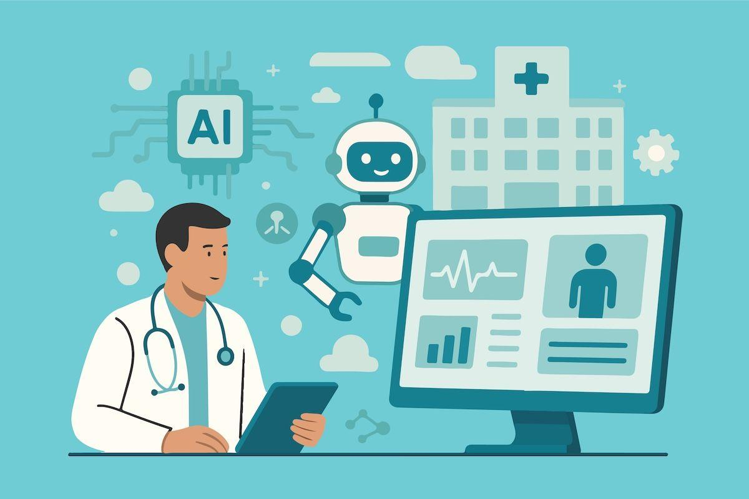
1. Introduction
• Machine Learning (ML) is a branch of Artificial Intelligence (AI) that enables computers to learn from data and make predictions.
• In healthcare, Machine Learning helps doctors predict diseases, analyze medical reports, and identify health problems at an early stage.
• It uses patient information such as
age, blood pressure, sugar levels, and
medical history to predict health risks.
• Machine Learning supports doctors
in making decisions and improving
the quality of healthcare services.
4

Slide 5
2.Literature Review
Sr. No | Approach Type | Technologies Used | Dataset | Key Objective | Limitations
1 | Review of AI in medicine | Medical AI methods | Published studies | Summarise imaging and clinical AI applications. | Clinical usefulness and safety need validation.
2 | Data-centric ML review | ML and data-quality methods | Healthcare datasets in reviewed studies | Explain deployment, data quality and data shift. | Performance may change in new settings.
3 | Deep-learning review | Neural networks | Medical images and clinical data | Describe deep learning in healthcare. | Requires suitable data and expert evaluation.

Slide 6
Sr. No | Approach Type | Technologies Used | Dataset | Key Objective | Limitations
4 | Human–AI collaboration | Clinical AI systems | Clinical research literature | Explore how AI can complement clinicians. | Technology must fit clinical workflows.
5 | Ethics and governance guidance | Governance principles | Health AI use cases | Promote safe, transparent and accountable use. | Requires implementation and oversight.
6 | Clinical decision support | Classification and regression | Clinical records | Support risk estimates and prioritisation. | Poor integration can create alert fatigue.
7 | Clinical data quality | Preprocessing and validation | Electronic health records | Reduce errors and leakage in model building. | Missing and inconsistent data remain common.

Slide 7
Sr. No | Approach Type | Technologies Used | Dataset | Key Objective | Limitations
8 | Medical image analysis | CNNs and deep learning | X-ray, CT, MRI and retinal images | Highlight patterns for professional review. | Equipment and population shifts affect results.
9 | Disease-risk prediction | Logistic regression, trees, ensembles | Clinical measurements and history | Estimate risk for a defined outcome. | Risk scores are not diagnoses.
10 | Privacy and security | Access control, encryption, minimisation | Sensitive health information | Protect patient data through the ML lifecycle. | Controls must be maintained and audited.
11 | Fairness and explainability | Subgroup evaluation and interpretation tools | Representative evaluation datasets | Identify bias and understand model limitations. | Explanations may not prove correctness.
12 | Deployment and monitoring | Drift monitoring and version control | Post-deployment performance data | Detect changing performance after launch. | Needs ongoing resources and clear ownership.

Slide 8
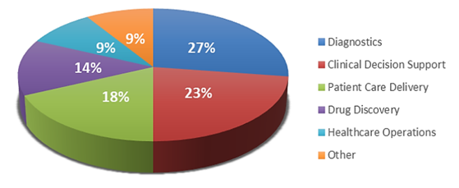
2. Literature Review
• In 2022, Angela Zhang and other researchers studied how Machine Learning can be used in healthcare. They explained the importance of medical data and the challenges of using ML in real hospitals.
• In 2022, Pranav Rajpurkar and other researchers studied AI in healthcare. They explained how AI helps analyze medical images, support doctors, and improve disease diagnosis.
Major Appllication of ML in Healthcare :-
8

Slide 9
3. Information to seminar topic
• Data Collection: Patient information, medical images, laboratory
reports and electronic health records are collected from healthcare
systems.
• Data Preparation: The collected data is cleaned and organized to
improve its quality before training the machine learning model.
• Machine Learning Analysis: A trained ML model analyzes medical
data to identify patterns and help predict possible diseases.
• Disease Prediction: The system provides predictions or highlights
suspicious findings for review by healthcare professionals.
• Clinical Support: Doctors use the model's results along with
medical knowledge to support diagnosis, treatment planning and
patient monitoring.

Slide 10
4. Advantages / Disadvantages
Advantages Disadvantages
Helps detect diseases at an early stage..
Predictions may be incorrect.
Can analyze medical images and reports quickly
Requires large amounts of quality medical data.
Supports doctors in diagnosis and treatment planning
Development and maintenance can be costly.
Helps predict disease risks.
Patient privacy and data security are important concerns.
Can improve patient monitoring and healthcare efficiency
Cannot completely replace doctors and clinical judgment

Slide 11
5. Conclusion
• Machine Learning is an important technology that helps improve
healthcare services and supports doctors in predicting diseases.
• It helps analyze patient data and medical images to identify possible diseases at an early stage.
• It can save time and support better medical decisions, but accurate data and patient privacy are important..
• In the future, Machine Learning can make healthcare smarter, faster, and more efficient.

Slide 12
6. Project Initiation
• The project focuses on using Machine Learning to help predict diseases and identify health risks using patient data. • It aims to understand how Machine Learning analyzes medical information and helps doctors in early diagnosis. • The project will study patient data such as age, blood pressure, sugar levels, and medical history. • This project will explain how Machine Learning can support healthcare and improve disease prediction.
 | 12

Slide 13
6.1 Description of problem statement, Identification.
• Problem Statement: Traditional healthcare diagnosis may take time and can be affected by human error. Analyzing large amounts of medical data manually can make early disease detection difficult. • Proposed Solution: Develop a Machine Learning prototype that analyzes medical data, identifies patterns and helps predict possible diseases. Display the results through a simple dashboard for healthcare professionals. • Assumptions: The prototype will use a limited medical dataset and a trained ML model. It will provide predictions for selected diseases and support doctors in decision-making. It will not replace professional medical diagnosis.
 | 13

Slide 14
6. 2 Scope and Objectives.
Scope
• Analyze medical data to identify patterns and predict possible
diseases.
• Support early disease detection using Machine Learning models.
• Provide a basic dashboard to display predictions and results.
• Assist doctors in clinical decision-making and patient monitoring.
Objectives
• Collect and prepare a suitable medical dataset.
• Train and test a Machine Learning model for selected diseases.
• Evaluate the model's accuracy and prediction performance.
• Support doctors by presenting results clearly while protecting
patient data.
14

Slide 15
6. 3 Stake Holder
Stakeholder Role/Interest
Doctors
Use ML predictions to support diagnosis and treatment
Patients
Benefit from early disease detection and better monitoring.
Project Team
Designs, develops, tests and documents the ML prototype.
Faculty Guide
Reviews progress and provides technical guidance.
Hospitals
Provide suitable medical data and healthcare requirements.
Data Scientist
Prepare datasets, train models and aluate accuracy.
1

Slide 16
6. 4 Seminar Exsicussion Plan
Session Activity Expected output
1.
Define the problem and project Approved problem statement.
Goals.
Study ML applications in Literature review notes. healthcare.
Prepare system architecture and Architecture diagram
workflow.
Identify tools, datasets and Resource list. resources.
Plan model development and Test Plan and testing. Evaluation criteria.
Review findings and prepare Final seminar presentation presentation.
2.
3.
4.
5.
6.
1

Slide 17
6.5 Platform/ Equipment/ Resources
Programming: Python for ML model development.
ML Libraries: Scikit-learn, TensorFlow or PyTorch.
Data Processing: Pandas and NumPy.
Frontend / Dashboard: HTML, CSS and JavaScript.
Hardware: Laptop or computer with sufficient memory.
Dataset: Suitable medical dataset for selected disease prediction.
Testing: Sample data, test cases and model accuracy evaluation.
.
17

Slide 18
Bibliography
Books
• Artificial Intelligence: A Modern Approach — Stuart
Russell and Peter Norvig.
• Hands-On Machine Learning with Scikit-Learn, Keras,
and TensorFlow — Aurélien Géron.
Websites
• https://scikit-learn.org
• https://www.who.int
• https://www.tensorflow.org

Slide 19
References
Research Papers
• Esteva, A. et al. (2019). A Guide to Deep Learning in Healthcare.
Nature Medicine.
• Rajpurkar, P. et al. (2022). Research on AI and medical imaging —
use the exact paper title and publication details from your
report.
• Zhang, A. et al. (2022). Research on Machine Learning in healthcare
— verify the exact citation from your report.
Technical Resources
• Scikit-learn documentation for machine learning.
• TensorFlow documentation for model development.
• World Health Organization resources on digital health.

Slide 20
Thank you
20
23

